Slide 1
Version Control
Felix Vaks, Actuary
Office of the Chief Actuary
Social Security Administration

Slide 2
Disclaimer
The views presented here are mine and do not represent the Social Security Administration or the Office of the Chief Actuary within SSA.

Slide 3
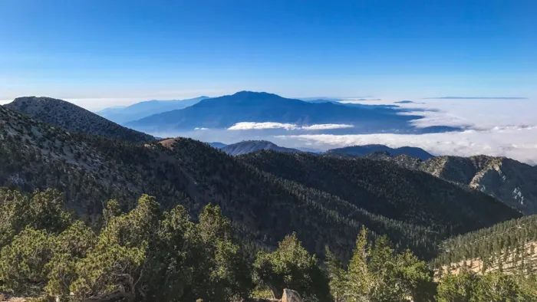

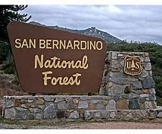
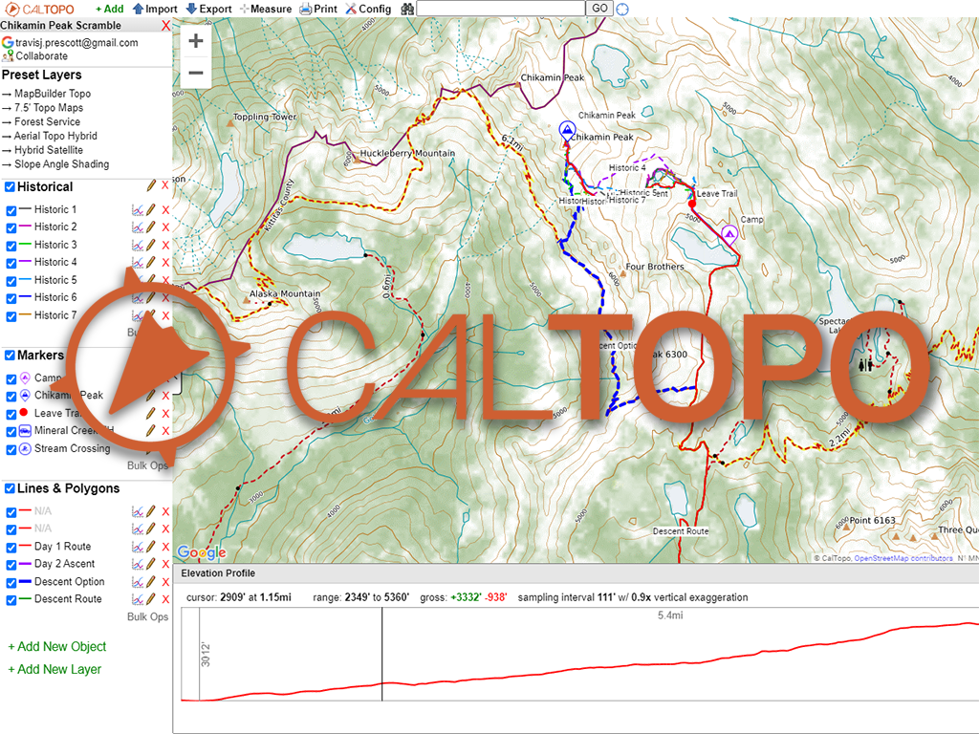
Notes:
Story of getting lost during hike and finding back – Caltopo or Strava – GPS – keeping track of where I went – last summer was asked to do create hiking trails, San Bernadino National Forest, hundreds of acres of woods, I am the “expert”
Two lessons learned: 1) With GPS program you can find your way back 2) you not afraid to go further and discover a beautiful scene – program to see where you have been helps to track where you are going

Slide 4
Outline
Benefits of Version Control
Different Types of Version Control
Git
Sourcetree
Notes:
Sourcetree (visual Git) / Concentrate on / most widely used

Slide 5
Version Control
Practice of tracking and managing changes to software code
Notes:
“Not a programmer” – track of program changes. Actuaries work with many different type of programs. Audit, Fixes etc. Keeping track of history / finding files /

Slide 6
Traditional Version Control
You probably use version control already
Documents, Spreadsheets, Presentations, Programs
Annual Projects/Reports/Scenarios
“Save As..”
Subfolders (2011/2013/2016)
Document.ver1.doc
FinalBudgetVersion_ALT2_NewAssum_2ndDemo.xlsx
Notes:
Keeping track of history ; folders of subfolders, different years, generally use older files and revise for new projects ; locate a file in one folder – what was the change/ how to keep track of it ; very cluttered

Slide 7
Version Control Software (VCS)
A system that records changes to a file or a set of files over time so that you can recall a specific version later.
Keep Track Of:
  Who made the change
  When it was made
  What was the change
  Why it was made
Notes:
Ideally / Efficient / timestamp / comment on why it was changed / Program that keeps those changes

Slide 8
Benefits of Version Control Software
Revert selected files back to a previous state
Revert the entire project back to a previous state
Compare changes over time
See who last modified something
Easy recovery from lost or modified files
Determine why you changed something
Notes:
Keeping track of history / mistake from long ago / keep notes on each change
If made changes but don’t want to keep them then easy to go back

Slide 9
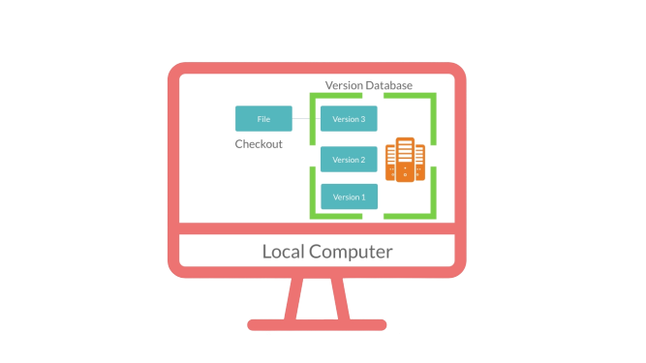
1st Generation VCS – Local Version Control
Dates back to 70s
Very basic saving of code
Single Computer
What if database needs to be used by several users?
Notes:
Different types of version controls/ mistake from long ago / keep notes on each change
If made changes but don’t want to keep them then easy to go back

Slide 10
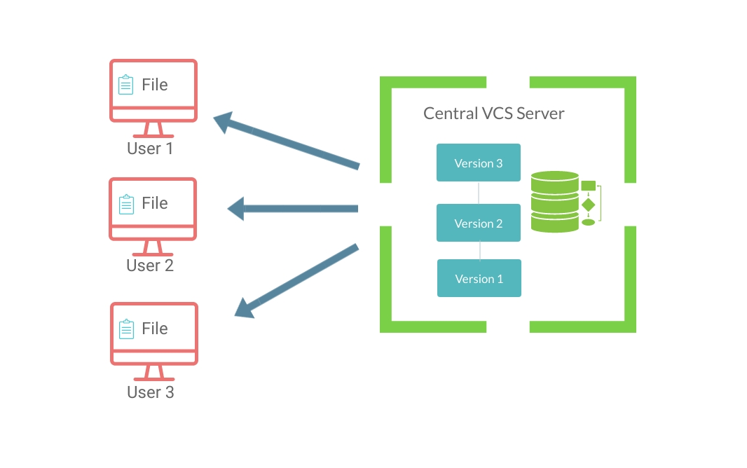
2nd Generation VCS – Central Version Control
Single Server that contains all the history.
Each developer can “check out” files from this central server.
Collaborate with developers on multiple computers.
Notes:
Took server out of local computer and put it on a central computer

Slide 11
2nd Generation VCS – Central Version Control
Examples: CVS, SVN, PTC Integrity (MKS)
Advantage: All users are in sync with all other computers
Disadvantage:
  Single point of failure
  Only one user can work on a specific file
Notes:
If central server is damaged,. then all history is gone
CVS – concurrent Version System / SVN – Subversion /

Slide 12
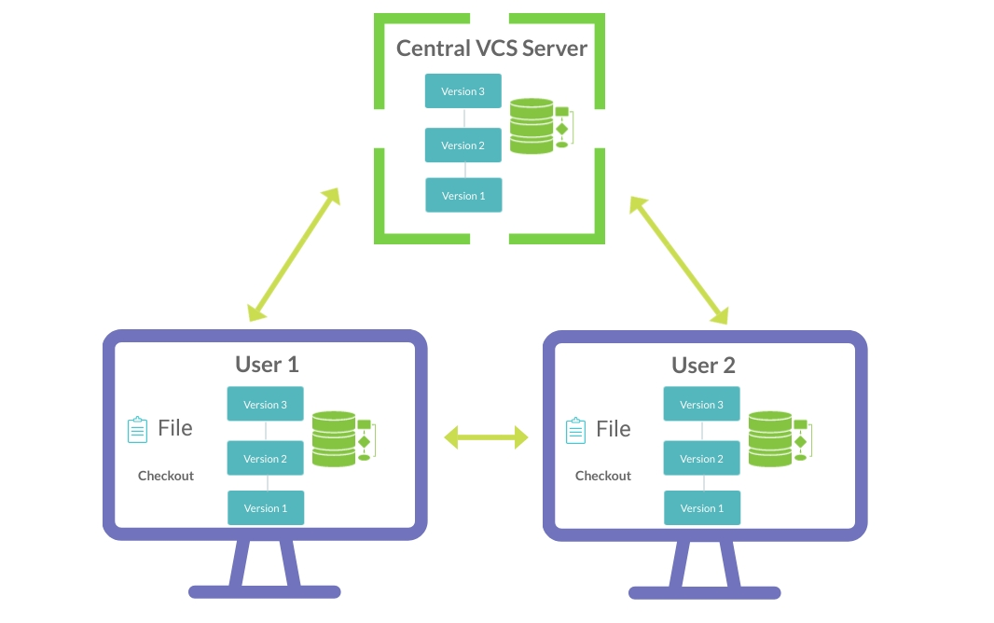
3rd Generation VCS – Distributed Version Control
Modern version control systems that are widely used today
Instead of just checking out the latest versions of the files; you will be fully mirroring the central server including its full history.
Its like having you own server locally, working in collaboration and in sync with other servers including the central server.
Notes:
In MKS – Sandbox that has the latest snapshot/ git has the full history on the local computer

Slide 13
3rd Generation VCS – Distributed Version Control
Examples: Git, Mercurial, etc.
Advantages:
  No need of active dependency with central server
  Easy backup (each computer is a backup)
  Easy branching and merging of code
  Allows multiple users to work on same file
Disadvantage:
  Does not work well with binary files (non-text files such as Word, Excel, PDF…)
Notes:
Will work even if server is down / branching: one of the most useful features – explain it later on in the presentation
Binary: anything that needs a third-party program to open the file (such as Microsoft) (not a text file – something a notepad cannot open)
What if file is 100MB / after ten version the history is 1GB and after 100 it’s 10 GB. This is on every computer.

Slide 14

Git LFS (Large Files Storage)
Extension to Git for versioning large files
Works exactly the same way as Git
Replaces the large files in local history as tiny pointer files
They point to a separate LFS server
Git handles both LFS and non-LFS files smoothly
Advantages:
  Has all the features of git
  Can lock files to avoid merge conflicts
Notes:
Making Git similar to Central Version Control but with all the advantages that Git has (creating Branches)
Binary files are extremely difficult to merge (as opposed to text files)

Slide 15
Git Workflow - Saving Changes
Your Computer
Bitbucket
Commit
Push
Working Directory
Local Server
Central Server
Notes:
Just showing a basic Git workflow ; local server is a subfolder that contains all the history ; 3 places where files are saved ; remote server

Slide 16
Git Workflow - Update Local Computer
Your Computer
Bitbucket
Push
Working Directory
Local Server
Central Server
Another User
Pull
Notes:
Your local repo is not up to date; not going to be working with most recent changes of all users

Slide 17
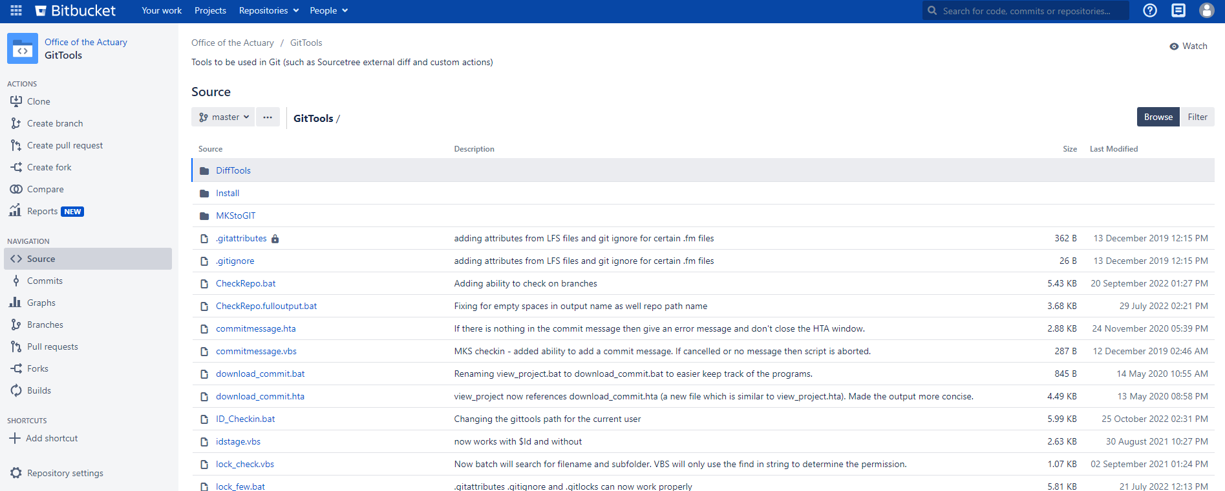
Viewing Git on Central Server
Notes:
Viewing changes ; GitHub, GitLab

Slide 18
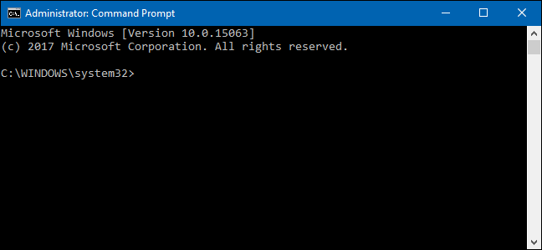
Using Git to Save Changes
This may be hard for some people to use.
Notes:
Problem #1 : CMD prompt / dos / before using Git have not used since 1998 / many people (not programmers) might not be comfortable using it

Slide 19
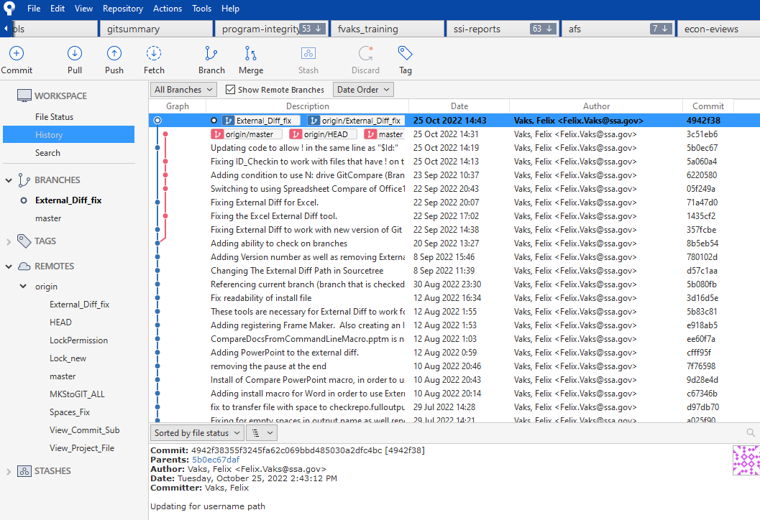
Sourcetree
Sourcetree is a visual, easy-to-use interface with Git.
No CMD line required (just point and click)
Do need to have an understanding of what the git commands do
Notes:
Can use any GUI (graphical User Interface) but Sourcetree is probably one of the best. Closer to what most people are used to.
Sends the git commands. Need to know Git commands to use it effectively (git flow – add commit push)

Slide 20
Benefits of Using Sourcetree
Process most git commands using point and click
Easily view history of individual files
Easily compare history at different points in time
External Diff to compare individual files
Blame
Search within history
Branch and merge
Custom Actions
Notes:
Some of these benefits I am going to show you more in depth

Slide 21
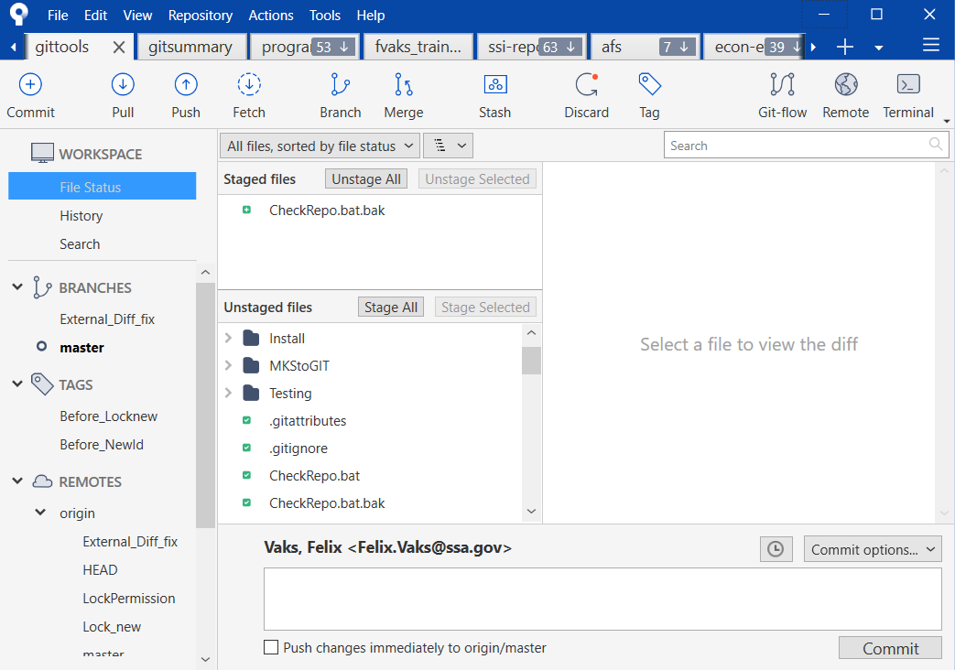
1) Point and Click

Slide 22
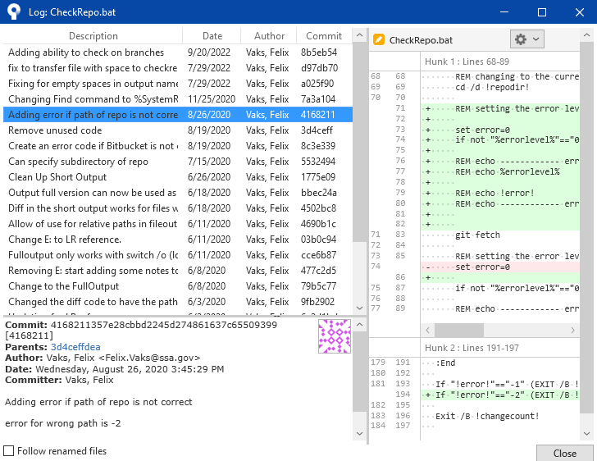
2) Individual File History
Notes:
See side by side comparison (External Diff) show soon / Green is what is added and Red is what is deleted

Slide 23
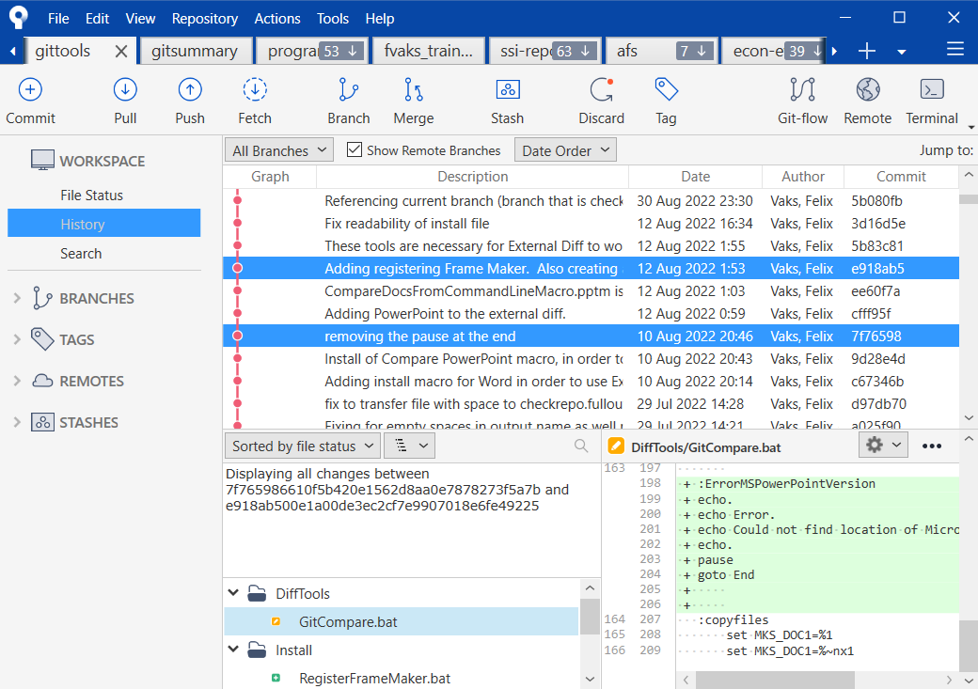
3) Comparing History Between Different Timepoints
Notes:
Green is what is added and Red is what is deleted

Slide 24
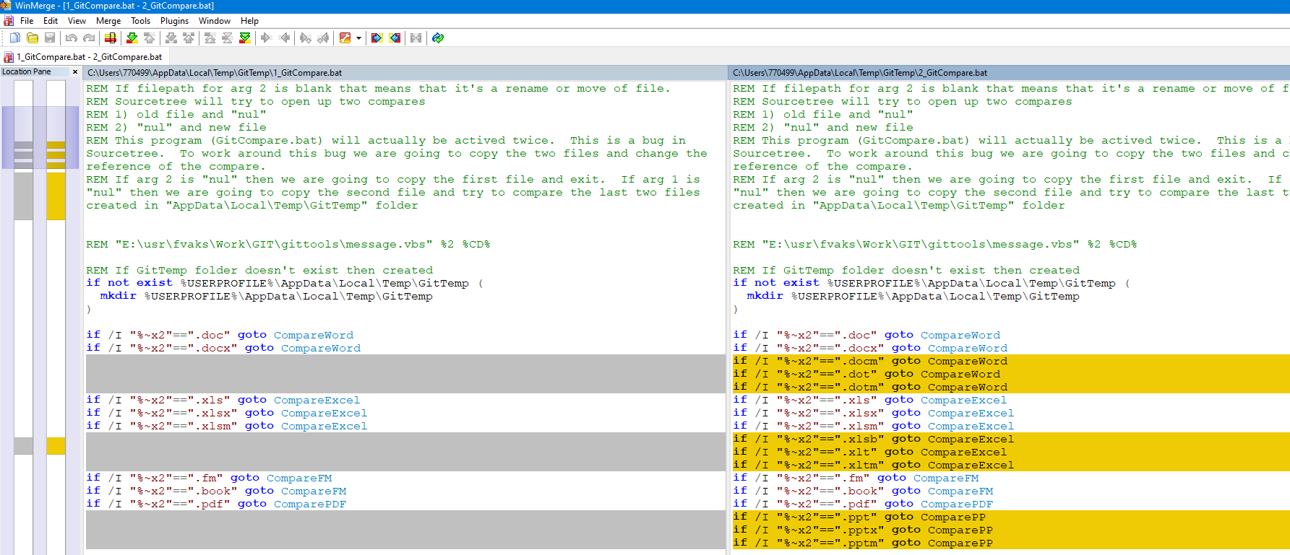
4) Using External Diff (WinMerge)
Notes:
Can also integrate comparison using Word/Excel/PowerPoint/PDF/Frame Maker / WinMerge is FREE

Slide 25
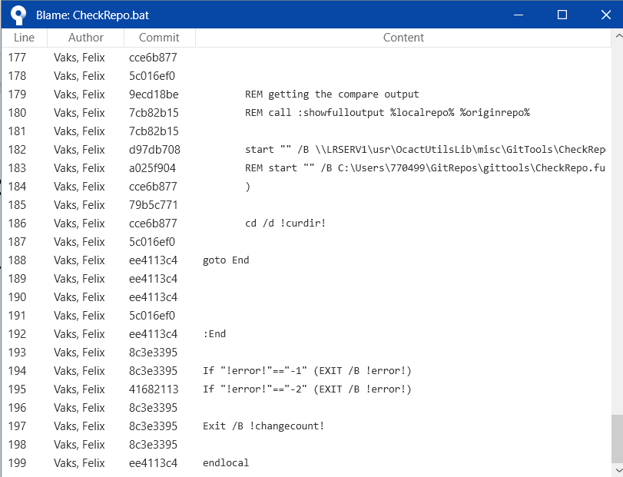
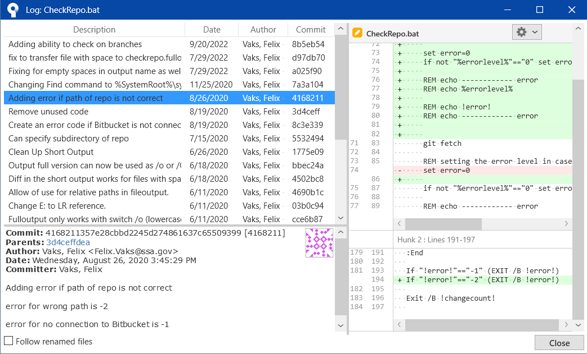
5) Using “Blame”
Quickly view who and when created the code (who is to “blame” for that code)
Notes:
Nice feature

Slide 26
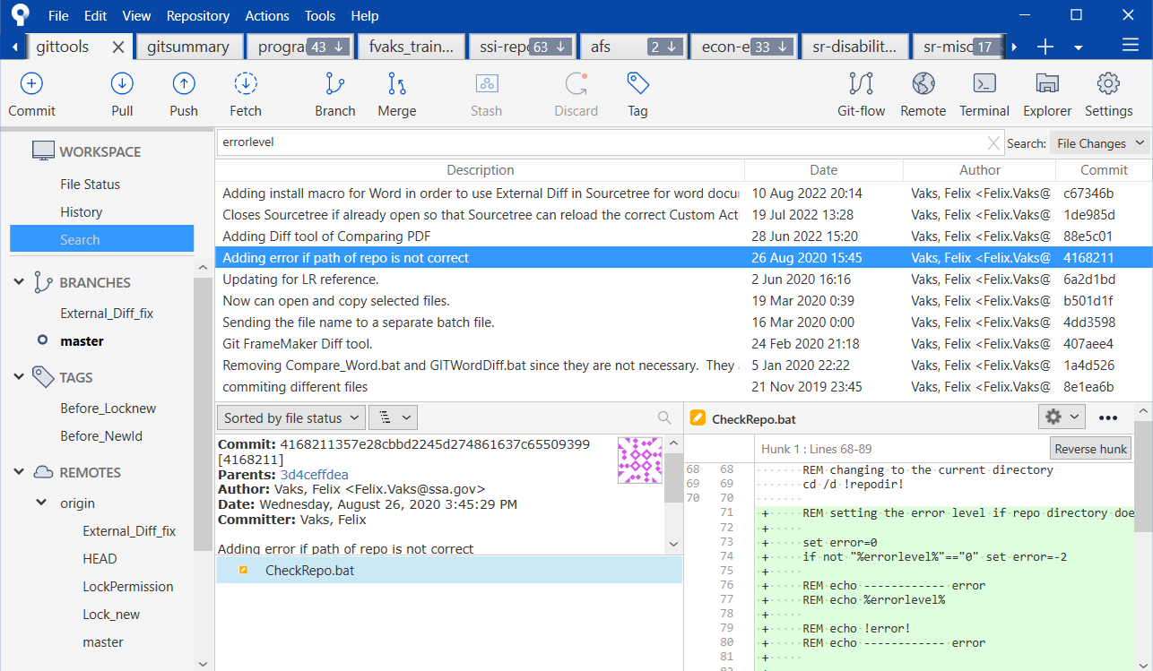
6) Search History

Slide 27
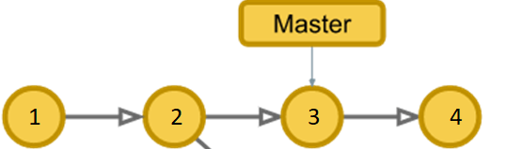
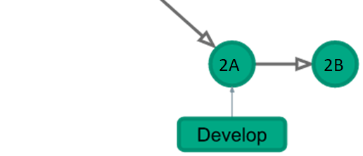
7) Branching
Best feature of Git
Off to the side model
Different groups can work on same project
Notes:
Alternate assumptions,

Slide 28
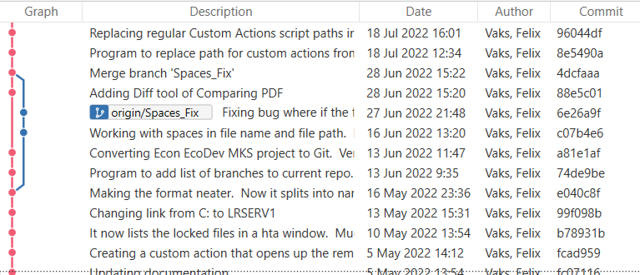
Basic Branch and Merge
Notes:
Blue is the main (master) line / working “off to the side”

Slide 29
8) Custom Actions
Can add helpful tools that are not found in Sourcetree
  Lock files
  See which files are locked
  Download files from history
  View all the files from a certain point in time
Notes:
Download zip / Many more features can be added

Slide 30
Summary
Benefits of Version Control
Different Types of Version Control
Git
Sourcetree
Use version control to travel further (Hike the Mountains)
Notes:
Benefits: finding your files from past, explanation of what or why code changed, also when it was changed and who did it
Git: Branching / Sourcetree: visual, seeing history of individual files, comparing different versions, COST – Open Source – Free

Slide 31
Resources
Version Control - https://www.atlassian.com/git/tutorials/what-is-version-control
Git - https://git-scm.com
Sourcetree - https://www.sourcetreeapp.com/
Notes:
Benefits: finding your files from past, explanation of what or why code changed, also when it was changed and who did it
Git: Branching / Sourcetree: visual, seeing history of individual files, comparing different versions, COST – Open Source – Free

Slide 32

Questions?
Notes:
Benefits: finding your files from past, explanation of what or why code changed, also when it was changed and who did it
Git: Branching / Sourcetree: visual, seeing history of individual files, comparing different versions, COST – Open Source – Free

