Slide 1
Statistics: The Good, The Bad and The Ugly (Bias in Statistics) Richard Flicker, Ph.D. Industrial/Organizational Psychologist Baton Rouge, Louisiana Middle Atlantic Actuarial Club Monday, November 14, 2022 3:00 p.m. EST (Zoom)

Slide 2
Today’s Objective: To provide a broad framework for viewing the role of statistics in actuarial work, as well as an overview of how various types of statistical biases can distort “reasonable” conclusions. And possibly cover some specific statistical concepts. It is not a crash course in advanced statistics – certainly not in one hour. From the March 2013 Actuarial Standard of Practice (ASOP) adopted by the Actuarial Standards Board 3.1.6 Unlike the ASOPs, which are binding upon actuaries, other actuarial literature provides information that an actuary may choose, but is not required, to consider when rendering actuarial services. For example, practice notes published by the Academy describe various methods actuaries may use, but do not establish standards of practice and are not binding upon actuaries. Similarly, research papers, learned treatises, study notes, actuarial textbooks, journal articles, and presentations at actuarial meetings can be informative, keeping the actuary abreast of developments as actuarial science evolves, but do not establish binding requirements upon the actuary.

Slide 3
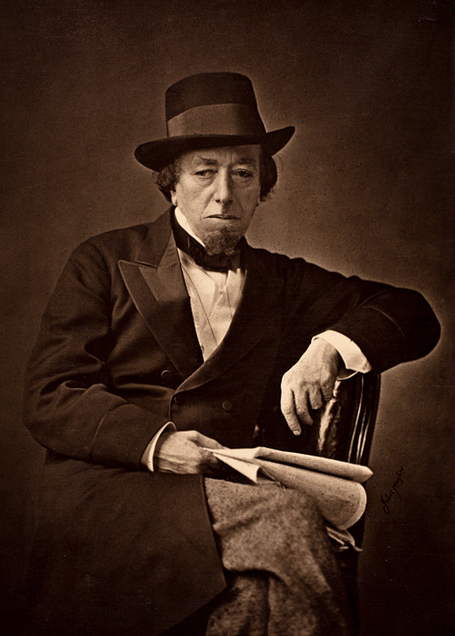
“There are three types of lies: lies, damned lies, and statistics.” (Benjamin Disraeli, 1804-1881, Earl of Beaconsfield, British Prime Minister)

Slide 4
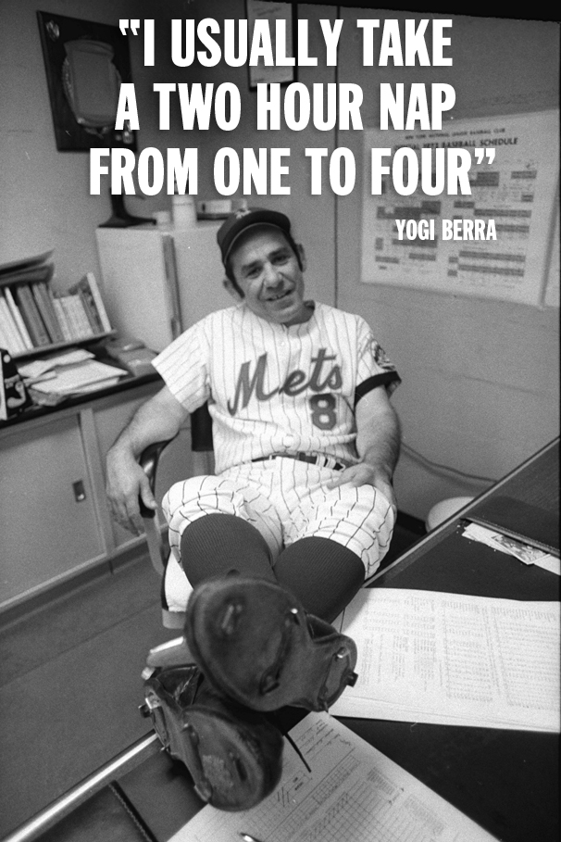
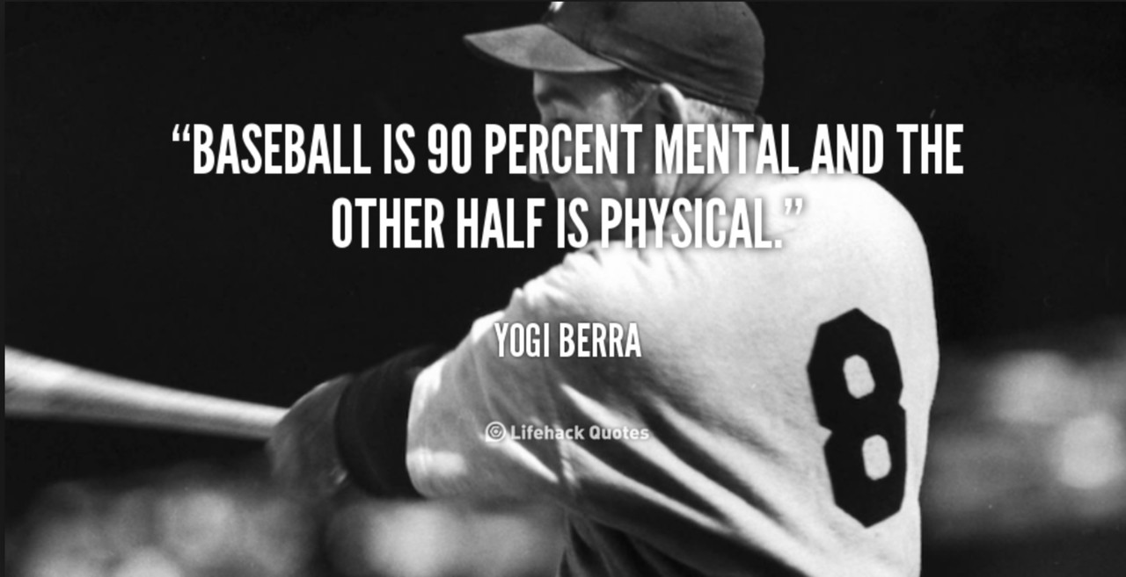
Lies, Damned Lies and Statistics should not be confused with Yogi-isms.

Slide 5
At this point, you might (or you might not) be wondering what the great philosopher Yogi Berra had to say about “Actuarial Science.”

Slide 6
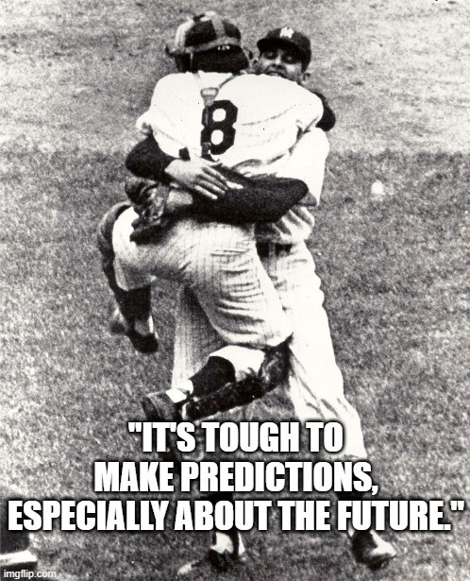

Slide 7
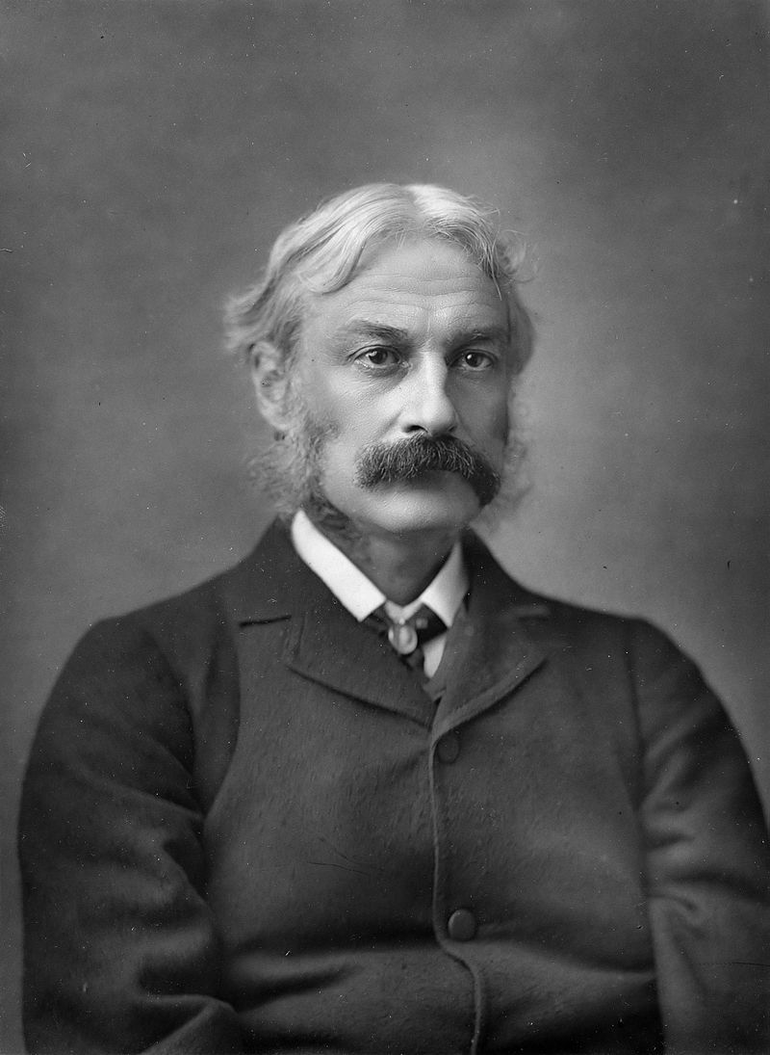
"He uses statistics as a drunken man uses lamp-posts... for support rather than illumination.” (Andrew Lang, FBA, 1844-1912 Scottish poet, novelist, historian, literary critic and contributor to the field of anthropology; Fellow of the British Academy – FBA)

Slide 8
“There are two things you don’t want to see made: sausage and statistics.” [Paraphrasing original quote by German Chancellor Otto von Bismarck who said “sausage and legislation.”] (Dr. Mel Harju, 1941 – Professor Emeritus of Economics, Louisiana State University in Shreveport)

Slide 9
1. (Merriam-Webster) statistics is a branch of mathematics dealing with the collection, analysis, interpretation, and presentation of masses of numerical data.
Some Definitions of “STATISTICS”
2. statistics is the study of data collection, analysis,
interpretation, presentation, and organizing in a
specific way.
3. (Oxford Languages) statistics is the practice or science of
collecting and analyzing numerical data in large quantities,
especially for the purpose of inferring proportions in a whole
from those in a representative sample.

Slide 10
Science – Is actuarial science really a science just because it uses statistics? What about …
Computer science? Environmental science?
Military science? Political science?
Health sciences? Social or Behavioral sciences?
In my field, many university psychology departments are now called departments of psychological sciences and are housed in the College of Science; but at other universities they’re still in Liberal Arts, General Studies, Education,
Allied Health, etc.

Slide 11
4. (cuemath.com) statistics is the process of collection
of data, classifying data, representing the data for easy
interpretation, and further analysis of data.
5. Statistics is the study and manipulation of data,
including ways to gather, review, analyze, and draw
conclusions from data.

Slide 12
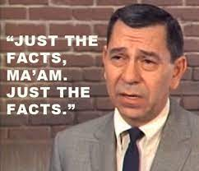
6. (Collins Dictionary) statistics are facts obtained from
analyzing information that is expressed in numbers.
Facts? Are statistics really facts? What
about “alternative facts” in an anti-science,
anti-expert climate.
Unlike opinions, judgements or conclusions,
facts are indisputable – that’s why they’re
facts.
Are actuary’s reports indisputable?
What does the profession have to say
about this?

Slide 13
from Introductory Actuarial Standard of Practice (ASOP No. 1 – March 2013) Adopted by the Actuarial Standards Board
ASOP … 2.9 Professional Judgment – Actuaries bring to the their assignments not only highly specialized training, but also the broader knowledge and understanding that come from experience. For example, the ASOPs frequently call upon actuaries to apply both training and experience to their professional assignments, recognizing that reasonable differences may arise when actuaries project the effect of uncertain events.

Slide 14
2.10 Reasonable – In many instances, the ASOPs call for the actuary to take “reasonable” steps, make “reasonable” inquiries, select “reasonable” assumptions or methods, or otherwise exercise professional judgment to produce a “reasonable” result when rendering actuarial services. The intent is to call upon the actuary to exercise the level of care and diligence that, in the actuary’s professional judgment, is necessary to complete the assignment in an appropriate manner. Because actuarial practice commonly involves the estimation of uncertain events, there will often be a range of reasonable methods and assumptions, and two actuaries could follow a particular ASOP, both using reasonable methods and assumptions, and reach different reasonable results.
3.1.4 … The ASOPs allow for the actuary to use professional judgment when selecting methods and assumptions, conducting an analysis, and reaching a conclusion, and recognize that actuaries can reasonably reach different conclusions when faced with the same facts.

Slide 15
Returning to the various definitions of statistics :
7. (Richard Flicker) statistics is a decision making tool,
that in the right hands and an ideal world, should eliminate
personal biases when summarizing data and/or drawing
conclusions from that data.
When properly used, statistics should paint an accurate,
realistic picture of the world based on numerical data. It
is not abstract art that should lead 2 people to 3 different
interpretations of what they’re looking at. Different people
should have similar, if not identical interpretations.

Slide 16
In science, researchers are naturally biased toward finding results that support their predictions (hypotheses).
That’s where statistics come in. The formulas used should lead everyone to the same conclusions when the data is analyzed – either the results are statistically significant or they are not statistically significant regardless of whether they support the researcher’s predictions. Statistics and the corresponding charts with cut-offs for determining statistical significance is the decision making tool. It takes away from researchers the subjective interpretation of results which would swing the conclusions in one direction or the other.
And if the results just miss being statistically significant, the researcher is not supposed to say it was close – there’s no such thing as “almost pregnant” – you either are or you’re not.

Slide 17
Descriptive Statistics vs. Inferential Statistics
DESCRIPTIVE Statistics paint a picture by summarizing numerical data …
What is typical – using terms such as mean, mode & median.
How does the data vary – using terms such as range, standard deviation,
variance, etc.
INFERENTIAL Statistics allow for drawing conclusions or inferences, and making decisions whether …
Variables are related – using terms such as correlation, regression, etc.
Sets of data differ from each other – using terms such as t-test, analysis
of variance, etc.

Slide 18
From the Society of Actuaries’ Code of Professional Conduct (January 1, 2001) Professional Integrity PRECEPT 1. An Actuary shall act honestly with integrity and competence, and in a manner to fulfill the profession‘s responsibility to the public and to uphold the reputation of the actuarial profession. ANNOTATION 1-4. An Actuary shall not engage in any professional conduct involving dishonesty, fraud, deceit, or misrepresentation or commit any act that reflects adversely on the actuarial profession. Which brings us to the next slide …

Slide 19
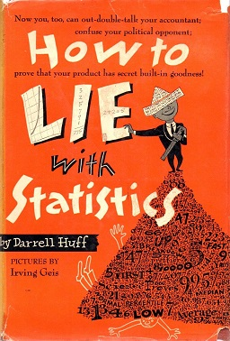
How to Lie with Statistics (1954)
by Darrell Huff
Not a statistician, Huff was a journalist who in his
best-selling introduction to statistics for the layperson outlines misuses of statistics which lead consumers of the data to misinterpret the data and draw erroneous conclusions. Graphs are often used to distort reality or paint misleading pictures – making small differences or changes look large and/or large differences or changes look small. Use of percentages is another way to lead people to draw wrong conclusions from data.
The intention of the book was not to teach people how to mislead others by abusing statistics, but rather how to protect oneself from being mislead by being knowledgeable about statistical concepts.

Slide 20
Statistical Bias … a term used to describe statistics which don’t provide an accurate representation of the data.
Some Types of Statistical Bias
Selection or Sampling Bias
Confirmation Bias
Outlier Bias
Omitted Variable Bias
Survivorship Bias

Slide 21
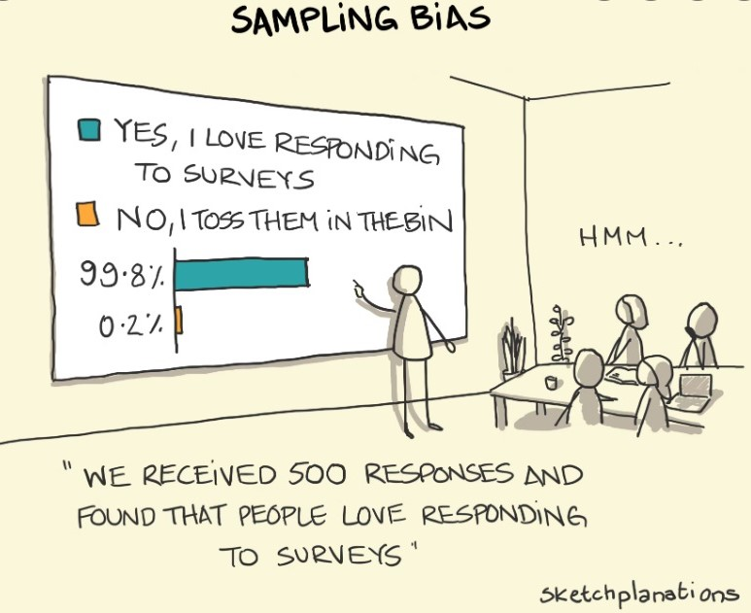
Selection or Sampling Bias – an error that results from selecting samples of population data that don’t accurately represent the entire target group or population. Or vice versa.

Slide 22
Confirmation Bias – an error when preconceived notions impact how information is selected, prioritized and/or interpreted. In scientific research, hypotheses or predictions based on theories, observations and/or past research findings are the preconceived notions.
In the day-to-day practice of a profession, including that of an actuary, expectations one believes their employer or client (principal) has for a certain outcome can bias the way the data is collected, what data is included vs. excluded, how it is analyzed and eventually interpreted. Decisions about what data to include or exclude should be made on some predetermined criteria other than what that data looks like once collected.
For example, since we often rely on others to provide the data we need, the decision whether that source is credible, competent and honest should be made before seeing whether the data is favorable to the employer or principal.

Slide 23
Some Types of Statistical Bias (continued)
Outlier Bias – an error that allows extreme scores to skew the data analysis. (often the case when using means & range)
Omitted Variable Bias -- one of the most common types of errors in which key relevant variables are missing from the data being analyzed. Sometimes data is either unavailable, or too time consuming or expensive to retrieve. It is our responsibility to fully disclose the limitations of our data and/or analyses, and of course not deliberately mislead, confuse or lie to the client. We should never intentionally overwhelm and distract a client by providing an overabundance of irrelevant data/analyses in an attempt to hide the fact that the most important, relevant data is either missing or bad.
The old GI-GO – Garbage In, Garbage Out.

Slide 24
Some Types of Statistical Bias (continued)
Survivorship Bias – an error when you only take into account surviving data points. An example would be to correlate college admissions test scores with grades in college … and you only include data from those who survived the admissions process and also those who survived 4 years of college to graduate.
This bias is often counter to what you’re hoping to find, such as in the above example where missing data is likely to lead to the conclusion that the two variables are not statistically correlated or correlated less than they actually are in reality. This is the result of “restriction in range.” The good news – there are formulas to estimate the true correlation of the variables (i.e., correct for restriction in range).

Slide 25
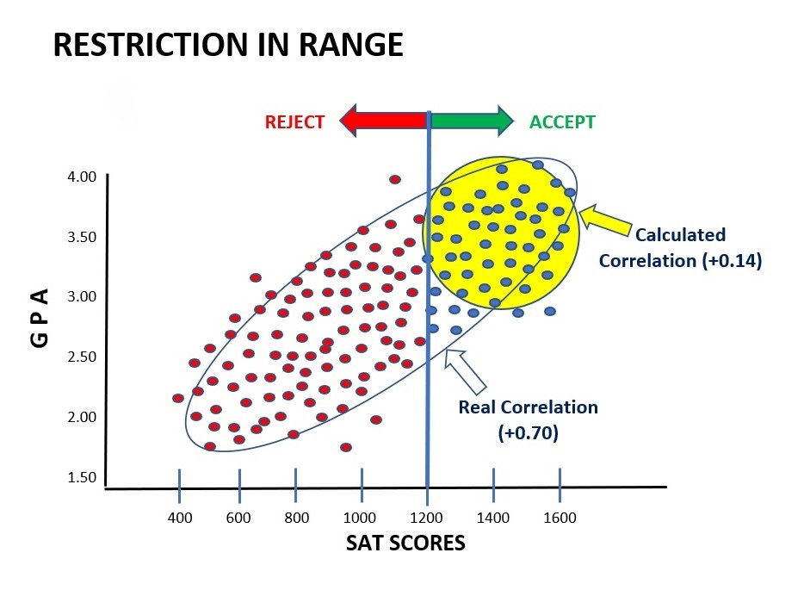

Slide 26
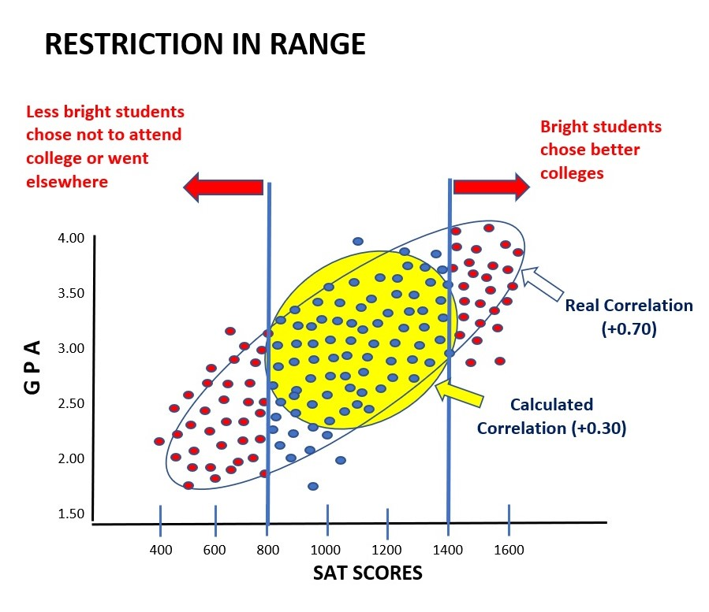

Slide 27
Statistical Significance vs. Practical Significance ASOP 2.10 Significance/Significant – Significance can have different meanings. A result may be deemed to be statistically significant if it is determined that the probability that the result was produced by random chance is small. An event may be described as significant if the likelihood of its occurrence is more than remote. In addition, a result may be significant because it is of consequence. Other uses may be encountered in actuarial practice. The actuary should exercise care in interpreting or using these words. Important to understand that because a result is statistically significant, it doesn’t necessarily mean that it is of any practical significance. In the above ASOP, practical significance refers to whether a result is of any real consequence in the real world. Researchers are generally obsessed with finding statistical significance in their data, frequently neglecting to ask the ultimate question – “So what?”

Slide 28
A Couple of Other Statistical Phenomenon To Be Aware Of (Time Permitting) ● Shrinkage in Multiple Regression ● Regression Toward the Mean

Slide 29
Shrinkage in Multiple Regression A multiple regression formula developed from a given set of data will not work as well for predicting the same outcome using the same predictor variables in the future. In other words, the coefficient of determination will shrink when that formula is applied to future data. This is because the formula was specifically developed using the first set of data, and that formula can never fit or work as well for any other set of data. To avoid shock and disappointment when beginning to use your multiple regression formula in the future, there are formulas to estimate how much shrinkage you can expect.

Slide 30
Regression Toward The Mean Observed scores on a variable are comprised of a True Score and Error. Observed Score = True Score + Error The goal is to collect data (Observed Scores) that are as close as possible to the True Scores of individuals. To do this, the measures of a variable must be reliable (i.e., contain little error). Whenever an individual or group scores well above average on some measure, the probability is that their score(s) will drop closer to the mean when retested; and if they scored extremely poorly the first time – their score(s) when retested will rise closer to the mean. One must be careful not to get overly excited when there is an intervention for a group of people who are well below average on some measure and you retest them – you can expect their scores to be higher when retested regardless of the effectiveness of the intervention.

Slide 31
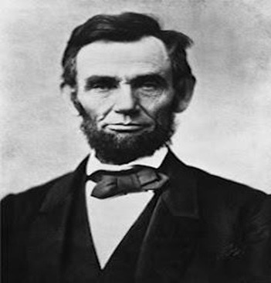
“Don’t believe everything you read on the Internet just because there’s a picture with a quote next to it, or lots of computer generated statistics.
Always ask intelligent questions.”
– Abraham Lincoln

Slide 32
Q & A

Slide 33
Richard Flicker, Ph.D. Industrial/Organizational Psychologist Baton Rouge, Louisiana
Cell: 225-931-1626
Email: flicker@premier.net
975 Ridgepoint Ct.
Baton Rouge, LA 70810

