Slide 1
COVID Effects on Social Security Demographic and Economic Assumptions Mark Bye, Kent Morgan, and Sven Sinclair Social Security Administration, Office of the Chief Actuary MAAC Fall Meeting November 15, 2022

Slide 2
Fertility

Slide 3
Birth Data Background
Age-specific central birth rates
Births during the year to mothers at the specified age divided by the midyear female population at that age.
Births from National Center for Health Statistics (NCHS).
Resident population from Census Bureau.
[Calendar Year] Total Fertility Rate (TFR_{x})
Sum of the age-specific central birth rates during year x.
Can be interpreted as the average number of children that would be born to a woman if she were to experience, at each age of her life, the birth rate observed in, or assumed for, year x, and if she were to survive the entire childbearing period.
Cohort Total Fertility Rate (CTFR_{y})
Sum of the age-specific central birth rates during each childbearing year for a group of women born in year y.

Slide 4
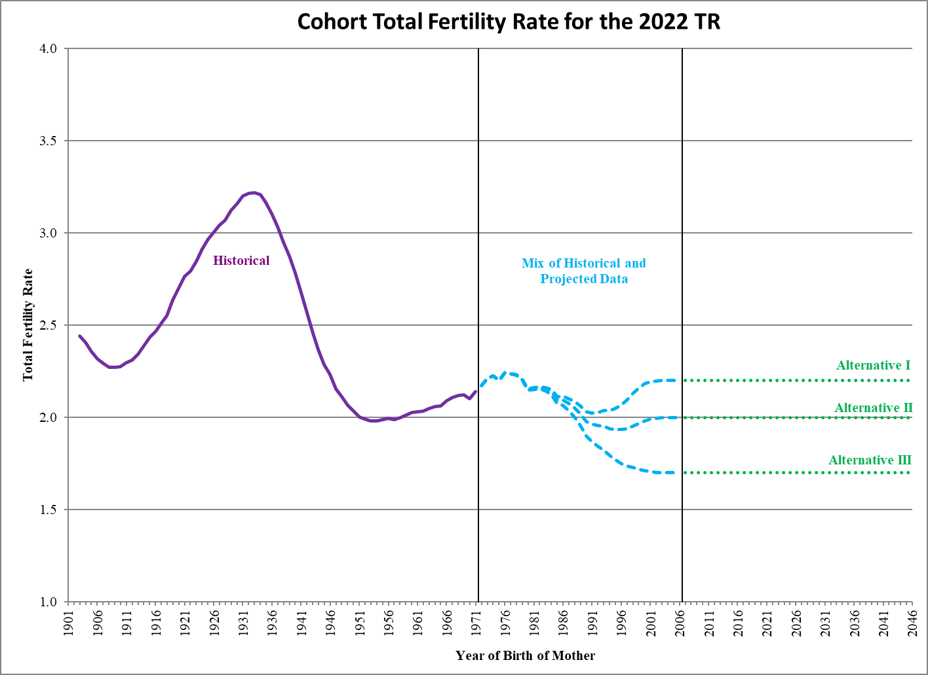

Slide 5
Flashback to 2020…
Half a million fewer children? The coming COVID baby bust (https://www.brookings.edu/research/half-a-million-fewer-children-the-coming-covid-baby-bust/)
“The pandemic has thrust the country into an economic recession. Economic reasoning and past evidence suggest that this will lead people to have fewer children. The decline in births could be on the order of 300,000 to 500,000 fewer births next year. We base this expectation on lessons drawn from economic studies of fertility behavior, along with data presented here from the Great Recession of 2007-2009 and the 1918 Spanish Flu.”
“Such speculation is based on persistent myths about birth spikes occurring nine months after blizzards or major electricity blackouts. As it turns out, those stories tend not to hold up to statistical examination (Udry, 1970).”
Will coronavirus cause a baby boom, or is that just a myth? Prepare for jokes, if not babies! (https://www.usatoday.com/story/life/parenting/2020/04/02/coronavirus-fact-check-could-covid-19-cause-baby-boom/5105448002/)
“Perhaps it's all an urban myth propagated (no pun intended) mostly by baby boomers, that giant cohort of Americans born in the years after World War II when everyone came home and got busy again.”
“The interest is such that people on Twitter are suggesting new names for this supposed coronavirus cohort: Coronials. Quaranteens. Baby Zoomers.”
“Still, there's little data to support the claim that catastrophes – regional power blackouts, hurricanes and snowstorms, terrorist attacks or global pandemics that force people to stay at home for extended periods – lead inexorably, as night follows day, to a quantifiable jump in births months later.”

Slide 6
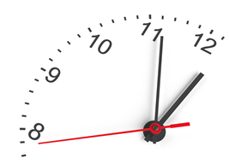
Flashforward to Early 2021…
There's No Coronavirus Baby Boom — It's More Like a Baby Bust (https://www.lx.com/community/theres-no-coronavirus-baby-boom-its-more-like-a-baby-bust/29596/)
Coronavirus Hasn't Lead To The Baby Boom That Was Anticipated, According To A New Study (https://www.forbes.com/sites/alicebroster/2021/02/03/coronavirus-hasnt-lead-to-the-baby-boom-that-was-anticipated-according-to-a-new-study/?sh=30402e8b4b79) “In June 2020, the Brookings Institute estimated that the U.S. would see between 300,000 to 500,000 fewer births than in 2019. This came just a few months after restrictions had been implemented across the States. After taking into consideration school and daycare closures and the pressures of working from home, researchers said that they think their estimation of 300,000 fewer births is accurate.”

Slide 7
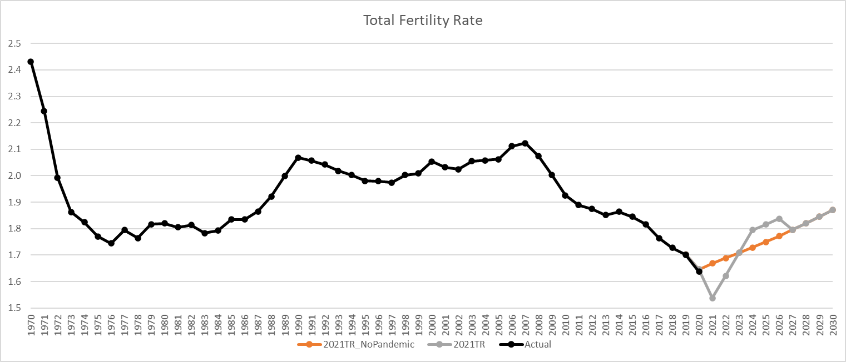

Slide 8
Flashforward to Now…
THE COVID-19 BABY BUMP:THE UNEXPECTED INCREASE IN U.S. FERTILITY RATES IN RESPONSE TO THE PANDEMIC (https://www.nber.org/system/files/working_papers/w30569/w30569.pdf)
“2020 declines began abruptly at the very beginning of the pandemic, suggesting that they reflect sharp declines in the entry of foreign-born, non-resident mothers into the U.S.—declines potentially reflecting travel restrictions, health concerns, and the sudden disappearance of economic opportunities for migrants.”
“Among U.S.-born mothers, there is little evidence of a protracted baby bust. Aside from a sharp reduction in births in January 2021 (9 months after the COVID-19 pandemic began in the U.S.), birth rates among U.S.-born women exceed their trend level for 2021 and 2022, suggesting that conceptions soared in May and June 2020 while the pandemic was still raging and have remained higher than before the pandemic began.”
“Births to foreign-born women also began to recover months before the border reopened.”

Slide 9
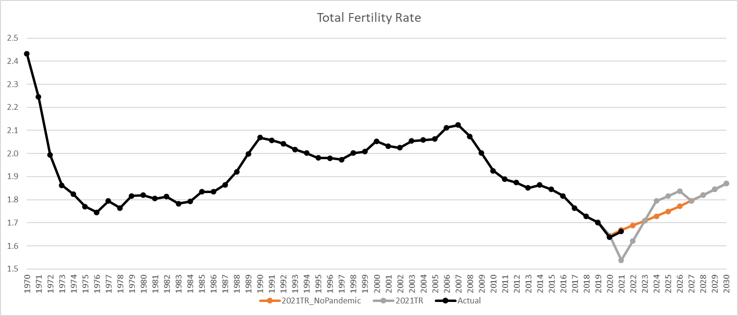

Slide 10
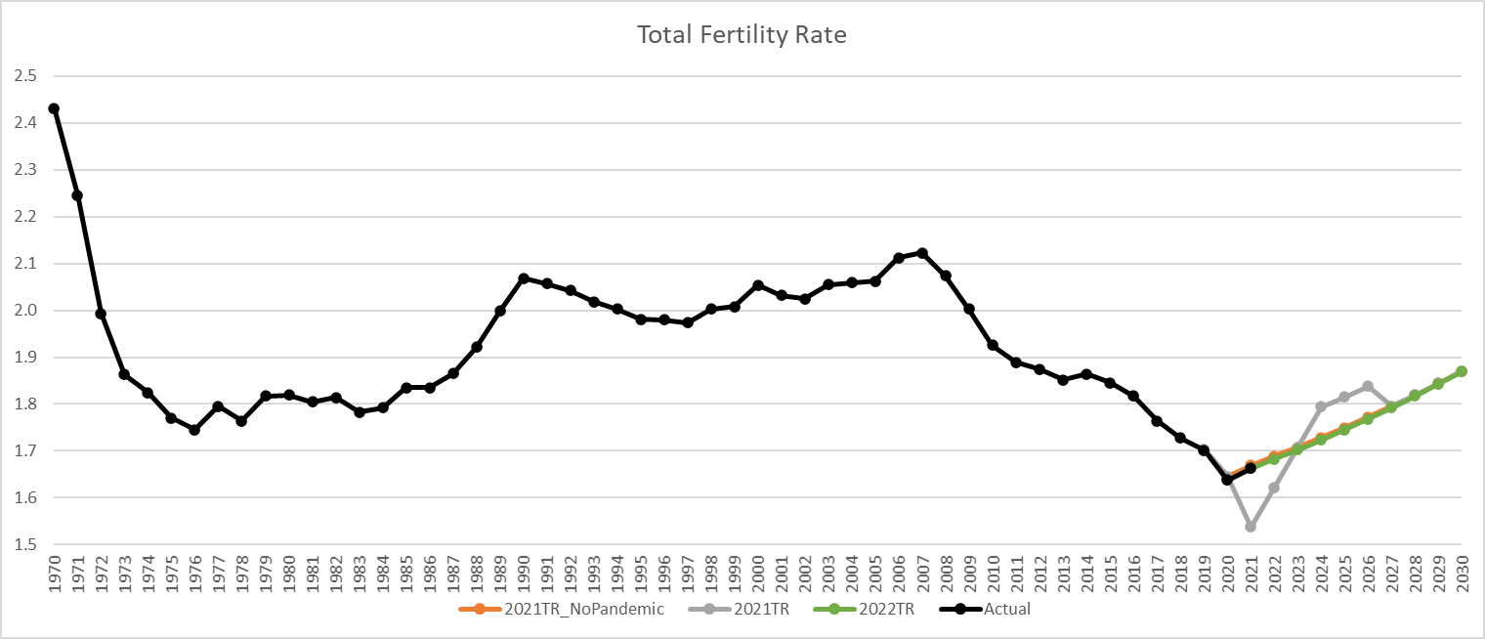

Slide 11
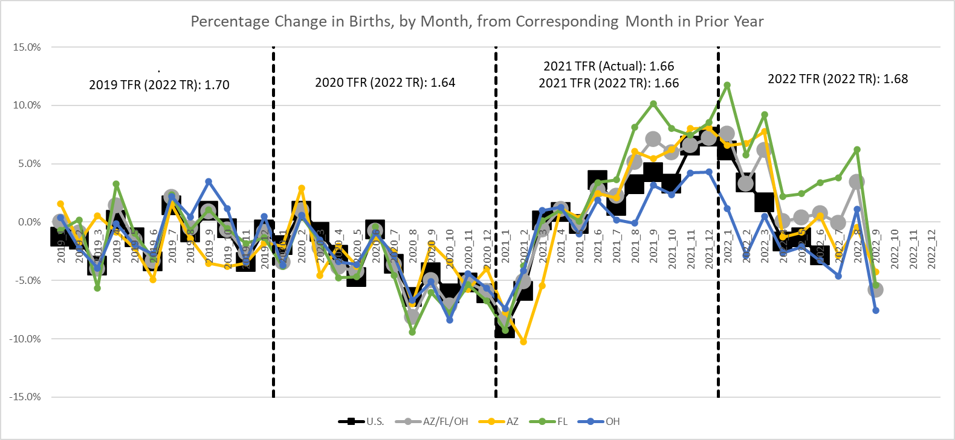

Slide 12
Mortality

Slide 13
Mortality Data Background
Age-specific central death rates (m_{x})
Deaths during the year at the specified age (x) divided by the midyear population at that age.
Under 65
Deaths from National Center for Health Statistics (NCHS).
Resident population from Census Bureau.
65 and Older: Deaths and exposure both come from the Centers for Medicare and Medicaid Services (CMS).
Probability of death (q_{x})
Probability of dying at age x within one year.

Slide 14
2022 TR Mortality Probability of Death (qx) COVID Factors by Age Group
Year | Age 0 | Ages 1 – 14 | Ages 15 – 64 | Ages 65+
2020 | 0.890 Actual: 0.981 | 1.008 Actual: 1.01 | 1.161 Actual: 1.187 | 1.161 Actual: 1.155
2021 | 0.960 | 1.040 | 1.195 | 1.175 Actual: 1.135
2022 | 0.990 | 1.010 | 1.059 | 1.047
2023 | 1.000 | 1.000 | 1.012 | 1.009
2024 | 1.000 | 1.000 | 1.000 | 1.000

Slide 15
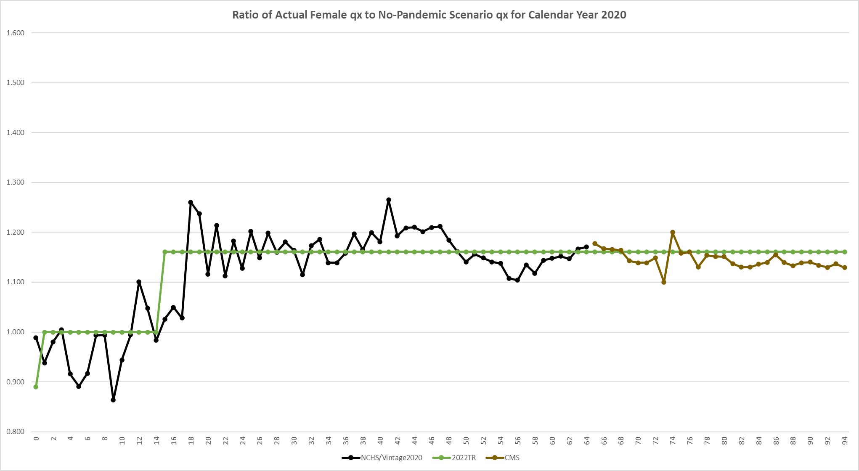

Slide 16
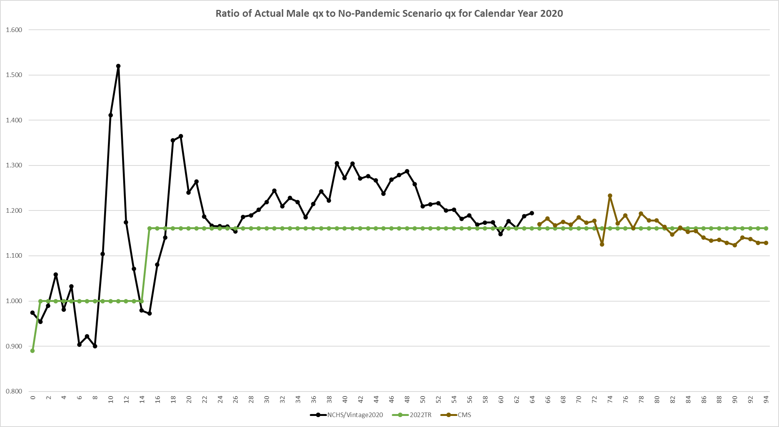

Slide 17
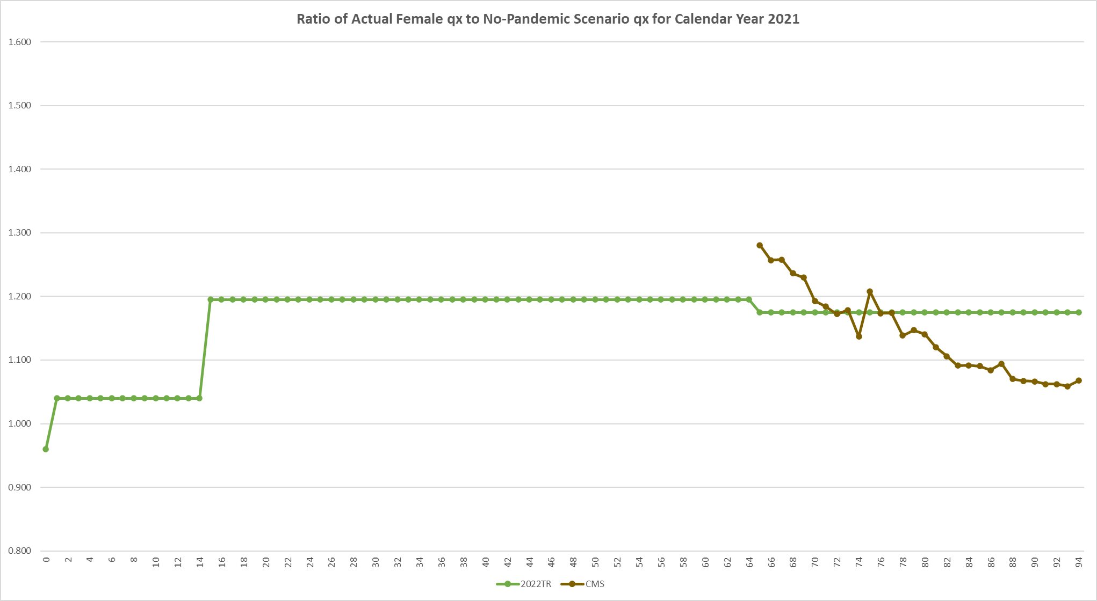

Slide 18
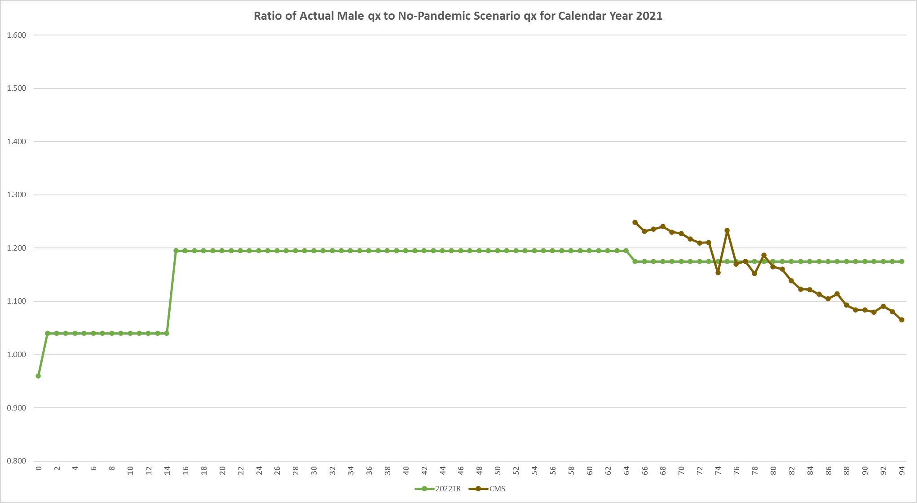

Slide 19
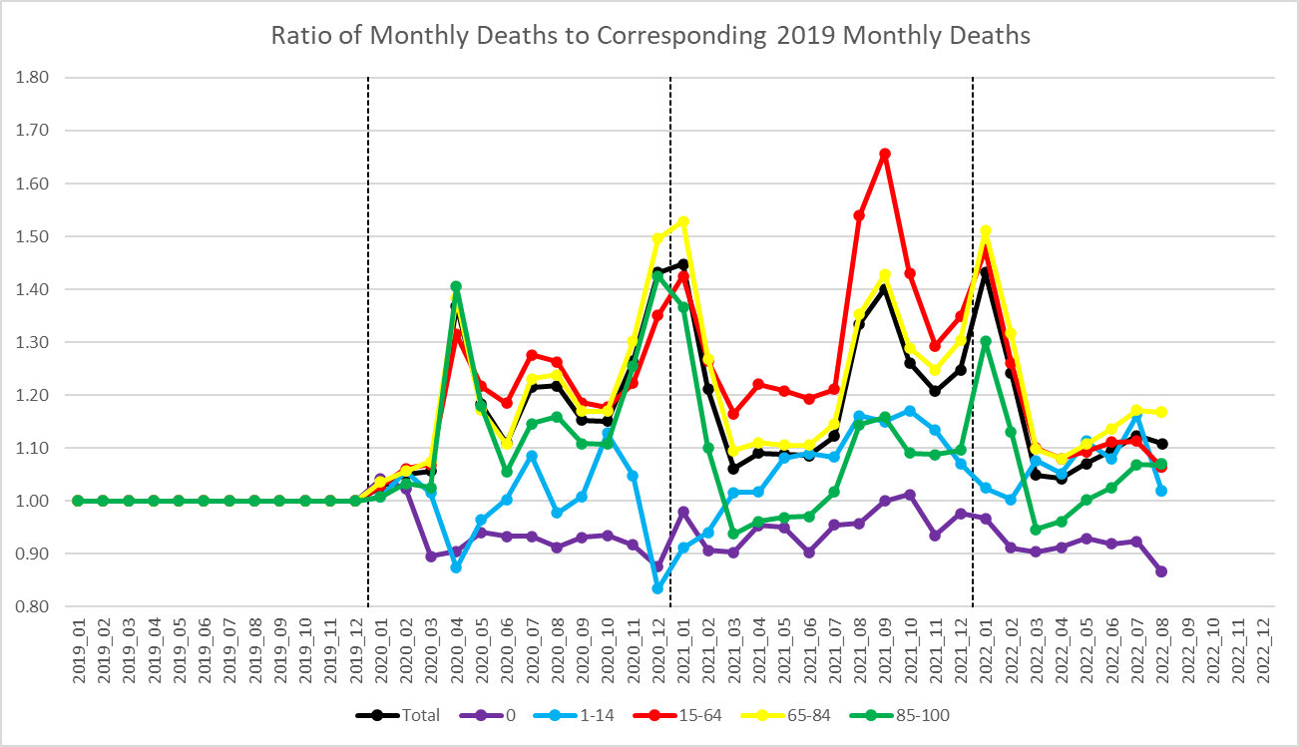
Source – CDC’s Wonder System at: https://wonder.cdc.gov/mcd-icd10-provisional.html

Slide 20
Immigration

Slide 21
Immigration: Data for Historical Period
Lawful Permanent Resident (LPR) immigration
Persons granted authorization to live and work in the United States on a permanent basis.
New Arrivals: persons becoming LPR’s upon entry into US.
Adjustments of Status: persons who do not become LPR’s upon entry, but who later attain LPR status.
Provided by Department of Homeland Security (DHS).
Other-than-LPR immigration
Persons entering the United States in a manner other than lawfully admitted for permanent residence.
Nonimmigrants: persons authorized to stay in US temporary period (e.g. students, exchange visitors, temporary workers, diplomats, other representatives).
Unauthorized immigrants: persons who overstayed their visas or who were never legally authorized to reside in the US.
Calculated by taking the American Community Survey’s (ACS) total number of immigrants entering US in given year, and then subtracting the number of new arrival LPR immigrants for that year.

Slide 22
Immigration: Assumed Ultimate Values for Projected Period
Lawful Permanent Resident (LPR) immigration
Assumed ultimate value (assumed to be reached within the first couple of years of projected period) is 1.05 million persons (0.60 million new arrivals and 0.45 adjustments of status) per year.
This value is based on: (1) annual LPR immigration has averaged 1.05 million persons for years 2010-2019, and (2) belief that future number of LPR immigrants in the “immediate relatives” category will approximate recent levels.
Other-than-LPR immigration
Assumed ultimate value (assumed to be reached within the first couple of years of projected period) is 1.35 million persons per year.
This value is based on the average number of other-than-LPR immigrants in the years leading up to the great recession.

Slide 23
Immigration: Assumed Initial Values for Projected Period
For the first few years of the projected period, we need to assume an appropriate “transition path” of values to bridge the gap between data in the historical period and the assumed ultimate values in the projected period.
This needs to be done for both LPR immigration and other-than-LPR immigration.

Slide 24
Effect of COVID on Assumed Initial Values for Projected Period
Due to new immigration restrictions that were made in response to COVID, it was assumed there would be a significant decrease in immigration for years 2020-2021.
It was also assumed that, for years 2023-2024, immigration levels would jump so as to completely “cancel out” the decrease in 2020-2021.
The latter assumption was based on:
For “immediate relatives” category of LPR immigration, there are no annual limits.
For other categories of LPR immigration, unused visas in one year can be used to increase the limits on the number issued in the following year.
For other-than-LPR immigration, increased demand for immigrant workers as the economy recovers from COVID.

Slide 27
Economics

Slide 28
Overview of the Effects of COVID-19 on the Economy
Immediate: Severe Recession
Record 1-quarter decreases in GDP and employment
Fortunately, also short-lived (2 months peak to trough)
The following quarter had record increases in GDP and employment
Fast recovery continued for more than a year
Not a “typical” recession
Indirect / Longer Term
Global recession and continuing pandemic led to supply shortages
Combined with sustained aggregate demand, this caused inflationary pressure
Measures to contain inflation may lead to another contraction
Possible (but highly uncertain) long-term effects on labor productivity

Slide 29
The Pandemic-Induced Recession (And Recovery)
Recessions are among the most obvious reasons for changes in short-range economic assumptions
Real GDP in 2020q2 decreased at a 30% annualized rate
Civilian employment decreased by 20 million (13%, or 42% annualized)
GDP exceeded pre-recession peak by 2021q1 and employment by 2022q3
Those milestones took 3 years and almost 7 years, respectively, after the last recession
Projecting recovery requires estimating sustainable GDP trend
Was the economy around this “potential” GDP before the pandemic?
Did the potential trajectory change due to the pandemic?

Slide 32
More Details on Recession and Recovery
Average earnings increased during the recession
Lower-earning workers suffered a disproportionate share of job losses
Early in the pandemic, it seemed that average annual wages would decrease
Denominator is the number who worked at any time during the year (including Jan, Feb)
Average annual wage growth determines the indexing of initial OASDI benefits
Average wage increased 2.8% in 2020
Within a percentage point of previous three years’ increases
2021 average wage increase also exceeded projections
But this is related to the inflation being higher than projected

Slide 34
Indirect Effect: Inflationary Pressure
Pandemic was a global supply shock
Production of a broad range of goods and services declined sharply
Closures, sick workers, travel restrictions affected not only production, but also shipping
Production of microchips and other electronic components is geographically concentrated in East/Southeast Asia
Stimulus in most of developed world kept demand relatively high
Excess of demand over supply causes prices to increase
Eventually, central banks increased interest rates to contain inflation
This has contractionary effect on GDP and employment
“Soft landing” or a second recession?

Slide 36
Possible Long-Term Effect: Labor Productivity
Productivity during the pandemic has behaved unusually
Initially increased, partly as an artifact of uneven job losses
Recently decreased, partly as a reversal of previous increase as employment recovered
Unclear what the “potential” productivity is right now, let alone in the future
Will productivity be permanently lower?
Recessions often cause permanent losses (but this one was unusual?)
Did a cohort lose a year of education? Will the workforce be sicker?
Will productivity be permanently higher?
Pandemic forced innovations in work arrangements (possibly more efficient)

