Slide 1

Daniel Nickerson daniel.e.nickerson@ssa.gov
Social Security Administration:
What Does Congress Want From Us?
Anna Kirjusina
anna.kirjusina@ssa.gov
Katie Sutton
katie.sutton@ssa.gov

Slide 2
Daniel Nickerson daniel.e.nickerson@ssa.gov
Provisions to Change Social Security

Slide 3
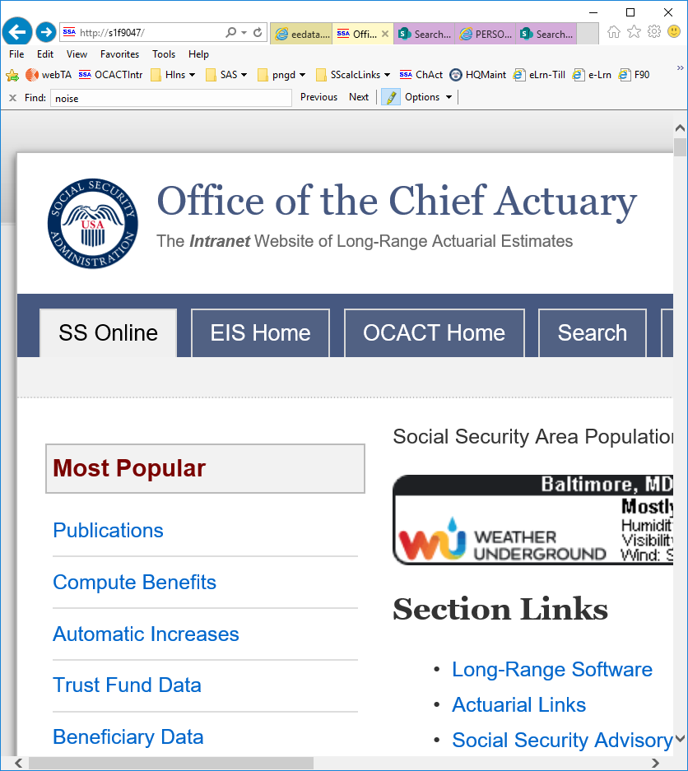
2019 Trustees Report Highlights
The OASI fund alone is projected to be depleted in 2034
The DI fund alone is projected to be depleted in 2052
The hypothetical combined OASDI fund is projected to be depleted in 2035
As of December 31, 2018, the trust funds hold about $2.89 trillion in asset reserves
The OASDI Summarized 75-year actuarial deficit is 2.78% of payroll
Both total outgo from and total income into the OASDI trust fund exceeded one trillion dollars in 2018 for the first time ever

Slide 4
OASDI Annual Cost and Non-Interest Income as % of Taxable Payroll
Persistent negative annual cash-flow balance starting in 2010
80% of scheduled benefits still payable at trust fund reserve depletion

Slide 5
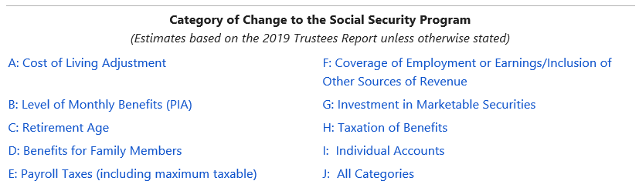
Provisions to Change the Social Security Program
Source: https://www.ssa.gov/oact/solvency/provisions/index.html

Slide 6
What Kind of Provisions Do We See In Solvency Packages?
Raise Scheduled Revenue
  Increase payroll tax
  Increase or eliminate the taxable maximum
  Increase revenue from taxation of benefits
  Find other sources of revenue
Lower Scheduled Benefits
  Change benefit formula
  Reduce cost of living adjustments
  Increase retirement age
  Reduce benefits for dependents
Restructure System
  Individual accounts
Offsetting Costs (“Goodies”)
  Targeted benefit increases
  Increase cost of living adjustments
  Raise thresholds for taxation of benefits

Slide 7
Benefit Provisions
2019TR Provision # | Description | Change in Actuarial Balance
A3 | Calculate COLA using chained CPI-W December 2020+ | 0.58
A6 | Calculate COLA using CPI-E December 2021+ | -0.40
B1.2 | Progressive Price Indexing 2026+ | 1.57
B3.11 | Increase the first PIA factor from 90 percent to 93 percent for all beneficiaries 2021+ | -0.24
B5.2 | Reconfigure the Special Minimum Benefit | -0.17
B6.3 | Uniform benefit bump at age 85 equal to 5% of the average retired-worker PIA | -0.14
C1.3 | Index the normal retirement age (NRA) to life-expectancy after the NRA reaches 67 | 0.58
D1 | Expand student benefits for children of disabled or deceased workers to age 22 | -0.06

Slide 8
Benefit Provisions

Slide 9
Revenue Provisions
2019TR Provision # | Description | Change in Actuarial Balance
E1.4 | Increase the payroll tax rate by 0.1 ppt annually from 2025-2044 to 14.4% in 2044+. | 1.47
E2.1 | Eliminate the taxable maximum in years 2020. No benefit credit. | 2.35
E2.2 | Eliminate the taxable maximum in years 2020. Full benefit credit. | 1.80
E2.6 | Apply a 3% payroll tax above the current-law taxable maximum 2020+. No benefit credit. | 0.61
E3.1 | Increase the taxable maximum to achieve 90% taxable ratio (phased in 2020-2029). Full benefit credit. | 0.73
F7 | Return to 2009 thresholds for the estate tax, gift tax, and GST tax and redirect all revenue to the combined OASDI Trust Fund. | 0.58
G1 | Invest 40 percent of reserves in equities (phased in 2020-2034). | 0.50
D1 | Expands student benefits for children of disabled or deceased wokrers to age 22 | -0.06

Slide 10
Revenue Provisions

Slide 11
Recent Non-Solvency Proposals
  Change to Windfall Elimination Provision
    Representative Neal, September 2019
    Representative Brady, July 2019
  Elimination of the Retirement Earnings Test
    Representative Walorski, May 2019
  Parental leave benefits in exchange for a reduction in normal retirement age
    Senator Rubio and Representative Wagner, April 2019
    Senators Lee and Ernst

Slide 12
PROPOSALS
Anna
Kirjusina
anna.kirjusina@ssa.gov

Slide 13
Proposed Acts for Social Security
Policymakers develop proposals and options
Financial effects on the OASDI Trust Funds
Intent of addressing the long-range solvency problem
Proposals with direct effects on the SS Trust Funds
  Committee on Ways and Means
    The Social Security 2100 Act
      introduced on January 30, 2019
        Congressman Larson
    Social Security Reform Act of 2016
      Introduced on December 8, 2016
        Representative Sam Johnson

Slide 14
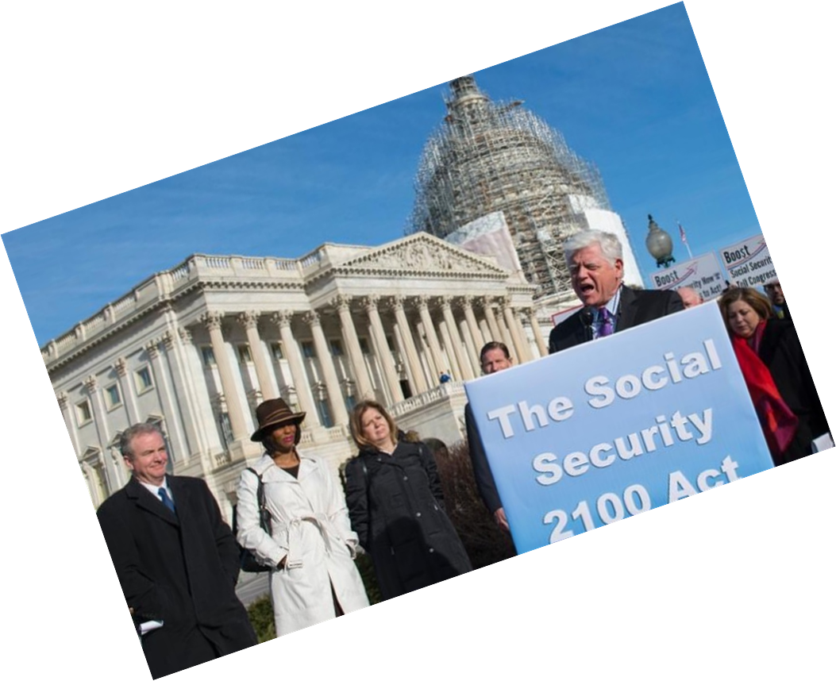

The Social Security 2100 Act
Increase benefits (PIA Formula) and the special minimum PIA
Use CPI-E increase rather than CPI-W increase to calculate COLA
    CPI-E (Consumer Price Index for the Elderly)
    CPI-W (Consumer Price Index for Urban Wage Earners and Clerical Workers)
    COLA (Cost-Of-Living Adjustment)
  estimated to increase the COLA by an average of 0.2 percentage point per year.
Replace current-law thresholds for federal income taxation of OASDI benefits with a single set of thresholds
  at $50k/$100k for single/joint filers
  up to 85 percent of OASDI benefits, effective for tax year 2020
Payroll tax on earnings above $400,000
  While no tax on earnings between $132,900 and $400,000 (donut)
2.4% gradual increase in payroll tax rate to 14.8% (phased in 2020-2043)
New Social Security Trust Fund
  combines the reserves of OASI and DI Trust Funds
Notes:
Section 101. Increase the first PIA formula factor from 90 percent to 93 percent for all benefits payable for months of entitlement January 2020 and later, including benefits for those becoming newly eligible both before and after January 2020.
Section 102. Use the Consumer Price Index for the Elderly (CPI-E) increase rather than the Consumer Price Index for Urban Wage Earners and Clerical Workers (CPI-W) increase to calculate the cost-of-living adjustment (COLA), effective for December 2019 and later COLAs. We assume this change would increase the COLA by an average of 0.2 percentage point per year.
Section 103. Increase the special minimum PIA, beginning for workers who become newly eligible for retirement or disability benefits or die in 2020 or later. For workers becoming newly eligible or dying in 2020, the minimum PIA for 2020 for workers with 30 or more years of coverage (YOCs) is 125 percent of the annual poverty guideline for a single individual published by the Department of Health and Human Services for 2019, divided by 12. For workers becoming newly eligible or dying after 2020, the minimum PIA for their initial year of eligibility is increased by the growth in the national average wage index (AWI). For all affected workers, the minimum PIA is increased after their year of initial eligibility by the COLA.
Section 104. Replace the current-law thresholds for federal income taxation of OASDI benefits with a single set of thresholds at $50,000 for single filers and $100,000 for joint filers for taxation of up to 85 percent of OASDI benefits, effective for tax year 2020. These thresholds would be fixed and not indexed to price inflation or average wage increase. The amount of revenue from taxation of OASDI benefits that would be allocated to the HI Trust Fund will be at the same level as if the current-law computation (in the absence of this provision) were applied. The net amount of revenue from taxing OASDI benefits, after the allocation to HI, would be allocated to the combined Social Security Trust Fund.
Section 201 and Section 202. Apply the combined OASDI payroll tax rate on covered earnings above $400,000 paid in 2020 and later. Tax all covered earnings once the current-law taxable maximum exceeds $400,000. Credit the additional earnings that are taxed for benefit purposes by: (a) calculating a second average indexed monthly earnings (“AIME+”) reflecting only additional earnings taxed above the current-law taxable maximum, (b) applying a 2-percent factor on this newly computed “AIME+” to develop a second component of the PIA, and (c) adding this second component to the current-law PIA.
Section 203. Increase the combined OASDI payroll tax rate to 14.8 percent, fully effective for 2043 and later. The combined rate is increased by 0.1 percentage point each year starting in 2020, reaching the ultimate 14.8 percent rate for 2043 and later.
Page 3 – The Honorable John Larson, Richard Blumenthal, and Chris Van Hollen
Section 204. Beginning in 2020, establish a new Social Security Trust Fund by combining the reserves of the separate OASI and DI Trust Funds and managing all future financial operations of the program on a combined basis.
The balance of this letter provides a summary of the effects of the eight provisions on the actuarial status of the OASDI program, our understanding of the specifications and intent of each of the eight provisions, and descriptions of our detailed financial estimates for trust fund operations, benefit levels, and implications for the federal budget. See the “Specification for Provisions of the Proposal” section of this letter for a more detailed description of these eight provisions.

Slide 15
The Social Security 2100 Act - LINGO
The special minimum benefit
A special minimum primary insurance amount (PIA) enacted in 1972 to provide adequate benefits to long-term low earners.
  The first full special minimum PIA in 1973 was $170 per month.
  Beginning in 1979, its value has increased with price growth and is about $875 per month in 2018.
This is the current law
By 2018, very few affected by this type of benefit
Minimum PIA for 2020:
for workers with 30 or more years of coverage
  125% of the annual poverty guideline*, divided by 12
for workers becoming newly eligible or dying after 2020,
  the minimum PIA for their initial year of eligibility is increased by the growth in the AWI
for all affected workers
  the minimum PIA is increased after their year of initial eligibility by the COLA
*for a single individual published by the Department of Health and Human Services for 2019

Slide 16
Current Law versus 2100 Act
CURRENT LAW
80% of scheduled benefits are projected to be payable on a timely basis in 2035 after depletion of the combined trust fund reserves
Declining to 75% for 2093.
2.78% long-range OASDI actuarial deficit
PROPOSAL
75-year solvency projected for OASDI program
100% of scheduled benefits paid for the foreseeable future
0.39% positive OASDI actuarial balance

Slide 17
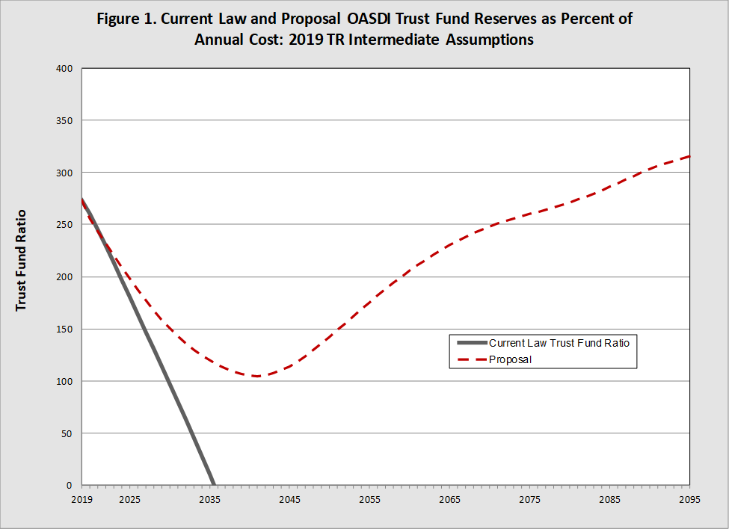
Trust Fund Ratio (CL vs 2100 Act)
Notes:
Figure 1 illustrates the projected OASDI Trust Fund ratio through 2093 under current law and assuming enactment of the proposal. The trust fund ratio is defined as the combined Social Security Trust Fund reserves expressed as a percent of annual program cost. Assuming enactment of the proposal, the combined Social Security Trust Fund would be fully solvent throughout the 75-year projection period, under the intermediate assumptions of the 2019 Trustees Report. In addition, because the projected trust fund ratio is increasing at the end of the period, the proposal meets the conditions for sustainable solvency.

Slide 18
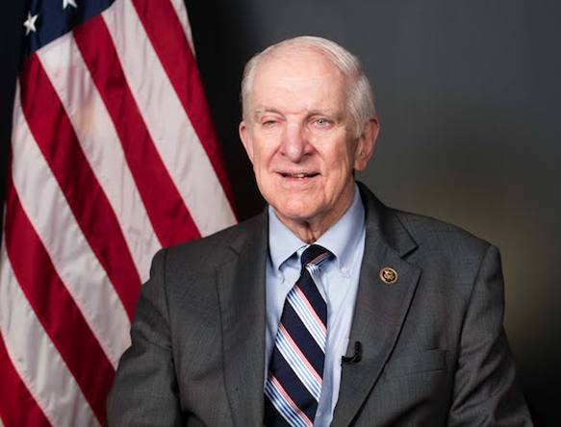
Social Security Reform Act of 2016
Representative Sam Johnson
Introduced on December 8, 2016
Committee on Ways and Means
  75-year solvency
  Benefit cuts rather than revenue increases
    Changes in the benefit formula
    Expand benefits for long term low-wage earners
    Reduction or elimination of COLA for all beneficiaries
    Eventually eliminate income taxation of Social Security benefits
Notes:
1) For retired worker and disabled worker beneficiaries becoming initially eligible in January 2023 or later, phase in a new benefit formula (from 2023 to 2032). Replace the
existing two PIA bend points with three new bend points and modified benefit formula
factors.
2) Use an annualized “mini-PIA” formula beginning with retired and disabled worker beneficiaries becoming newly eligible in 2023, phased in over 10 years. The mini-PIA
calculation would use a single year’s average monthly indexed earnings (mini-AIME) and primary insurance amount (mini-PIA) for each year with taxable earnings.
3) Replace the current-law Windfall Elimination Provision (WEP) with a new calculation
for most OASI and DI benefits based on covered and non-covered earnings, phased in for beneficiaries becoming newly eligible in 2023 through 2032.
4) After the normal retirement age (NRA) reaches 67 for those attaining age 62 in 2022,
increase the NRA by 3 months per year starting for those attaining age 62 in 2023 until it
reaches 69 for those attaining age 62 in 2030. Increase the age up to which delayed
retirement credits may be earned from 70 to 72 on the same schedule.
5) Beginning with the December 2018 COLA, provide no COLA for those with modified
adjusted gross income (MAGI) above specific thresholds and compute the COLA using
the chain-weighted version of the CPI-U (C-CPI-U) for all other beneficiaries.
6) For spouses and children of retired workers and disabled workers becoming newly
eligible beginning in 2023 and phased in for 2023 through 2032, limit their auxiliary benefit to the amount based on one-half of the PIA of a hypothetical worker with earnings equal to the national average wage index (AWI) each year up to his or her eligibility year, and who has the same eligibility year as the worker.
7) Beginning in January 2019, require full time school enrollment as a condition of eligibility for child benefits at age 15 up to 18.
8) Provide a new minimum benefit for workers with more than 10 years of covered earnings above a specified level, phased in for retired and disabled worker beneficiaries becoming
newly eligible in 2023 through 2032.
9) Beginning in January 2019, eliminate the retirement earnings test for all beneficiaries under NRA.
10) Eliminate federal income taxation of OASDI benefits that is credited to the OASI and DI Trust Funds for 2054 and later, phased in from 2045 to 2053.
11) Provide an option to split the 8-percent delayed retirement credit (DRC) to offer a lump
sum benefit at initial entitlement equivalent to 2 of the 8 percent DRC earned, and a 6
percent DRC on subsequent monthly benefits, effective for workers attaining age 62 in
2023 and later.
12) Beginning in January 2023, provide an addition to monthly benefits for all beneficiaries who have been eligible for at least 20 years. The additional amount is calculated based on 5 percent of the PIA for a hypothetical worker with earnings equal to the national average wage index each year.
13) Beginning in January 2023, for new and current disabled widow(er) beneficiaries, change the requirement that disability must occur no later than 7 years after the worker’s death, or after surviving spouse with child-in-care benefits were last payable, to no later than 10 years.
14) Beginning in January 2023, for new and current disabled surviving spouse beneficiaries, eliminate the requirement to be age 50 or older for receipt of benefits.
15) Beginning in January 2023, for new and current beneficiaries, waive the two-year duration of divorce requirement for divorced spouse benefit eligibility in cases where the worker (former spouse) remarries someone other than the claimant before the two-year period has elapsed.
The balance of this letter provides a summary of the effects of the fifteen provisions on the actuarial status of the OASDI program, our understanding of the specifications and intent of each of the fifteen provisions, and descriptions of our detailed financial estimates for trust fund operations, benefit levels, and implications for the federal budget. See the “Specification for Provisions of the Proposal” section of this letter

Slide 19
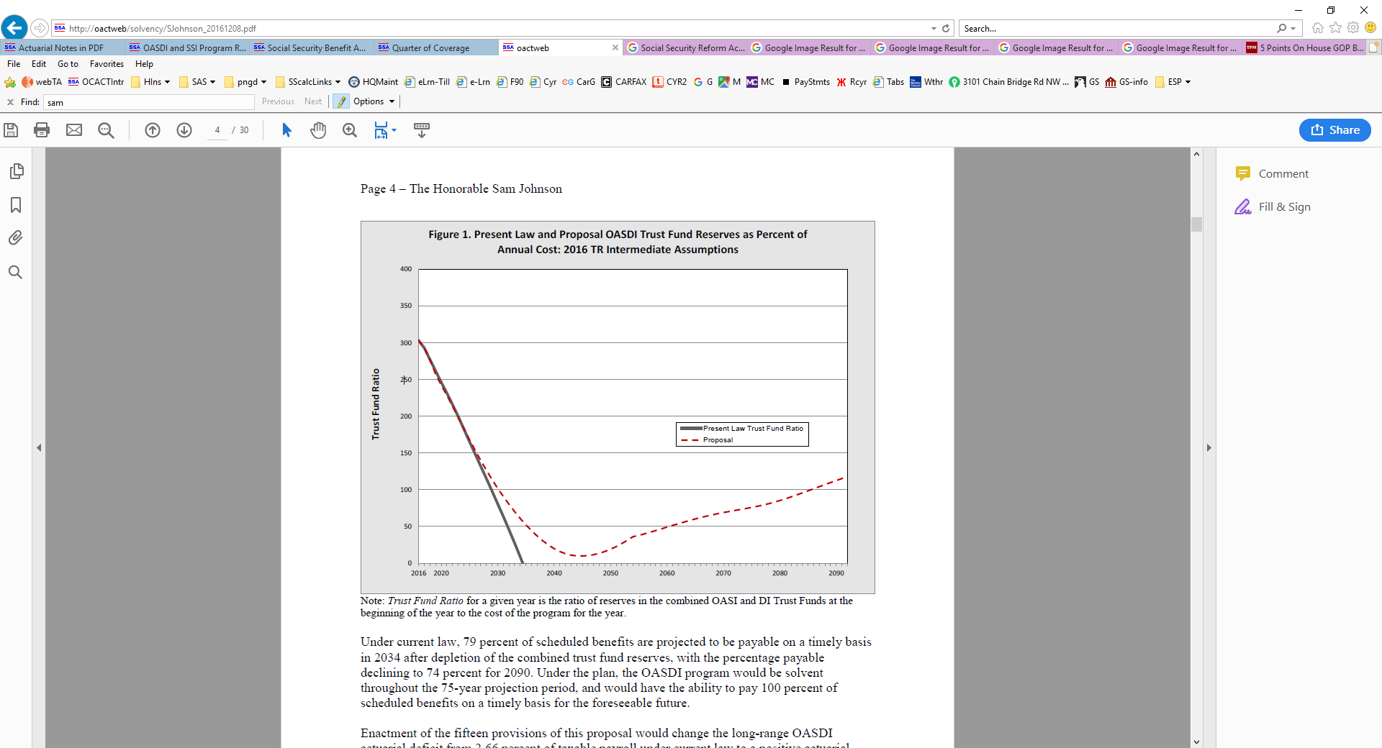
Sam Johnson Bill
Notes:
Figure 1 illustrates the projected trust fund ratio through 2090 under present law and assuming enactment of the proposal. The trust fund ratio is defined as the combined Old-Age and Survivors Insurance (OASI) and Disability Insurance (DI) Trust Fund reserves expressed as a percent of annual program cost. Assuming enactment of the proposal, the combined OASI and DI Trust Funds would be fully solvent throughout the 75-year projection period, under the intermediate assumptions of the 2016 Trustees Report. In addition, because the projected trust fund ratio is increasing at the end of the period, the plan meets the conditions for sustainable solvency. It should be noted, however, that because the projected level of reserves reaches as low as 10 percent of annual program cost around 2045, unexpected fluctuations in the economy or other factors affecting program cost or revenue could require additional temporary measures to maintain solvency through this period.
Under current law, 79 percent of scheduled benefits are projected to be payable on a timely basis in 2034 after depletion of the combined trust fund reserves, with the percentage payable declining to 74 percent for 2090. Under the plan, the OASDI program would be solvent throughout the 75-year projection period, and would have the ability to pay 100 percent of scheduled benefits on a timely basis for the foreseeable future.
Enactment of the fifteen provisions of this proposal would change the long-range OASDI actuarial deficit from 2.66 percent of taxable payroll under current law to a positive actuarial balance of 0.02 percent of payroll under the proposal.

Slide 20

Sam Johnson Bill
Notes:
Figure 2 illustrates annual projected levels of cost, expenditures, and non-interest income as a percent of the current-law taxable payroll. The projected level of cost reflects the full cost of scheduled benefits under both current law and the proposal. Under the proposal, projected expenditures equal the full cost of scheduled benefits throughout the long-range period.
OASDI program annual cost under the proposal is higher than under current law, starting in 2019. This difference decreases and by 2022, annual cost under the proposal is lower than under current law. The reduction in cost grows quickly through 2055, reaching over 4 percent of current-law payroll, and then gradually, reaching about 5.5 percent of current-law payroll for 2090. Beginning in 2019, non-interest income under the proposal is projected to be slightly higher than under current law through 2022. For 2023 and later, non-interest income under the proposal is lower than under current law due to reduced and eventual elimination of revenue from income taxation of benefits, with the difference increasing to 0.9 percent of current-law payroll for 2090. The annual balance (non-interest income minus program cost) under the proposal is slightly worse (more negative) than under current law from 2019 through 2021. For 2022 and later, the proposal improves the annual balance.
It is also useful to consider the projected cost, expenditures, and income for the OASDI program expressed as a percentage of Gross Domestic Product (GDP). Figure 3 illustrates these levels under both current law and the proposal

Slide 21
BENEFIT
TABLES
Katie
Sutton
katie.sutton@ssa.gov

