Slide 1
Developments in
Actuarial Professionalism 2016
Paul Kollmer-Dorsey
General Counsel, American Academy of Actuaries
November 10, 2016

Slide 2
The American Academy of Actuaries
The American Academy of Actuaries is an 18,500+ member professional association whose mission is to serve the public and the United States actuarial profession.
To accomplish this (among other activities), the Academy provides for the establishment, maintenance, and enforcement of high professional standards of actuarial conduct, qualification, and practice.

Slide 3
Objectives of Today’s Presentation
Review the basic structures and key elements of U.S. actuarial professionalism.
Discuss developments in actuarial professionalism in 2016.
Identify tools and resources that are available to help actuaries keep up to date on professionalism.

Slide 4
The Web of Professionalism The Basis of Self-Regulation of the US Actuarial Profession
The presentation will trace the “web of professionalism” based on 2016 Presidential Papers covering Academy’s role in developing:
The Code of Professional Conduct
U.S. Qualification Standards (USQS)
Actuarial standards of practice (ASOPs)
Counseling and discipline

Slide 5
Code of Professional Conduct

Slide 6
Code of Professional Conduct
The current identical Code was individually adopted by the five U.S.-based actuarial organizations (Academy, ASPPA, CAS, CCA, and SOA) and took effect Jan. 1, 2001.
The Code sets forth professional/ethical standards for actuarial members of the five U.S.-based actuarial organizations.
Actuaries who commit material violations of the Code are subject to counseling or discipline.
Most complaints to, and 80% of requests for guidance handled by, the ABCD in 2015 involved alleged material violations of Precepts 1, 2, and/or 3.

Slide 7
Professional Integrity
Precept 1
An Actuary shall act honestly, with integrity and competence, and in a manner to fulfill the profession’s responsibility to the public and to uphold the reputation of the actuarial profession.

Slide 8
Qualification
Precept 2
An Actuary shall perform Actuarial Services only when the Actuary is qualified to do so on basis of basic and continuing education and experience, and only when the Actuary satisfies applicable qualification standards.
Notes:
I will speak about these at length later.

Slide 9
Standards of Practice
Precept 3
An Actuary shall ensure that Actuarial Services performed by and under the direction of the Actuary satisfy applicable standards of practice.
Notes:
I will speak about these at length later.

Slide 10
Other Precepts
Communications and Disclosure: Precepts 4, 5, and 6
Conflict of Interest: Precept 7
Control of Work Product: Precept 8
Confidentiality: Precept 9
Courtesy and Cooperation: Precept 10
Advertising: Precept 11
Titles and Designations: Precept 12
Violations of the Code of Professional Conduct: Precepts 13 and 14

Slide 11
Practical Example: Big Data and Actuarial Professionalism Professionalism webinar, June 2016
“With great power comes great responsibility” – Spider Man, 2002, Uncle Ben to Peter Parker
Professional Integrity PRECEPT 1. An Actuary shall act honestly, with integrity and competence, and in a manner to fulfill the profession’s responsibility to the public and to uphold the reputation of the actuarial profession.
Annotation 1-2. An Actuary shall not provide Actuarial Services for any Principal if the Actuary has reason to believe that such services may be used to violate or evade the Law or in a manner that would be detrimental to the reputation of the actuarial profession.
Annotation 1-4. An Actuary shall not engage in any professional conduct involving dishonesty, fraud, deceit, or misrepresentation or commit any act that reflects adversely on the actuarial profession.
Notes:
Ross
Thanks, Bob.
Encourage periodic review and discussion with your colleagues of the code of professional conduct.
Much of the code is intuitive and ingrained in our profession, but the words were chosen carefully and have deep meaning.
Have pulled some of the most relevant requirements.

Slide 12
Practical Example: Big Data and Actuarial Professionalism Professionalism webinar, June 2016
Some Legal Reference Points on Big Data
Applicable law includes, but not limited to
State insurance laws and regulations
The Unfair Claims Practices Act and Unfair Trade Practices Act
The Fair Credit Reporting Act
Gramm-Leach-Bliley Act privacy provisions
Notes:
Ross [Bob and Jim to chime in]
Panelists to discuss the examples of ‘applicable law’
Source: ISO Letter to NAIC Big Data Working Group – March 30, 2016
Rating laws which require that rates and rating factors not be excessive, inadequate or unfairly discriminatory.
• Actuarial Standards of Practice which deal directly with the appropriateness of data and risk characteristics.
• The rate filing process and the Market Conduct process, as well as consumer complaints, which inform regulators of insurer practices and provide opportunities for regulatory oversight.
• The Unfair Claims Practices Act and Unfair Trade Practices Act which regulate insurer's claims handling, marketing, underwriting and advertising practices.
• The Fair Credit Reporting Act which requires that insurers provide transparency and guarantee accuracy of certain data used in rating and underwriting.
• Gramm-Leach-Bliley privacy laws which regulate transparency and confidentiality of policyholder's data.
Ross will go other some ethical considerations to keep in mind.

Slide 13
Practical Example: Big Data and Actuarial Professionalism Professionalism webinar, June 2016
Questions to consider about Big Data and Precept 1
Does your approach comply with applicable law – both letter of the law and in spirit?
Are certain permissions needed?
Are you comfortable describing what you are doing to stakeholders (consumers, insurance companies, providers, DOI, auditors, etc.)?
Notes:
Ross
Thanks Bob.
[add any script notes]
Now, let’s look at some ASOPs. Jim?

Slide 14
U.S. Qualification Standards

Slide 15
Background: Precept 2
“An Actuary shall perform Actuarial Services only when the Actuary is qualified to do so on the basis of basic and continuing education and experience, and only when the Actuary satisfies applicable qualification standards.” [emphasis added]
“It is the professional responsibility of an Actuary to observe applicable qualification standards that have been promulgated by a Recognized Actuarial Organization for the jurisdictions in which the Actuary renders Actuarial Services and to keep current regarding changes in these standards.” [emphasis added] (Annotation 2-1)

Slide 16
USQS—SAO—COQ
Academy Board adopted the current Qualification Standards for Actuaries Issuing Statements of Actuarial Opinion in the United States (USQS) in 2008.
A Statement of Actuarial Opinion (SAO) is defined as having two components: (i) an opinion expressed by an actuary in the course of performing actuarial services; and (ii) an opinion that is intended by the actuary to be relied upon by a principal.
The Academy’s Committee on Qualifications (COQ) is the authoritative source for questions and answers about the application of, and how to satisfy, the USQS.

Slide 17
Scope of USQS
Three essential components in USQS: basic education, experience, and continuing education.
USQS reflects the dynamic qualities of practice.
If you issue SAOs in the U.S. — and almost every U.S. actuary does — you are required under Precept 2 of the Code to meet the USQS.
If you render actuarial services outside the U.S., the Code requires you to observe the applicable qualification standards for that jurisdiction.

Slide 18
Structure of USQS
The structure of the U.S. Qualification Standards (effective Jan. 1, 2008)
Section 1. Introduction (including definitions)
Section 2. General Qualification Standard
Basic Education and Experience Requirements
Continuing Education Requirements
Section 3. Specific Qualification Standards (when necessary)
Section 4. Changes in Practice and Application
Section 5. Acknowledgement of Qualification
Section 6. Recordkeeping Requirements

Slide 19
USQS: Section 2 Basic Education and Experience Requirements
Must be an Academy member, a Fellow or Associate of the SOA or the CAS, a Fellow of the CCA, a Member or Fellow of ASPPA, or a fully qualified member of another IAA-member organization;
Must have 3 years of responsible actuarial experience; and
Must be knowledgeable through examination or documented professional development of the Law applicable to the SAO.

Slide 20
USQS: Section 2 Basic Education and Experience Requirements
In addition, if you issue an SAO in an area covered by an SOA specialty track, or in a practice area covered by CAS or ASPPA exams, you must meet one of the following:
Attain the highest possible actuarial designation in an IAA full-member organization (other than the Academy) and complete a specialty track in an area relevant to the SAO; or
Attain highest possible actuarial designation in IAA full-member organization (other than the Academy) and have at least 1 year responsible actuarial experience in the relevant area under the review of an actuary qualified to issue the SAO; or
Have at least 3 years of responsible actuarial experience in the relevant area under the review of an actuary qualified to issue the SAO.

Slide 21
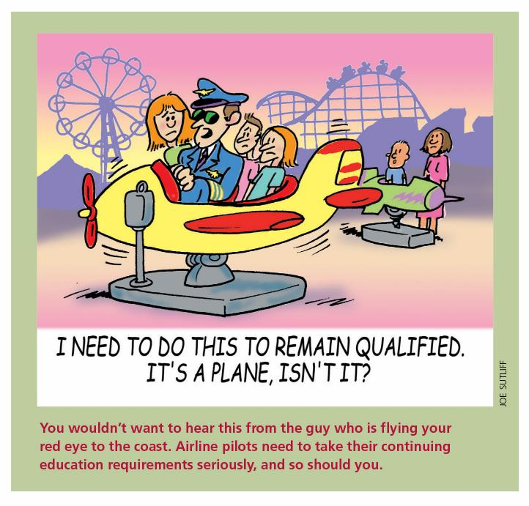
USQS: Section 2 General Continuing Education Requirements
At least 6 hours on “Organized Activities”
At least 3 hours on professionalism topics
General business subjects, which are not required under the USQS, are limited to no more than 3 hours annually.
30 hours of relevant continuing education (CE) annually
Notes:
“

Slide 22
USQS: Continuing Education
Each actuary must make a “reasonable, good-faith determination” of what CE opportunities enhance the actuary’s ability to practice in a desired field.
The USQS states that CE must be “relevant.” This requirement is satisfied if the continuing education
broadens or deepens an actuary’s understanding of one or more aspects of the work an actuary does;
expands an actuary’s knowledge of practice in related disciplines that bear directly on an actuary’s work; or
facilitates an actuary’s entry into a new area of practice.

Slide 23
USQS: Section 3 Specific Qualification Standards
Apply to actuaries who issue the following SAOs:
NAIC Life and A&H Annual Statement
NAIC Property and Casualty Annual Statement
NAIC Health Annual Statement
Specific Qualification Standards are developed when an actuary needs to possess specific qualifications beyond those required to satisfy the “General Qualification Standard.”
Apply only to the types of SAOs for which they have been adopted.

Slide 24
USQS: Section 3 Specific Qualification Standards
To issue an SAO subject to the Specific Qualification Standards, an actuary must successfully complete examinations on the topics listed in section 3 (or obtain the knowledge through alternative education).
Experience Requirement: Three years of responsible experience relevant to the subject of the SAO under the review of an actuary who was qualified to issue the specific SAO at the time of the review.
CE Requirement: 15 hours of the 30 must be directly relevant to the listed topics.

Slide 25
Look in the Mirror Test
Not a purely subjective test.
Requires you to objectively examine your professional qualifications (basic and continuing education and experience) and make a reasoned judgment about whether you can fulfill the requirements of the USQS and your obligations under the Code:
The bar under Precept 2, Annotation 2-2 is very high: “The absence of applicable qualification standards for a particular type of assignment . . . does not relieve the Actuary of the responsibility to perform such Actuarial Services only when qualified to do so . . . .”
Professionalism Counts article in March 2016

Slide 26
New USQS FAQs 2016
Long-Term Care (section 2.3.2)
Blend of life and health elements
Qualified if qualified in either life or health
CE should include all areas of practice relevant to SAO
Prudent to work with actuary qualified in complementary area
Changing practice area (section 4.1)
Must satisfy basic education and experience requirement
Not required to take exams, but may do so
Specific Qualifications Experience (section 3.2)
Reviewing actuary must have been qualified to issue the relevant SAO at the time of review
Notes:
UPDATE
[draft talking points below-kl]
Frank Stone, member of CoQ and a regulator, brought up a question on qualifications guidance regarding long-term care (LTC) to the committee. Other regulators had noted there is a principle-based reserves (PBR) FAQ but not one for LTC.
A subgroup was formed to discuss and draft an LTC FAQ.
It is similar to the FAQ on PBR qualifications, but based largely on section 2.3.2, Statements of Actuarial Opinion in Two or More Distinct Areas of Actuarial Practice.

Slide 27
Other Qualifications Highlights
Professionalism and the US Qualifications Standards:
March 17, 2016 webinar on USQS FAQs; available to Academy members on our website
Life and Health Qualifications Seminar
November 13-17, 2016

Slide 28
Helpful Tool: Attestation Form
Made available to Academy members in January 2016 at attest.actuary.org
Specific and General Qualifications tracks
Printable attestation
Can complete multiple attestations for multiple SAOs
Can download complete attestation package (form and attachments)

Slide 29
Actuarial Standards of Practice

Slide 30
Structure of the ASB
The ASB has 9 members who are broadly representative of all areas of actuarial practice.
Under Academy Bylaws, the members of the ASB must be broadly representative of all areas of actuarial practice.
ASB members play a standard-setting role, not an advocacy role, and serve the profession rather than any individual interest groups or coalitions.
Actuarial Standards Board
General Committee
Casualty Committee
ERM Committee
Health Committee
Life Committee
Pension Committee

Slide 31
Standard-Setting Principles
Precept 3 of the Code requires Actuaries to comply with ASOPs
ASOP 1: ASOPs identify what the actuary should consider, document, and disclose.
They also provide a basic framework for other considerations, such as legal/regulatory requirements, professional requirements, evolving actuarial practice, and the actuary’s professional judgment.
See July and August 2016 Professionalism Counts articles on ASOP 1
ASOPs provide guidance for appropriate practice, not merely codify current practice or best practice.
ASOPs should apply as broadly as possible.
Disclosure is a cornerstone of compliance with standards.

Slide 32
Developing ASOPs

Slide 33
Overview of Cross-Practice Standards Professionalism Webinar October 2016
Currently, there are about 50 ASOPs. Cross-practice and practice-specific standards work together to provide actuaries with effective guidance for appropriate practice.
Most cross-practice standards provide guidance for appropriate practice that is common across all practice areas.
Cross-practice standards help to articulate broad principles and align terminology across practice areas.
Together with the Code of Professional Conduct, cross-practice standards help to unify the actuarial profession.

Slide 34
Structure of ASOPs
Cross-Practice ASOPs
ASOP 1 Introductory ASOP
ASOP 41 Actuarial Communication
ASOP 12 | Risk Classification
ASOP 17 | Expert Testimony by Actuaries
ASOP 21 | Responding to or Assisting…
ASOP 32 | Social Insurance
ASOP 23 | Data Quality
ASOP 25 | Credibility Procedures
Exposure | Modeling
TBD | Assumptions
Practice-Specific ASOPs
Casualty
ERM
Health
Life
Pension
ASOP 13, 19, 20, 29, 30, 36, 38, 39, 43
ASOP 46, 47
ASOP 3, 5, 6, 8, 11, 18, 19, 22, 26, 28, 42, 45, 49, 50
ASOP 2, 7, 10, 11, 15, 19, 22, 24, 33, 37, 40, 48
ASOP 4, 6, 27, 34, 35, 44

Slide 35
History of Cross-Practice ASOPs
 | 1980s | 1990s | 2000s | 2010s
ASOP 1: Introductory ASOP
ASOP 12: Risk Classification
ASOP 17: Expert Testimony | In Process
ASOP 21: Assisting Auditors…
ASOP 23: Data Quality | In Process
ASOP 25: Credibility Procedures
ASOP 32: Social Insurance
ASOP 41: Actuarial Communications
Modeling | In Process
Assumptions | In Process

Slide 36
ASB Actions– Approved 2016
Revision to ASOP No. 21, Responding to or Assisting Auditors or Examiners in Connection with Financial Audits, Financial Reviews and Financial Examinations
Exposure draft of ASOP on Life Insurance and Annuity Pricing
Exposure of proposed new ASOP titled Capital Adequacy Assessment
Exposure draft of revisions to ASOP No. 24, Compliance with the NAIC Life Insurance Illustrations Model Regulation
Second exposure of proposed new ASOP titled Assessment and Disclosure of Risk Associated with Measuring Pension Obligations and Determining Pension Plan Contributions
Third exposure draft of proposed new ASOP on Modeling
Following release of Pension Task Force Report in June, directed ASB Pension Committee to draft modifications to pension-related ASOPs

Slide 37
ASB In Action Third Exposure Draft of Modeling ASOP (Comment Deadline was October 31st)
Key Provisions:
“…ASOP applies to…all types of models that are not simple models.” (1.2)
Definition of Simple Model – “…model results are transparent and can be predicted without an actual model run or readily obtained from an external source that is not another model.” (2.12)

Slide 38
Exposure Draft: Modeling Key Provisions
Model Meeting the Intended Purpose
Model should reasonably meet the intended purpose (3.4).
Understanding the Model
“the actuary should understand…important aspects of the model…and whether, and the extent to which, the model can fulfill its intended purpose…” (3.4.4)
Model Structure
Considerations include provisions of business segment, level of granularity, deterministic or stochastic results, and options available to entity (3.4.5).

Slide 39
Exposure Draft: Modeling Key Provisions
Mitigation of Model Risk
“The actuary should examine the potential for model risk and undertake reasonable and appropriate steps to mitigate such risk, using validation, governance, and controls, as appropriate to the intended purpose.” (3.5)
Models Developed by Others
The actuary should make a reasonable attempt to have a basic understanding of the model. (3.2)
Reliance on Another Actuary on a Modeling Team
“…the relying actuary should be reasonably satisfied that the other actuary’s … use of the model was performed in accordance with this ASOP…” (3.3)

Slide 40
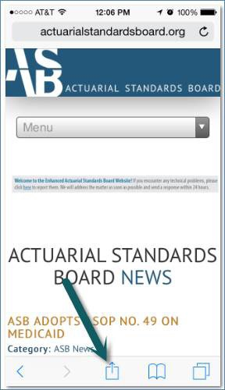
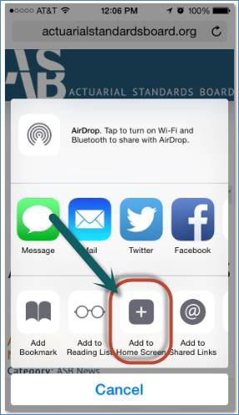
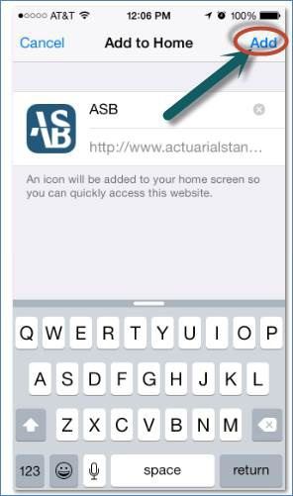
Tools for the Actuary: ASB Mobile-Friendly Website
Users can add an icon to their device’s home screen for convenient access to the mobile site.
For iPhones:
1
2
3

Slide 41
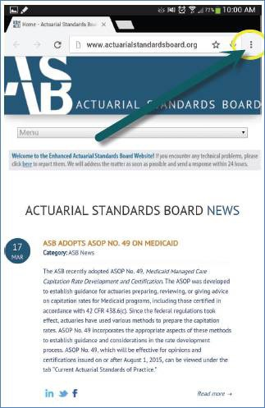
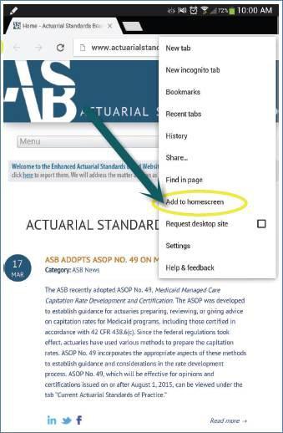
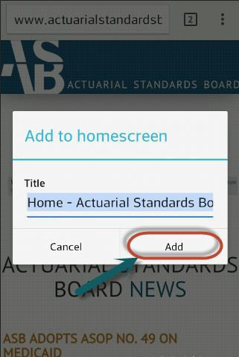
Tools for the Actuary: ASB Mobile-Friendly Website
Users can add an icon to their device’s home screen for convenient access to the mobile site.
For Androids:
1
2
3

Slide 42
Applicability Guidelines
ASOP 1: “Actuaries are responsible for determining which ASOPs apply to the task at hand.”
The Council on Professionalism’s Applicability Guidelines assist actuaries in identifying which ASOPs apply in specific situations.

Slide 43
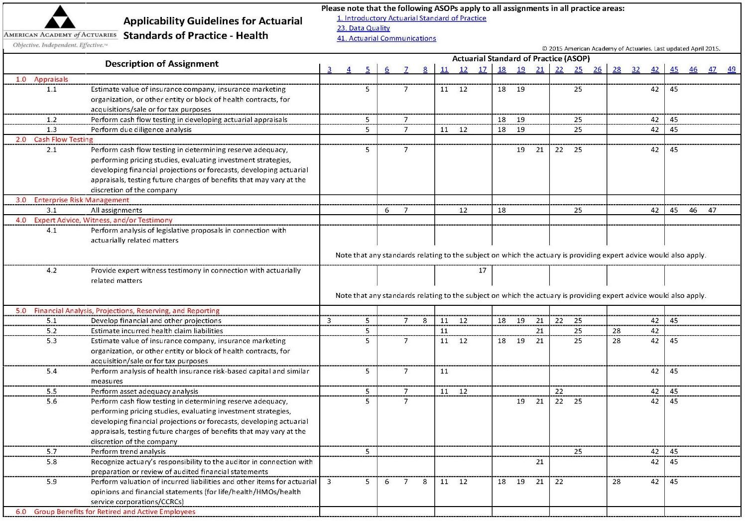

Slide 44
Actuarial Board for Counseling and Discipline

Slide 45
The ABCD
Two primary functions:
Respond to requests for guidance (RFGs) on professionalism issues.
October 2016 Professional Counts article on “ABCD Guidance: A Critical Element of Actuarial Self-Regulation”
Consider complaints about possible violations of the Code.
ABCD will also mediate disputes between actuaries and others if all parties agree to it.
Facilitate resolution of issue without inquiry.

Slide 46
Requests for Guidance
Actuaries may seek guidance on an actuarial matter that they believe may affect their obligations under the Code.
Confidential and can be made anonymously.
An individual member of the ABCD or the whole ABCD may respond with confidential advice on good professional practice.
RFGs are not a substitute for peer review.

Slide 47
Complaints
Inquiries into possible material violations of the Code can be initiated by a complainant, receipt of outside information, or other means (i.e., newspaper article).
The ABCD can initiate an inquiry without a complaint from an actuary or outside source.
Example: An ABCD board member sees a newspaper article about an actuary being indicted. That member can bring the information to the chair and vice chairs of the ABCD for them to decide whether a possible material violation exists. If they agree one may exist, they can vote for the ABCD to initiate an inquiry based on that article and any other public documents.

Slide 48
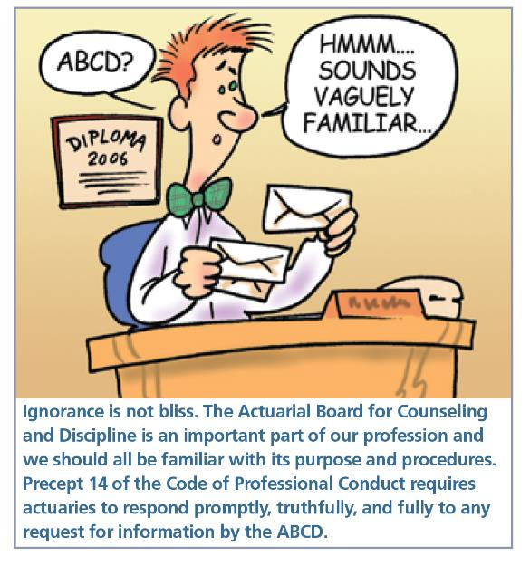
ABCD Complaint Process
Complaint is sent to Subject Actuary (SA), and a response is requested.

Slide 49
ABCD Complaint Process
ABCD chairperson and vice chairs perform preliminary review and decide whether to
dismiss the case (with or without guidance),
investigate further, or
refer the case for mediation.
If decision is to continue investigation, ABCD appoints an investigator and sends notice of the investigator to SA.
SA can object to investigator for good cause.

Slide 50
Findings and Recommendation
After hearing, ABCD decides whether to (a) request additional information; (b) dismiss the case; (c) confidentially counsel the subject actuary; or (d) recommend that the subject actuary be disciplined.
If decision is to recommend discipline, ABCD writes a Findings and Recommendation report.
Disciplinary recommendations may include private or public reprimand, suspension, or expulsion from membership (i.e. losing one’s actuarial credentials).
ABCD does not impose discipline: Findings and recommendations sent to membership organizations.

Slide 51
ABCD Annual Report –2015
Inquiries
Cases in progress in 2015: 29
Cases resolved in 2015: 15
11 Dismissed
3 Counseled
1 Recommended Public Discipline
Primary practice area of Subject Actuaries for cases resolved in 2015
3 Casualty
2 Health
7 Pension
3 Life

Slide 52
ABCD Report – 3Q 2016
Inquiries
Cases in progress as of 6/30/16: 14
New cases in 3rd quarter: 3
Cases resolved in 3rd quarter 2016: 2
Cases in progress as of 9/30/16: 15
Primary practice area of Subject Actuaries for cases under consideration during 3rd quarter 2016:
1 Casualty
2 Health
12 Pension
2 Life

Slide 53
ABCD Annual Report –2015
96 Requests for Guidance were responded to in 2015
27 Pension
22 Health
19 Life
23 Property & Casualty
5 General

Slide 54
ABCD Report –3Q 2016
29 Requests for Guidance have been responded to in 3rd quarter 2016
9 were Pension
7 were Health
5 was Life
8 were Property & Casualty

Slide 55
Upcoming Professionalism Webinar
ABCD Professionalism Panel
on
ASOP 41: Actuarial Communications
December 2016

Slide 56
And In Honor Of The 2016 Election…
A little walk down
actuarial professionalism
memory lane.

Slide 57
Unknown Unknowns: Challenges to Professionalism
October 30, 2015
Washington, D.C.
Sponsored by the Academy’s Council on Professionalism and cosponsored by ASPPA (ACOPA), CAS, CCA, and SOA

Slide 58
Health: The ACA
The Affordable Care Act
Completely restructured the individual health insurance market
Required a whole new federal regulatory structure to be built from scratch
Required numerous policy decisions to implement the law
All this occurred in a deeply polarized political environment.
Notes:
Market rules
Products that can be offered
Way products are purchased
Provided significant subsidies and an individual mandate
Complex new regulations had to be written
New regulatory processes and bureaucracies had to be built

Slide 59
Challenge: Am I Qualified?
Many actuaries had decades of experience in what was effectively an entirely different market.
Work now had to be done under an entirely new set of rules – many of which were still being written.
Answer cannot be:
Business as usual – of course I’m qualified (even if I do nothing else)
No one is qualified
Notes:
Look in the mirror

Slide 60
Challenge: Am I Qualified?
Possible questions to ask myself
Have I familiarized myself with the new law?
Am I reading and understanding the new rules as they are released?
Am I following sub-regulatory guidance as it’s released?
Am I talking to others about how to practice in the new environment?
Are the techniques and principles I’ve used in the past still relevant?
Notes:
Continuing education and keeping up to date on rules and regulations
Look in the mirror

Slide 61
Challenge: What Can I Certify?
Past experience data were of limited relevance.
Guidance was changing right up to – and past – the deadline for products and rates.
No one knew how the program would be received or what the insured population would look like.
New non-profit co-ops had no prior experience, no existing customer base, and limited capital.
Answer cannot be:
Business as usual – run things through the way we did them last year
It’s impossible to file anything
Notes:
creating a particularly large margin for error in pricing and financial exposure
Federal regulatory overlay complicated the filing process

Slide 62
Challenge: What Can I Certify?
Possible questions to ask myself
What assumptions am I making about the new market?
Are there significant aspects of the new rules that I’m not including in my calculations? If so, why not?
What outstanding regulatory questions could affect my work?
What additional explanations do I need to provide for my assumptions?
What caveats and qualifications do I need to include for the regulator to understand the applicability of my certification?
What opportunity – if any – do I have to modify the filing if new guidance is issued?

Slide 63
Unknown Unknowns
Lessons Learned
Being aware of the “big picture” – when something unexpected happens, how do you approach it?
Consider the Code, USQS, ASOPs
Consider all relevant information as it becomes known or available, e.g. Practice Notes, White Papers, Seminars
Network with colleagues, create a culture of sharing information within your organization: connect the dots.
Professionalism requires you to act with integrity and competence. Confront unknown unknowns with a framework of decision-making based on the Code.

Slide 64
Professionalism Resources
Professionalism Webinar Archive (free to Academy members) http://www.actuary.org/professionalism-webinars
Discussion Papers on various professionalism issues http://www.actuary.org/discussion-papers
Academy Professionalism webpage http://www.actuary.org/content/professionalism
* Code of Conduct * Qualification Standards
* Standards of practice (ASB) * Counseling and discipline (ABCD)
Qualifications Attestation Form: http://attest.actuary.org
eLearning Modules: http://www.actuary.org/content/actuarial-elearning-center

Slide 65
Questions?

