Slide 1
Sustainability of Public Finance in the United States Sven H. Sinclair, FSA, MAAA, PhD MAAC Fall Meeting November 10, 2016

Slide 2
Presentation Disclaimer
Opinions expressed in this presentation are those of the author and should not be construed as the opinions or positions of the Social Security Administration or the United States Government.

Slide 3
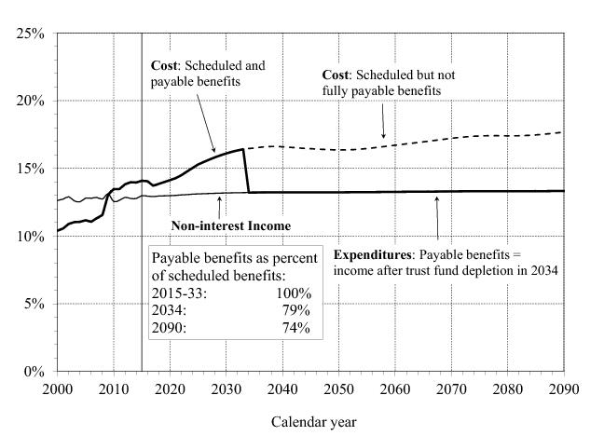
What do we mean by “sustainable”? Example: Social Security

Slide 4
Is Social Security “Going Broke”? Be More Precise, Please!
The trust funds fail the test of long-range close actuarial balance under the intermediate assumptions
Simplistically: Projected cost exceeds projected income
The combined OASDI trust fund reserves are projected to be depleted in 2034
Only 79% of scheduled benefits will be payable then (declining to 74% in 2090)

Slide 5
Does Social Security Imbalance Lead to an “Exploding Debt”?
[Spoiler Alert] No.
OASI and DI trust funds have no borrowing authority
Scheduled (dashed line) vs. payable (solid line) benefits
Budget-scoring convention: presume all scheduled benefits are paid after reserve depletion, through transfers from the general fund of the Treasury
Illustrates the gap between scheduled benefits and revenues, but not outlays under current law

Slide 6
So, All Is Good, Right?
[You guessed it] No.
Current law stipulates a benefit formula, to be applied indefinitely
Current law specifies income sources, mostly payroll taxes with rates that can only be changed by an act of Congress
Current-law obligations cannot be satisfied with current-law revenues
Unfunded obligation is $11.4 trillion over 75 years

Slide 7
Trillions and Trillions!? OMG!!!!!
Don’t panic.
--Douglas Adams, The Hitchhiker’s Guide to the Galaxy
Present values of 75-year cash flow streams can look huge.
PV of taxable payroll over the same period is $455 trillion.
PV of GDP is well over $1 quadrillion.
Relative measures are much more informative:
UO is 2.49% of taxable payroll
UO is 0.9% of GDP

Slide 8
A Stylized Fix and a Messy Reality
The 75-year actuarial deficit could be eliminated by increasing the payroll tax rate from 12.4% to 15.15% or cutting benefits by 17%
2016 Trustees Report uses these numbers to illustrate the magnitude of the change required, but it is not a proposed policy change
The Trustees Report does not recommend policy
Such a change would cause hardship to current beneficiaries
A flat change does not address the pattern of annual balances

Slide 9
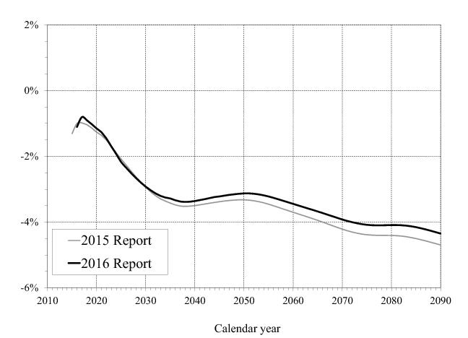
OASDI Annual Balances (Intermediate Projections)

Slide 10
Sustainable Solvency
Sustainable solvency for the financing of the program under a specified set of assumptions is achieved when the projected trust fund ratio is positive throughout the 75‑year projection period and is either stable or rising at the end of the period.
Changes that address the long-range actuarial balance, but then leave the financing to deteriorate on auto-pilot (like the 1983 reforms) fail the sustainable solvency test
Changes better aligned with annual balances are more likely to meet the sustainable solvency standard

Slide 11
Present Values Are Great, But…
To fulfill their mission, programs have to be sufficiently financed in every year (in every fiscal period)
Trust fund reserves enable surpluses from past years to be used in later years
But redeeming trust fund assets is an outlay for the general fund
Even if the assets were invested in the market, they would be claims on shares of other entities’ incomes
Eventually, any consumption must come from (roughly) contemporaneous production

Slide 12
What Is Driving Federal Expenditures?
Federal government is “an insurance company with an army”
Often said by Paul Krugman, who attributed it to Peter Fisher, the Under Secretary of the Treasury for Domestic Finance (2001-04)
Social insurance programs’ expenditures are largely driven by demographics (and health care costs)
Society is aging (world-wide)
Longer life spans
Lower birth rates

Slide 13
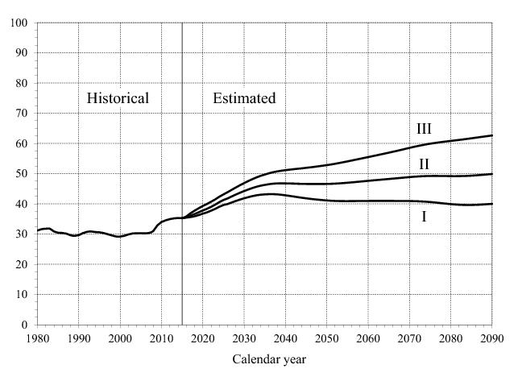
OASDI Beneficiaries per 100 Covered Workers

Slide 14
The Whole World Is Aging We Are Staying Relatively Young
Source: OECD

Slide 15
Medicare: More Complicated
More parts
HI trust fund works much like the OASI and DI trust funds
The rest is financed through premiums and general revenues
Cost projections depend also on the rate of increase in prices and utilization of health care
Benefits not paid directly to beneficiary as cash, but to providers of services
Complicates the relation between what the government pays and what the beneficiary receives

Slide 17
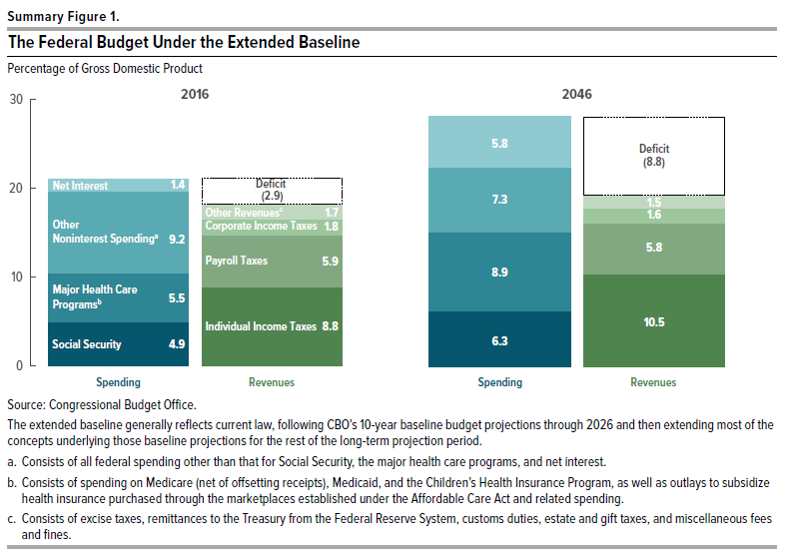
Aging Population Requires Higher Spending on Social Insurance

Slide 18
Other Federal Programs
Discretionary spending: no long-term commitment
“Current law” convention projects current levels
Projections typically show a shrinking % of GDP
Not realistic, for example:
Defense – spending increases are common, may want to keep strengthening the military as the resources grow
Food stamps – keeping the program’s generosity constant probably requires ~constant % of GDP
“Current policy” discretionary spending is likely to grow proportionally with the GDP

Slide 19
Federal Revenues
“Current law” income taxes increase slightly as a % of GDP due to bracket creep
“Current policy” tax revenues often assumed to grow proportionally with the GDP
This is in step with most discretionary programs (realistically) but not with health programs
Payroll taxes grow slightly slower than GDP
As the population ages, unless programs are cut, revenues must increase as % of GDP (or deficits will)

Slide 20
We Have a Relatively Small Government Now

Slide 21
What Do Budget Deficits Do?
Accounting identities:
Y = C + I + G + NX
Spvt = Y – T – C Spub = T – G
S = Spvt + Spub = Y – C – G
Immediate direct effect of deficit is a decrease in national savings
S = I + NX, so S↓→I↓ or NX↓
Short-term effect on output:
G↑→Y↑ or T↓→C↑→Y↑

Slide 22
Long-Run Effects of Budget Deficits
Reduced output and wealth (due to lower investment)
Foreign debt (due to trade deficit)
Increased future taxes (or reduced gov. spending)
But gov’t can often roll debt over forever
Redistribution – winners and losers

Slide 23
US Deficit and Debt Numbers
Budget deficit: 2.4% of GDP in 2015 (3.2% in FY 2016)
Total public debt: 105% of GDP
Debt held by the public: 76% of GDP (34% foreign)
Trade deficit: 2.7% of GDP in 2015
Interest on debt: 2.4% od GDP in FY 2016

Slide 24
Final Remarks
As population ages, social insurance programs will grow relative to GDP, in the US and world-wide
Current level of individual benefits can only be sustained with higher taxes
Society must decide what share of resources to allocate to these programs at any given time
This is ultimately a political question, not an actuarial one
Aggregate spending is essentially PAYG
Global economy as a whole cannot stockpile and save over extended periods

