Slide 1
Networks and/or Provider-based care Financial Performance
Greger Vigen, FSA, MBA
GregerVigen@yahoo.com

Slide 2
Agenda for today's session
Highlight the value of networks and differences across various populations/lines-of-business
Review two important financial issues
Identify potential allies based on core goals
Approaches to evaluate potential networks / managers
Answer questions
There is an appendix with references and examples

Slide 3
Sustained value from higher performance networks (those done well)
Some providers and networks have sustained higher performance in some locations and lines of business.
But, there are still many mediocre or poor networks. Stronger financial performance is not automatic.
This starts with actions from the Primary Buyer (those who pay most of the costs). They may manage the program themselves or delegate to carriers, providers, or others.
Successful programs do not just "transfer risk". They "transfer risk and responsibility" selectively. In some cases, full risk and responsibility can go to large, aligned, and capable providers. But, often risk and responsibility are targeted (by size, type of provider, and capabilities).

Slide 4
Differences by Population and Line-of-Business
There are major differences in data sources, provider fees, financial arrangements, pharmacy coverage, and network size, and other factors
Some financial levers are the same across populations (such as admissions and emergency care). But, others are far more important for certain populations. For example:
Medicare - high risk patients and post-acute care
Commercial - hospital fees and variations in state regulatory approaches to networks
Exchange - same as above plus participation levels
Medicaid - maternity and behavioral health

Slide 5
Identify allies based on core goals

Slide 6
Why start with a discussion of goals
Healthcare is both a policy and business issue for providers. This is a reminder of the provider business goals.
More providers are willing to improve financial performance (with the right business offer). However, some are not interested.
Buyers must understand their depth of any provider commitment to financial performance.
Words like "value" and "accountable" have become very common but are used in many different ways. A provider may only focus on one of the three major buyer goals but, still call themselves a "value" provider.

Slide 7
Core goals - buyers
Buyer goals
(six-word triple aim from CMS)
Better Care
Healthier People
Smarter Spending (CMS)
Affordable (buyers)
Sustainable (public)

Slide 8
Possible core goals - providers and carriers
Buyer goals
(six-word triple aim from CMS)
Better Care
Healthier People
Smarter Spending (CMS)
Affordable (buyers)
Sustainable (public)
Business
Increase revenue
Manage Expenses
= Net income

Slide 9
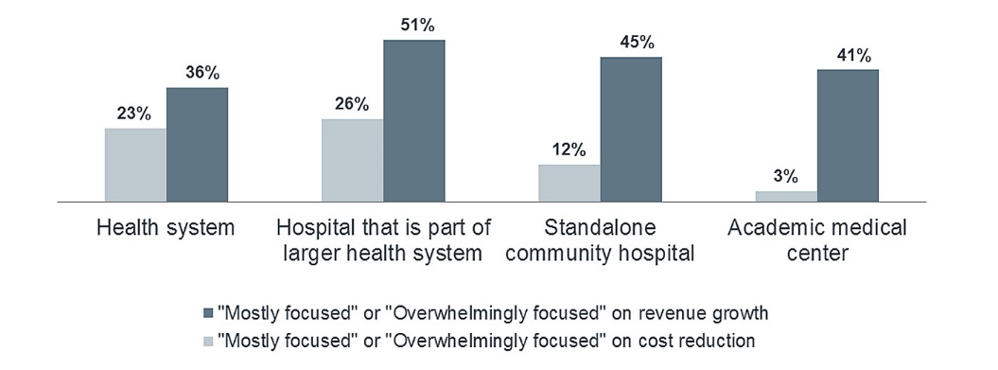
Hospital goals (executive survey)
https://www.advisory.com/research/health-care-advisory-board/blogs/at-the-helm/2017/04/hcab-topic-poll

Slide 10
Commitment to "reduce waste"
There is no common word used for expense management. Yet, wording is important; the wrong words create confusion or tension.
This uses the phrase "reduce wasted services". This phrase was consistently used internally by a very successful Chief Medical Officer.
Sustained affordability requires reduction in wasted services. This includes both claims and internal expenses (non-claim) within providers.
Some providers committed to reduce waste prefer to move away from FFS payments. This lets them focus on net income rather than just increasing revenue. This is why some providers support capitation or two-sided risk.

Slide 11
Approaches to evaluate potential networks / managers

Slide 12
Financial evaluation - used in private sector (if data available)
Trends / cost drivers
Local comparisons
National comparison of utilization (or fee-adjusted total costs normalized to the same fee schedule)
Specific metrics and rates: emergency treatment, complications, readmission, ambulatory sensitive care, case mix of DRGs, etc.)
Full market analysis (all products)
Risk adjustment based on pharmacy claims
Analyze higher performers

Slide 13
Business assessment
Goals (as discussed above)
Management approach
Financial initiatives taken (specific to line of business)
Care Coordination and Engagement
Infrastructure to support provider action
Payment alternatives
Additional details available in "Lessons from Higher Performance Networks" from PBGH (see Appendix)

Slide 14
Payment alternatives
One major objective is transfer "risk and responsibility" to providers since they have better opportunities to manage many risks.
New payment system needs to support all three buyers goals and allow the providers to reduce waste.
Provider payment systems are subject to various state and federal laws.
Analysis is deeper than just the formal contract. For example, some buyers create ongoing financial analysis for the management team. This creates economies of scale for providers.
Buyers focus on claims. Providers focus on net income (including potential savings from less waste).

Slide 15
Overall payment to organizations
Strong payment systems/incentives work with experienced and committed providers. No payment system works with providers focused on increasing revenue. Weak or payment mediocre have little impact.
Payment systems and incentives need to be customized to the organization. The private sector uses many approaches (partial capitation, risk pools, etc.) Some services can be done by the buyer/carrier if there are major problems with economies of scale.
Payments to individual providers must work alongside overall payments.

Slide 16
Payment to individual providers
Payment options to individual providers are precisely targeted. There is a toolkit of payment options; a specific payment option is used for specific services and types of providers.
Many provider-based networks consider provider payment as compensation to an employee rather than payment for services from a outside contractor.
Payments come in many business forms:
Financial performance: Capitation, gainsharing, etc.
Fewer administrative tasks to reduce expenses
Fees may be flat with growing upside-only bonuses
Incentives can be paid for specific tasks.

Slide 17
Closing comments
This is a very important time; an opportunity to have a big impact
Actuaries with a broad vision of their role have many opportunities to grow their skills and careers.
Different analysis
Different audiences
A new view inside the health system
Develop new provider-based solutions to old problems
Learn new data sources
More time on expense management

Slide 18
Questions

Slide 19
Appendix

Slide 20
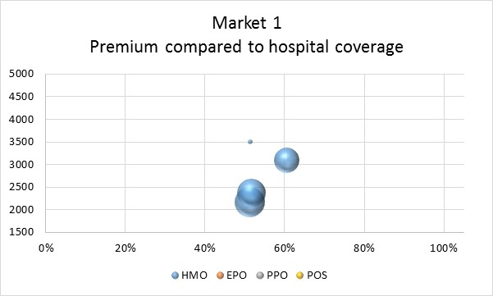
Exchange Case Study #1

Slide 21
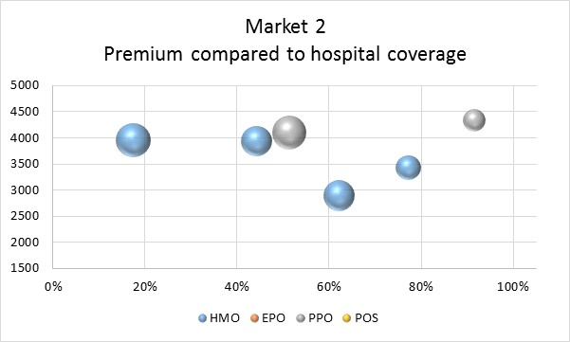
Exchange Case Study #2

Slide 22
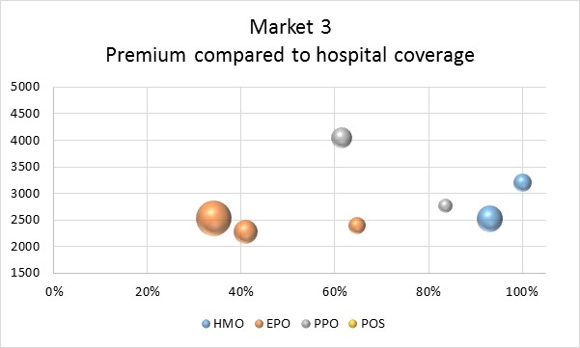
Exchange Case Study #3

Slide 23
Public papers Networks and provider measurement
Performance In and Out of Exchanges
https://www.soa.org/research-reports/2018/provider-networks-performance/
Lessons from Higher Performing Networks
http://www.pbgh.org/storage/documents/commentary/HiPerfNetworkBrief_Final3.pdf
http://www.pbgh.org/storage/documents/commentary/HiPerfNetworkBrief_ExecSummary.pdf
Measurement of Healthcare Quality and Efficiency
https://www.soa.org/resources/research-reports/2013/research-quality-report/
Primary Care (in process)

