Slide 1


OFFICE OF THE ACTUARY
Medicare Diabetes Prevention Program
Presentation for the Middle Atlantic Actuarial Club
November 10, 2016
Matthew Rader, ASA

Slide 2
Agenda
Path to Actuarial Certification
MDPP Expansion Program Description
Differences between MDPP and other DPPs
Effectiveness of HCIA Y-USA
Effectiveness of Other DPP Programs
Savings Impact Model
Conclusions

Slide 3
Requirements for Certification
Taking into account the evaluation, the Secretary may, through rulemaking, expand (including implementation on a nationwide basis) the duration and the scope of a model that is being tested if-
  The Secretary determines that such expansion is expected to-
    Reduce spending under applicable title without reducing the quality of care; or
    Improve the quality of patient care without increasing spending;
  The Chief Actuary of the Centers for Medicare & Medicaid Services certifies that such expansion would reduce (or would not result in any increase in) net program spending under applicable titles.

Slide 4

Path to Actuarial Certification
Expansion proposed.
Reviewed primary evidence (HCIA Y-USA).
Reviewed secondary evidence.
Modelled projected cost impact of expansion.
Guidance issued for interpretation of expansion requirements.
Discussed findings with CMMI.

Slide 5
MDPP Expansion Program Description
Target participants are Medicare beneficiaries within pre-diabetes definition.
16 “core” sessions given in a group-based setting provide training in dietary change, increased physical activity and behavioral change.
Post-core (i.e. maintenance) sessions ensure that participants maintain healthy behaviors.
Primary goal: At least 5% average weight loss among participants.

Slide 6
MDPP Expansion Program Description: Medicare Payments
Incentive | Incentive Payment
1/16 sessions attended | $25
4/16 sessions attended | +$50
9/16 sessions attended | +$100
5% weight loss from baseline | +$160
9% weight loss from baseline | +$25
3 Maintenance sessions attended and 5% weight loss | $45
6 Maintenance sessions attended and 5% weight loss | +$45
3 Maintenance sessions attended and 5% weight loss | $45
6 Maintenance sessions attended and 5% weight loss | +$45
9 Maintenance sessions attended and 5% weight loss | +$45
12 Maintenance sessions attended and 5% weight loss | +$45
Maximum 16 core sessions provided over 16 to 26 weeks.
Maximum Payment w/weight loss = $360
Maximum Payment w/ w.l. = $90
First Year Maximum Payment = $450
Maximum annual payment years 2+
=$180

Slide 7
Overview of Other DPP Programs
HCIA YMCA of the USA DPP (HCIA Y-USA) – Program funded through the Health Care Innovation Awards
DPP Clinical Trial (DPPCT) - 27-center randomized clinical trial to determine whether lifestyle intervention or pharmacological therapy (metformin) would prevent or delay the onset of diabetes
CDC DPRP recognized DPPs (DPRP) – CDC recognizes DPPs nationwide through its Diabetes Prevention Recognition Program
Large National Carrier – 1 of the DPPs recognized by the CDC DPRP.

Slide 8
Differences between MDPP and other DPPs
Participant Ages
  MDPP will focus only on Medicare beneficiaries.
  HCIA Y-USA is the only other program with this focus.
Individual vs. Group Sessions
  MDPP will only offer group sessions.
  Other programs include both individual and group sessions, with the DPPCT focusing on individual sessions.

Slide 9
Differences between MDPP and other DPPs (contd.)
Maintenance Sessions
  MDPP is the only program that provides maintenance sessions indefinitely
Pre-diabetes Definition
  MDPP uses an adjusted pre-diabetes definition by targeting only participants with an Impaired Fasting Glucose of 110 to 125 mg/dl
  Other programs use the American Diabetes Association range of 100 to 125 mg/dl for this metric

Slide 10
Differences between MDPP and DPPs (contd.)
Payments (Cost of program)
  MDPP will be an added Medicare benefit to DPRP programs, eliminating start-up costs. Participant performance payments will be the only program cost.
  Other programs include front end start-up costs. Performance payment model was not tested in HCIA or DPPCT. DPRP programs have variable payment systems.
Weight loss
  All programs target 5% weight loss except DPPCT (7%).

Slide 11
Effectiveness of HCIA Y-USA
As of March 2015, almost 7,000 participants.
Almost 6,000 participants attended 4 or more sessions.
Over 60% of participants between ages 65 and 75.
Average weight loss among participants that attended at least 4 sessions = 4.7%, 5.2% for participants attending at least 9 sessions. (Year 1 evaluation results)
Of participants attending at least 4 sessions, 44% achieved weight loss goal.
The following slides show average quarterly spending for participants within the intervention and comparison groups.

Slide 12
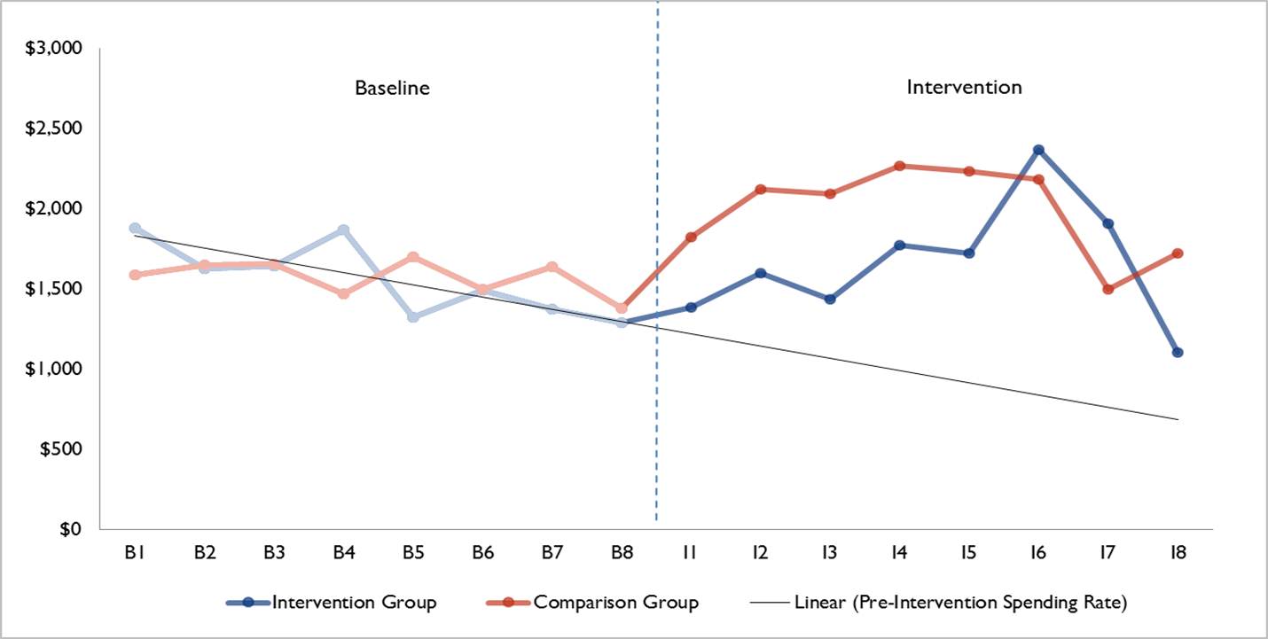
Effectiveness of HCIA Y-USA (contd.)
https://innovation.cms.gov/Files/reports/hcia-ymcadpp-evalrpt.pdf

Slide 13
Effectiveness of HCIA Y-USA (contd.)
Difference-In-Differences OLS Regression Estimates for
Quarterly Medicare Spending per Participant
Quarter | Coefficient ($) | Std Error | P-Values | Unique Participants in Quarter
I1 | −411 | 119 | 0.001 | 1,679
I2 | −495 | 165 | 0.003 | 1,429
I3 | −636 | 152 | <.0001 | 1,136
I4 | −517 | 248 | 0.038 | 765
I5 | −591 | 260 | 0.023 | 515
I6 | 128 | 322 | 0.691 | 362
I7 | 319 | 381 | 0.403 | 138
I8 | −833 | 399 | 0.037 | 57
https://innovation.cms.gov/Files/reports/hcia-ymcadpp-evalrpt.pdf

Slide 14
Effectiveness of HCIA Y-USA (contd.)
Results are preliminary – data for later program quarters are limited.
Model was not conducted as a randomized control trial.

Slide 15
Effectiveness of Other DPP Programs: DPPCT
1,079 participants in the lifestyle intervention – average starting age was 50.6.
Reduced diabetes by 58% within 3 years of the DPP program.¹
After a 15-year follow-up, diabetes was reduced by 27% in the lifestyle intervention group when compared to the placebo group.²
After 3 years placebo group was offered the lifestyle intervention, so difficult to determine long term effectiveness.

Slide 16
Effectiveness of Other DPP Programs: CDC DPRP
696 recognized DPPs as of September 2015
Based on available CDC data:
  31% of participants are aged 65 or older
  More than 80% of age 65+ are between ages 65 and 75
  5.2 percent average weight loss for aged 65+ attending 4+ sessions
  Aged 65+ participants had higher adherence rates

Slide 17
Effectiveness of Other DPP Programs: Large Nat. Carrier
Less than 10% of participants are aged 65 or older.
Average weight loss by number of sessions attended:
# of sessions attended | Average weight loss
1-3 | 0.2 percent
4-8 | 1.4 percent
9-15 | 3.8 percent
16+ | 6.2 percent

Slide 18
Effectiveness of Other DPP Programs: Nat. Carrier (contd.)
Per participant gross savings were positive in the first 3 years of the intervention and nearly covered the approximately $200 per participant costs.
Including the cost of the intervention, program was expected to achieve breakeven savings during year 4.
Spending reductions achieved for participants aged 55 or older were slightly higher than average when compared to the entire intervention group.

Slide 19
Savings Impact Model
Spend X dollars to reduce the incidence rate of diabetes for participants (performance payments for attending training and achieving weight loss).
Reduced diabetes progression rates for a portion of MDPP participants is worth Y dollars.
If X<Y then positive savings.

Slide 20
Savings Impact Model (contd.)
Projected average lifetime per participant savings from the delay or prevention of diabetes progression.
  No savings from participants who never would’ve transitioned to diabetes.
  No savings if diabetes progression isn’t slowed.

Slide 21
Savings Impact Model (contd.)
Key Model Inputs:
  Marginal Medicare costs of diabetes vs pre-diabetes
  Mortality rates of diabetes vs. pre-diabetes
  Diabetes progression rates with and without program
  Performance payment amounts

Slide 22
Savings Impact Model (contd.): Diabetes Progression Rates
Diabetes Care 33:1665–1673, 2010

Slide 23
Savings Impact Model (contd.):
Mortality Improvement
Diabetes Care 2014;37:2557–2564

Slide 24
Requirements for Certification: Revisited
Taking into account the evaluation, the Secretary may, through rulemaking, expand (including implementation on a nationwide basis) the duration and the scope of a model that is being tested if-
  The Secretary determines that such expansion is expected to-
    Reduce spending under applicable title without reducing the quality of care; or
    Improve the quality of patient care without increasing spending;
  The Chief Actuary of the Centers for Medicare & Medicaid Services certifies that such expansion would reduce (or would not result in any increase in) net program spending under applicable titles.

Slide 25
Guidance Regarding Mortality Improvement
Regarding the actuarial certification of prevention models, “The Centers for Medicare & Medicaid Services has made a determination that costs associated with expected improvements in longevity are not appropriate for consideration in the evaluation of net program spending.”
With this guidance, we were able to assume the same mortality rates for pre-diabetes and diabetes when modeling projected program savings.

Slide 26
Savings Impact Model: Revisited
Annual marginal diabetes costs versus lifetime marginal diabetes costs.
Ignoring mortality improvements provided a significant buffer, allowing other assumptions to change and still result in budget neutrality.

Slide 27
Conclusions
Evaluation results from HCIA Y-USA, CDC, and Large National Carrier indicate that beneficiaries participating in diabetes prevention programs have achieved success with losing weight and reducing the incidence of diabetes.
Results support reductions in medical spending in the near term.
Modelling showed high probability of savings greater than or equal to zero when improvements in mortality were ignored.

