Slide 1
Disability Application Experience of the OASDI and SSI Programs
Office of the Chief Actuary
Social Security Administration
MAAC Presentation
November 19, 2019

Slide 2
Plan
Background
SSA programs and composition
Types of disability benefits
Application and decision process
Total SSA application
Disability experience – Applications by:
Field office apps by program and geography
DDS receipt by program, impairment
DI receipt rates
SSI receipt rates
2

Slide 3
Programs Administered by SSA
SSA administers two major benefits programs
Social Security (comprised of the separate OASI and DI programs)
Supplemental Security Income (SSI)
Disability benefits payable under both
Social Security Disability
DI is primarily disability benefits, along with benefits to dependents
OASI pays disability benefits to several relatively small groups (widows, adult children)
SSI: Primarily comprised of disabled recipients
3

Slide 4
Social Security Beneficiary Composition
Figure 1: Distribution of OASDI Beneficiaries
4

Slide 5
Supplemental Security Income Recipient Composition
Figure 2: Distribution of SSI Recipients
5

Slide 6
Disability Benefit Types
Social Security Disability
Disabled workers – insured for benefits on their own earnings history
Generally need 20 QCs out of the last 40 quarters (age 31+)
Reclassified as retired workers upon attainment of NRA
8.4 million, 86% of disabled beneficiaries in 10/19
Disabled adult children – at least age 16 with a disability beginning before age 22
Children of a beneficiary entitled to Social Security (retired or disabled worker)
Surviving children of a deceased worker who had the appropriate insured status
1.1 million, 12% of all disabled beneficiaries in 10/19
Disabled widow(er)s – at least age 50, survivor of a deceased spouse and disabled
0.2 million, 3%
6

Slide 7
Disability Benefit Types (Cont’d)
SSI Adult Disability
Ages 18 and older and disabled
Unlike Social Security, generally not reclassified as “Aged” at attainment of age 65
4.7 million 18-64, 67% of SSI disabled in 10/19
1.1 million 65 or older, 16% of SSI disabled in 10/19
SSI Childhood Disability
Under age 18
Definition of disability different than other categories (Social Security, SSI adults)
At attainment of age 18, re-evaluated to see if they meet the adult definition
7

Slide 8
Definition of Disability
Adult Disability Standard
Applies to adults age 18 or older
Inability to engage in substantial gainful activity (SGA) due to a medically determinable impairment expected to result in death or last at least 12 months
Includes mental and physical impairments
SGA = $1,220 per month in 2019. Adjusted by average wages each year
Working at or above SGA generally results in a finding of not disabled at application
Post-entitlement: Periodic reviews to ensure beneficiaries still meet the definition of disability (MIRS)
Post-entitlement: Rules regarding working at or above SGA are different
8

Slide 9
Definition of Disability (Cont’d)
Childhood Disability Standard
Applies to children under age 18 applying for SSI
Has a medically determinable impairment that results in marked and severe functional limitations that is expected to result in death or last at least 12 months
Concept of SGA does not apply
Post-entitlement periodic reviews to ensure beneficiaries still meet the definition of disability (MIRS)
Upon attainment of age 18, the recipient is re-evaluated under the adult criteria; terminated if definition not met
9

Slide 10
Application Process
File an application for benefits:
At any of SSA’s 1,300 field offices (FOs)
Over the telephone through the 800-number system
Over the internet (for most Social Security and some SSI claimants)
Separate applications for Social Security and SSI, even for claimants filing for both
FOs/PSCs evaluate whether the claimant is
Working at SGA (if an adult)
Insured for benefits (for Social Security benefits)
Not a clear denial (for SSI payments)
10

Slide 11
Application Process (Cont’d)
If FOs cannot deny a claim, gather medical evidence and forward to claimant’s state Disability Determination Services (DDS)
Responsible for determining if claimant is disabled according to the appropriate criteria
Each state has at least one DDS, some have multiple
For denials, there is an administrative appeals process
Reconsideration at the DDSs
Hearing before an Administrative Law Judge
Appeals Council
After all appeals are exhausted, claimant can appeal to the Federal Court system
11

Slide 12
Benefit Applications in Fiscal Year 2019
In fiscal year 2019 (Oct 2018-Sep 2019), SSA field offices received 10.0 million applications for benefits.
6.9 million Social Security claims
4.8 million retired worker and non-disabled auxiliary claims
2.1 million disability claims
1.8 million SSI claims
0.2 million based on age (65 or older and not alleging disability)
1.6 million disability claims
1.4 million claims for Medicare benefits (HI and/or SMI)
Includes claims filed at field offices as well as claims taken through SSA’s 800 number and claims filed on the internet
12

Slide 13
Why does OCACT care about applications?
Estimate applications for baseline projections
Social Security Trustees Report
SSI Annual Report
President’s Budget projections
Evaluate effects on incidence rates
Informative for estimates of legislative and regulatory proposals
SSA uses our application projections in the formulation of its administrative budget
13

Slide 14
Disability Applications Are Expensive!
October 2019 – 15% of Social Security beneficiaries were disabled
In FY 2019
About 31% of Social Security benefit applications alleged disability
Over 90% of SSI claims involve disability
Average cost to process disability claim = $1,300 in FY 2018
Does not account for appeals costs – can be several thousand dollars more
Total administrative expenses
Social Security – DI is about 41% of all OASDI administrative expenses ($2.8 billion for DI vs $3.9 billion for OASI in FY19)
In FY 2018, SSI administrative expenses were $4.4 billion – SSI is primarily disability-driven
14

Slide 15
Field Office Disability Receipt Experience
15

Slide 16
Field Office Disability Receipt Experience (Cont’d)
16

Slide 17
Field Office Disability Receipt Experience (Cont’d)
17

Slide 18
Field Office Disability Receipt Experience by State (OASDI)
18

Slide 19
Field Office Disability Receipt Experience by State (SSI)
19

Slide 20
Field Office Disability Receipt Experience by ACA Expansion
20

Slide 21
Field Office Disability Receipt Experience by Rural vs Urban
21

Slide 22
Field Office Disability Receipt Experience by Rural vs Urban
22

Slide 23
Initial DDS Receipt Experience
23

Slide 24
Initial DDS Receipt Experience
24

Slide 25
Initial DDS Receipt Experience
25

Slide 26
Initial DDS Receipt Experience
26

Slide 27
Disability Receipts by Impairment - OASDI
27

Slide 28
Disability Receipts by Impairment – SSI Adults
28

Slide 29
Disability Receipts by Impairment – SSI Children
29

Slide 30
Application Receipt Rates
DI Workers – Initial DDS receipts relative to exposed population
Number insured less number already on DI rolls
SSI – Field office applications relative to exposed population
Total population less other than legal immigrant population less those already in SSI receipt
30

Slide 31
Application Receipt Rates (DI)
31

Slide 32
Application Receipt Rates (SSI)
32

Slide 33
Application Receipt Rates (DI males)
33

Slide 34
Application Receipt Rates (DI females)
34

Slide 35
Application Receipt Rate Ratios (DI males)
35

Slide 36
Application Receipt Rate Ratios (DI females)
36

Slide 37
Recent Favorable Disability Experience
Applications and incidence are at historic low levels
Numbers of beneficiaries /recipients have been declining since 2013
Prevalence rates have peaked and are dropping
What about the future: Are declines temporary, or the new state?
Economy and jobs—temporary
Drop in hearings allowance rates—temporary?
Changing nature of work in the economy
Increased access to health care (ACA)
Field office consolidations
Attorney representation
Something more fundamental?
37

Slide 38
Long-Range Disability Projection Model
Office of the Chief Actuary
Social Security Administration
MAAC Presentation
November 19, 2019

Slide 39
Overview
The Social Security Administration pays monthly disability benefits to disability-insured workers who meet the definition of “disability”. If they meet certain requirements, spouses and children of disabled-worker beneficiaries may also receive monthly benefits.
155 million workers under age 66 are insured against becoming unable to work
8.5 million workers now receive DI benefits
1.6 million “dependents” – mostly children
Many more protected from loss of insured status
And from low retirement benefits
Benefits replace 40% to 45% of career earnings on average
About 80% for very-low earner, about 28% for steady maximum earner

Slide 40
Long-Range Disability Model
The long-range disability model projects the number of disabled-worker beneficiaries in current-payment status at the end of each year by age at entitlement, sex, and duration from entitlement.
We calculate the number of disabled-worker beneficiaries at the end of year by adding the number of newly entitled during the year and subtracting the number who leave the disability rolls during the year to the number of disabled-worker beneficiaries at the beginning of the year.
Currently Entitled_{EOY} = Currently Entitled_{BOY} + New Entitlements(year) – Exits(year)

Slide 41
Long-Range Disability Model
New Entitlements(year) = Exposure_{BOY} * Incidence Rate(year)
Disabled-worker beneficiaries who leave the disability rolls do so by
recovering from disabilities,
dying, and
converting to retired worker status.
Exits(year) = Recoveries(year) + Deaths(year) + Conversions(year)
Recoveries(year) = Currently Entitled_{BOY} * Recovery Rate(year)
Deaths(year) = Currently Entitled_{BOY} * Death Rate(year)

Slide 42
Incidence rates
In the 2019 TR, the ultimate age-sex-adjusted disability incidence rate was 5.2 per 1,000 exposed.
The 5.2 incidence rate equals the historical average experienced from 1995 through 2018 and is slightly higher than the most recent ten-year historical average (5.1 awards per thousand) experienced from 2009 through 2018.

Slide 43
Effect of the Economy on DI Incidence Rate—2019 TR

Slide 44
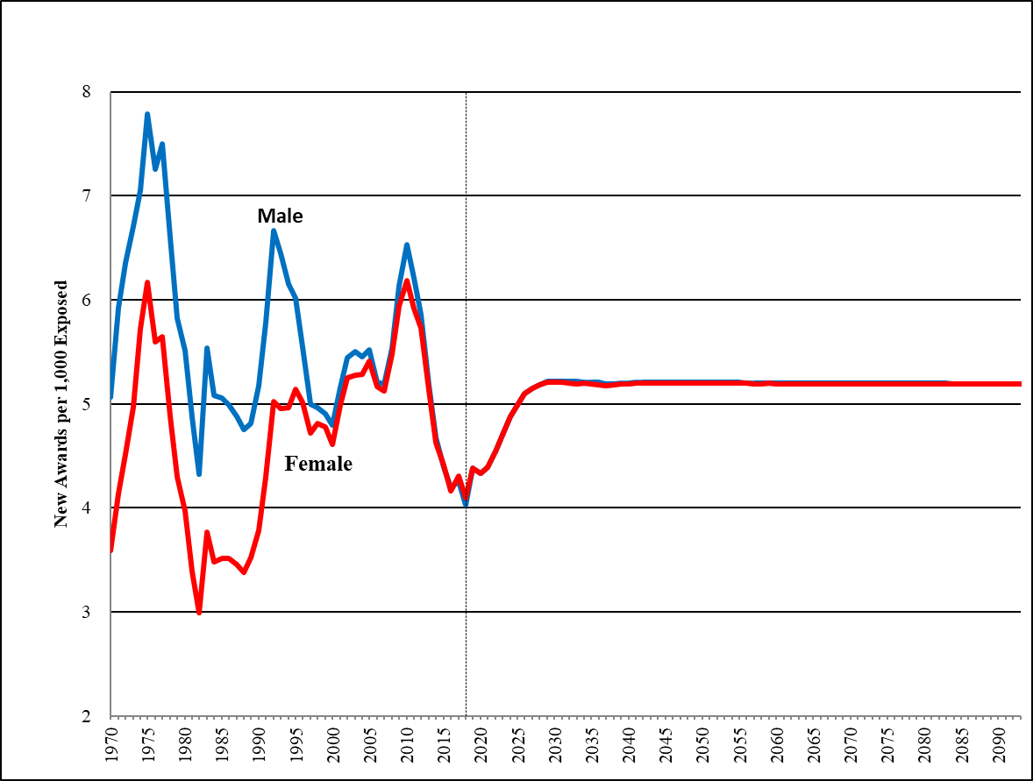
New Disabled-Worker Awards per 1,000 Exposed Age-Adjusted (2000), 2019 TR

Slide 45
Deaths
Death rates are much higher for the disabled population than the general population.
In the model, the base probabilities of death by duration, age, and sex are applied to the disabled-worker population.
Death Projection
First Year – 10 year Regression
Mortality Improvement – General Population

Slide 46
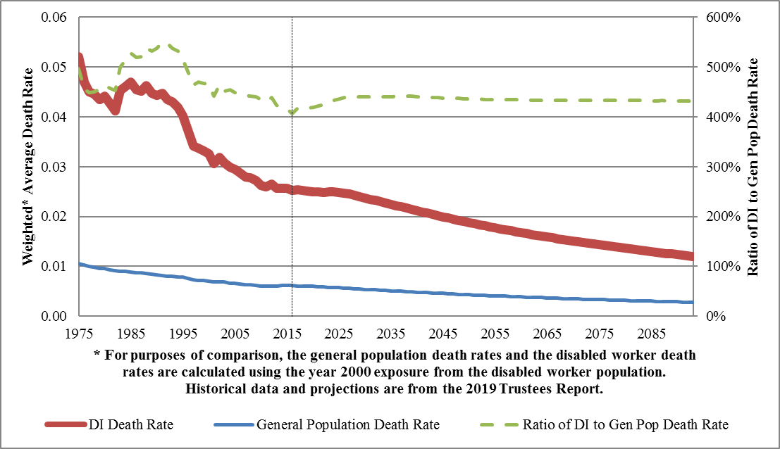
Age-Sex-Adjusted Comparison of SSA General Population to Disabled-Worker Death Rates

Slide 47
Recovery Rates
Disabled-worker beneficiaries who recover from their medically-determinable disabling condition or return to substantial work for an extended period are deemed to have recovered, and their benefits are then terminated.
The ultimate disability recovery rate is equal to the average recovery rate by age group and sex for the years 1985-2005, excluding 1997.
The projected age-sex-adjusted recovery rate (medical improvement and return to work) in the 2019 TR is 10.3 per thousand.

Slide 48
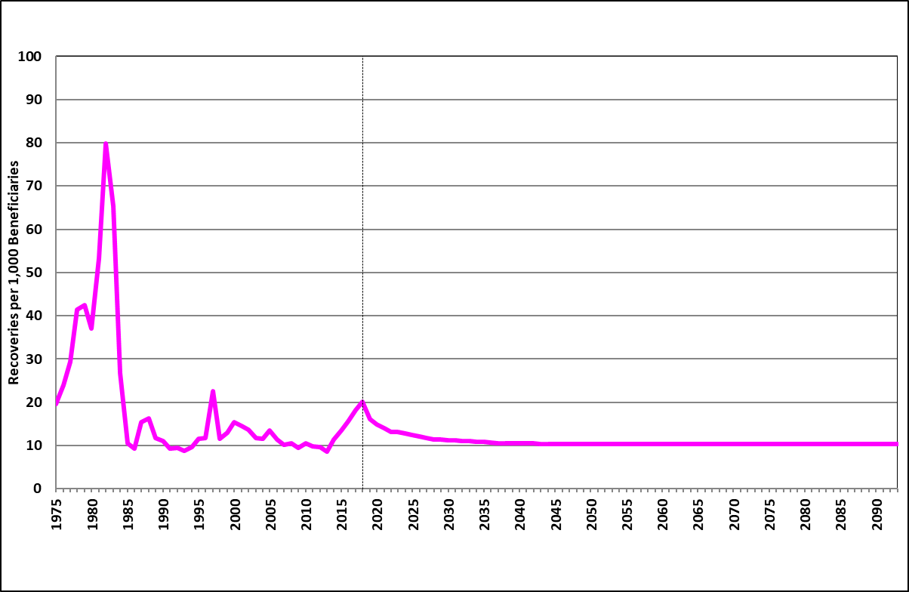
Disabled-Worker Recoveries per 1,000 Beneficiaries Age-Sex-Adjusted (2000), 2019 TR

Slide 49
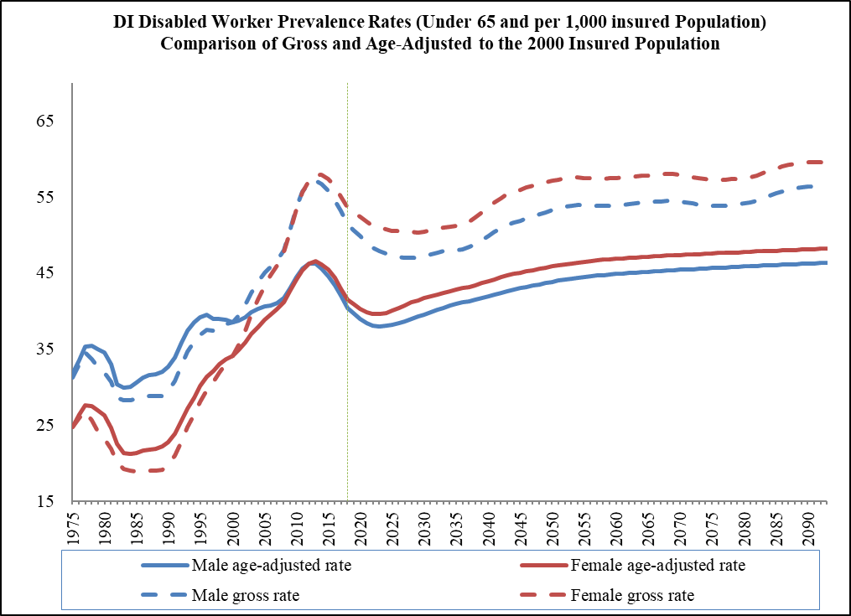
Disabled Worker Prevalence Rates (all through age 64)

Slide 50
Dependent Beneficiary of Disabled Workers
The disability model also projects the number of future dependent beneficiaries of disabled workers by category, age, and sex.
Six categories: minor child, student child, disabled adult child, young spouse, married aged spouse and divorced aged spouse.
We generate the numbers of dependent beneficiaries of disabled workers by multiplying the relevant subset of the SSA area population (Exposures) by a series of probabilities that relate to the regulations and requirements for obtaining benefits (Linkages)
Dependent Beneficiaries of DIB_{EOY} = Exposures_{EOY} * Linkages_{EOY}

Slide 51
Resource information
2019 Social Security Trustees Report: https://www.ssa.gov/OACT/TR/2019/index.html
2019 SSI Annual Report: https://www.ssa.gov/OACT/ssir/SSI19/index.html
2019TR Long-Range Model Documentation:
https://www.ssa.gov/OACT/TR/2019/2019_LR_Model_Documentation.pdf
2019TR Long-Range Disability Assumption Memo:
https://www.ssa.gov/OACT/TR/2019/2019_Long-Range_Disability_Assumptions.pdf
Contact us by email at actuary@ssa.gov.
51

