Slide 1
Longevity Trends and their Implications
Michael Morris
Tiffany Bosley
Michael Clingman

Slide 2
Mortality Projections
Michael Morris

Slide 3
Data Sources
For under age 65:
  Deaths from the National Center for Health Statistics
  Resident population from the Census Bureau
For ages 65 and over:
  Deaths and enrollments of the Medicare population.
For all ages:
  Deaths by cause from the National Center for Health Statistics.

Slide 4
Projecting Mortality
Mortality rates are assumed to decline in the future. But how fast?
The annual Trustees Report (TR) uses three sets of (deterministic) projections:
  Low cost (alternative I)
  Intermediate (alternative II)
  High cost (alternative III)
Stochastic projections
The 2018 intermediate projections assumed significant mortality declines in the future, as shown by:
  Calendar year life expectancy at birth
  Calendar year life expectancy at age 65

Slide 5
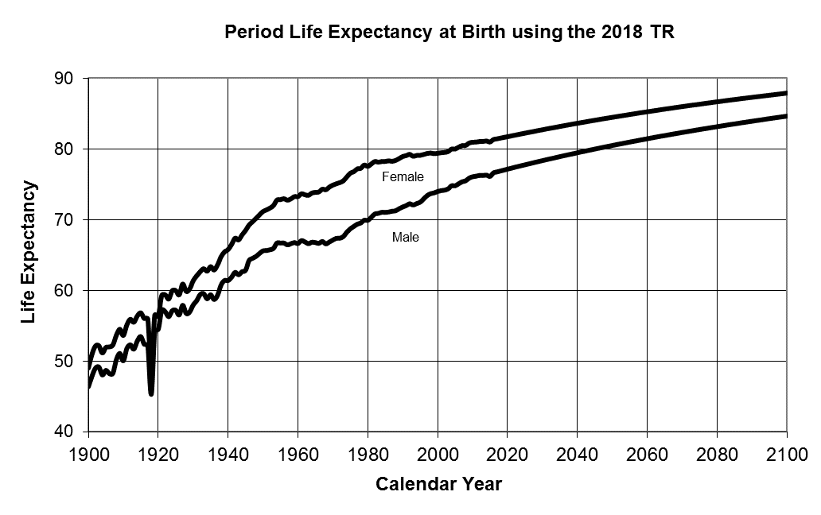
Life Expectancy at Birth

Slide 6
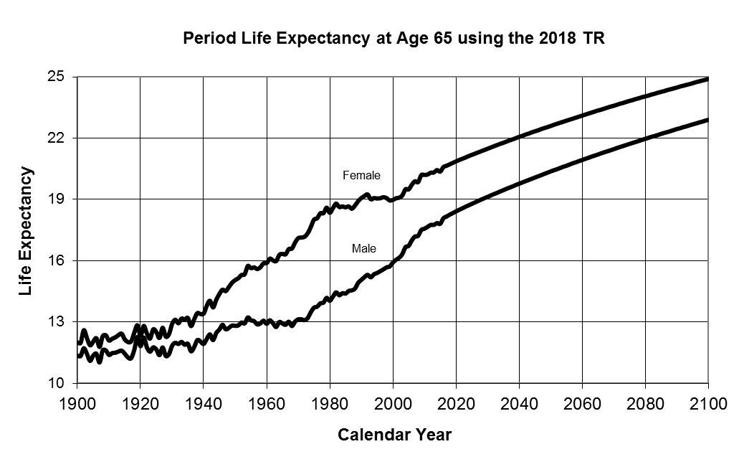
Life Expectancy at Age 65

Slide 8
Projecting Mortality
Incorporating future mortality improvement results in a new calendar year life table each year.
Assumptions as to the percent reduction in mortality rates by:
  Age group
  Cause of death
Central death rates are the key variables used in the projections
  A central death rate is the number of deaths during the year divided by the mid-year population.
  Central death rates for the starting year
  Rate of decline in the central death rates

Slide 9
Central Death Rates for the Starting Year
Annual historical central death rates calculated
  For 21 age groups, 2 sexes, and 5 causes of death.
Last year of final data (2015 NCHS and 2015 Medicare) is not used as the starting year.
Instead, starting year values are determined using the last 12 years of historical central death rates
  Computed as the values for the most recent year falling on a weighted least square line.

Slide 10
Rates of Decline in Central Death Rates
Historical average annual declines in central death rates are calculated:
  Over the most recent 10 year period
  For 21 age groups, 2 sexes, and 5 causes of death
Ultimate average annual declines in central death rates are determined by the Trustees.
  Reached in the 24th year following the year of the Trustees Report (2042)
  For 5 age groups and 5 causes of death.
  Male and female rates are the same.
Formula is used to transition from the average annual declines over the historical period to the ultimate rates of decline

Slide 11
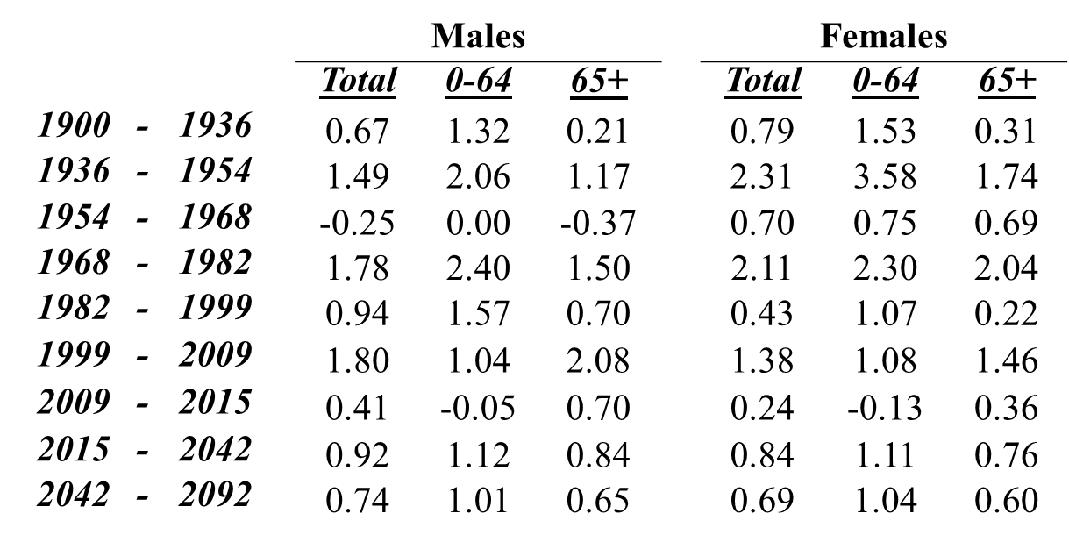
Average Annual Rate of Decline in Age-adjusted
Central Death Rates
Based on the intermediate assumptions of the 2018 Trustees Report
(Using the 2010 Census Resident Population as the standard population for age adjusting)

Slide 12
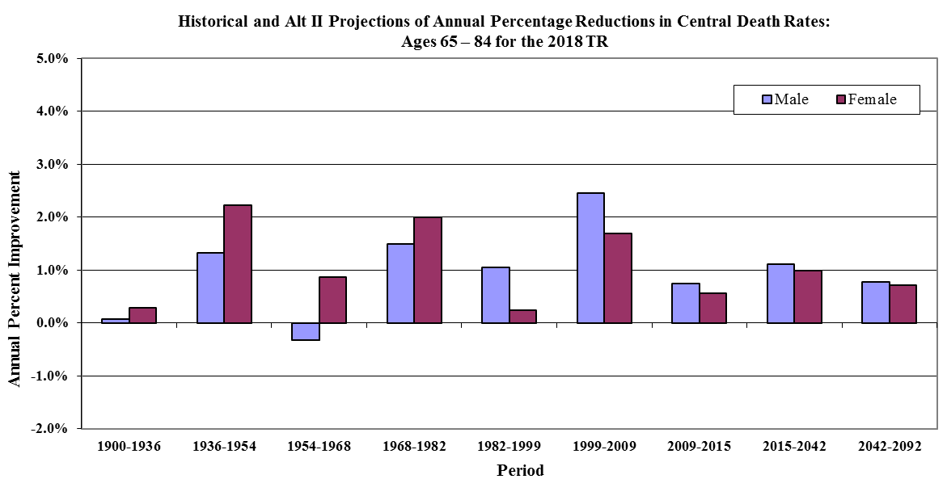
Historical and Intermediate Projections of Annual Percentage Reduction in Central Death Rates:
Ages 65-84

Slide 13
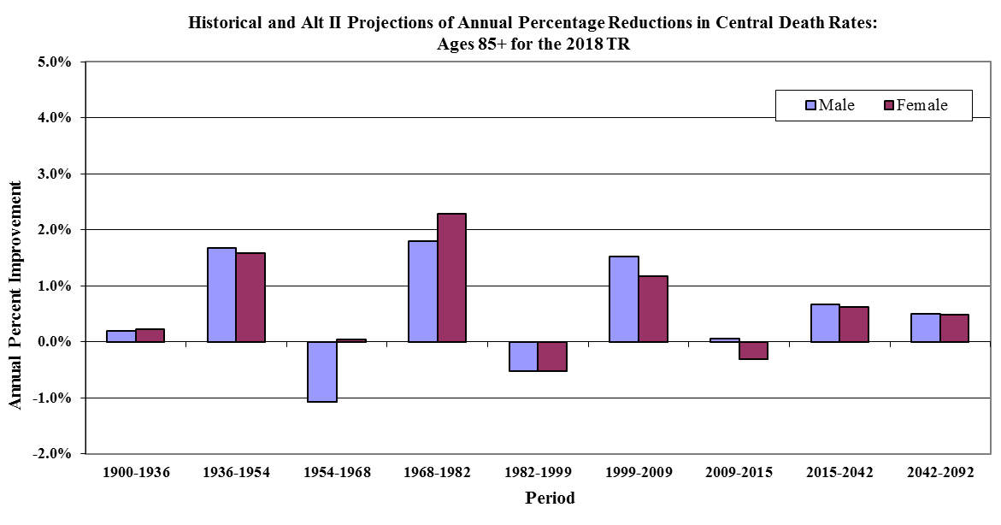
Historical and Intermediate Projections of Annual Percentage Reduction in Central Death Rates:
Ages 85+

Slide 14
Other Considerations
Death rates by marital status
Differential mortality between the disabled and non-disabled.
Mortality differential by earnings levels

Slide 15
Mortality by Career-Average Earnings Level
Tiffany Bosley

Slide 16
Mortality By Career-Average Earnings Level
Previous research has shown higher income levels are associated with lower mortality rates.
Higher lifetime earnings are also likely to be associated with lower mortality rates. This relationship is important for analyzing and projecting the costs for the Social Security program.
Average indexed monthly earnings (AIME) is a useful measure of a person’s lifetime earnings.
We analyzed the relationship between AIME levels and mortality rates for Social Security retired-worker beneficiaries.

Slide 17
Mortality By Career-Average Earnings Level Study
Compared the death rates among retired-worker beneficiaries by sex, age group, and lifetime career-average earnings level (AIME) to the annual death rate among retired-worker beneficiaries for that sex and age group.
For each sex and age group, we calculated the relative mortality ratios at various AIME levels.

Slide 18
Data and Methods

Slide 19
Data
Data Source: Social Security Administration’s June 2017 Master Beneficiary Record (MBR) file.
Excluded:
  Windfall Elimination Provision
  Totalization agreements
  AMW PIA benefit calculation
  Previously entitled for a Social Security disability benefit

Slide 20
Average Indexed Monthly Earnings Calculation
At age 62, index earnings to reflect the change in general wage levels that occurred during the worker’s years of employment.
Up to 35 years of earnings are needed to compute the average indexed monthly earnings.
AIME = Average of the highest 35 years of indexed earnings / 12

Slide 21
AIME Quintiles

Slide 22
Calculations
For each record, we determined:
  Sex and age
  AIME level
  Exposure: Active, Death, Termination Other Than Death
  Deaths
Group data by sex, age group, and AIME level, and calculated annual death rates by dividing the number of death by the years of exposure.
Relative Mortality Ratio – divide the death rates for each AIME level by the death rate for everyone in the sex and age group at all AIME levels.

Slide 23
Results by AIME Quintile

Slide 24
Results
We observed lower death rates for retired-worker beneficiaries with higher-than-average AIME levels, and higher death rates for retired-worker beneficiaries with lower-than-average AIME levels.
At older ages, the differences in death rates across AIME levels diminish.
Trends from 1995-2015 show the spread in death rates among the AIME levels remaining fairly steady.

Slide 25
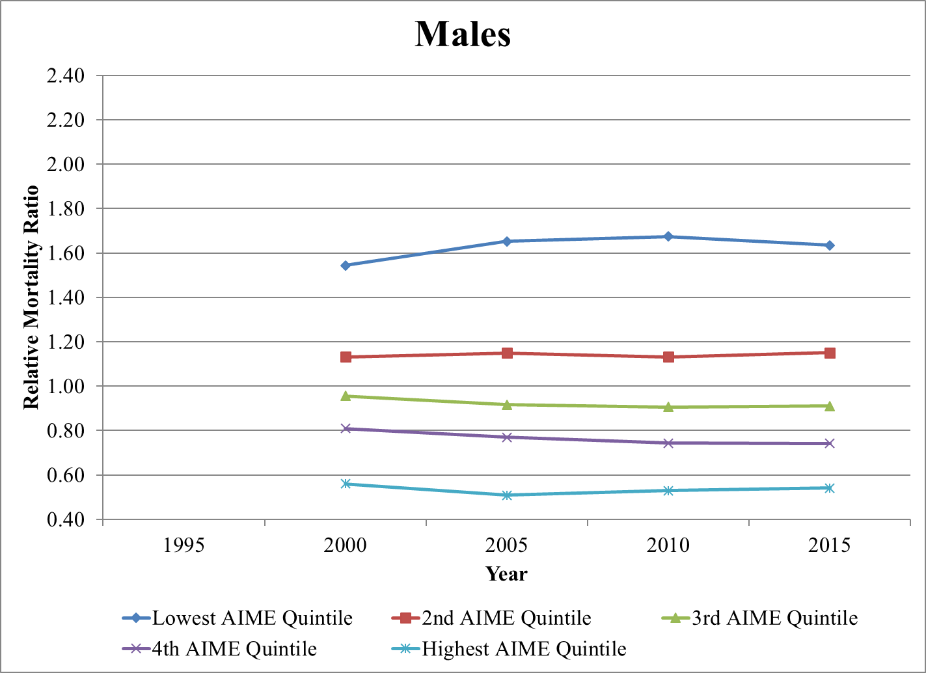
Age Group 65-69 Relative Mortality Ratios

Slide 26
Male / Female Comparison
Females generally follow the same relative mortality pattern as males, in the higher earners have lower mortality.
Spreads in the female relative mortality ratios among AIME quintiles are smaller than those for males.
Questions: Is the socioeconomic status gradient smaller for women? Or are earnings a less accurate measure of socioeconomic status for women?

Slide 27
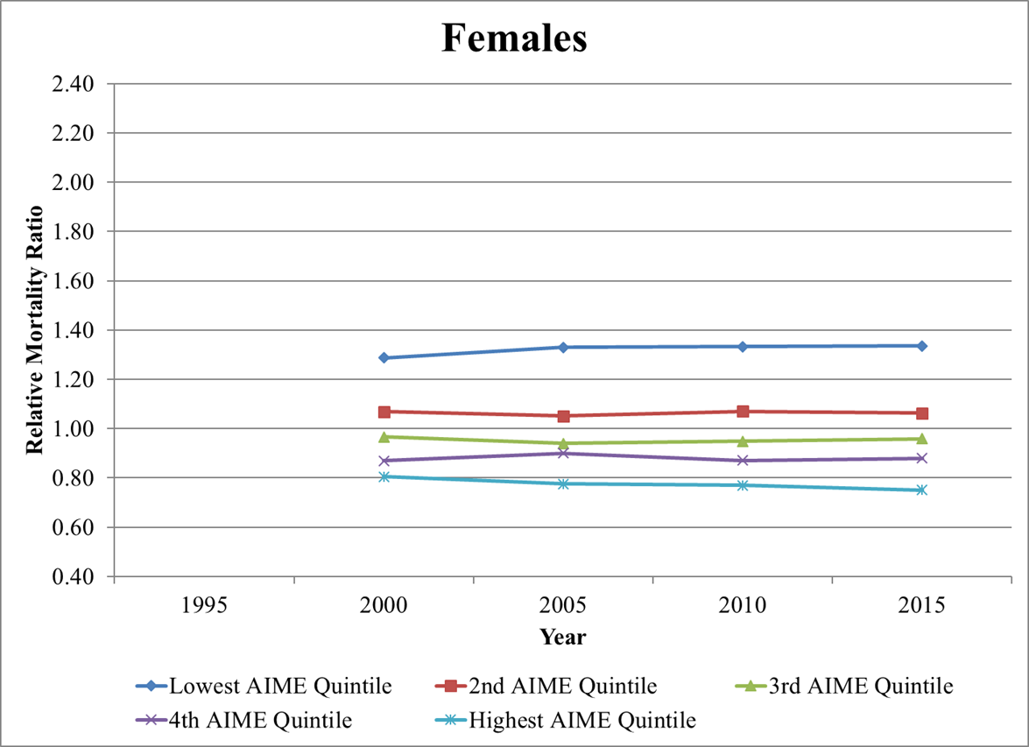
Age Group 65-69 Relative Mortality Ratios

Slide 28
Age Groups
Spread in relative mortality ratios among the quintiles decreases at older ages.

Slide 29
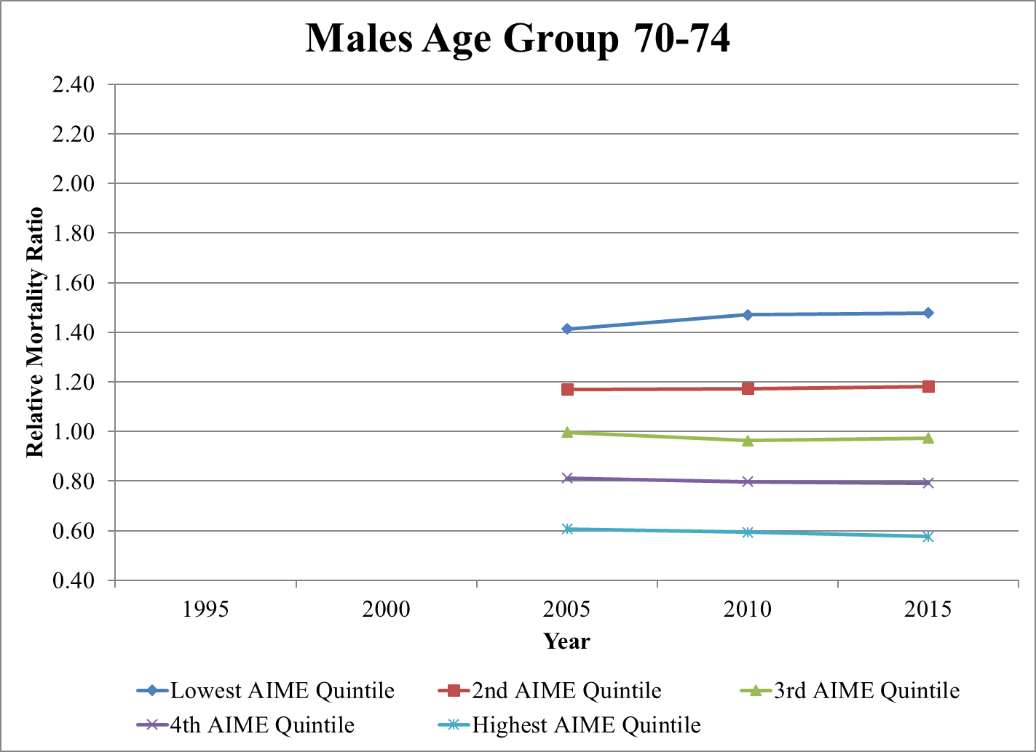
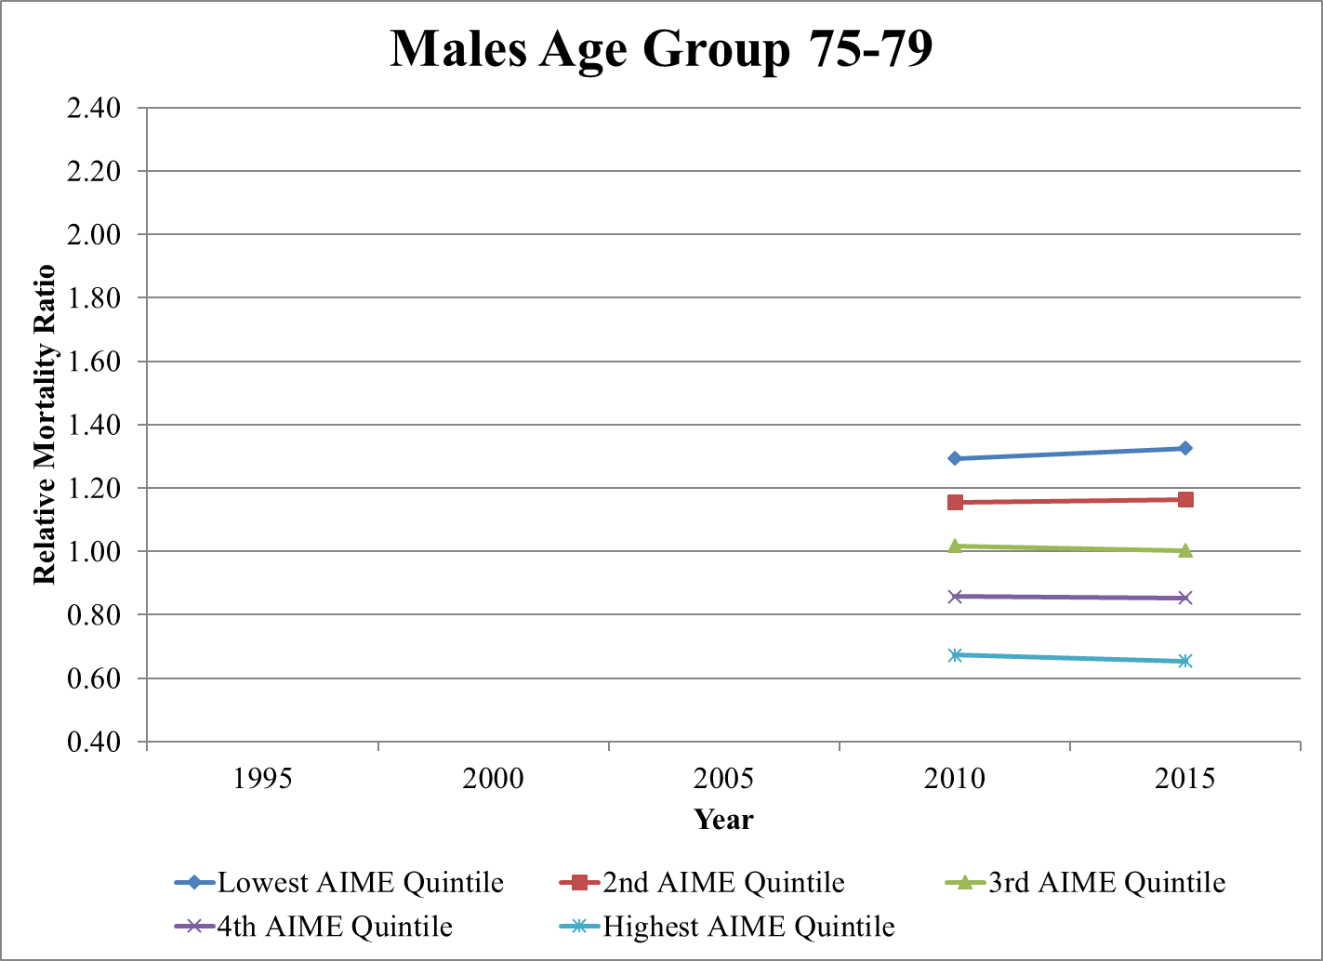
Age Groups 70-74 and 75-79 Relative Mortality Ratios

Slide 30
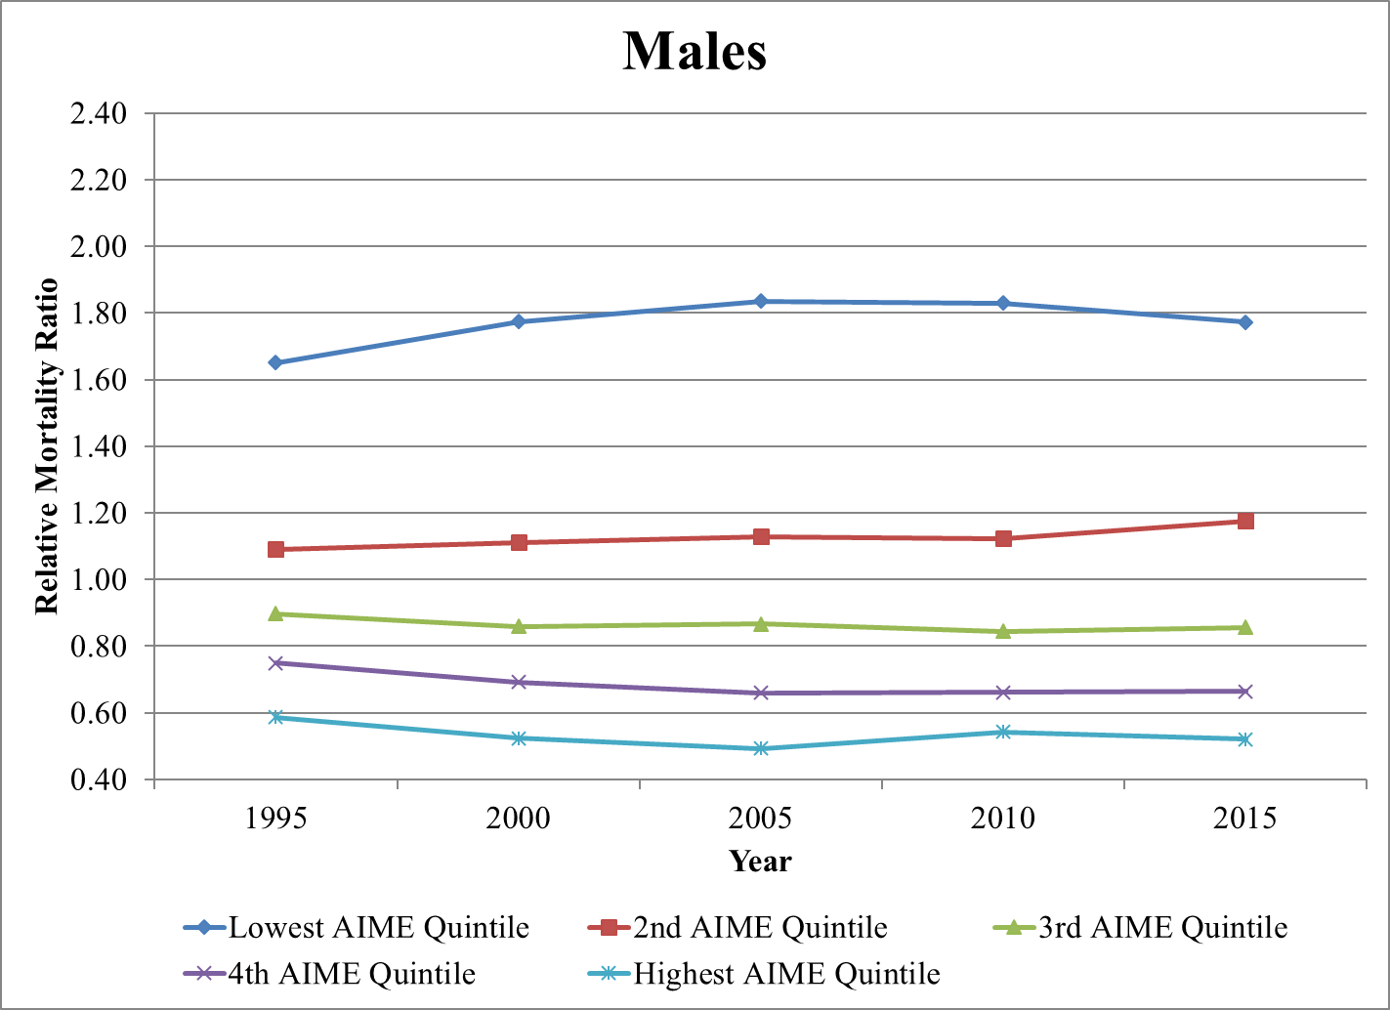
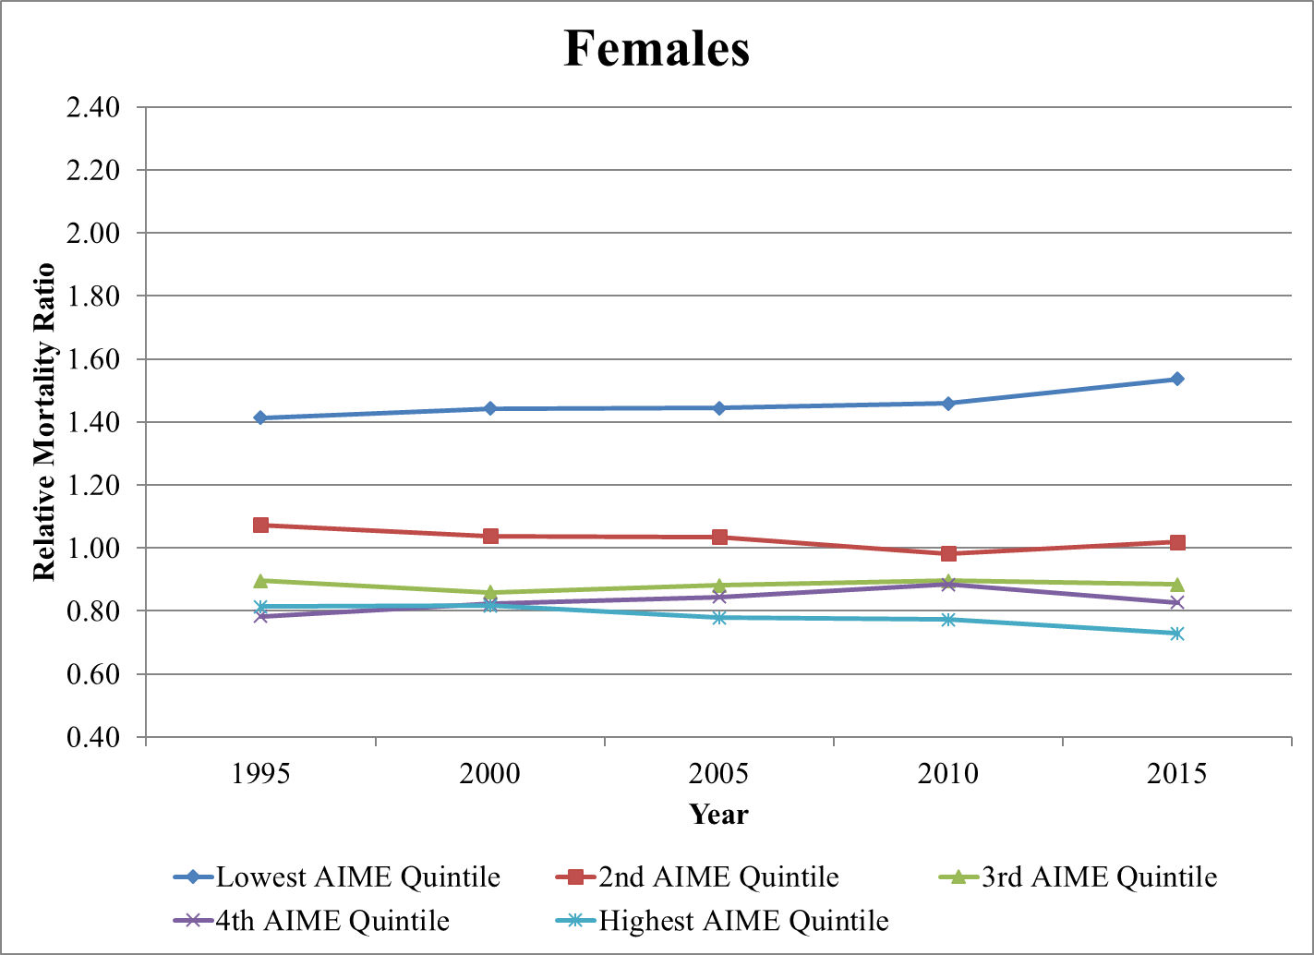
Age Group 62-64 Relative Mortality Ratios

Slide 31
Conclusion
Higher AIME levels correlate with lower mortality rates, while lower AIME levels correlate with higher mortality rates.
The trends from 1995 to 2015 show that the spread in relative mortality ratios among the AIME quintiles remain fairly steady. The spreads widens, but not significantly, and even slightly compresses for some age groups in recent years.

Slide 32
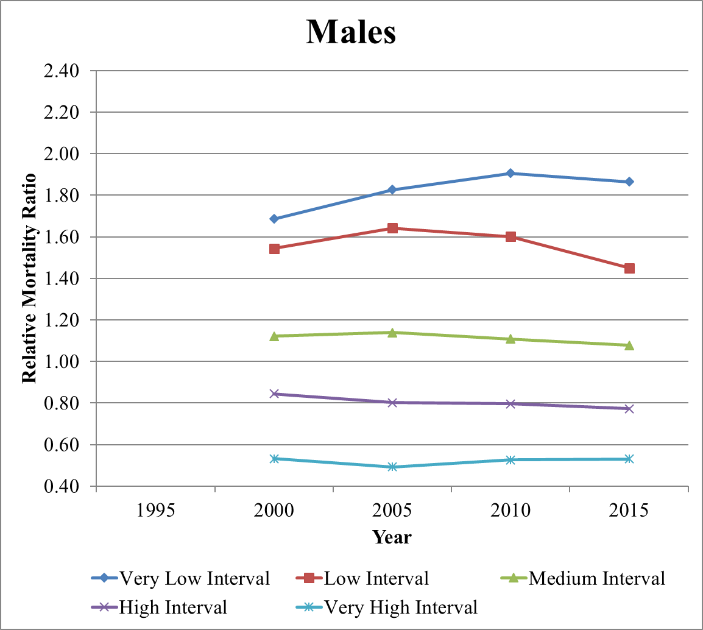
Age Group 65-69 Relative Mortality Ratios

Slide 33
Mortality by Career-Average Earnings Level
Link to the Mortality by Career-Average Earnings Level Study - https://www.ssa.gov/OACT/NOTES/pdf_studies/study124.pdf

Slide 34
Internal Rates of Return and Moneys Worth Ratios
Possible Application of Mortality Differential
Michael Clingman

Slide 35
Introduction
Most of the work in OCACT involves looking at the Social Security OASDI program as a whole.
With the Internal Rate of Return (IRR) and Moneys Worth (MW) programs OCACT analyzes the effects of Social Security on individuals and their families in recurring annual actuarial notes.
We do these analyses using hypothetical workers with either “scaled” earnings or maximum taxable earnings and across four different family combinations.

Slide 36
Introduction (continued)
Scaled earnings are designed to represent typical earnings patterns
  Lower earnings at younger ages when worker starting out in the workforce
  Rising earnings as worker gains experience and expertise
  Leveling off or drop in earnings at older ages as some workers take early retirement or move to part time or less demanding work
Maximum taxable earnings are the maximum amount of earnings that are subject to FICA taxes each year -- $132,900 in 2019
  This is also the maximum amount of earnings for each year used in benefit computations

Slide 37
Hypothetical Workers
Five types of hypothetical worker earnings
  Scaled:
    Very Low
    Low
    Medium
    High
  Maximum
    Earnings at taxable maximum
Earnings in each year
  Scaled earnings = scaled factor for age in year * average wage in year
  Maximum earnings = taxable maximum in year

Slide 38
Hypothetical Workers (continued)
Scaled Factors
  “Raw” scaled factors are determined for each age using 20 years of recent actual earnings from a sample of fully entitled workers up to age 62 and not receiving Social Security benefits.
  For ages 62 and over the data did not show a consistent pattern due to the large number of retirees. We assume that earnings stay constant in nominal dollars to obtain preliminary factors.
  We apply an adjustment factor to the preliminary factors so that a hypothetical medium worker, born in 1960 and retiring at age 65 in 2025, would have career average earnings equal to the average wage in 2024.
  Scaled factors for very low, low, and high scaled workers are set at 25%, 45%, and 160% of the medium scaled factors.

Slide 39
Hypothetical Workers (continued)
These hypothetical workers give a wide range of typical earnings histories from the very low representing a minimum wage worker to the maximum representing a worker with the highest possible benefits and taxes paid.

Slide 40
Assumptions
Scaled earnings begin at age 21
Maximum earnings begin at age 22
Workers remain in continuous employment until either retirement at age 65, death, or disability
If a worker becomes disabled, he or she may continue receiving benefits until death or may recover before age 65 and return to the workforce.
Family members will receive all benefits for which they are eligible.

Slide 41
Assumptions (continued)
There are numerous possible family structures. We chose to analyze four family types.
Family types are:
  Single Male Worker
  Single Female Worker
  One-earner Couple with Male Worker
  Two-earner Couple
Hypothetical couples are assumed to:
  be the same age
  marry at age 22 and stay married
  have children at ages 27 and 29

Slide 42
Definitions
Internal Rate of Return (IRR)
  IRR = the real (above inflation) interest rate which results in PV(Benefits Received) = PV(Taxes Paid)
  If one thinks of the taxes paid as an investment, then the IRR is the return on the investment.
Moneys Worth (MW)
  MW = PV(Benefit Received) / PV(Taxes Paid)
  Measure of whether the worker gets his/her “money’s worth” from the program.
  Effective interest rates of the Trust Funds are used in present value calculations.
In this presentation we will focus mainly on IRR. The analysis for MW is similar.

Slide 43
Time effects on IRR results
We computed IRR values for different birth cohorts. Results varied over time for various reasons.
Mortality effects:
  Later cohorts generally have lower mortality rates than earlier ones.
  Lower mortality leads to longer life, more benefits being paid, and higher IRR.
  This is partially offset for couples where there can be survivor benefits.

Slide 44
Time effects on IRR results (Continued)
Tax rate effect
  Social Security benefit computations are based on taxable earnings.
  The tax rate does not affect the benefit computation.
  All other things being equal, lower tax rates increase IRR while higher tax rates decrease them.
  Tax rates increased from 2% employer/employee combined in 1937 to 12.4% in 1990 and have largely stayed steady since then.
  So earlier cohorts have higher IRR.

Slide 45
Time effects on IRR results (Continued)
Other time effects:
  Increases in wage base
  Increase in normal retirement age
  Changes to benefit formula (more or less generous)
  (MW results are also affected by fluctuating interest rates)

Slide 46
Time effects on IRR results (Continued)
Combined results:
  From the 1920 to 1949 cohort there is a large drop in IRR due to increasing tax rates.
  For scaled workers there is an increase in IRR from the 1949 to 2004 cohort due to improving mortality.
  For maximum earners, the increase in IRR from the 1949 to 1964 cohort due to mortality improvements is offset by increases in the taxable maximum.

Slide 48
Earnings level effects IRR results
Benefits increase with higher earnings but are also progressive:
  A worker with higher earnings will obtain a higher absolute benefit.
  A worker with lower earnings will receive a higher benefit relative to his/her pre-retirement income.
  All other things being equal, a worker with lower earnings will have a higher IRR.
  Highlighted values in the following table show how IRR decreases for the 1964 cohort single male worker as the earnings level goes up.

Slide 50
Family effects on IRR results
Family effects
  Single females have higher IRR values than single males due to increased female longevity.
  One-earner couples have higher values than single workers due to spouse, child, and survivor benefits.
  Two-earner couples with the same earnings have IRR values approximately equal to those for single female workers. The lower male benefit is approximately offset by child benefits. (To simplify the presentation, this category was left off the charts but is in the written actuarial note. Results are similar to those for the single female worker.)
  Highlighted values in the following chart show how IRR increases for the 1964 cohort medium earner category across family types.

Slide 52
Alternatives to Present Law Scheduled Scenario
The 2017 and 2018 Trustees Reports predict that, if Congress does nothing, the Social Security Trust Fund reserves will deplete in 2034. To avoid this situation Congress has 3 basic options:
  Transfer money from general revenues
  Increase taxes
  Reduce benefits
If Congress were to fully cover the shortfall with general revenues then we would get the “Present Law Scheduled” scenario.

Slide 53
Alternatives to Present Law Scheduled Scenario (continued)
For illustrative purposes our office came up with 2 simple scenarios that represent possible options for increasing taxes or reducing benefits.
  Increased Payroll Tax Scenario: Payroll tax rates are increased each year so that there are sufficient funds to pay present law benefits.
  Payable Benefits Scenario: Benefits are reduced each year so that the total benefits paid plus administrative costs equals the tax income.
Since any solution chosen by Congress would likely be some combination of the 3 basic options, these 3 scenarios give a reasonable range of future IRR results.

Slide 55
Alternatives to Present Law Scheduled Scenario (continued)
The following 2 tables show the effects of the Increased Payroll Tax and Payable Benefits scenarios on IRR and MW values.
The Increased Payroll Tax Scenario:
  This scenario only affects workers with earnings after 2033 – the 1985 and 2004 cohorts in the table.
  Affected values for the Medium Scaled Earner are highlighted in green.
The Payable Benefits Scenario:
  The scenario affects all cohorts still potentially receiving a benefit in 2034.
  Reduction is larger than for the Increased Payroll Tax Scenario for all affected cohorts
  Affected values for the Medium Scaled Earner are highlighted in red.
For both scenarios, later cohorts are generally more affected than earlier ones

Slide 58
Differential Mortality
The IRR and MW results published in December 2017 and earlier used the same mortality rates for workers at all earnings levels.
We saw from Tiffany’s presentation that mortality varies with earnings levels – higher earners have lower mortality.
Differential mortality would improve IRR and MW results for higher earners but worsen them for lower earners.

Slide 59
Differential Mortality (continued)
We plan to apply differential mortality to the IRR/MW calculations in the future.
We have differential mortality rates after entitlement from Tiffany’s study.
We need to estimate differential mortality rates by earnings levels prior to entitlement and also differential disability incidence and termination rates
  One issue is incomplete death data, especially at younger ages.
  There is no requirement to report deaths to SSA if there is no beneficiary.
  May extrapolate the results of Tiffany’s study to younger ages, informed by partial data we have.

Slide 60
MW and IRR Actuarial Notes
Link to the Internal Rate of Return note - https://www.ssa.gov/OACT/NOTES/ran5/index.html
Link to the Moneys Worth Ratios note - https://www.ssa.gov/OACT/NOTES/ran7/index.html

Slide 61
Questions?

