Slide 1
Social Security Actuarial Status
The 2017 Annual Trustees Report
and Proposals to Change the Law
Presented by Steve Goss, Chief Actuary, SSA
Middle Atlantic Actuarial Club Annual Meeting
November 8, 2017

Slide 2
What Is the Legislative Mandate for the Annual Report?
Trust Fund operations of the past year and the next five years
Actuarial status of the trust funds
This means the ability to meet the cost of scheduled benefits with scheduled revenue and trust fund reserves
And the extent to which scheduled revenue will fall short, forcing cuts or delays in benefits in the absence of legislative change
75-year projections under intermediate assumptions

Slide 3
Also—Full Scope Audit of the 75-year projections
Statement of Social Insurance in the Agency Financial Statement, and in the Federal Govt Consolidated Financial Statement
Mandated by the FASAB
This year KPMG, actuaries, economists and accountants
We are anticipating a clean opinion---again!!

Slide 4
SOLVENCY: OASDI Trust Fund Reserve Depletion 2034 (same as last year)
Reserve depletion date varied from 2029 to 2042 in reports over the past 25 years (1992-2017)
DI Trust Fund — reserve depletion in 2028, five years later than last year
Due largely to lower recent and near-term disability applications and incidence rate
4

Slide 5
Applications for Disability Benefits Continue to Fall
At the peak of the last economic cycle in 2007, applications were low, but increased rapidly in the recession to over 2 million in 2010. In 2016, with the economy still below the sustainable full-employment level, applications have dropped below the 2007 level
5

Slide 6
Employment Remains below Full Employment Despite the low unemployment rate (4.8 percent in 2016), employment is estimated to be about 2 percent below full employment level
6

Slide 7
Disability Incidence Rate Falls to Historic Lows
DI disabled worker incidence rate rose sharply in the recession, and has declined since the peak in 2010 to an extraordinarily low level for 2016
7

Slide 8
Fewer Disabled Worker Beneficiaries Fewer now and in near term based on recent applications and incidence rates

Slide 9
DI Annual Cost and Non-Interest Income as Percent of Taxable Payroll 93% of scheduled benefits still payable at trust fund reserve depletion Annual deficit in 2091: 0.38 percent of payroll — 0.01 percent smaller than last year
9

Slide 10
OASDI Annual Cost and Non-Interest Income as Percent of Taxable Payroll Persistent Negative Annual Cash-Flow Balance Starting in 2010 77% of scheduled benefits still payable at trust fund reserve depletion Annual deficit in 2091: 4.48 percent of payroll — 0.13 percent larger than last year
10

Slide 11
SUSTAINABILITY: OASDI Cost as Percent of GDP Rises from a 4.2-percent average in 1990-2008, to about 6.1% by 2037, then declines to under 5.9% by 2050, and generally increases to 6.1% by 2091
11

Slide 12
OASDI Beneficiaries per 100 Workers
12

Slide 13
Aging (change in age distribution) mainly due to drop in birth rates

Slide 14
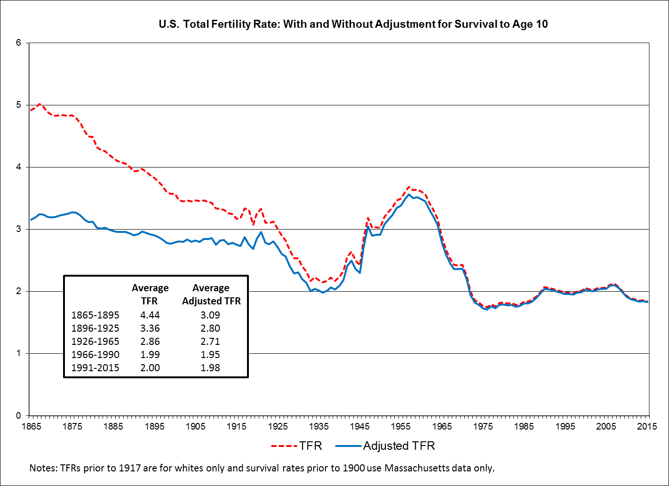
14

Slide 15
Changing Adult Age Distribution: Boomers increase of prime disability age (45-64) is over ----- Next is increasing share at retirement age (65+) as boomers replaced at working ages
Notes:
Alternative chart format

Slide 16
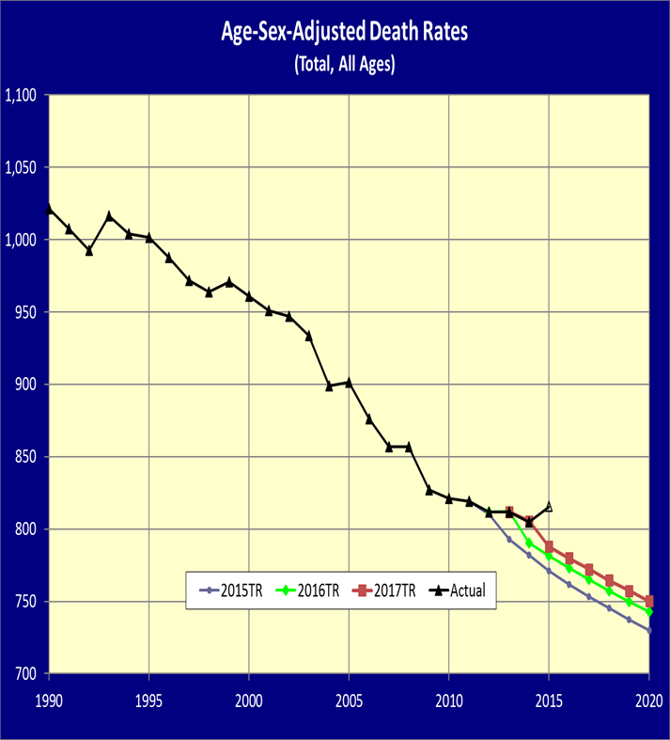
Mortality Experience: All Ages Reductions continue to fall short of expectations

Slide 17
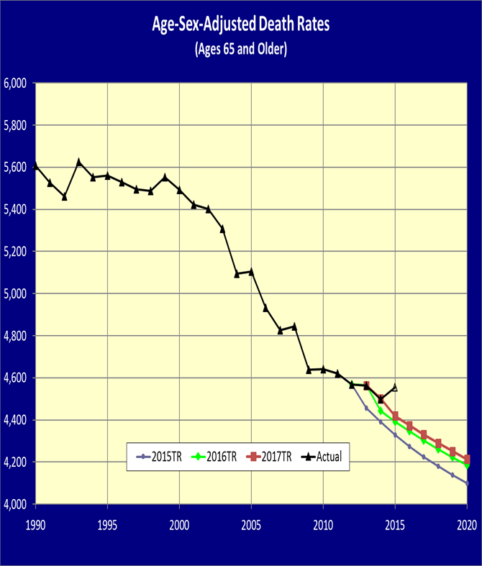
Mortality Experience: Ages 65 and Older Reductions since 2009 continue to fall short of expectations

Slide 18
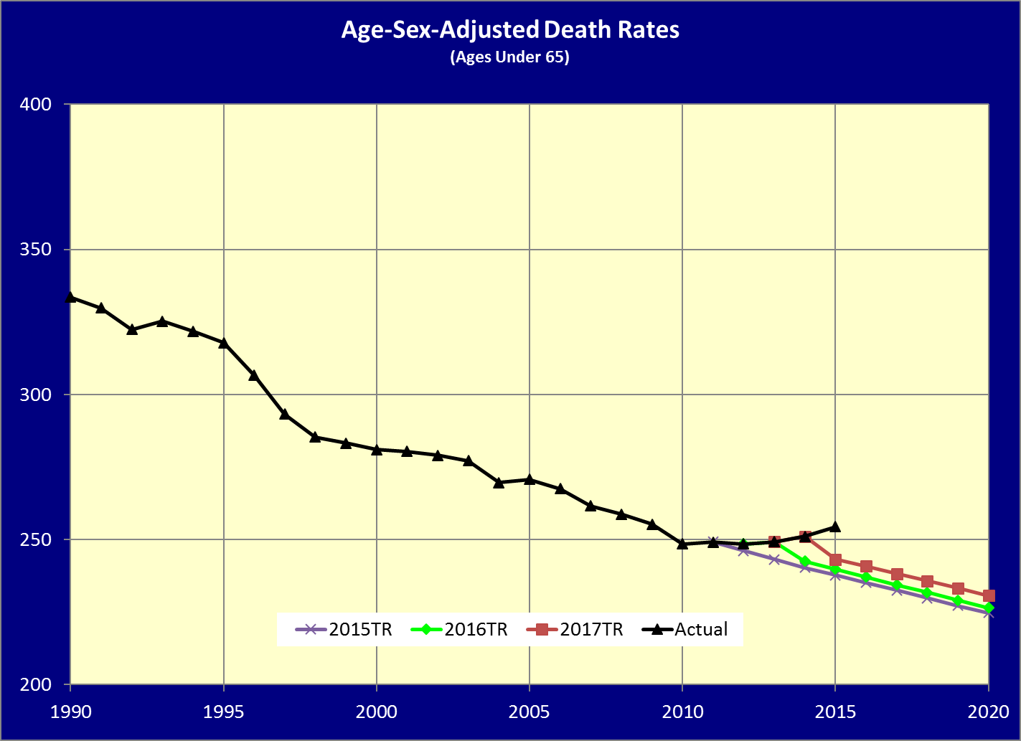
Mortality Experience: Ages under 65 Actual Increase since 2010

Slide 19
Principal Reasons for Change in 2017 Report
Actuarial Balance—Net Change of -0.17 percent of payroll
Valuation Period -0.05 percent
Higher recent mortality +0.04 percent
Lower recent fertility, immigration and other data updates -0.07 percent
Lower level of productivity & GDP (down by about 1 percent) -0.02 percent
Lower avg real wage differential in near- and long-term -0.03 percent
Starting values and other near-term economic assumptions -0.03 percent
Lower recent and near-term disability applications and incidence rate +0.03 percent
Other new data and methods improvements -0.04 percent
19

Slide 20
Uncertainty Illustrations Unrealistically narrow stochastic results due to lack of central tendency variation

Slide 21
Replacement Rates Based on the 2017TR
Source: Annual Recurring Actuarial Note #9 at www.ssa.gov/oact/NOTES/ran9/index.html

Slide 22
How About at Age 62, Where Most Start Benefits?
Source: Annual Recurring Actuarial Note #9 at www.ssa.gov/oact/NOTES/ran9/index.html

Slide 23
Payable Benefits Under the Law, After Trust Fund Reserves Are Depleted, Are Even Lower
Source: Annual Recurring Actuarial Note #9 at www.ssa.gov/oact/NOTES/ran9/index.html

Slide 24
But, Wait—How About Budget Scoring? Don’t entitlements just keep borrowing?
Source: Congressional Budget Office, June 2016

Slide 25
Actually, NO. Budget Scoring Is Inconsistent With the Law, and All Past Experience.
See Actuarial Opinion in the 2017 TR (also 2014, 2015, and 2016 TR)
After reserves deplete, $12.5 trillion unfunded obligation through 2091 cannot be paid under the law.
Budget deems these “expenditures” creating publicly held debt
Reserve redemptions spend excess “earmarked” revenues invested in an earlier year.
Budget deems these “a draw on other Federal resources”
Trust Fund operations have NO direct effect on total Federal debt subject to ceiling in any year—and no net effect on publicly held debt.
Budget says redemptions increase Federal debt held by the public and often gives no credit for reserve accumulation

Slide 26
So—What If We Project Federal Debt Consistent With the Law?
Notes:
Note: In their July 2016 projections, CBO no longer provides projections for the 75-year horizon. Now they stop at the 30-year horizon , i.e. in 2046. As a result, this chart does not look as visually compelling as it did last year – because only about a dozen years go by after the depleting of the trust funds.
To make the point more vividly, we might want to consider using the chart from last year’s presentation.
Also note that the CBO’s baseline changed quite a bit from their 2015 repot to their 2016 report – the 2016 report shows significantly higher future federal debt compared to the 2015 report.

Slide 27
So—What If We Project Federal Debt Consistent With the Law? Projection to 2090 back in 2015

Slide 28
The Bottom Line
Long-term projections provide information to assess solvency and changes needed to eliminate shortfalls
If trust fund reserves were to deplete:
Full benefits cannot be paid timely
NO pressure on the Budget or Federal Debt
So Congress must and WILL act, as always
Straightforward solutions:
Add revenue and/or lower cost for OASDI
Comprehensive changes implemented by 2034

Slide 29
How to Fix Social Security Long-Term
Make choices addressing OASDI deficits 2034-2091:
Raise scheduled revenue after 2033 by about 33%: increase revenue from 4.6 to 6.1% of GDP
Reduce scheduled benefits after 2033 by about 25%: lower benefits from 6.1 to 4.6% of GDP
Or some combination of the two
Invest trust funds for higher return?
Limited help—it is a PAYGO world
So invest in coming generations of workers

Slide 30
Ways to Lower Cost
Lower benefits for retirees—not disabled?
Increase normal retirement age (lowers OASDI cost, but increases DI cost)
Can exempt long-career low earners
Lower benefits mainly for high earners?
Reduce PIA above some level
Often combined with increasing PIA below some level, subject to work year requirements
Lower benefits mainly for the oldest old?
Reduce the COLA
Some say increase it with the CPI-E (based on purchases of consumers over age 62

Slide 31
Ways to Increase Revenue
Raise tax on highest earners?
Increase taxable maximum amount
Some tax on all earnings above the maximum
Tax employer group health insurance premiums?
Affects only middle class if taxable maximum remains
Maintain larger trust fund reserves?
Added interest can lower needed taxes

Slide 32
For More Information Go To http://www.ssa.gov/oact/
There you will find:
This and all prior OASDI Trustees Reports
Detailed single-year tables for recent reports
Our estimates for comprehensive proposals
Our estimates for the individual provisions
Actuarial notes; including replacement rates
Actuarial studies; including stochastic
Extensive databases
Congressional testimonies

