Slide 1
Issues About the Future
Reality and Perceptions
Discussion Session 6A
Middle Atlantic Actuarial Club
November 9, 2016

Slide 2
Birth rates: For 2016, CBO assumes the total fertility rate is permanently lower.
2

Slide 3
But NCHS surveys of expected births for women in 2002 through 2013 are consistently above 2.0.
3

Slide 4
Labor force participation: CBO never recovers, and goes much lower in the future.
4

Slide 5
Earnings concentration at the top has decelerated since 2001. TR continues deceleration. But CBO assumes acceleration to nearly double the pace seen from 1983 to 2001.
5

Slide 6
Interest Rates, Return to Capital, Labor Productivity
All low since 2000, and especially since the recession
Is this temporary, but slow to return to normal?
Or is this the “new normal”?
Permanent shift down around the world economy
In return to capital?
In demand and improved standard of living?
In economic growth and tech innovation?

Slide 7
But, Wait—How About Budget Scoring? Don’t entitlements just keep borrowing?
Debt Held by the Public, Total Spending, and Total Revenues
Source: Congressional Budget Office, June 2015

Slide 8
Actually, NO. Budget Scoring Is Inconsistent With the Law, and All Past Experience.
See actuarial opinion in the 2014-2016 TR:
After reserves deplete, $11.4 trillion unfunded obligation through 2090 cannot be paid under the law.
Budget deems these “expenditures” creating publicly held debt
Reserve redemptions spend excess “earmarked” revenues invested in an earlier year.
Budget deems these “a draw on other Federal resources”
Trust Fund operations have NO direct effect on total Federal debt subject to ceiling in any year—and no net effect on publicly held debt.
Budget says redemptions increase Federal debt held by the public and often gives no credit for reserve accumulation

Slide 9
So—What If We Project Federal Debt Consistent With the Law?

Slide 10
How about Future Mortality? Approaches for Projection
Extrapolating past trends of:
Life expectancy at birth or other ages?
Improvement by cohort?
Mortality rate by age and sex?
Mortality rate by age, sex, and cause?
Use a statistical extrapolation?
Consider factors affecting mortality change?
10

Slide 11
Can Life Expectancy Rise Linearly?
Requires accelerating rate of decline in mortality rates if retain age gradient
LE most affected by lowest ages—only so much gain possible
Is there an omega? Squaring the curve
11

Slide 12
Extrapolation by Cohort?
U.K. and RPEC
“Phantoms never die” data issues
What does change up to age x say above age x?
Is cohort healthier at x if lower mortality up to x?
Or is cohort compromised by impaired survivors?
What does one cohort imply for the next cohort?
Period effects from known conditions appear to be stronger—at least in the U.S.
12
12

Slide 13
Extrapolation by Age and Sex? Age-gradient in past reduction is clear
13
13

Slide 14
Mortality Decline Varies Over Time Antibiotics/economy 1936-54; health spending 1968-82
14

Slide 15
Mortality Decline by cause of Death: rate of change 1979 to 2013

Slide 16
Age-sex extrapolation VS Age-sex-cause projection Lee maintaining full age-gradient offsets lack of deceleration
16

Slide 17
What Future Conditions Might Change
Smoking decline for women
Started and stopped later than men
Obesity—sedentary lifestyle
Health spending—must decelerate
Advances help only if apply to all
Human limits?
Has omega changed? Will it?
17

Slide 18
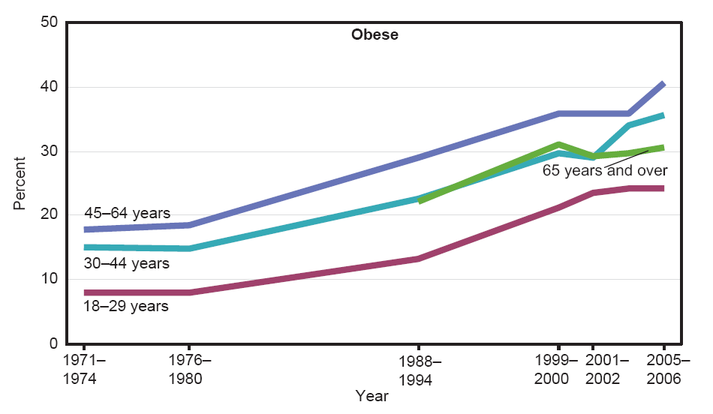
Trends in Obesity: US 1971-2006
Sam Preston 2010—must consider cumulative effects
Increasing duration of obesity for aged in future
18
Notes:
18

Slide 19
Does Health Spending Affect Mortality? Note stability 1990-2000 and since 2009
19
19

Slide 20
Health Spending Cannot Continue to Rise at Historical Rates Note Trustees’ deceleration
20
20

Slide 21
Is There an Omega? It appears we are squaring the survival curve?
21

Slide 22
Mortality Improvement: Slow Since 2009 Trustees Reports have overestimated reduction lately
22
22

Slide 23
Death Rates Will Continue to Decline: But How Fast and for Whom?
Must understand past and future conditions
Persistent historical “age gradient”
Death rates drop fastest at young ages
Avoid simple extrapolation of past periods
Cannot ignore changing conditions, or “limits” on longevity
Latter half of 20th century was extraordinary
So deceleration seems likely
23

