Slide 1
SSI Multirecipient Households and the Effect of a Maximum Family Federal Benefit Rate Structure
Melissa Schaible
Social Security Administration

Slide 2
The Motivation Behind this Note
We have received several multirecipiency proposal requests and decided that it would be beneficial to have a written note.

Slide 3
Background
The SSI program was established by Congress in 1972
SSI stands for “Supplemental Security Income”
Needs-based program administered by the Social Security Administration
Replacement for former Federal-State programs providing public assistance to the aged, blind, and disabled
The SSI program added a new assistance category-disabled children under the age of 18
SSI program is funded from general revenues
SSI program intended to provide a uniform Federal income floor for aged, blind or disabled individuals
At inception child recipients 4.3%
As of December 2017 child recipients 16.9%

Slide 5
Distribution by Age Band
Table 1: Individuals due a Federal SSI payment in July 2018ª, by age group and SSI eligibility category
 |  | Total recipients |  |  | Blind or Disabled recipients
Age group |  | Number | Percent |  | Number | Percent
Under 18 |  | 1,148,938 | 14.47% |  | 1,148,938 | 16.79%
18 to 64 |  | 4,720,667 | 59.45% |  | 4,720,667 | 68.99%
65 and older |  | 2,070,469 | 26.08% |  | 972,574 | 14.21%
Total |  | 7,940,074 | 100.00% |  | 6,842,179 | 100.00%
ª Based on June 2018 administrative data.

Slide 6
Couple and individual FBR
SSI provides a maximum Federal monthly payment called the FBR (Federal Benefit Rate) that is reduced dollar-for-dollar by the individual’s countable income (resources)
The eligible couple FBR is 1.5 times the individual FBR
There is no provision for reducing the payments of non-couple SSI recipients who live with other SSI recipients (non-couple multirecipients)

Slide 7
Proposals
Since the mid-1990s there have been various proposals to limit the total maximum Federal SSI payment available to families or households

Slide 8
Reason for proposals and interest in non-couple multirecipients
Perceived inequality of payments between married couples who both receive SSI payments and non-couple multirecipients whose payments are not subject to any “economies of scale” reduction
Potential for reducing Federal expenditures by applying an “economies of scale” reduction to the Federal SSI payments of these non-couple recipients
According to our study about 24% of SSI recipients under 18 lived with other eligible family members

Slide 9
Other Studies
“SSI Recipients in Multirecipient Households, March 1994” by Kennedy, Scott, and Brooks –
address matching technique on a representative 5% sample
Finding was that 8.5% of SSI recipients in March 1994 lived with another SSI recipient who was not a spouse
“SSI Recipients in Households and Families with Multiple Recipients: Prevalence and Poverty Outcomes” by Koenig and Rupp –
Based on the SIPP (Survey of Income Program and Participation) which is a small sample (about 5%) survey done by the Census Bureau
In 1998 21% of all SSI recipients lived in a household with another non-spousal SSI recipient, with the prevalence being 38% for children under the age of 18

Slide 10
National Commission on Childhood Disability
The NCCD was established by Congress in the Social Security Independence and Program Improvements Act of 1994
Goal to review the definition of childhood disability in the SSI program
Is the present definition of disability appropriate and what would be the advantages or disadvantages of an alternative definition?
Alternatives for meeting high medical costs for families with children who have serious impairments
Feasibility of providing benefits to children through noncash means, e.g., vouchers, debit cards, and electronic benefit transfer systems
Methods that SSA could use to increase the provision of social services, education, and vocational instruction needed to promote the ability to engage in substantial gainful activity
The effects of the SSI program on children and their families

Slide 11
NCCD report to Congress
SSI is not designed to provide a person living alone with an income equal to the federal poverty level
The report states that Federal poverty guidelines take account of economies of scale, however SSI payments do not
SSI payments to families can rise significantly above federal poverty guidelines as the number of eligible family members increases

Slide 12
Sliding Scale NCCD Proposal
NCCD(National Commission on Childhood Disability) October 1995 report to Congress laid out a sliding-scale payment structure
Formula for maximum monthly combined Federal payment that a family could receive collectively for its eligible children
Formula based on a poverty scale developed by the National Research Council
FBR is the Federal Benefit Rate
${COMBFBR}_{N,P}=FBR ∗[{\left(N+P\right)}^{0.7}−P]$
N is the number of eligible children
P is zero if neither parent is eligible and 1 if one OR both parents are eligible

Slide 13
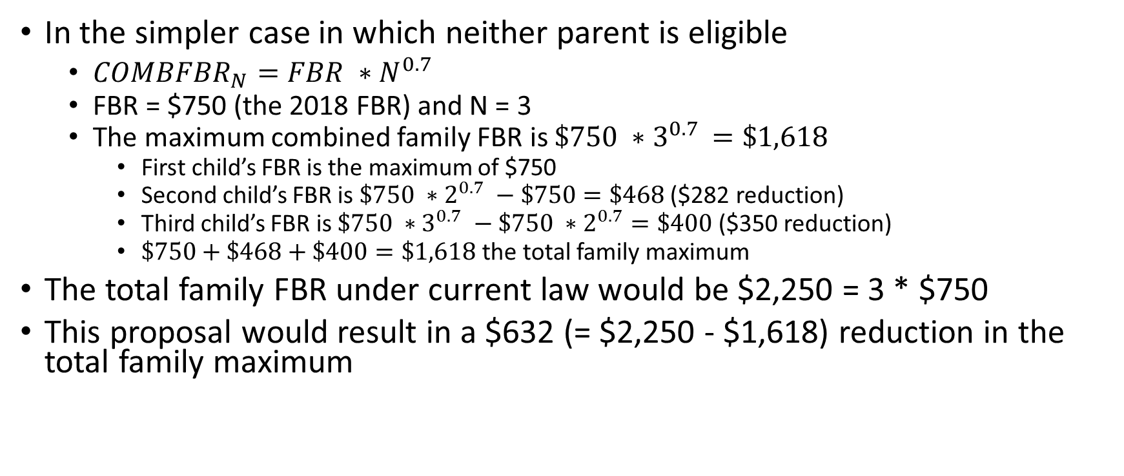
Example calculation of sliding scale FBR
In the simpler case in which neither parent is eligible
${COMBFBR}_{N}=FBR ∗N^{0.7}$
FBR = $750 (the 2018 FBR) and N = 3
The maximum combined family FBR is $\$750 ∗3^{0.7 }=\$1,618$
First child’s FBR is the maximum of $750
Second child’s FBR is $\$750 ∗2^{0.7} −\$750=\$468$ ($282 reduction)
Third child’s FBR is $\$750 ∗3^{0.7} −\$750 ∗2^{0.7}=\$400$ ($350 reduction)
$\$750+\$468+\$400=\$1,618$ the total family maximum
The total family FBR under current law would be $2,250 = 3 * $750
This proposal would result in a $632 (= $2,250 - $1,618) reduction in the total family maximum

Slide 14
Equal FBR Calculation
Same formula to compute the family maximum with 4 eligible children and no eligible parents
${COMBFBR}_{N,P}=FBR ∗N^{0.7}$
The maximum combined family FBR is $\$750 ∗4^{0.7}=\$1,$980
Each child’s FBR would be one-fourth of the total, $495 (= $1,980 / 4)
The total family FBR under current law would be $3,000 = $750 * 4
This proposal would result in a $1,020 (= $3,000 - $1,980) reduction in the maximum family FBR ($255 per child)

Slide 15
Limitations and Assumptions
Limitations
Assembled family units cannot account for children residing without the parents but with other family members who are head of household (e.g., grandparents) unless that other family member is a legal guardian
Also cannot account for children age 18 or older residing with the family
Assumptions
Included in our analysis are children designated as living with their parents or children living with their parents in a household in which the parent is not head of household
Children not living with their parents were assumed to be living outside of the household
The multirecipient family was defined to include-
The eligible child
Any parent(s) with whom the child was living, and
Any eligible children under age 18 who were living with the same parent(s) as the child
A parent is considered to be a natural, adoptive, step-parent or a legal guardian

Slide 16
Living Arrangements
A=Living in own household
B=Living in the household of another and not paying share of household expenses
C=Living in parental household
D=Institutionalized (Medicaid pays over 50% of cost of care)

Slide 17
Living Arrangements
For SSI purposes,
the FBR is different for different living arrangements
For example,
Living arrangement B cases are often subject to a reduction of the FBR in cases in which both food and shelter are provided
Living arrangement D cases have an FBR equal to $30
For the purposes of this study note,
We focus mainly on living arrangement B and C cases. The living arrangement is used in the PARENT_MATCH_KEY that will be defined later in these slides

Slide 18
Development of Family Units
Used information on the Supplemental Security Record (SSR)
SSR links
Cohabiting married couple in which both members receive SSI
Child to parents
Not child to other children
The SSR does contain information on the number of eligible and ineligible children in the family but not reliable
No parent to child deeming or deemed amount is zero
The term “deeming” identifies the process of considering another person’s income and resources to be available for meeting an SSI claimant’s (or recipient’s) basic needs of food and shelter

Slide 19
Methodology
June 2018 Administrative Extract
SSI recipients
Spouses of adult recipients
Deemors
In a nutshell, everyone who has ever applied for SSI and their deemors
4 Steps

Slide 20
Assembling the Family Units
Step 1-
2 files created
File of eligible individuals
File of parents-MFT (Master File Type) of ‘XM’ or ‘XF’
Several indicator variables to determine eligible child status and parent status
Also, determined whose TOA (Type of Action) had been updated prematurely
Our program was written to take the CSTOA (COMP-STAT-TOA) (if there is one) regardless of effective date
The effective date could be later than June 2018

Slide 21
Assembling the Family Units
Step 2-Fixing the prematurely updated TOA
Look back at the previous 3 months- March, April, and May 2018
Files are updated often enough that 3 months is sufficient
Replace prematurely updated TOA
Creation of the PARENT_MATCH_KEY
HUN (Housed Under Number)
Concatenation of HUN, 2nd position of the TOA, LIVF(Living Arrangement Code)

Slide 22
Assembling the Family Units
Step3-
Matching children to their parents by merging the files based on PARENT_MATCH_KEY
Counting number of parents within the PARENT_MATCH_KEY for the purpose of assigning the parent count to each child’s record

Slide 23
Assembling the Family Units
Step 4-
Assembling family units by using the FAMILY_MATCH_KEY
Concatenation of the first parent’s SSN, the second parent’s SSN (if there was a one), and the TOA
Ranking of the children in the family
Important for sliding scale FBR scenario
Ranked by date of first eligibility and then birthdate within date of first eligibility

Slide 24
Family data
For each family unit we determined-
The number of parents
The number of eligible parents
The total number of eligible children in the family, and
The relative position of each child in the family, ordering by date of first eligibility and date of birth within eligibility

Slide 25
Distribution of Children by Living Arrangement-living arrangement A and B cases
Living arrangement |  | Number of children | All SSI children
Own household........................................... |  | 151,594 | 13.42
Household of another, which includes:
Eligible parent(s) only............................... |  | 759 | 0.07
Eligible sibling(s) only............................... |  | 1,546 | 0.14
Eligible sibling(s) and parent(s)................ |  | 140 | 0.01
Subtotal, with other eligible individuals.. |  | 2,445 | 0.22
No other SSI eligible individuals............... |  | 17,188 | 1.52
Subtotal, household of another................. |  | 19,633 | 1.74

Slide 26
Distribution of Children by Living Arrangement-living arrangement C and D cases
Living arrangement |  | Number of children | All SSI children
Parents' household, which includes:
Eligible parent(s) only............................... |  | 73,118 | 6.47
Eligible sibling(s) only............................... |  | 175,557 | 15.54
Eligible sibling(s) and parent(s)................. |  | 29,229 | 2.59
Subtotal, with other eligible individuals.. |  | 277,904 | 24.60
No other SSI eligible individuals............... |  | 668,660 | 59.19
Subtotal, parent's household...................... |  | 946,564 | 83.79
Institutionalizedª |  | 11,903 | 1.05
Unknown ^{b} |  | 3 | 0.00
Total, all living arrangements:
 |  | 1,129,694 | 100.00

Slide 27
Most families are single parent with parent ineligible
 |  | Number of eligible children within the SSI family
Federal SSI family units with children by number of parents in family and parent eligibility status |  | 1 | 2 | 3 | 4 | 5 or more | Total | Percent of total families
Living with other non-parent individuals |  | 19,236 | 0 | 0 | 0 | 0 | 19,236 | 2.25%
One parent in family unit
Parent eligible for federal SSI |  | 55,679 | 7,997 | 1,254 | 240 | 55 | 65,225 | 7.62
Parent ineligible for federal SSI |  | 535,881 | 55,073 | 6,313 | 792 | 155 | 598,214 | 69.90
Total |  | 591,560 | 63,070 | 7,567 | 1,032 | 210 | 663,439 | 77.53
Two parents in family unit
One parent eligible for federal SSI |  | 15,614 | 2,577 | 439 | 91 | 23 | 18,744 | 2.19
Both parents eligible for federal SSI |  | 2,584 | 497 | 92 | 28 | 4 | 3,205 | 0.37
Neither parent eligible for federal SSI |  | 149,967 | 17,711 | 2,296 | 303 | 96 | 170,373 | 19.91
Total |  | 168,165 | 20,785 | 2,827 | 422 | 123 | 192,322 | 22.47
Total federal SSI family units
One parent eligible for federal SSI |  | 71,293 | 10,574 | 1,693 | 331 | 78 | 83,969 | 9.81
Two parents eligible for federal SSI |  | 2,584 | 497 | 92 | 28 | 4 | 3,205 | 0.37
No parent eligible for federal SSI |  | 705,084 | 72,784 | 8,609 | 1,095 | 251 | 768,587 | 89.81
Total |  | 778,961 | 83,855 | 10,394 | 1,454 | 333 | 855,761 | 100.00

Slide 28
Most families no eligible parents

Slide 29
Most SSI multirecipient families just have a Mom

Slide 30
Average benefit per child increases in families with more children (current law)
Average Federal benefit due per child living with their parent(s) in July 2018
 |  | Total SSI eligible children in each family
 |  | 1 | 2 | 3 | 4 | 5 or more | Total
Federal Amount due
Parents' Household |  | $649.44 | $678.17 | $697.35 | $709.68 | $710.82 | $656.54
Household of Another |  | $463.58 | $475.63 | $470.54 | $500.00 | -- | $464.08
Parents' Household and Household of Another |  | $640.57 | $676.34 | $696.19 | $709.43 | $710.65 | $648.95
Percent of full SSI Federal Benefit Rate
Parents' Household |  | 88.60% | 92.52% | 95.14% | 96.82% | 96.97% | 89.57%
Household of Another |  | 63.24% | 64.89% | 64.19% | 68.21% | -- | 63.31%
Parents' Household and Household of Another |  | 87.39% | 92.27% | 94.98% | 96.78% | 96.95% | 88.53%

Slide 31
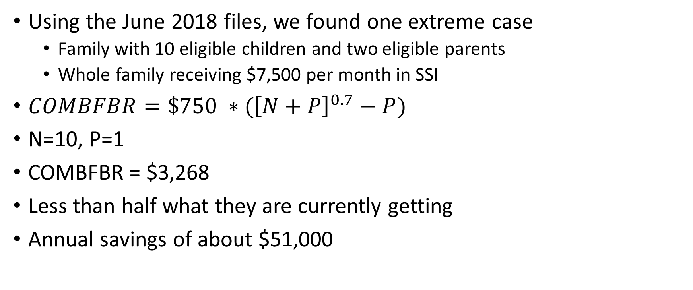
Large Payment for 10 child family
Using the June 2018 files, we found one extreme case
Family with 10 eligible children and two eligible parents
Whole family receiving $7,500 per month in SSI
$COMBFBR=\$750 ∗({\left[N+P\right]}^{0.7}−P)$
N=10, P=1
COMBFBR = $3,268
Less than half what they are currently getting
Annual savings of about $51,000

Slide 32
Across the board increase with more kids

Slide 33
Time Series Distribution of Family Units
 | Number of eligible children |  |  |  |  | Percentage distribution
July | 1 | 2 | 3 | 4 | 5 or more | 1 | 2 | 3 | 4 | 5 or more
2011 | 811,445 | 96,723 | 12,973 | 1,995 | 467 | 87.9% | 10.5% | 1.4% | 0.2% | 0.1%
2012 | 839,645 | 99,056 | 13,219 | 2,021 | 466 | 88.0% | 10.4% | 1.4% | 0.2% | 0.0%
2013 | 850,526 | 99,922 | 13,300 | 1,954 | 470 | 88.0% | 10.3% | 1.4% | 0.2% | 0.0%
2014 | 848,229 | 99,040 | 12,878 | 1,883 | 449 | 88.1% | 10.3% | 1.3% | 0.2% | 0.0%
2015 | 822,801 | 95,212 | 12,039 | 1,733 | 401 | 88.3% | 10.2% | 1.3% | 0.2% | 0.0%
2016 | 801,010 | 90,024 | 11,304 | 1,598 | 365 | 88.6% | 10.0% | 1.3% | 0.2% | 0.0%
2017 | 783,790 | 86,371 | 10,654 | 1,540 | 346 | 88.8% | 9.8% | 1.2% | 0.2% | 0.0%
2018 | 759,725 | 83,809 | 10,394 | 1,454 | 333 | 88.8% | 9.8% | 1.2% | 0.2% | 0.0%

Slide 34
Scenarios and source of request
This was done to satisfy a proposal to be included in the President’s fiscal year 2019 budget submission
Sliding scale and equal FBR scenarios
Not currently implemented

Slide 35
Savings Under Equal FBR Proposal
Under current law projected total outlays of about $108 billion dollars over the 10 year period 2019-2028
The savings over 10 years for this proposal was $8-$9 billion
8.1% decrease in outlays
The number of recipients in current pay status would decrease by about 0.42%
The benefit of about 25% of recipients would be affected

Slide 36
References to other studies
Kennedy, Lenna D., Charles G. Scott, and Alfreda M. Brooks. “SSI Recipients in Multirecipient Households, March 1994.” Social Security Bulletin 58, 3 (1995): 49-54
https://www.ssa.gov/policy/docs/ssb/v58n3/v58n3p49.pdf
Koenig, Melissa, and Kalman Rupp. “SSI Recipients in Households and Families with Multiple Recipients: Prevalence and Poverty Outcomes.” Social Security Bulletin 65, 2 (2003/2004).
https://www.ssa.gov/policy/docs/ssb/v65n2/v65n2p14.html

Slide 37
Reference to NCCD Report to Congress
https://www.ssa.gov/history/reports/SSI/ChildhoodDisabilityReport.html

