Slide 1

Healthcare
Intervention
Programs
Current State and Measuring results

Slide 2
Introductions
Ed Pudlowski, FCA, MAAA, ASA
  President, MorningStar Actuarial Consulting
  Ed.Pudlowski@MorningStarActuarial.com
Mac McCarthy, FCA, MAAA, ASA
  President, McCarthy Actuarial Consulting
  Chief Strategy Officer, MorningStar Actuarial Consulting
  Mac.McCarthy@MorningstarActuarial.com
Notes:
Mac

Slide 3
Healthcare Intervention Programs
Agenda
Background / Definitions
Current State / Examples
Success Metrics
Actuarial Role

Slide 4
Background and Definitions
  Programs designed to target and manage events within the employer’s population that drive costs
  May be comprehensive or narrow in focus
Typical Health Care Intervention Aspects
  Wellness
  Patient Advocacy and Navigation
  Pre-authorization
  Concurrent Review
  Case Management
  Demand management
  Disease management
  Pharmacy Management
  Population Health Management
  Telehealth
  On-site clinics
Notes:
Mac
Our definition
Some programs may include multiple aspects
Other programs may be much more narrow in focus
Cost and effectiveness vary greatly

Slide 5
Current State
Notes:
Mac
Powerful tools
Can have a dramatic, positive impact on both costs and employee satisfaction
Often little documentation of actual results
Assertions of savings/ROI may rely on questionable study methodology
Assertions should be validated with actual results
Employers need to assess applicability to their population
Consider impact on quality of care and participant satisfaction
We will provide two examples of widely different “Healthcare Intervention Programs” from our experience.

Slide 6
Example A
Quantum Health*
A Comprehensive Healthcare advocacy and navigation
* Disclosure: Quantum Health is a client of McCarthy Actuarial Consulting
Notes:
Mac

Slide 7
Example A: Quantum Health
Personalized Human
Connection
Provider Connection
Supported by
state-of-the-art
technology
Expert Support in Benefits,
Clinical, Life Needs and
Care Coordination
A GUIDED EXPERIENCE THROUGH
THE HEALTHCARE JOURNEY
Notes:
Mac

Slide 8






SIMPLIFIED EXPERIENCE
Quantum Health is the single point of entry to employees’ healthcare journey
CONSUMER
PROVIDERS
Real-Time Intercept ^{tm}
MEMBER/PROVIDER SERVICES (MEDICAL & RX)
BENEFITS AND CLAIMS
ELIGIBILITY
PROVIDER SELECTION AND COST/QUALITY
ADVOCACY
CLINICAL/CARE COORDINATION SERVICES
PRE-NOTIFICATION
CONCURRENT/UTILIZATION REVIEW
PRE-ADMISSION/POST-DISCHARGE
EPISODIC CARE COORDINATION
CASE MANAGEMENT
CHRONIC CONDITION MANAGEMENT
MATERNITY MANAGEMENT
INCENTIVE MANAGEMENT
CLAIMS ADMINISTRATION
& NETWORK
POINT SOLUTIONS
PHARMACY BENEFIT
MANAGEMENT
Notes:
Mac

Slide 9
REAL-TIME
TM
INTERCEPT
PRIMARY SOURCES OF IDENTIFICATION
SECONDARY SOURCES OF IDENTIFICATION
MEMBER AND
CAREGIVER CALLS
REFERRALS
MEDICAL CLAIMS
BIOMETRICS
Rx CLAIMS
PROVIDER CALLS
HEALTH RISK
ASSESSMENT
GAPS IN CARE
PRE-CERTIFICATION
PREDICTIVE RISK
NURSE OUTREACH
CALLS FOR PAC/PDC
Notes:
Mac

Slide 10
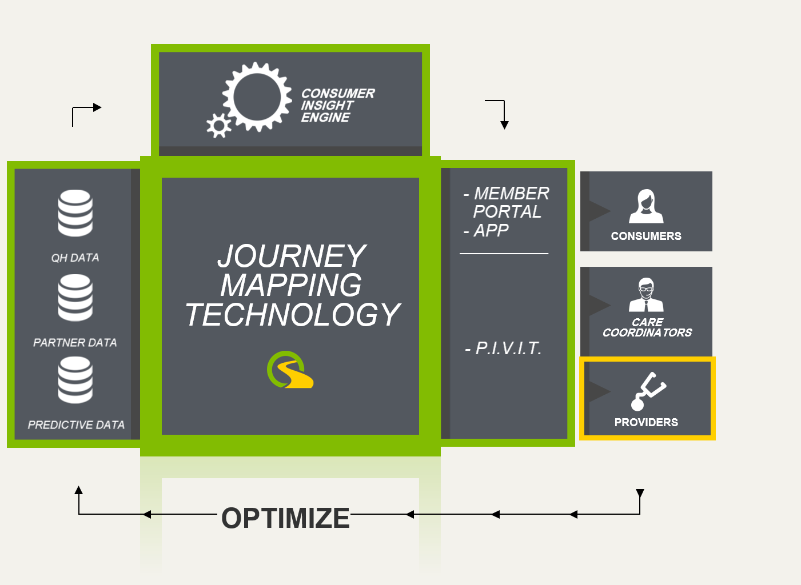
QH DATA
Interventions
Conversations / Activities
(Including Digital)
Pre-Certs / Authorization
Provider Referrals
Benefits Quoted
Risk Score
Identification & Stratification
Engagement Preferences
Gaps & Barriers to care
Patient Reported Data
Provider Searches
Depression Screen
PARTNER DATA
Claims (Medical & Rx)
Engagement Preferences
Decision Support
Eligibility
Networks
Point Solutions
- Wellness Activities
Biometrics
Gaps & Barriers to Care
Provider Care Plans
PREDICTIVE DATA
Risk Score
Care Paths
Notes:
Mac

Slide 11

REAL-TIME INTERCEPT
TM
COST
PREDICTIVE
MODELING
SAVINGS
REAL TIME
INTERCEPT
TIME
Notes:
Mac

Slide 12

IMPACT OF REAL-TIME INTERCEPT™
 | Population Distribution |  |  |  |  | Real-Time Intercept™ pre $1K Claims Month
 | Members | % of Membership | % of Total Cost |  |  | % of Members | Average Days Before Claim Processed | Contacts per Member | % Contacts with Provider | % First Contact with Provider
Members with Claims >= $10,000 | 41,249 | 8.7% | 73.8% |  |  | 87.7% | 56 | 9.5 | 64.1% | 58.0%
+ 87.7% of members identified through Real-Time Intercept™
+ Identification taking place on average, 56 days prior to claim processing
+ Early identification and engagement provides opportunity to positively impact member journey and save money
MEMBER
ENGAGEMENT
IMPROVED
UTILIZATION
LOWER
COST
Notes:
Mac

Slide 13

UTILIZATION CATEGORY
YEAR 1
YEAR 2
Primary Care Visits
+ 7.1%
+ 7.8%
DRAMATIC IMPACT
ON KEY DRIVERS OF
HEALTHCARE COSTS
Utilizing Primary Care
+11.3%
+12.3%
Preventative Services
+14.2%
+18.0%
INCREASED UTILIZATION
DECREASED WASTEFUL SPENDING
UTILIZATION CATEGORY
YEAR 1
YEAR 2
UTILIZATION CATEGORY
YEAR 1
YEAR 2
Inpatient Admissions
- 4.8%
- 8.9%
Specialist Visits
+ 0.1%
+ 6%
Inpatient Length of Stay
- 8.1%
- 6.1%
Cost of Cases >$25K
- 5.7%
- 12%
Inpatient Days
- 12.5%
- 14.5%
MEMBER
ENGAGEMENT
IMPROVED
UTILIZATION
LOWER
COST
13 / QUANTUM HEALTH / CONFIDENTIAL AND PROPRIETARY
Notes:
Mac

Slide 14

CONSISTENT TREND RESULTS
Healthcare trend –CLIENTS Implemented Between 2012 - 2016
QUANTUM HEALTH
QUANTUM HEALTH
3-YEAR CAGR*:
$120
$119
INDUSTRY AVERAGE
$115
1.6% vs 6.0%**
$112
$110
AonHewitt
Mercer
WillisTowersWatson
Segal
S&P
5.2%
7.5%
5.8%
7.2%
4.4%
$106
$105
$100
$105
$100
$103
COST AT YEAR 3:
$100
$100
11.9% LOWER
$95
THAN OTHERWISE PROJECTED
$90
YEAR 0
YEAR 1
YEAR 2
YEAR 3
AVERAGE YEAR ONE GROSS SAVINGS: $756 PEPY
MEMBER
ENGAGEMENT
IMPROVED
UTILIZATION
LOWER
COST
*CAGR: Compound Annual Growth Rate
Notes:
Mac

Slide 15
Example B
Focused Surgery Benefit manager
Notes:
Ed

Slide 16
Surgery Benefit Management
Surgical costs represent the largest component of US health care spending, at approximately $700 billion or 31% of annual health care spend
Surgical complications can drive up the costs of care by 93% on average
Up to 30% of surgical procedures are medically unnecessary
Notes:
Ed
Information from the vendor based on national statistics

Slide 17
Eight Categories of Surgery Benefits Covered
General
Cardiac
Bariatric
Ortho
Women’s Health
Spine & Neuro
Vascular
Cancer
Notes:
Ed
Eight categories of surgeries covered by the vendor in their program. Note relationship to $700 billion dollar industries.

Slide 18
How the Program Works…
Vendor has contracts with select providers to cover the 8 categories of surgeries for a fixed bundled case rate
Program includes:
  Member engagement outreach
  Surgery decision support tools
  Second opinion support
  Surgery scheduling
  Travel assistance (if necessary)
Surgeries are moved from coverage under the health plan and covered under the vendors program via the negotiated bundled case rate
Employer option to make the service voluntary or mandatory
Program has a PEPM fee and a “Service and Access” fee
Notes:
Ed
Service and access fee was indicated to be a percentage (15% - 20%) of the bundled case rate but there was some inconsistency whether it was inclusive or exclusive of the savings that the case rates generated over traditional health plan pricing.
Also the same question about the travel expenses incurred to send a participant to a provider outside a set range.
Finally, need to better understand how vendor captured lack of out-of-pocket costs into their analysis

Slide 19
Vendor Claims
Saving of 20% to 40% versus traditional network cost per surgery
A high-quality global network of US and overseas providers
Reduced complications and infection rates due to high-performing provider quality
Providers will receive increased case volume and avoid collection costs
Employers benefits from lower costs and simplified billing
Plan members benefit from lower cost and certainty of quality outcomes
20% participation rate in first year, expect to grow in subsequent years
Notes:
Ed
Claims made by the vendor

Slide 20
Additional Information
Average cost per surgery under traditional pricing is $30,000
On average, there are 257 surgeries per 10,000 employees that can be impacted each year
Return in Investment (ROI) guarantees offered if over 1,000 employees.
Estimated Savings calculation:
  Employer Size x Estimated Surgeries That Can Be Impacted x Assumed Participation Rate x
  (Average Cost per Surgery – Bundled Case Rate)
  Ex: 1,000 x .0257 x 20% x ($30,000 - $24,000) = $30,840
Notes:
Ed
Information obtained during interviews with vendor representatives

Slide 21
ROI Analysis
Return on Investment
Number of Employees in Group
Notes:
Ed
ROI based on actual fees and averages and information claimed by the vendor (see prior slides) and not from actual group experience.
Assumed 20% participations rate and 20% savings from traditional health plan pricing.
ROI looks like it is a promising program but…

Slide 22
Savings versus Annual Healthcare Spend
Savings as a Percent of
Total Healthcare Spend
Number of Employees in Group
Notes:
Ed
Savings analysis as a percent of total group spend based on information claimed by vendor and 2017 Kaiser Health Plan Survey assuming 25% individual only and 75% family contracts for all plan types to arrive at total health care spend to compare against savings estimates.
This graph shows that the total savings may not be worth the effort by the employer to administer the plan and the potential employee disruption.
Note that groups with an older population or greater the average number of surgeries covered that could be impacted may exhibit greater savings.
Also note that even if we make the program mandatory (e.g., 100% participation rate) we only generate savings of less than 1% using the generic assumptions. If we take it one step further and assume a 40% savings from the Bundled Case Rate we only get less than 2% total savings.
Final note, generic savings analysis for one client provided by the vendor suggested access fee and travel costs were components of their expenses along with the PEPM fees but also showed a savings from the health plan surgery cost of 60% so there were inconsistencies between statements and analyses.
The next step, if in fact the client has any interest in continuing, would be to capture actual claim data and share with the vendor (if available) and clarify the discrepancies on how the access fee and travel expenses are handled. This analysis offers the client has more information to make a decision on whether it wants to make the investment of time to talk with the vendor. It can also assess what programs / vendors might be better suited to investigate further and help HR better manage their staff resource allocation.

Slide 23
Success?
Notes:
Ed

Slide 24
Defining Success
Actuarial:
  Return on Investment
  Net Program Savings
  Health care trend
  PEPM / PMPM
  Change from control group
Clinical:
  Smoking quite rate
  Hospital readmission
  Emergency room visits
  LDL levels
  Blood pressure
  Etc.
Benefit:
  Participation Rate
  Eye / foot exams
  Employee Satisfaction
  Productivity
  Absenteeism / Presenteeism
  Disabilities
Notes:
Ed

Slide 25
Measuring Success
Is a valid methodology used?
What assumptions and adjustments are made to prepare results?
Are the result’s arithmetically correct?
How easy is it for a non-actuary to understand the methodology?
Notes:
Ed
Review what employers and health plans want (or should want) in any analysis of potential savings.

Slide 26
Direct Methods
Type | Description | Advantages | Disadvantages
Randomized | Equivalent samples drawn randomly from the same population | Greater assurance of the effect of the intervention | Not typically used in commercial settings
Geographic | Equivalent populations drawn from different locations | May make sense to introduce intervention in one location before expanding to others | Geographical differences in how medicine is practiced can confound true differences between the groups
Historical | Compares results from same population or an equivalent population over different time periods (before and after intervention) | Greater assurance of similarity in risk profile of population pre- and post-intervention | Requires a medical trend assumption to assess difference due to intervention. Regression to the mean a bigger factor with
Notes:
Ed
Discuss approaches and practical application when applied in a plan-sponsor setting

Slide 27
Direct Methods
Type | Description | Advantages | Disadvantages
By Plan | Compares samples from populations defined by the plan elected (e.g., PPO vs HMO) | May make sense to introduce intervention in one plan before expanding to others | Differences in benefit design, networks, risk profile of those electing products, etc. could confound true differences between the groups
Participant versus Non-Participant | Experience of those who elect the intervention program are compared against those who choose not to participate | Easy to define comparison populations | Voluntary participants are likely to exhibit a different risk profile than non-participants confounding the comparison
Notes:
Ed
Discuss approaches and practical application when applied in a plan-sponsor setting

Slide 28
Indirect Methods
Type | Description | Advantages | Disadvantages
Trend Comparison | Compare actual year over year per capita costs to industry trend benchmark | Easily understood Data readily available No need to allocate savings to specific intervention aspects | Published trend benchmarks vary significantly Does not identify which aspects are impactful Must adjust for plan design, network & other changes
Utilization Impact | Reduction of key utilization measures times average unit cost | Utilization stats generally tracked by programs Savings are easily attributed by aspect | Difficult to confirm that change is due to interventions Unit costs for avoided utilization may differ
Notes:
Mac

Slide 29
Indirect Methods
Type | Description | Advantages | Disadvantages
Member Surveys | Satisfaction survey of total population, or a relevant subset | Measures non-financial success Good supplement to savings calculations | Little / no insight into claim savings or ROI Costly
Notes:
Mac

Slide 30
Actuarial Roles
Notes:
Ed

Slide 31

Actuaries can help employers make the right decision on the value of Healthcare Intervention Programs
Notes:
Ed

Slide 32

Actuaries can help Healthcare Intervention Programs measure and demonstrate value to employers
Notes:
Mac
Last slide before Q&A

Slide 33
Questions?
Ed Pudlowski | Mac McCarthy
Ed.Pudlowski@MorningStarActuarial.com (214) 912-7334 | Mac.McCarthy@MorningStarActuarial.com (804) 651-5293
Notes:
Mac & Ed

