Slide 1
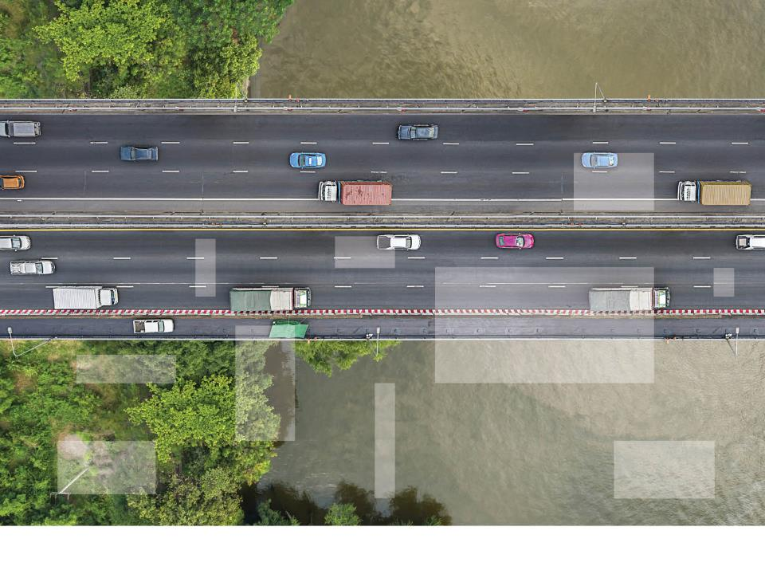
Predictive Modeling Applications for Life Insurers
A presentation to Middle Atlantic Actuarial Club
Presented by Kim Steiner
November 5, 2018
© 2018 Willis Towers Watson. All rights reserved. Proprietary and Confidential.

Slide 2
Agenda
1 | Applications
2 | Data
3 | Team Structure
4 | Modeling Methodology
5 | Technology
Notes:
Housekeeping – restrooms, breaks, lunch, questions as we go, etc.

Slide 3
New techniques are needed to derive the most value from historical data
    Limits of traditional analysis
      Changes in exposure
      Changes in underwriting or pricing
      Interactions of factors
    Benefits of predictive analytics
      More granular risk assessment
      Variation by certain characteristics
      Better predictions when mix of business changes

Slide 4
Use of Predictive Analytics Varies Materially
Percent of Companies Using Predictive Analytics Now vs. Within 2 Years
Amount of Premium | Over $3 billion |  | $1 billion - $3 billion |  | less than $1 billion
Line of Business | Now | In two years | Now | In two years | Now | In two years
Individual life insurance | 70% | 90% | 50% | 75% | 53% | 89%
Group insurance | 71% | 100% | 67% | 100% | 23% | 46%
Retail individual annuities | 71% | 71% | 13% | 38% | 18% | 32%
Institutional annuities | 50% | 83% | 50% | 75% | 11% | 33%
Individual health | 40% | 80% | 20% | 40% | 15% | 38%
<20% | 20%-39% | 40%-59% | 60%-79% | 80%+
Base: Those who sell or have in-force business on the books (n varies).

Slide 5

Applications

Slide 6
Applications of Advanced Analytics to Insurance
    Next best action determination (sales, servicing, claims)
    Real time tailored offers based on customer
    profile
    Persistency analysis and management
    Campaign optimization
    Personalized customer experience
Real Time
Decision
Making
Customer Analytics
Quotes
Analytics
    Leads value analysis
    Resource allocation / optimization per sales channel
    Workforce assurance
    and forecast
    Workforce allocation, and resource optimization
Workforce Analytics
DATA
Fraud Analytics
Underwriting Analytics
    Streamlined Underwriting
    Risk selection optimization
    Mortality / Profitability assessment
    Fraud detection / investigation
Claims Analytics
    Claim triage optimization
    Claims performance analysis

Slide 7
Life Insurance – Experience Studies
Predictive modeling will continue to improve quantification of cost
Mortality
Morbidity
Loss Ratio
      Lapse Rate
    This is done by more granularly assessing the impact of policyholder characteristics that may be difficult to quantify using traditional analysis. Examples of factors include:
      Face amount band
      Risk class
      Application questions
    This may significantly increase the number of factors used in the pricing of new products and granularity of pricing differentials (reducing risk to anti-selection)
    This also provides improved confidence in setting in-force assumptions allowing for more informed in-force management
      Distribution channel
      Prescription drug history
      Wear-off

Slide 8
Use of predictive analytics for mortality and morbidity is most prominent in annuities, but significant growth is expected in individual life insurance
Now | In two years | Growth
55% | 91% | 65%
40% | 73% | 83%
28% | 64% | 129%
23% | 75% | 226%
19% | 56% | 195%
Base: Those currently using or planning to use predictive analytics in at least one line of business (n varies).
Notes:
Surprising how much predictive analytics used for mortality in annuities

Slide 9
Life Insurance - Customer Behavior
Existing Policies
Assess potential behavior
Lapse
Premium payment
Loan
Assess event that could trigger behavior
Credited rate changes
Premium increases on term
Change in interest rates
Life event change
COI or load changes
Behavior Related to New Policies
Can incorporate learnings on in-force policies into pricing
Determine how changes in premium can impact the level of sales and the mix of business written
In order to quantify, will need ability to collect information related to sales when premiums / charges have changed
Term may be the first mover in this space

Slide 10
Use is growing across all products
Now | In two years | Growth
60% | 87% | 45%
36% | 64% | 78%
32% | 72% | 125%
28% | 64% | 129%
25% | 69% | 176%
Base: Those currently using or planning to use predictive analytics in at least one line of business (n varies).
Notes:
32% of individual life is a surprise

Slide 11
Life Insurance – Accelerated Underwriting
    No one is happy with the historic approach
      Expensive
      Slow, many drop out
      Invasive tests are a negative for customers
    Growing use of predictive models
      Streamline the process
      Fit models that predict the underwriting class
      Use external data to replace invasive tests

Slide 12
Use of predictive analytics for underwriting is highest in individual life, but is growing in other lines
Now | In two years | Growth
52% | 92% | 77%
44% | 63% | 43%
27% | 73% | 170%
25% | 56% | 124%
Base: Those currently using or planning to use predictive analytics in at least one line of business (n varies).

Slide 13
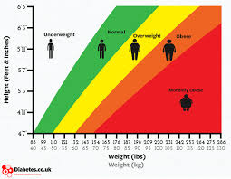

Life Insurance – Advanced Analytics
    As a further example of innovation, models have been developed that use a selfie...
    … to estimate BMI (Body Mass Index)!

Slide 14
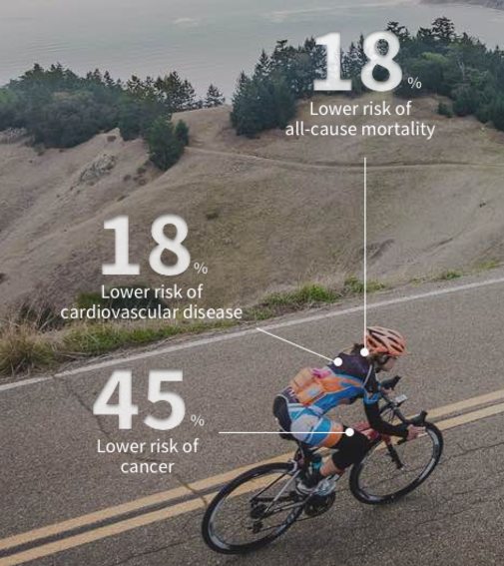
Life Insurance – Wearables
    Some life insurance companies have begun to offer discounts
    Not based on rigorous statistical models
    Potentially used more broadly once a sufficient volume of data has been collected
Notes:
Some life insurance companies have begun to offer discounts for clients able to demonstrate a certain amount/intensity of physical activity
Based on heuristic studies rather than rigorous statistical models
Potentially used more broadly once a sufficient volume of data has been collected

Slide 15
Limited use of wearables currently, but growth is expected in individual life and health
Now | In two years
5% | 42%
4% | 17%
0% | %
0% | %
0% | %
Base: Those currently using or planning to use predictive analytics in at least one line of business (n varies).
Notes:
Interesting – so many not planning to use wearables
Not enough data to link wearable data to mortality
John Hancock using wearables to engage customers

Slide 16

Data

Slide 17
Uses of Predictive Modeling and Big Data
Loyalty Reward Programs
Manufacturing
Marketing
    Airlines, hotels, credit cards, on-line travel
    Expanding beyond liability estimation
    into deeper understanding of cost drivers and even liability optimization
    Adjusted prices based on demand
    Amazon, Google, Wal-Mart
Hospitals & Universities
Oil & Gas
    Workforce analytics
    Used to design health, safety, wellness programs
    Beginning to explore opportunities in forecasting planned giving
Notes:
All things TW has worked on except last one
Loyalty – initially to calculate liabilities – what is the cost? Probably that will use – when are you going to use? Now moving beyond to include marketing and customer interaction
could add entertainment – casinos looking to see who is most profitable customers
House of cards on netflicks was derived using predictive analytics – characteristics of shows that drive people to like it
Oil & Gas – workforce analytics, metrics to gauge their performance, initially on health & wellness, but now into more general productivity
Manufacturing – price optimization
Hospitals & universities – forecasting planned giving – what characteristics make alumni more or less willing to give money
Marketing – eerie offerings that get in form of video that show up on screen, early days amazon did customized pricing, now focus is on customizing experience for consumer, putting resources in right places

Slide 18
Big Data within the Insurance Industry
A favorable environment | The right skills | Some hurdles to overcome
Data intensive Segmentation and automated algorithms | Leading analytical talents Actuaries have a very good profile to become Big Data scientists | Change of mind-set An evolution of IT is required
Notes:
FAA can analyze flight data
Taxes – most likely to cheat – where to focus audit resources
Insurers have a lot of data, good skills including actuaries
Hurdles – more traditional, don’t really think outside the box, IT systems to support data format

Slide 19

Explosion in Internal and External Data Assets
Insurance Company data
Public and Pooled data
    Policyholder characteristics: age, gender,
    marital status, tenure etc.
    Policy level: face amount,
    risk class, product etc.
    MIB: results from prior insurance applications
    MVR: motor vehicle records, citations, crash data
    Fraud: Identify check
Modeling Data
    Pharmacy: flags for
    medication use, dosage,
    frequency
    Lab test: cholesterol, drug
    testing
    Attending Physician Statement:
    current conditions, historical
    record
    Geo-demographic data
    Credit attributes
    Social Media
    Derived characteristics
3rd Party, Medical
3rd Party, Misc.

Slide 20
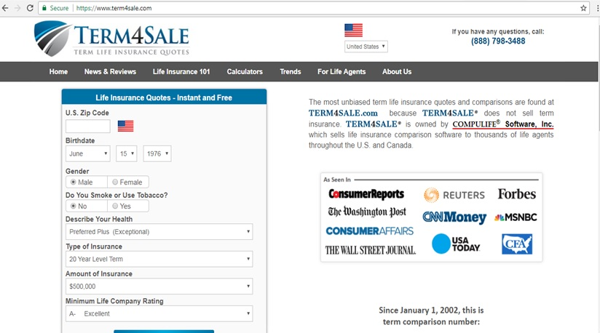
Competitor Price Information can be Useful
    Determine competitive rank at a granular level

Slide 21
Available competitor price information may be challenging to use
    Sources of this information include
      Web-scraping (issues with receiving junk)
      Third party providers
    Issues related to competitor price information
      Access to this information depends strongly on the market
      Hard to compare prices for complex product designs
      May be possible to extrapolate simple rates from a sample

Slide 22
Unstructured data may prove to be valuable assets for insurers
    Definition: Data that is not organized in a pre-defined matter (i.e., nicely formatted columns)
    Types: freeform text, audio recordings, and images
    Examples:
      Text: attending physician statements
      Audio: description of conditions giving in a tele-interview
      Images: images of submitted applications or selfies

Slide 23
Considerations related to use of data
    Questions about data
      Is it reliable?
      Is it complete?
      Is it more predictive than other sources?
      Will is be available when and where you need it in future?
Notes:
The answers to these questions may not be obvious, and may change over time

Slide 24

Team Structure

Slide 25
Do you believe actuaries or data scientists are more equipped to handle predictive analytics at your company, based on the following characteristics?
Base: Those currently using predictive analytics in at least one line of business (n = 30).

Slide 26
What do companies use?
%
Data science
Domain experts
Notes:
CM: as we decide what to use where, it’s important to engage expertise from both the data science community and domain experts. BTW – since I’m addressing a room that I expect is mostly actuaries, you may find yourself on one of both sides of this see saw.

Slide 27

Lessons Learned from P&C – Strike the right balance
Systematic
Component
Unsystematic
Component
= +
1. Separate the signal from the noise
Response
Variable
Overall mean
Best Models
One parameter per observation
2. Balance predictive
and explanatory
effects
Underfit:
Predictive
Poor explanatory power
Model Complexity
Overfit:
Poor predictive power
Explains history
    The risk in not using big data is to miss signal whereas
    the risk in using big data is to highlight the noise
Notes:
The goal is to produce an analysis that explains recent historical experience and is predictive of future experience

Slide 28
It’s domain expertise that helps decide
%
Data science
Domain experts
Notes:
CM: But given the range of evaluation criteria (beyond simply predictive power) I’d have to tip the scale to the domain experts to ensure all requirements of a method are being considered. This is the end of the context section of our agenda … let’s now start exploring some of the individual ML methods.

Slide 29

Modeling Methodology

Slide 30
Is it really all about the method?
The problem dimension
Original problem, solved with original methods
Newly defined problem, solved with original methods
The method dimension
Original problem, solved with new techniques
Newly defined problem, solved with new techniques
Notes:
CM: but is it really all about the method? You can think about solving original problems using original methods … and then maybe exploring those same problems with new methods. We refer to this as moving across the method dimension. But what about the problem dimension? You can use traditional methods to solve new problems or solve new problems using new methods.
KS: Life example –
Original problem: How do I put customers into different risk classes?
Original method: Use protective value studies using various medical tests to determine the impact on mortality.
Newer problem: How do I put customers in the same risk classes with less information?
New method: Use predictive models to predict the underwriter decision.
The next question: How do I charge the appropriate price for each customer using all available information?
Future Method: use predictive models to determine an algorithm that estimates mortality at a more granular level

Slide 31
Where is the value?
The problem dimension
$
$$
The method dimension
$$
$$$
Notes:
CM: Where is the value? Feels natural that the least amount of value added is with old methods and old problems. And the most amount of value is new problems with new methods
KS: Point – it would be difficult to solve the new problem without new method (i.e., predictive analytics?)

Slide 32
It’s not really a 2 x 2, more a continuous spectrum
Increasing thought about
redefining the problem
Increasing range of methods
Notes:
CM: in reality this is not a 2x2 problem – it’s a continuous spectrum. There is continuous value added whenever we increase our thought about redefining the problem or learn about new methods

Slide 33
The problem dimension
The problem dimension
Original problem, solved with original methods
Newly defined problem, solved with original methods
The method dimension
Original problem, solved with new techniques
Newly defined problem, solved with new techniques
Notes:
CM: First let’s discuss the problem dimension

Slide 34
Choosing a method
Predictive power
Dimensions of choice
Analytical time and effort
Interpretation
Method
Execution speed
Table
implementation
Stability
Notes:
Graham – is this animation right? It’s shows 1) purple and 2) all else?
CM: There are several criteria to consider when evaluating a method.
-How well do we need to be able to interpret results – i.e., how transparent? (mgt, agents, regulators, customers)
-Do we require a table-based solution for deployment? (many rating engines are set up this way)
-How important is model stability?
-and what about speed – both in terms of time to perform the analysis (relative to predictive power needed and delivered) and time to process the model (say – at point of sale)
- The predictive power of a method is clearly an important consideration, but sometimes the most predictive methods involve a lot of time and effort to get up and running and can be difficult to implement quickly.
- This is typically more worthwhile in risk modeling exercises where having the slightest predictive edge can be the difference between accessing a profitable untapped segment or getting hurt by anti-selection.
- In many retail pricing applications, we are constantly trying to hit a moving a target and we need to extract fast, actionable insights.
- This means we need interpretable results and low analytical time and effort costs.
- If we want to use the models we fit as part of a live rating environment, we need prediction routines that execute quickly and often that can be implemented in table form.
- If we are refitting our models on a frequent basis, we may want the results to be stable to random permutations of the input data and only change significantly when the underlying effects change.

Slide 35
A summary…

Slide 36
GLM techniques are by far the most popular currently
 | Underwriting (case-level or medical) (n = 31) | Pricing/ Rate setting (n = 25) | Experience analysis: mortality/ morbidity (n = 31) | Experience analysis: policyholder behavior (n = 32) | Marketing/Lead generation/ Targeting customers (n = 27) | Claim management (n = 18) | in-force management (e.g., cross selling) (n = 24) | Agent selection (n = 18)
One-way analyses | 55% | 52% | 45% | 47% | 59% | 61% | 67% | 44%
Decision trees | 52% | 32% | 19% | 38% | 56% | 39% | 38% | 39%
Generalized additive models (GAMs) | 16% | 32% | 23% | 16% | 19% | 17% | 8% | 22%
Generalized linear models (GLMs) | 58% | 68% | 74% | 69% | 63% | 56% | 63% | 61%
Gradient boosting machines (GBMs) | 23% | 28% | 13% | 22% | 37% | 22% | 25% | 28%
Random forests (RF) | 42% | 28% | 23% | 28% | 48% | 11% | 29% | 33%
Penalized regression methods (e.g., lasso, ridge, elastic net) | 26% | 32% | 16% | 22% | 30% | 28% | 17% | 28%
Neural networks | 32% | 24% | 10% | 9% | 26% | 22% | 25% | 28%
Support vector machines | 13% | 12% | 3% | 3% | 11% | 6% | 17% | 22%
Model combining methods (e.g., stacking, blending) | 45% | 32% | 19% | 22% | 44% | 33% | 21% | 28%
<20% | 20%-39% | 40%-59% | 60%-79% | 80%+
Base: Those currently using or planning to use predictive analytics in at least one line of business (n varies).
Notes:
Color code or heat map to contrast high vs low percentages

Slide 37

Technology

Slide 38








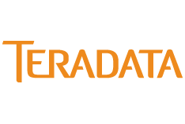






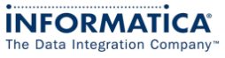
Big data requires an evolution of the current technology paradigm
Data
Treatment/Modelling
Analysis
Data
Sources
Data
Cleansing/Enrichment
Data “Repositories”
Front-end
Analytics
Business
Functions
Volume
Data
Mining
Velocity
Variety
Data
Visualization
ILLUSTRATIVE example
BIG DATA
Reporting
Structured Query language-
Structured / relational
ETL
Data-warehouse
Data-marts
Exploitation of big data requires an evolution of the current technology estate to tackle variety, volume and velocity

Slide 39
Many companies use more than one tool in their predictive analytics work
Base: Those currently using or planning to use predictive analytics in at least one line of business (n = 45).
Notes:
Interesting

