Slide 1
Overview of US Retirement Income after 40 years of ERISA
(or what happened to the 3 legged stool)

Slide 2
3 LEGGED STOOL?
THE HISTORY OF RETIREMENT INCOME IN THE 40 YEARS OF ERISA
OR
WHAT HAPPENED TO THE

Slide 3
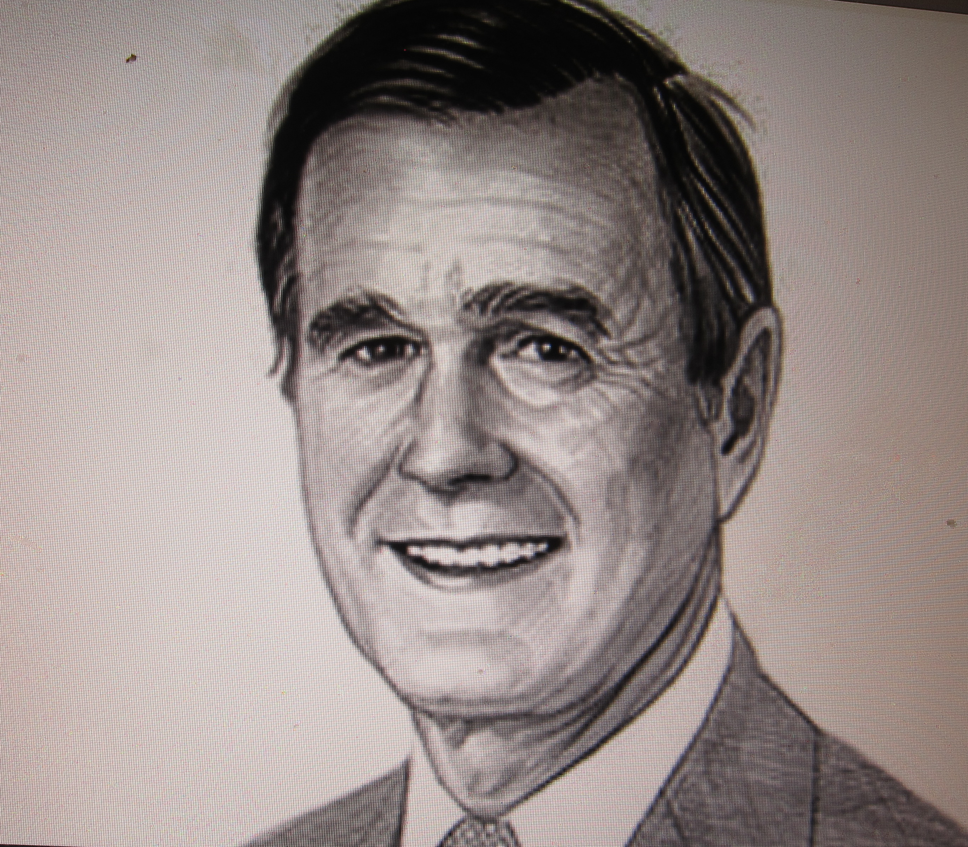
WHAT HAPPENED?
Notes:
Innovative products /
Ads. /
loans-instant bad creit/
Double digit health care inflation
Non-profit CEO & Accountant 2005
1.06^N - - > 50% GDP = Health care . - - last 3or 4 yrs very low & none
Graded assumption 10% to 5% over 10 yrs CPI = 4%
Declining interest rates
Not always good asset return
“Interest rates can’t keep going down”
Medical Science miracles
Everyone deserves them
Air evacuation/ artificial heart/ new knees & hips / dialysis/ exercise & diet
Decline in mortality Faster & than expected
Rising cost of dying but right to life and no right to death
Full prisons / “Law & Disorder”
Lack of funding for public education high school & college & TECHNICAL SCHOOLS
www.gearup.org
Backwards tax code
Not graduated / graduated backwards
level tax rates
No minimum tax
Loop holes - need tax deductions
- super tax deductions [wages – etc.] against minimum
-tax credits (50% tax credit/ 50% tax deduction)
10 year / 20 year federal budget
Financing of elections
2 party system - be careful – playoffs all in
David Duke/ Roemer/Edwards / round robin if > 20% / then if > 30% mechanism to avoid splitting the vote
Clinton/ Trump
Gerrymandering
Rank 1 – 20
Add 2 factors on top of list
Report top 10 in next session

Slide 4
WHAT HAPPENED?
George H W Bush summarized . . .
  “No New Taxes”
Jerry Brown . . .
  an age of “spend now and worry about it later.”
Notes:
Innovative products /
Ads. /
loans-instant bad creit/
Double digit health care inflation
Non-profit CEO & Accountant 2005
1.06^N - - > 50% GDP = Health care . - - last 3or 4 yrs very low & none
Graded assumption 10% to 5% over 10 yrs CPI = 4%
Declining interest rates
Not always good asset return
“Interest rates can’t keep going down”
Medical Science miracles
Everyone deserves them
Air evacuation/ artificial heart/ new knees & hips / dialysis/ exercise & diet
Decline in mortality Faster & than expected
Rising cost of dying but right to life and no right to death
Full prisons / “Law & Disorder”
Lack of funding for public education high school & college & TECHNICAL SCHOOLS
www.gearup.org
Backwards tax code
Not graduated / graduated backwards
level tax rates
No minimum tax
Loop holes - need tax deductions
- super tax deductions [wages – etc.] against minimum
-tax credits (50% tax credit/ 50% tax deduction)
10 year / 20 year federal budget
Financing of elections
2 party system - be careful – playoffs all in
David Duke/ Roemer/Edwards / round robin if > 20% / then if > 30% mechanism to avoid splitting the vote
Clinton/ Trump
Gerrymandering
Rank 1 – 20
Add 2 factors on top of list
Report top 10 in next session

Slide 5
Overview of Retirement Income History
Military Retirement 1636 - - Plymouth: military retirement program; (Blue State from the start?)
Profit Sharing 1797- - Gallatin Glassworks’ profit-sharing plan
Pension 1875 - - American Express Company’s

Slide 6
Overview of Retirement Income History (cont.)
LEG 1 – Employer Provided Pension
1875 - - American Express Company

Slide 7
Overview of Retirement Income History (cont.)
1921, 1923, 1925 Tax Incentives
GRADUATED INCOME TAX without endless loop holes

Slide 8
Overview of Retirement Income History (cont.)
LEG 1 – Employer Provided Pension
Deductibility - -
1921- income=tax free to Stock Bonus & P Share &’26 Pensions
1928 – Tax deductible pre-funding

Slide 9
Overview of Retirement Income History (cont.)
Health 1910 - - Montgomery Ward’s group health, life, and accident insurance program
Hospitalization 1929 - - Baylor University Hospital’s formalized prepaid group hospitalization plan in 1929
Fed. Gov’t provided retirement coverage 1935 - - Social Security

Slide 10
Overview of Retirement Income History (cont.)
Fed. Gov’t provided retirement coverage
1935 - - Social Security

Slide 11
Overview of Retirement Income History (cont.)
Brief History - From EBRI Data Book see EBRI.ORG
A Brief History of Benefit Plans - since colonial times
(See EBRI Data book Chapter 1, and McGill, Brown, (Grubbs), Haley & Schieber updated 2005
&other sources to follow

Slide 12
Overview of Retirement Income History (cont.)
Crash 1929 & Depression 1929 – 1940
FDR
Hitler, Musollini & Stalin & WWII
1936 Olympics – Jesse Owens & Jim Thorpe
Move to cities & increase in availability of cars

Slide 13
Overview of Retirement Income History (cont.)
Health 1910 - - Montgomery Ward’s group health, life, and accident insurance program
Hospitalization 1929 - - Baylor University Hospital’s formalized prepaid group hospitalization plan in 1929
Fed. Gov’t provided retirement coverage 1935 - - Social Security

Slide 14
Overview of Retirement Income History (cont.)
2nd LEG - Fed. gov’t provided retirement coverage
1935 - - Social Security

Slide 15

Overview of Retirement Income History (cont.)
1935

Slide 16
Overview of Retirement Income History (cont.)
Fed. Gov’t provided retirement coverage 1935 - - Social Security
Fed. Gov’t Disability Coverage 1956 - - income protection for disabled workers and their dependents
Fed. Gov’t 1965, added health insurance for the elderly and disabled under the Medicare program.

Slide 17
Overview of Retirement Income History (cont.)
PRE ERISA
Survival of Depression
WW II - Cooked the economy
Babby Boomers
Home ownership
1945 – 1970 strong economy

Slide 18
A LOOK AT EVENTS & FACTORS-1960 to 1964
President/VP Kennedy/Johnson
Congress D but many ”Southern Democrats” (now R)
30 Year Mortgage =5%?; CPI = 4%? GNP $3.8 Trillion
Events – Missile crisis & Nov. 1963 Assassination of Kennedy
Integration of schools begun with turmoil
The Beach Boys, Ann Margaret, Elvis & the Beetles
Benefits issues Studebaker - Mobility, Individual policy pension trusts

Slide 19

A LOOK AT EVENTS & FACTORS-1952 to 1963

Slide 20
Overview of Retirement Income History (cont.)
1963 Studebaker terminated its employee pension plan
more than 4,000 auto workers at its automobile plant in South Bend, Indiana, lost some or all of their promised pension plan benefits.

Slide 21
A LOOK AT EVENTS & FACTORS-1965 to 1969
President/VP Johnson/Humphries (D)
Congress D but many ”Southern Democrats” (now R)
30 Year Mortgage =6%?; CPI = 1%? ; GNP $4.7 Trillion
Events – Vietnam, Protests begin,
      “ban the bomb “, ( Gitlin to Berkley & later occupy Wall Street) – “Toad” Gitlin - Dick Amberg Wash Times;
      - Assasinaions B Kennedy & MLK Jr.
Benefits issues AAA & ASPA;
    Private Pension Consulting; - see Wyatt et al, 1945
    Medicare,
    Union Plans strong, triannual negotiations

Slide 22
A LOOK AT EVENTS & FACTORS-1969 to 1973
President/VP Nixon/Agnew-Ford-Rockefeller
Congress D 241/433;& 56/99 but many ”Southern Democrats” (now R)
30 Year Mortgage =8%;? CPI ~= 7+%?; GNP $5.5 Trillion
Events Protest & getting out of Vietnam; Watergate; Trump & Bernie Madoff starting; gas & milk crises
Benefits issues Pre- ERISA ! - Watergate & Viet Nam overpowered

Slide 23
THE 1970’S
NIXON/AGNEW
VIET NAM / WATERGATE
FORD /ROCKEFELLER
1974 FORD SIGNED ERISA EFFECTIVE 1976
TRA 78 401 (k) ADDED TO IRS CODE
1979 Carter Exec. Order: President’s Commission on Pension Policy

Slide 24
A LOOK AT EVENTS & FACTORS-1973 to 1977
President/VP Ford/Rockefeller
30 Year T-bond= 8%; CPI = 9%; GNP $5.5Trillion to $6.0
Events Protest & getting out of Vietnam; Watergate; Trump & Bernie Madoff starting; gas & milk crises
Benefits ERISA - Watergate & Viet Nam overpowered

Slide 25
A LOOK AT EVENTS & FACTORS-1977 to 1981
President/VP: Carter/ Mondale (D)
Congress D 292/455;& 61/100, many ”Southern Democrats” (now R)
30 Year Mortgage =8.9%; CPI = 6.8%; GNP $6.0 Trillion to 6.6
Events Vietnam over; Watergate past ; gas prices, Middle East, Hostages in Iran, fall of Sha, Camp David Accords;” hyper” inflation. First TV Remote controls, Cable TV growing, Fox started +/-8 yrs, Superstations starting
Benefits issues: more ERISA regulations! NO GOOD DEED GOES UNPUNISHED.“The deficit” J& S Regs, Pres Commission on Pension Pol.
A&P & others begin merging & stripping pensions

Slide 26
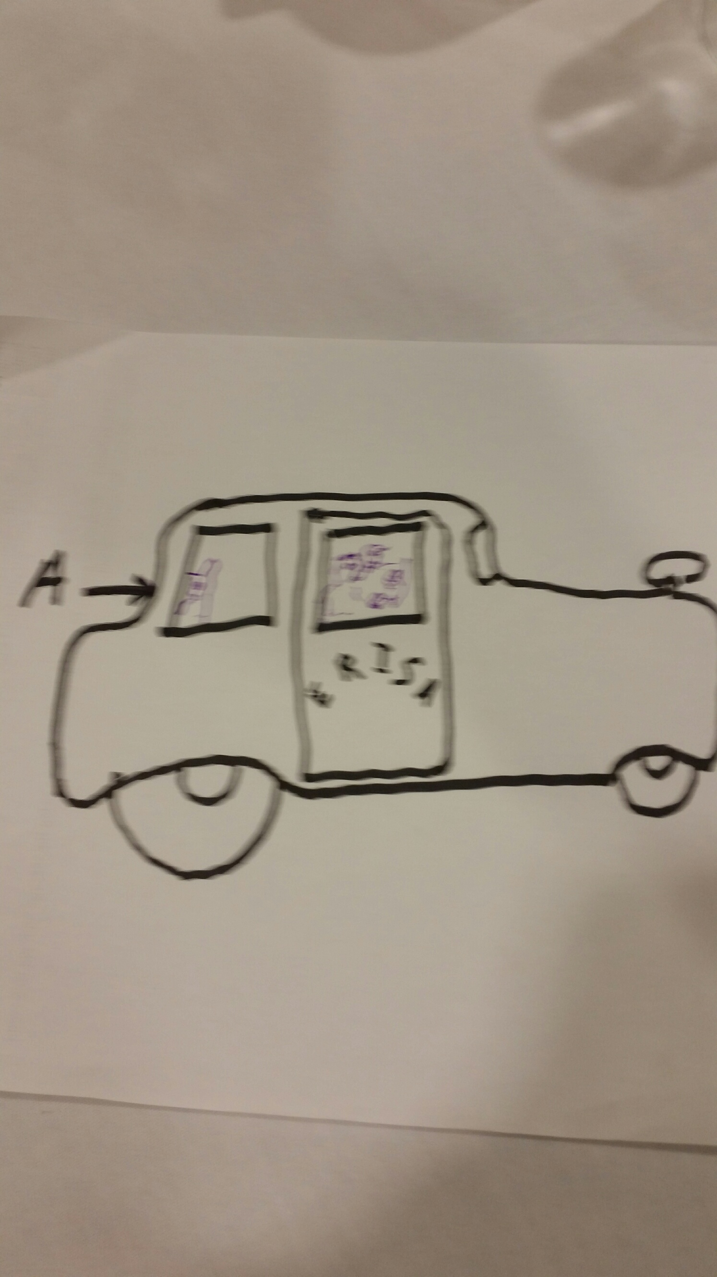
A LOOK AT EVENTS & FACTORS-1976 to 1981
THE ERISA CAR
Retirement
Income Express
Notes:
2 Sets of pedals - Gas & Breaks Accountant giving directions and occasionally pumping the gas or the breaks.
Actuary in Back seat looking out back window telling where to go.
Law maker – can’t see him – asleep in the back - unintented consequences – only wake up to tell us to put breaks on when cruising comfortably down a hill (OBRA ‘87 & MAP21 & amendments)
Passenger passed out because he bumpted his head on a bump in the road (lost his job & spent the lump sum

Slide 27
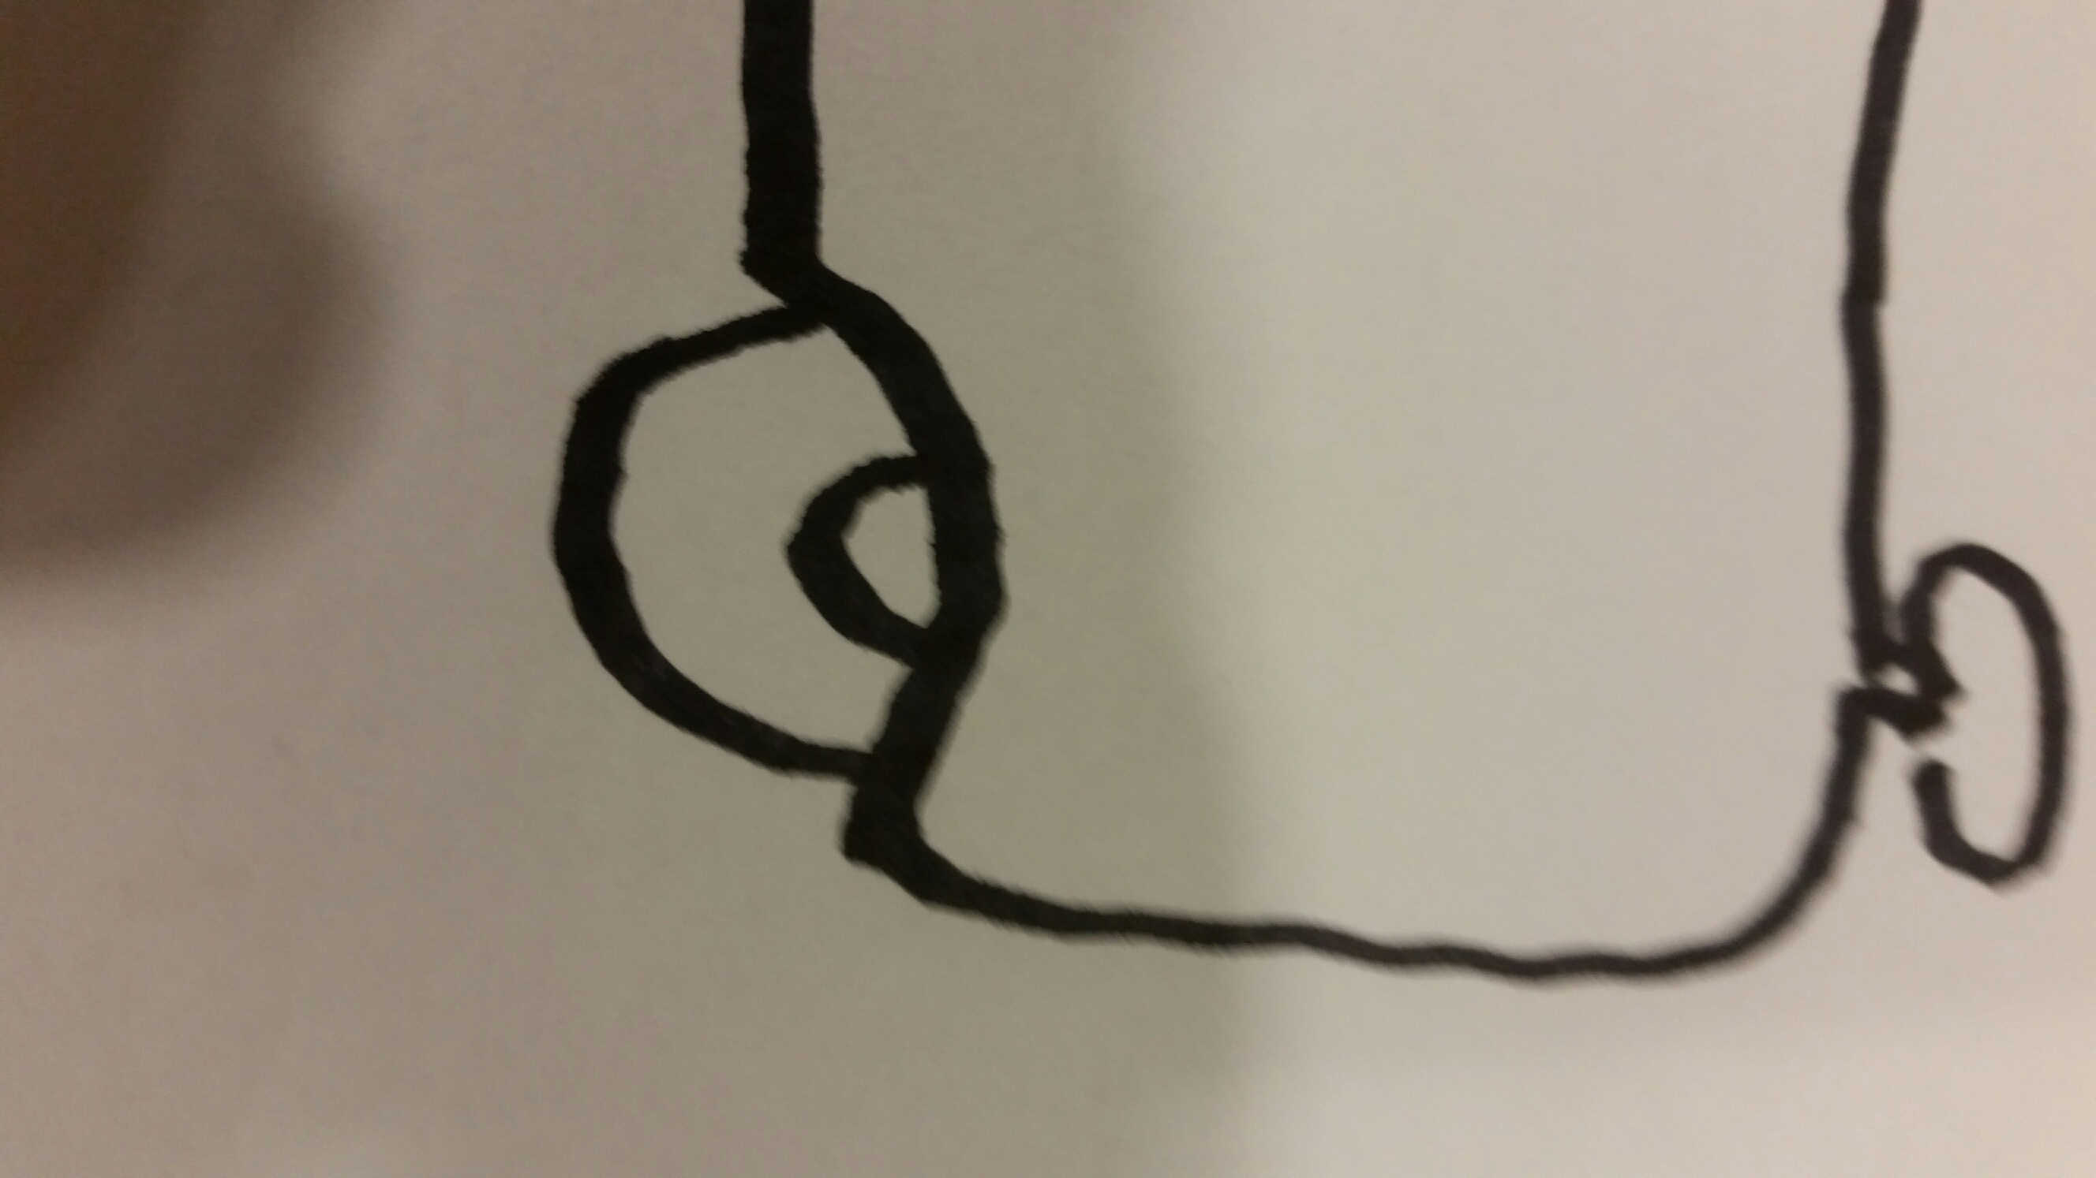
A LOOK AT EVENTS & FACTORS-1976 to 1981
THE ERISA CAR
FRONT
TIRE
Retirement
Income Express
Notes:
2 Sets of pedals - Gas & Breaks Accountant giving directions and occasionally pumping the gas or the breaks.
Actuary in Back seat looking out back window telling where to go.
Law maker – can’t see him – asleep in the back - unintented consequences – only wake up to tell us to put breaks on when cruising comfortably down a hill (OBRA ‘87 & MAP21 & amendments)
Passenger passed out because he bumpted his head on a bump in the road (lost his job & spent the lump sum

Slide 28
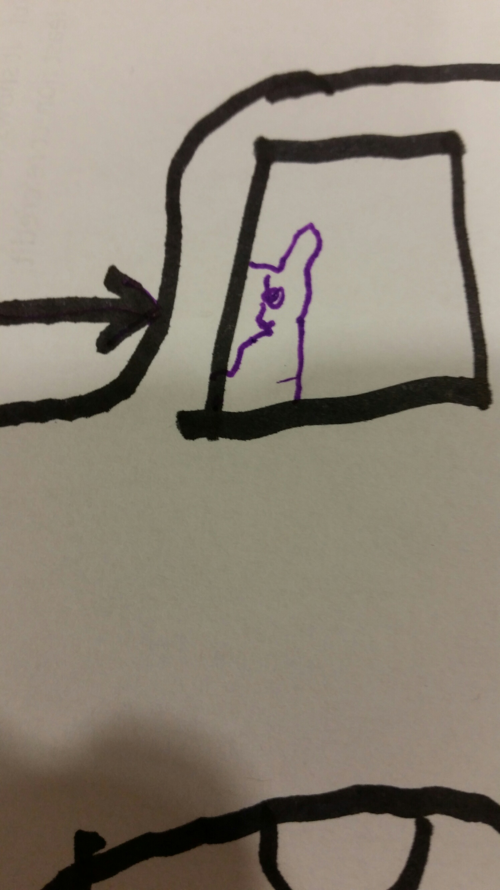
A LOOK AT EVENTS & FACTORS-1976 to 1981
THE ERISA CAR
Actuary
Retirement
Income Express
Notes:
2 Sets of pedals - Gas & Breaks Accountant giving directions and occasionally pumping the gas or the breaks.
Actuary in Back seat looking out back window telling where to go.
Law maker – can’t see him – asleep in the back - unintented consequences – only wake up to tell us to put breaks on when cruising comfortably down a hill (OBRA ‘87 & MAP21 & amendments)
Passenger passed out because he bumpted his head on a bump in the road (lost his job & spent the lump sum

Slide 29
A LOOK AT EVENTS & FACTORS-1976 to 1981
THE ERISA CAR
PASSENGERS
Retirement
Income Express
Notes:
2 Sets of pedals - Gas & Breaks Accountant giving directions and occasionally pumping the gas or the breaks.
Actuary in Back seat looking out back window telling where to go.
Law maker – can’t see him – asleep in the back - unintented consequences – only wake up to tell us to put breaks on when cruising comfortably down a hill (OBRA ‘87 & MAP21 & amendments)
Passenger passed out because he bumpted his head on a bump in the road (lost his job & spent the lump sum

Slide 30
A LOOK AT EVENTS & FACTORS-1976 to 1981
THE ERISA CAR
LATER
Retirement
Income Express
Notes:
2 Sets of pedals - Gas & Breaks Accountant giving directions and occasionally pumping the gas or the breaks.
Actuary in Back seat looking out back window telling where to go.
Law maker – can’t see him – asleep in the back - unintented consequences – only wake up to tell us to put breaks on when cruising comfortably down a hill (OBRA ‘87 & MAP21 & amendments)
Passenger passed out because he bumpted his head on a bump in the road (lost his job & spent the lump sum

Slide 31
Start of THE 1980’S -MUPS
REGAN/ BUSH 1981-1989 Feb 1981 Pres Commission on Pen Pol report
MUPS – Minimum Universal (DC) Pension System
  Min Soc. Sec. Benefit (SSBen) tied to poverty level
  No cash outs < Ret. Age - Mandatory Survivor & Spouse benefits
  Strengthen Soc. Sec. - Increase Soc. Sec. Ret. Age
  Reduce taxes on SSBen - Faster vesting & portability

Slide 32
THE 1980’S
REGAN/ BUSH 1981-1989 Regan Tax cuts
Legislation(legislation, legislation & more legislation)
  IRS Regulations 1980 & 1981 and DoL Regs. 4-40 vesting fight
  1980 MPPAA (Multiemployer Pension Plan Amendment Act of 1981)
  1981 ERTA 81 (Economic Recovery Tax Act of 1981 )
  1982TEFRA (Tax Equity & Fiscal Responsibility Act of 1982) Top Heavy
  1983 Soc. Sec. Amendments
  1984 DEFRA & REA (Deficit Reduction Act & Retirement Equity Act)
  DEFRA “highly compensated” discrimination rules & REA – PRD-J&S rules
  IRS fights 5% interest Assumption

Slide 33
A LOOK AT EVENTS & FACTORS-1981 to 1985
President/VP: Reagan / G H W Bush (R)
97th Congress 244/435(D);& 53/100 (R) ”So.Dem.” (now R)
30 Year T-bonds 12.4% to 11.6%; CPI decline 8.9%to4%; GNP $6.59 Tril’n to 7.71
Events –Iran-Contra hearings;
IRA Cohen “5% not OK” –begin of Small Plan Audit fiasco

Slide 34
A LOOK AT EVENTS & FACTORS-1985 to 1989
President/VP: Reagan / G H W Bush (R)
Congress 253/435(D);& 53/100 (R) some”So.Democrats” (now R)
30 Year T-bonds 11.6% to 9%; CPI 3.8%to4.1%; GNP $7.7 to8.8 Tril’n
Events –Iran-Contra hearings; Middle East, Peristroyka& Glasnose Gorbachov, Berlin Wall down; PC-s&Apple vs Microsoft, rudimentary internet
Benefits issues: TRA86/OBRA87! &regulations for TEFRA,DEFRA, REA not final, Reagan Tax Cuts without benefit cuts, “The deficit”, MUPS ignored, FAS 87&88 & 132 ABO PBO SRV Cst & NPPC

Slide 35
THE 1980’S (cont.)
Yet more Legislation(legislation, legislation & yet more legislation)
  1986 TRA 86 & OBRA 86 (Tax Reform Act & Omnibus Budget Reconciliation Act)
  (major overhaul of Tax Code & ERISA)
  1987 OBRA 87 (Omnibus Budget Reconciliation Act of 1987)
    Deadly New Full Funding Limitation - 15o% of “Current Liability” (CL)
    incorrectly defined CL so 150% of CL< Termination liability
  1988 TAMRA ( Technical & Miscellaneous Revenue Act of 1988)
  1989 OBRA 89 (Omnibus Budget Reconciliation Act of 1989)

Slide 36
THE 1990’S
George HW BUSH 1989-1993 “No new taxes!”
Still more legislation(legislation, legislation & still more legislation)
1990 Omnibus Budget Reconciliation Act of 1990
Older Workers Benefit Protection Act of 1990
1991 The Comprehensive Deposit Insurance Reform and Taxpayer Protection Act of 1991
1992 Unemployment Compensation Amendments of 1992
1993 Pension Benefit Guaranty Corporation (PBGC) Lease Settlements Act of 1993
Omnibus Budget Reconciliation Act of 1993 (OBRA ‘93)
Pension Annuitants Protection Act of 1993

Slide 37
THE 1990’S
SBA Study submitted 1990
“Cost Impact of Regulations on Small vs Large Business Retirement Plans” (Washington, DC, US Small Business Administration, Office of Advocacy, SBA-3058-OA-88, December 1989, James Bell & Associates, Inc. and Lewin/ICF) (JDG Co-author)
Anything OK but not constant change
JDG Explained impact of OBRA Full Funding

Slide 38
A LOOK AT EVENTS & FACTORS-1989 to 1993
President/VP: G H W Bush/ Quale (R)No new taxes!/Darmin OMB
Congress 251/435(D);& 55/100 (D) some”So.Democrats” (now R)
30 Year T-bonds 9% to 7.6%; CPI 4.8%to3%; GNP $8.8to9.7 Tril’n
Events – 1st Gulf War, Peristroyka& Glasnose-Yeltsin, PCs common, some internet; first cell phones in cars;
Benefits issues: regulations for TRA86 not final, Reagan Tax Cuts without benefit cuts &”no new taxes” a problem, “The dah-fah-cit”, <JDG -Trutco-Kennell to SBA = “the Problem is change”> - - [Congress &Jesse James]

Slide 39
Overview of Retirement Income History (cont.)
GROWTH & DECLINE
OF PENSION COVERAGE

Slide 40
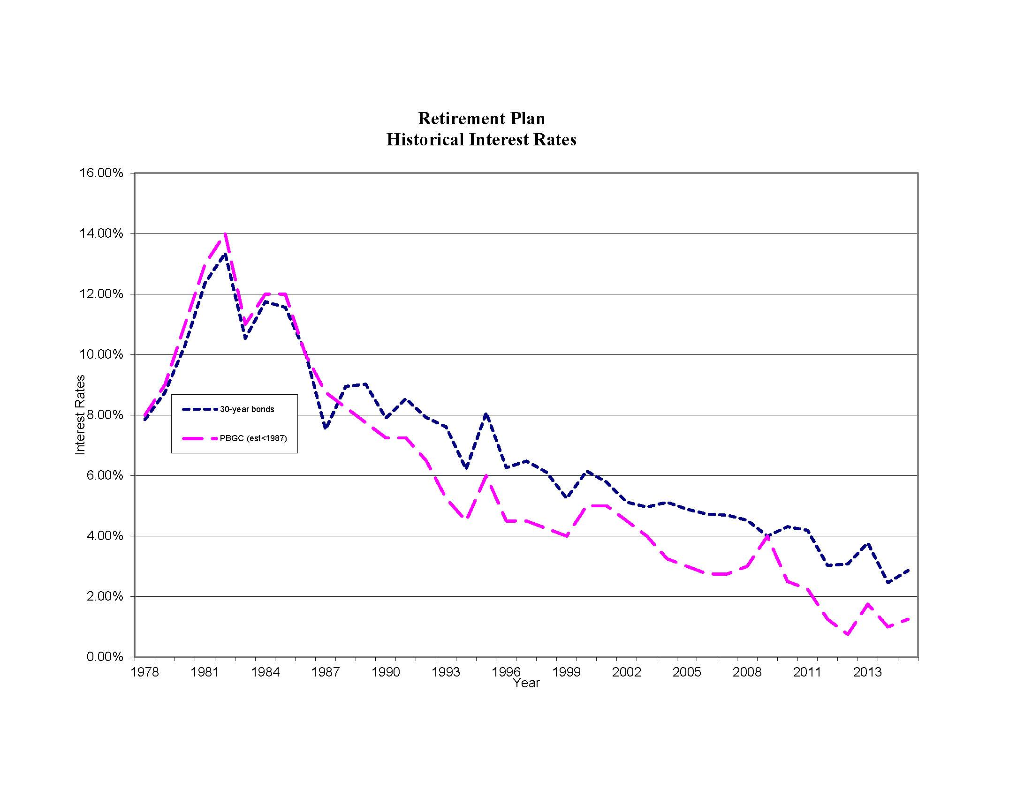
DECLINE in RATES

Slide 41
Overview of Retirement Income History (cont.)

Slide 42
Overview of Retirement Income History (cont.)
GROWTH & DECLINE
OF PENSION COVERAGE
vs GDP & BONDS

Slide 43
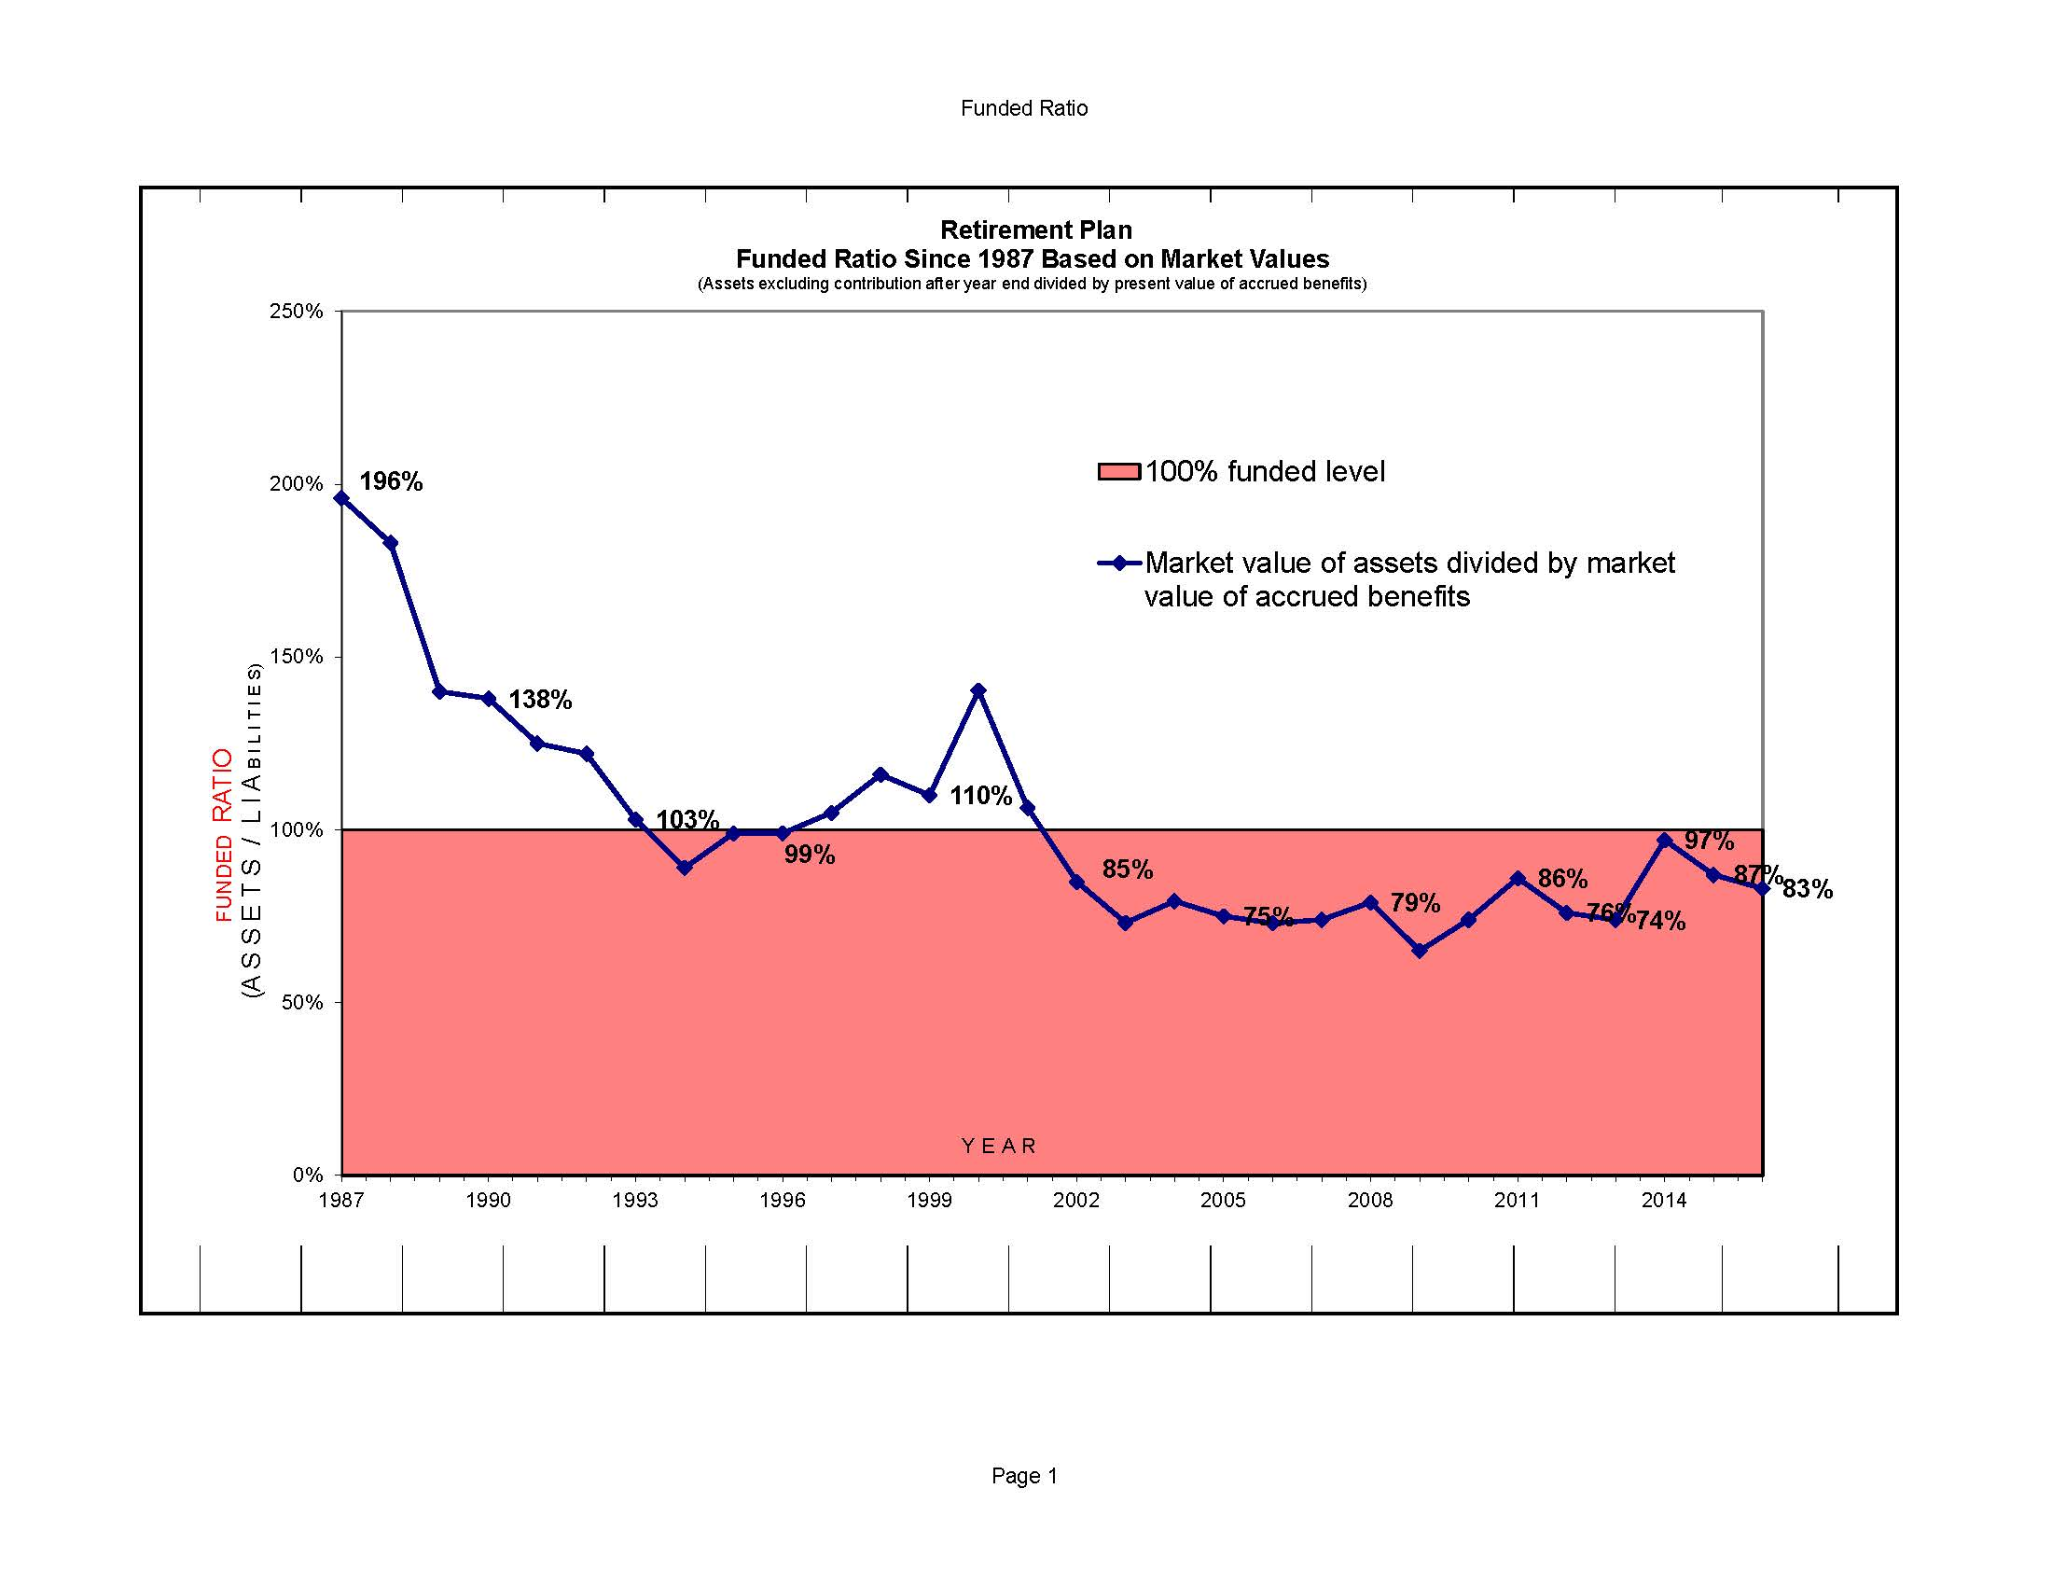
DECLINE in FUNDED LEVEL

Slide 44
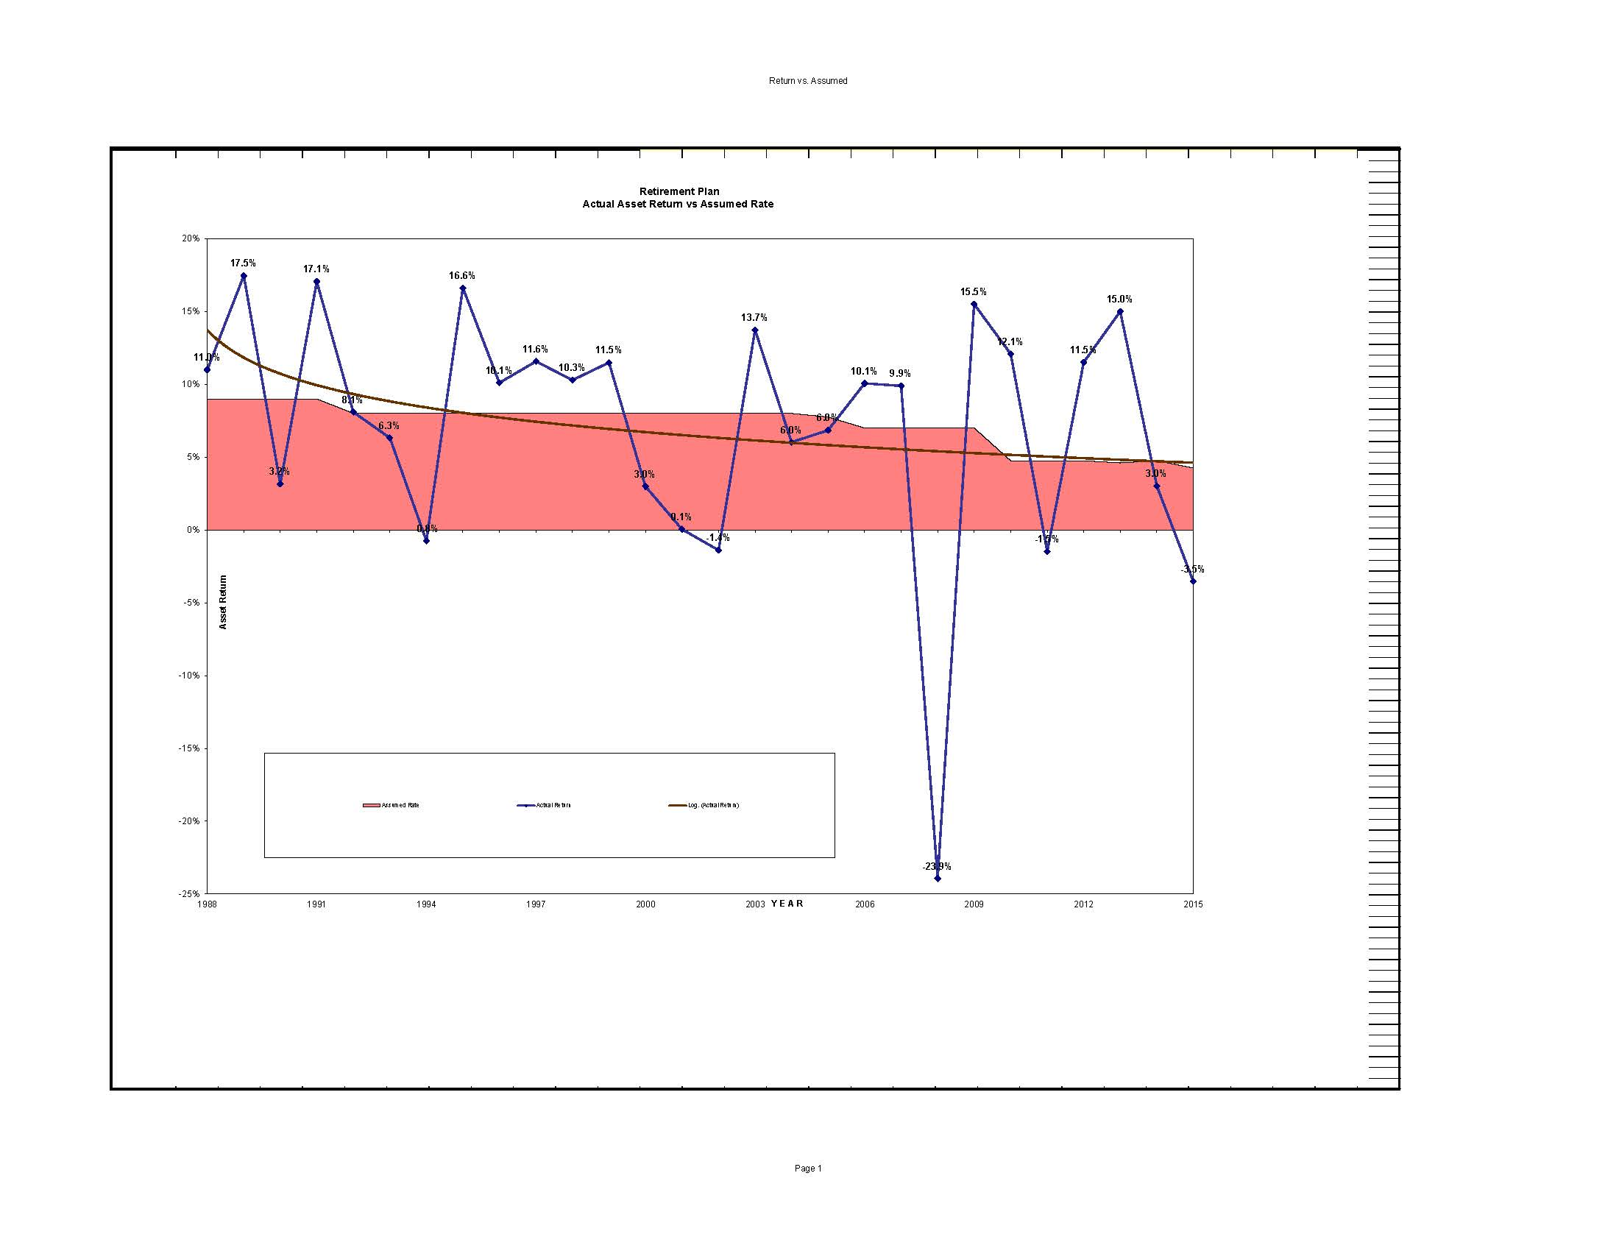
DECLINE in RETURN

Slide 45
THE 1990’S (cont.)
Bill Clinton/Al Gore 1993-2001 <Lewinski Scandal>
1994 USERA Uniformed Services Employment and Reemployment Rights Act of 1994
1994 Social Security Administrative Reform Act of 1994
Bankruptcy Reform Act of 1994
1997 Amendment to title I of the ERISA to clarify treatment of investment mgrs
  SAVER Savings Are Vital to Everyone’s Retirement Act of 1997
  TRA 97 Taxpayer Relief Act of 1997 (TRA 97)
1998 Higher Education Act Amendments

Slide 46
A LOOK AT EVENTS & FACTORS-1993 to 1997
President/VP: Clinton/Gore(D)
Congress103 258/435(D);& 57/100 (D)
Congress104 230/435(R);& 53/100 (D)
30 Year T-bonds 7.6% to 6.5%; CPI 4.8%to3%; GNP $9.65 Tril’n
Events – 1st Gulf War, Peristroyka& Glasnose-Yeltsin, PCs common, some internet; first cell phones in cars;
Benefits issues: regulations for TRA86 not final, Reagan Tax Cuts without benefit cuts &”no new taxes” a problem, “The dah-fah-cit”, MUPS ignored,

Slide 47
A LOOK AT EVENTS & FACTORS-1997 to 2001
President/VP: Clinton/Gore(D)
Congress105 228/435(R);& 55/100 (R) – Newt Gingrich
Congress106 233/435(R);& 55/100 (R)
30 Year T-bonds 6.5% to 5.8; CPI 2.34%to2.8%; GNP $12.71 Tril’n
Events – Glasnose over Yeltsin to Putin Chechnia, PCs & Internet common, first personal cell phones in regular use but not common; Trump multiple bankruptcies, Maddoff Ponzi to light; Lewinski
Benefits issues: “Full Funding”, no agreement on Soc. Sec.; The Newt

Slide 48
Talk in Moscow 1999
Change!

Slide 49


Slide 50
A LOOK AT EVENTS & FACTORS-2001 to 2009
President/VP: G W Bush/Cheney Sept. 11, 2001!
Congress107th 221/435(R);& 50/100 (D)
Congress108th 229/435(R);& 51/100 (R)
Congress109th 232/435(R);& 55/100 (R)
Congress107th 233/435(D);& 49+2/100 (D)
30 Year T-bonds 5.8% to 4%; CPI 2.8%to0%; GNP $12.7 Tril’n to 14.5
Events – 2nd Gulf War, Peristroyka over!-Putin,-dictator stages atrocities, Cell phones & internet become common;
Benefits issues: Double digit health care inflation/ cash balance

Slide 51
A LOOK AT EVENTS & FACTORS- 2016
THE SUV CROSS OVER
DB to Cash Balance
“Simplify” our lives

Slide 52
A LOOK AT EVENTS & FACTORS-2009 to 2017
President/VP: OBama/Biden (D)
Congress 111th 255/435(D); & 56+2/100 (D)
112th 242/435(R); & 50+2/100 (D)
113th 233/433(D); & 53+2/100 (D)
2015 114th 247/435(D); & 54/100 (R)
115th ?/435(D); & ?/100 (R)
30 Year T-bonds 4% to 2.9%; CPI 0%to1.3%; GNP $14.5 Tril’n to 16.5
Events – Cell phones & internet become common take over our lives;
Benefits issues: Cash Balance replaces DB

Slide 53
THE ERISA CAR NOW
Actuary/ lawmaker / Passenger
Driver / Accountant
Notes:
2 Sets of pedals - Gas & Breaks Accountant giving directions and occasionally pumping the gas or the breaks.
Actuary in Back seat looking out back window telling where to go.
Law makers & Regulators – can’t see them – asleep in the back - unintented consequences – only wake up to tell us to put breaks on when cruising comfortably down a hill (OBRA ‘87 & MAP21 & amendments)
Passenger passed out because he bumpted his head on a bump in the road (lost his job & spent the lump sum

Slide 54
new California Secure Choice
Retirement Savings Program
Brown described the program as a “step forward,” especially in an age of “spend now and worry about it later.”
“This is save now and prepare for later,”
State Senate leader Kevin de León (D-Los Angeles), who wrote the bill, called it the “largest expansion of retirement security since the New Deal.”
“This bill is about personal responsibility,” he said. “The retirement insecurity crisis is looming on the near horizon.”

Slide 55
A LOOK AT EVENTS & FACTORS-1981 to 1985
GROWTH & DECLINE
OF PENSION COVERAGE vs GDP & Bonds rates

Slide 56
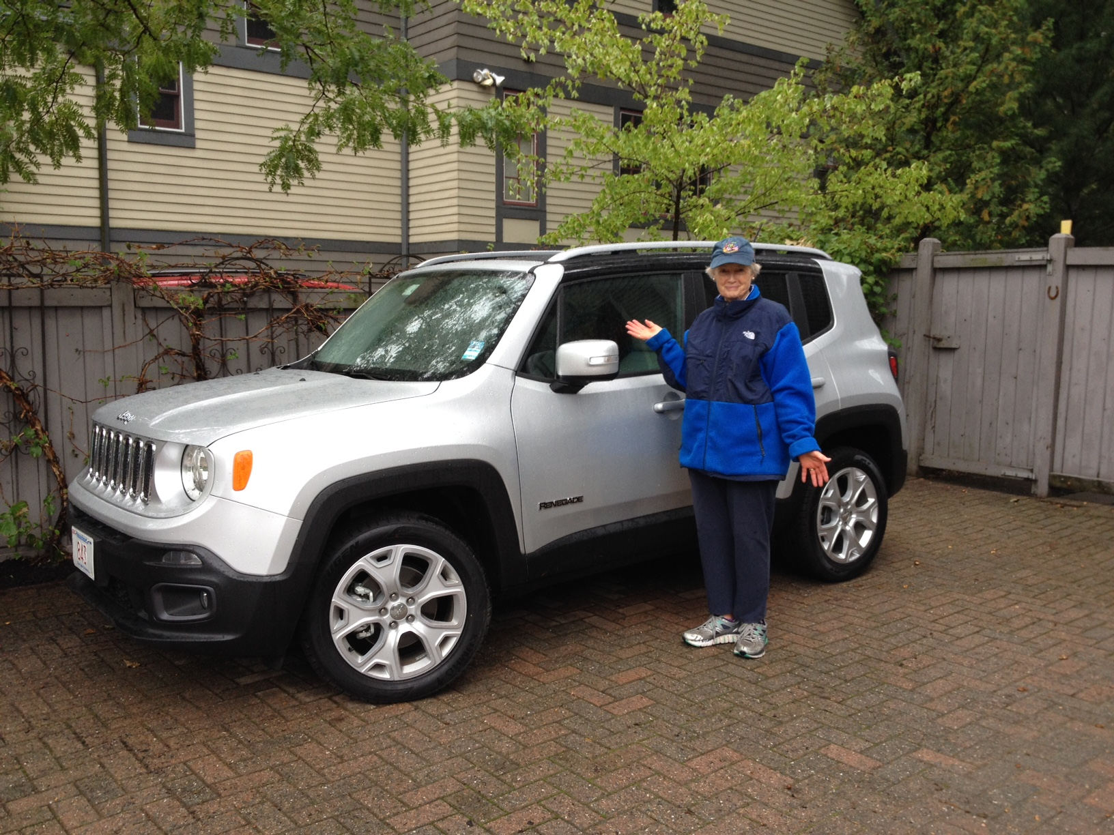
The future of Retirement Income????

Slide 57
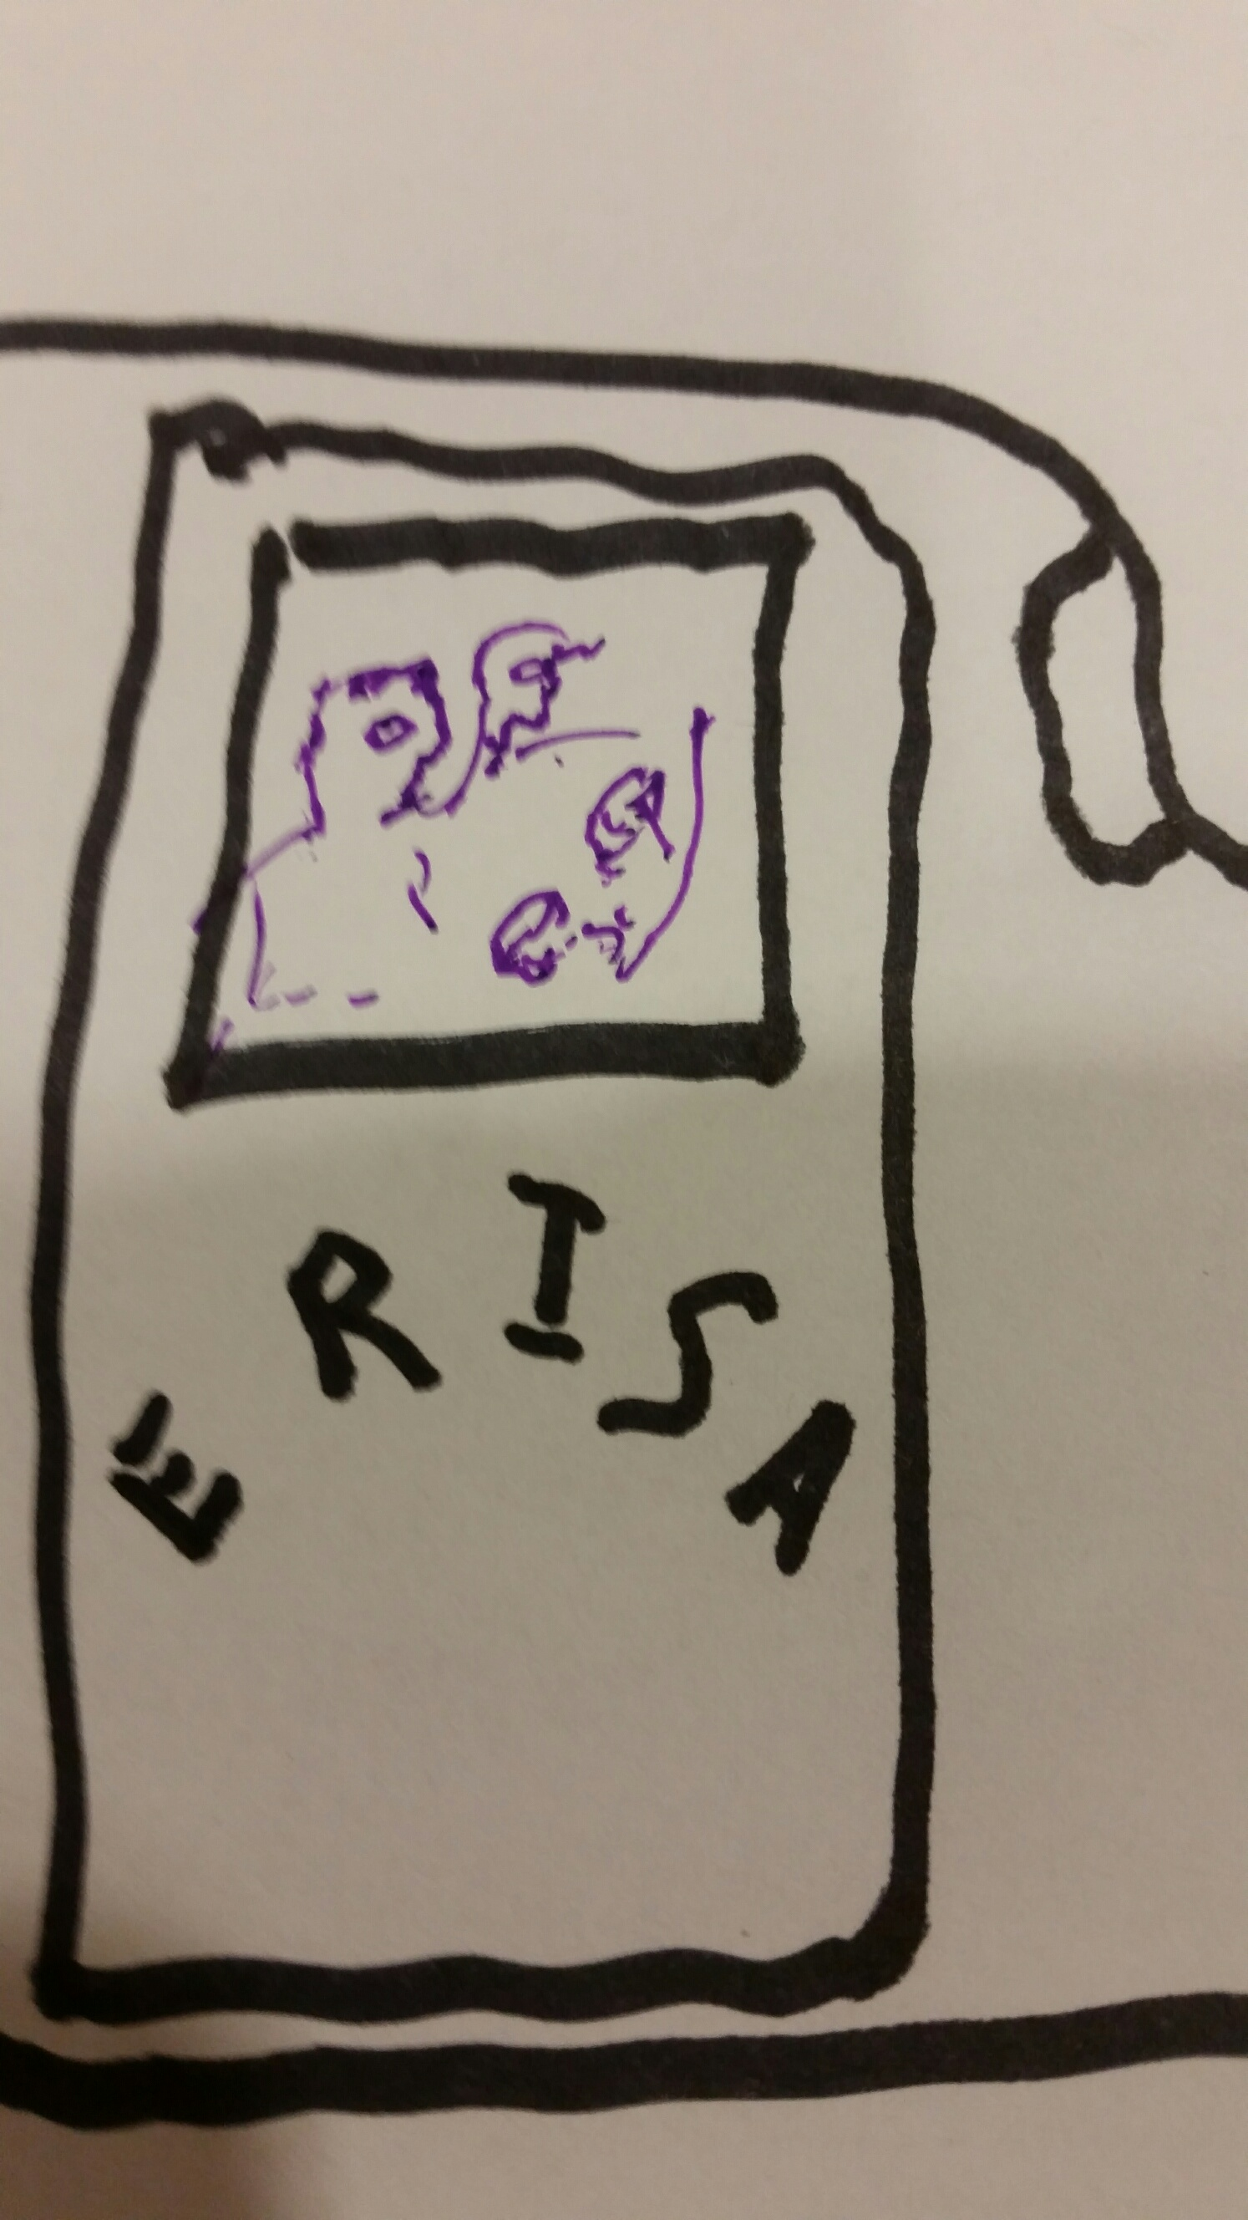
The future of Retirement Income????
FRONT SEAT
BACK SEAT

Slide 58
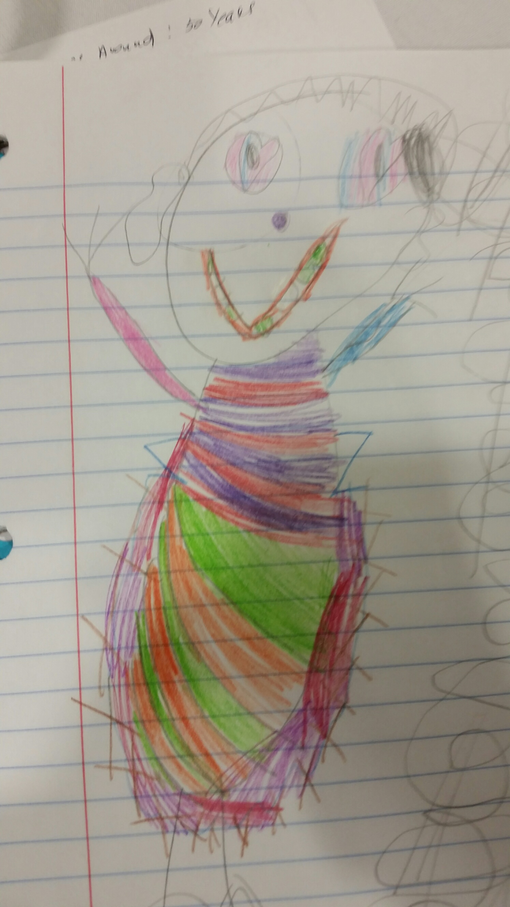
The future of Retirement Income????
AFTER
THE
ELECTION!

