Slide 1
Developments in Actuarial Professionalism in 2016-17 Paul Kollmer-Dorsey, Esq. General Counsel, American Academy of Actuaries
November 8, 2017

Slide 2
Disclaimer
The statements and opinions expressed herein do not constitute legal advice. They are also not definitive interpretations of standards of qualification or practice or discipline matters, except for those that may be publicly available through the Academy’s website and may have been issued by the appropriate board or committee.

Slide 3
The American Academy of Actuaries
The American Academy of Actuaries is a 19,000 member professional association whose mission is to serve the public and the United States actuarial profession.
To accomplish this (among other activities), the Academy provides for the establishment, maintenance, and enforcement of high professional standards of actuarial conduct, qualification, and practice.

Slide 4
Objectives of Today’s Presentation
Review the basic structures and key elements of U.S. actuarial professionalism.
Discuss recent developments in actuarial professionalism.
Identify tools and resources that are available to help actuaries keep up to date on professionalism.

Slide 5
Web of Professionalism: Basis of Self-Regulation
The Code of Professional Conduct
U.S. Qualification Standards (USQS)
Actuarial standards of practice (ASOPs)
Counseling and discipline

Slide 6
Objective of Professionalism
Code of Professional Conduct
U.S. Qualification Standards
Protecting the Public
Actuarial Standards Board
(Actuarial Standards of Practice)
Actuarial Board for Counseling and Discipline
Notes:
The Actuarial Standards Board, and the Standards of Practice that it promulgates, is only one part of a web of professionalism. Creating and maintaining this professionalism infrastructure is at the heart of the Academy’s mission, and the primary reason it was established.
Building this infrastructure was a slow, deliberate process – the Academy spent its first 25 years putting this structure in place.
Before the ASB was created, the Academy issued “Recommendations and Interpretations”. While useful guidance, these were largely created in response to pressures from external entities, e.g. as a response to developments in the accounting profession or the passage of legislation (e.g., ERISA in 1974).
Establishment of the ASB marked an important change in the self-governance of the U.S. actuarial profession from a reactive to a proactive posture in development of standards of practice.
Precept 3 of the Code of Professional Conduct requires actuaries to follow the ASOPs.
Precept 3 also requires actuaries to observe applicable standards of practice outside the U.S.

Slide 7
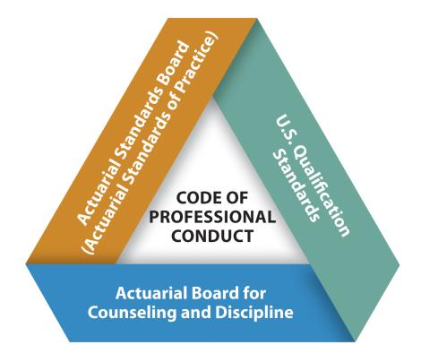
Code of Professional Conduct

Slide 8
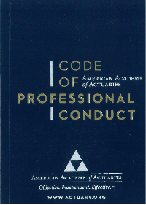
It All Starts With the Code
“The Code of Professional Conduct sets forth what it means for an actuary to act as a professional. It identifies the responsibilities that actuaries have to the public, to their clients and employers, and to the actuarial profession.”

Slide 9
Code of Professional Conduct
The current identical Code was individually adopted by the five U.S.-based actuarial organizations (Academy, ASPPA, CAS, CCA, and SOA) and took effect Jan. 1, 2001.
The Code sets forth professional/ethical standards for actuarial members of the five U.S.-based actuarial organizations.
Actuaries who commit material violations of the Code are subject to counseling or discipline.
Most complaints to, and 80% of requests for guidance handled by, the ABCD in 2016 involved alleged material violations of Precepts 1, 2, and/or 3.

Slide 10
Professional Integrity
Precept 1
An Actuary shall act honestly, with integrity and competence, and in a manner to fulfill the profession’s responsibility to the public and to uphold the reputation of the actuarial profession.

Slide 11
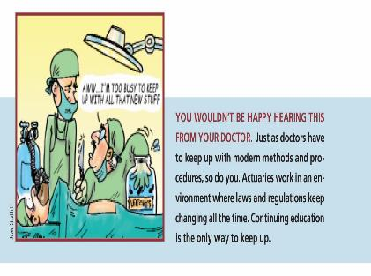
Qualifications
Precept 2
An Actuary shall perform Actuarial Services only when the Actuary is qualified to do so on basis of basic and continuing education and experience, and only when the Actuary satisfies applicable qualification standards.

Slide 12
Standards of Practice
Precept 3
An Actuary shall ensure that Actuarial Services performed by and under the direction of the Actuary satisfy applicable standards of practice.
Notes:
I will speak about these at length later.

Slide 13
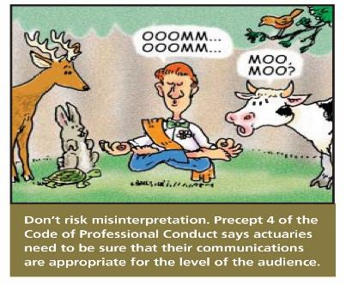
Other Precepts
Communications and Disclosure: Precepts 4, 5, and 6

Slide 14
Other Precepts
Conflict of Interest: Precept 7
Control of Work Product: Precept 8
“The Actuary should… take reasonable steps to present the Actuarial Communication clearly and fairly.”

Slide 15
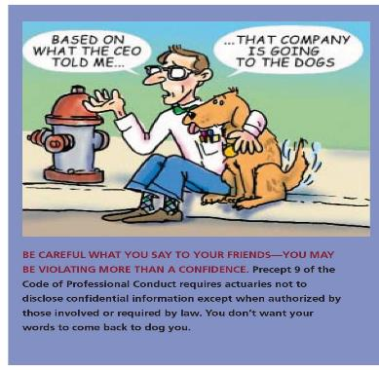
Other Precepts
Confidentiality: Precept 9

Slide 16
Other Precepts
Courtesy and Cooperation: Precept 10

Slide 17
Additional Resources on Precept 10
“Webinar: Actuary-to-Actuary Communication, June 28, 2017
“The ABCDs of Precept 10,” Actuarial Update, July 2017

Slide 18
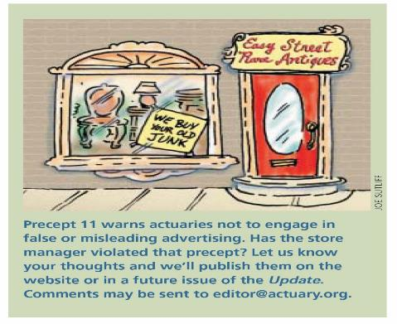
Other Precepts
Advertising: Precept 11
Titles and Designations: Precept 12

Slide 19
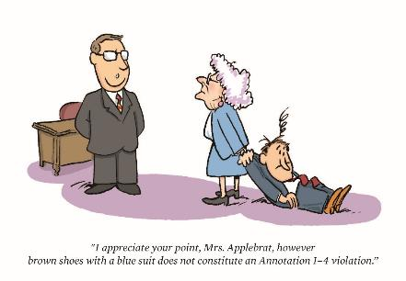
Other Precepts
Violations of the Code of Professional Conduct: Precepts 13 and 14

Slide 20
Focus on Precept 13
“An Actuary with knowledge of an apparent, unresolved, material violation of the Code by another Actuary should consider discussing the situation with the other Actuary and attempt to resolve the apparent violation. If such discussion is not attempted or is not successful, the Actuary shall disclose such violation to the appropriate counseling and discipline body of the profession, except where the disclosure would be contrary to Law or would divulge Confidential Information.” [emphasis added]

Slide 21
Precept 13 and Self-Regulation
The importance of Precept 13 to self-regulation:
Actuaries in best position to observe other actuarial work.
Actuaries have best knowledge to audit poor actuarial work.
If a self-regulating profession does not prevent unethical behavior and practice by relying on members to monitor compliance, it is highly likely that some other body will emerge who can and will do so.
Notes:
Ref the infographic handout

Slide 22
Professionalism in Action series
“Are You Modeling Professionalism?”
“Talking the Talk: Professionalism and Actuary-to-Actuary Communications”
“Shiny, New…and Professional: Professionalism and new and Emerging Practice Areas”
“Setting the Temperature to ‘Ethical’”
Academy President Bob Beuerlein, Contingencies, 2017
Notes:
Academy President Bob Beuerlein

Slide 23
U.S. Qualification Standards

Slide 24
Rooted in Precept 2
PRECEPT 2. “An Actuary shall perform Actuarial Services only when the Actuary is qualified to do so on the basis of basic and continuing education and experience, and only when the Actuary satisfies applicable qualification standards.” [emphasis added]
“It is the professional responsibility of an Actuary to observe applicable qualification standards that have been promulgated by a Recognized Actuarial Organization for the jurisdictions in which the Actuary renders Actuarial Services and to keep current regarding changes in these standards.” [emphasis added] (Annotation 2-1)

Slide 25
U.S. Qualification Standards—SAO
Academy Board adopted the current Qualification Standards for Actuaries Issuing Statements of Actuarial Opinion in the United States (USQS) in 2008.
USQS defines a Statement of Actuarial Opinion (SAO) as having two components:
(i) an opinion expressed by an actuary in the course of performing actuarial services; and
(ii) an opinion that is intended by the actuary to be relied upon by the person or organization to which it is addressed.

Slide 26
USQS Structure
Section 1. Introduction (including definitions)
Section 2. General Qualification Standard
Basic Education and Experience Requirements
Continuing Education Requirements
Section 3. Specific Qualification Standards (when necessary)
Section 4. Changes in Practice and Application
Section 5. Acknowledgement of Qualification
Section 6. Recordkeeping Requirements

Slide 27
USQS: Section 2 Basic Education and Experience Requirements
Must be
an Academy member,
a Fellow or Associate of the SOA or the CAS,
a Fellow of the CCA,
a Member or Fellow of ASPPA, or
a fully qualified member of another IAA-member organization;
Must have 3 years of responsible actuarial experience; and
Must be knowledgeable through examination or documented professional development of the Law applicable to the SAO.

Slide 28
USQS: Section 2 Basic Education and Experience Requirements
In addition, to issue an SAO in an area covered by an SOA specialty track, or by CAS or ASPPA exams, you must
Attain highest actuarial designation in IAA full-member organization (other than Academy) and complete a specialty track in an area relevant to the SAO; or
Attain highest actuarial designation in IAA full-member organization (other than Academy) and have at least 1 year responsible actuarial experience in the relevant area under the review of an actuary qualified to issue the SAO; or
Have at least 3 years of responsible actuarial experience in the relevant area under the review of an actuary qualified to issue the SAO.

Slide 29
USQS: Section 2 General Continuing Education (CE) Requirements
30 hours of relevant CE annually
At least 6 hours on “Organized Activities”
At least 3 hours on professionalism topics
General business subjects
not required under the USQS
capped at 3 hours annually
Notes:
Professionalism Counts Article, “Don’t Lose Your Way on CE: Remember the ‘Why’! “ Actuarial Update, September 2017
President Bob Beuerlein
“The reasons we must maintain necessary expertise are twofold. To begin with, as an actuary, you have a profound impact on people’s lives. Earlier this year, I asked our members to “[t] ake a moment to think about what is at stake when actuaries don’t put professionalism into action: People’s lives, health, property, retirement, or other critical interests may be harmed. As an actuary, your practice of professionalism can contribute to others’ well-being—or the opposite.”
Second, when you became an actuary, you chose to master actuarial science, which the USQS describe as “a constantly evolving discipline.”3 And you chose to do so in an ever-changing world marked by increasing economic and technological sophistication. The USQS explain that “[i]f actuaries are to provide their Principals with high-quality service, it is important that they remain current on emerging advancements in actuarial practice and science that are relevant to the Actuarial Services they provide.”
These two reasons are why the Code of Professional Conduct requires an actuary to act with competence and “perform Actuarial Services only when the Actuary is qualified to do so on the basis of basic and continuing education and experience, and only when the Actuary satisfies applicable qualification standards.”5 CE is part of “a lifelong effort to acquire and enhance a continuously changing set of skills,” as I said in my inaugural address to the Academy almost one year ago.”

Slide 30
The “Why” of CE
You must maintain necessary expertise because
(i) you have a profound impact on people’s lives; and
(ii) actuarial science is “a constantly evolving discipline.”
Beuerlein, “Don’t Lose Your Way on CE: Remember the ‘Why’!” Actuarial Update, September 2017.

Slide 31
USQS: Continuing Education
You must make a “reasonable, good-faith determination” of what CE opportunities enhance your ability to practice in a desired field.
CE must be “relevant.” That is, it must
broaden or deepen your understanding of one or more aspects of your work;
expand your knowledge of practice in related disciplines that bear directly on your work; or
facilitate your entry into a new area of practice.
“Make Sure Your CE is ‘Relevant’”
Actuarial Update, June 2017

Slide 32
USQS: Section 3 Specific Qualification Standards
Apply to actuaries who issue the following SAOs:
NAIC Life and A&H Annual Statement
NAIC Property and Casualty Annual Statement
NAIC Health Annual Statement
Apply only to the types of SAOs for which they have been adopted.
Notes:
Are developed when an actuary needs to have specific qualifications beyond those required to satisfy the General Qualification Standard.

Slide 33
USQS: Section 3 Specific Qualification Standards
Education Requirement
Successfully complete examinations on the topics listed in section 3.1.1 (or obtain the knowledge through alternative education as in section 3.1.2).
Experience Requirement
3 years of responsible experience relevant to the subject of the SAO under the review of an actuary who was qualified to issue the specific SAO at the time of the review.
CE Requirement
15 of the 30 must hours be “directly relevant” to the topics listed in 3.1.1.

Slide 34
Look in the Mirror Test
Requires you to
objectively examine your professional qualifications (basic and continuing education and experience) and
make a reasoned judgment about whether you can fulfill the requirements of the USQS and your obligations under the Code.
The bar under Precept 2, Annotation 2-2, is very high:
“The absence of applicable qualification standards for a particular type of assignment . . . does not relieve the Actuary of the responsibility to perform such Actuarial Services only when qualified to do so . . . .”
Resource: “Making Sense of the ‘Look in the Mirror’ Test of Qualifications,” Actuarial Update, April 2016

Slide 35
FAQs on the USQS
Frequently Asked Questions on the U.S. Qualification Standards
Developed and revised by the Academy Committee on Qualifications
Currently 52 FAQs
On the Academy website: www.actuary.org/professionalism/faqs-revised-qualification-standards

Slide 36
New USQS FAQs 2016-17
Long-Term Care (section 2.3.2)
Changing practice area (section 4.1)
Specific Qualifications Experience
(section 3.2)
Notes:
Available on Academy website, Professionalism Counts article in Jan. 2017 Actuarial Update
[draft talking points below-kl]
Frank Stone, member of CoQ and a regulator, brought up a question on qualifications guidance regarding long-term care (LTC) to the committee. Other regulators had noted there is a principle-based reserves (PBR) FAQ but not one for LTC.
A subgroup was formed to discuss and draft an LTC FAQ.
It is similar to the FAQ on PBR qualifications, but based largely on section 2.3.2, Statements of Actuarial Opinion in Two or More Distinct Areas of Actuarial Practice.

Slide 37
Helpful Tool: Attestation Form
Available to Academy members at attest.actuary.org
Specific and General Qualification tracks
Can complete multiple attestations for multiple SAOs
Can download complete attestation package (form and attachments)
Printable

Slide 38
Actuarial Standards of Practice

Slide 39
Reasons for Development of ASOPs
Actuaries must effectively police ourselves to:
Protect the public
Protect the reputation of the profession
Avoid or reduce risk of external regulation
Provide a defense against charges of bad practice

Slide 40
ASB Structure
The ASB’s 9 members broadly represent of all areas of actuarial practice.
ASB members play a standard-setting role, not an advocacy role, and serve the profession rather than any individual interest groups or coalitions.
Actuarial Standards Board
General Committee
Casualty Committee
ERM Committee
Health Committee
Life Committee
Pension Committee

Slide 41
Standard-Setting Principles
Actuarial standards of practice (ASOPs) should provide guidance for appropriate practice, not merely codify current practice or best practice.
ASOPs set principles to guide actuaries and users of actuarial services, but do not replace professional judgment.
ASOPs should apply as broadly as possible.
Disclosure is a cornerstone of compliance with standards.

Slide 42
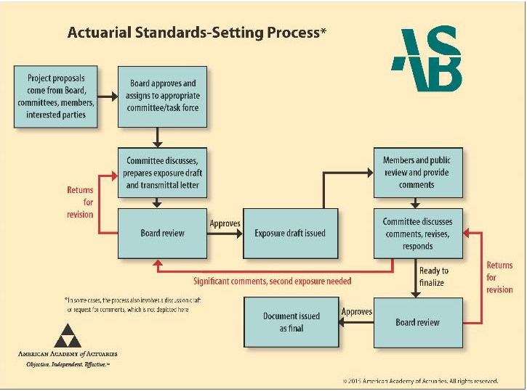

Slide 43
Structure of ASOPs
Cross-Practice ASOPs
ASOP No. 1 ‒ Introductory ASOP
ASOP No. 41 ‒ Actuarial Communication
ASOP No. 12 | Risk Classification
ASOP No. 17 | Expert Testimony by Actuaries
ASOP No. 21 | Responding to or Assisting Auditors…
ASOP No. 32 | Social Insurance
ASOP No. 23 | Data Quality
ASOP No. 25 | Credibility Procedures
Exposure | Modeling
Exposure | Assumptions
Practice-Specific ASOPs
Casualty
ERM
Health
Life
Pension
ASOP Nos. 13, 19, 20, 29, 30, 36, 38, 39, 43
ASOP Nos. 46, 47
ASOP Nos. 3, 5, 6, 8, 11, 18, 19, 22, 26, 28, 42, 45, 49, 50
ASOP Nos. 2, 7, 10, 11, 15, 19, 22, 24, 33, 37, 40, 48, 52
ASOP Nos. 4, 6, 27, 34, 35, 44, 51

Slide 44
Key Cross-Practice Standards
ASOP No. 1
Introductory ASOP

Slide 45
ASOP No. 1: Introductory Standard of Practice
Establishes a roadmap for interpreting ASOPs.
Provides important guidance for the exercise of professional judgment in applying all other ASOPs.
Provides the analytical framework that pairs professional judgment with principles-based standards.

Slide 46
ASOP No. 1: Introductory Standard of Practice
Establishes common terminology.
Sets out the purpose of ASOPs: identify what should be considered, done, documented, and disclosed when rendering actuarial services.
Confirms the format of ASOPs.
Provides guidance for compliance with ASOPs.
Applies to all other ASOPs.

Slide 47
ASOP No. 1: Introductory Standard of Practice
Defines common terms that appear in ASOPs
Must – The actuary is unlikely to have any reasonable alternative but to follow the course of action (infrequently used).
Should – Indicates what is normally the appropriate practice for an actuary to follow when rendering actuarial services.
Should Consider – Suggests potential courses of action. If, after consideration, in the actuary’s professional judgment, action is not appropriate, then it is not required.
May – The course of action is one that would be considered reasonable and appropriate in many circumstances.
Notes:
Resource: Professionalism Counts article, “Must, Should, May: Small Words, Huge Implications,” Actuarial Update, August 2017

Slide 48
Key Cross-Practice Standards
ASOP No. 41
Actuarial Communications

Slide 49
ASOP No. 41: Actuarial Communications
A fundamental ASOP; some overlap with Code of Professional Conduct
“[A]pplies to actuaries issuing actuarial communications within any practice area” (1.2)
“[D]oes not apply to communications that do not include an actuarial opinion or other actuarial findings” (1.2)

Slide 50
ASOP No. 41: Actuarial Communications
In report, disclose or identify:
The intended users (4.1.3.a)
The scope and intended purpose (4.1.3.b)
The actuary(ies) responsible for the communication (4.1.1)
The documents that comprise the report (3.2)
Any limitations on use (4.1.3.e)
Any conflict of interest (3.4.2, 4.1.3.f)

Slide 51
ASOP No. 41: Actuarial Communications
In report, disclose or identify (cont’d):
Disclosures regarding assumptions (and methods)
Consider and disclose “what cautions regarding possible uncertainty or risk in any results should be included” (3.4.1, 4.1.3.d)

Slide 52
ASOP No. 41: Actuarial Communications
Deviation: If actuary “has deviated materially from the guidance set forth in an applicable ASOP…the actuary can still comply with that ASOP by …[disclosing] the nature, rationale, and effect of such deviation.” (4.4)
This clause does not apply to disclosures regarding certain assumptions or methods prescribed by law and disclosures regarding responsibility for assumptions and methods (sections 4.2 and 4.3 of ASOP No. 41).

Slide 53
ASOP No. 41 Professionalism Webinar
ABCD Panel on ASOP No. 41: Actuarial Communications
December 2016
Available to members on Academy website

Slide 54
Recent ASB Actions – Approved
Final revisions to
ASOP No. 51, Assessment and Disclosure of Risk Associated with Measuring Pension Obligations and Determining Pension Plan Contributions
Takes effect for any actuarial work product with a measurement date on or after November 1, 2018.
ASOP No. 52, Principle-Based Reserves for Life Products under the NAIC Valuation Manual
Takes effect for valuation dates on or after December 31, 2017.
ASOP No. 5, Incurred Health and Disability Claims
Took effect for any actuarial work product covered by this standard’s scope issued on or after September 1, 2017.

Slide 55
ASB Upcoming Actions – 2017-2018
Review revisions to
ASOP No. 2, Nonguaranteed Charges or Benefits for Life Insurance Policies and Annuity Contracts
ASOP No. 11, Financial Statement Treatment of Reinsurance Transactions Involving Life or Health Insurance
ASOP No. 17, Expert Testimony by Actuaries
ASOP No. 32, Social Insurance

Slide 56
ASB Upcoming Actions – 2017-2018
Review revisions to
ASOP No. 42, Health and Disability Actuarial Assets and Liabilities Other Than Liabilities for Incurred Claims
ASOP Nos. 4, 27, and 35
ASOP No. 4, Measuring Pension Obligations and Determining Pension Plan Costs or Contributions
ASOP No. 27, Selection of Economic Assumptions for Measuring Pension Obligations
ASOP No. 35, Selection of Demographic and Other Noneconomic Assumptions for Measuring Pension Obligations

Slide 57
ASB Upcoming Actions – 2017-2018
Review new standards or exposures
Estimating Future Costs for Prospective Property/Casualty Risk Transfer and Risk Funding
Modeling
Capital Adequacy Assessment
Setting Assumptions
Pricing of Life Insurance and Annuity Products

Slide 58
The great assumptions debate October 26, 2017
Sponsored by the Academy’s Council on Professionalism and co-sponsored by ACOPA, CAS, CCA, and SOA

Slide 59
Intended Applicability of Proposed ASOP on Setting Assumptions
Guidance applies if actuary:
Develops or otherwise sets assumptions
Assesses the reasonableness of assumptions set by others
Provides advice to another party who has the responsibility to set assumptions
Uses assumptions set by others
Applies to selection of methodology/matching of assumptions to methodology in limited circumstances
When setting of assumptions is largely inseparable from the selection of methodology

Slide 60
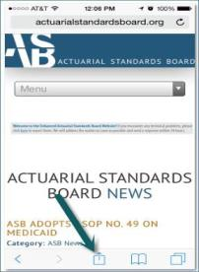
Tools for the Actuary: ASB Mobile-Friendly Website
For iPhones: Add an icon to your device’s home screen for quick access to the mobile site.
1
2
3

Slide 61
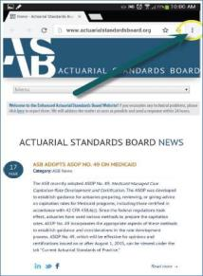
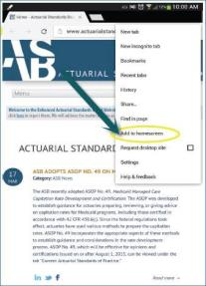
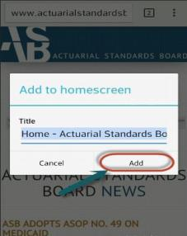
Tools for the Actuary: ASB Mobile-Friendly Website
For Androids: Add an icon to your device’s home screen for quick access to the mobile site.
1
2
3

Slide 62
Applicability Guidelines
ASOP No. 1: “Actuaries are responsible for determining which ASOPs apply to the task at hand.”
Applicability Guidelines list the ASOPs that usually apply to common assignments.
Not created by ASB – resource document only
Not authoritative guidance – does not create obligation on Actuary to comply with referenced ASOPs
www.actuarialstandardsboard.org/applicability-guidelines/

Slide 63
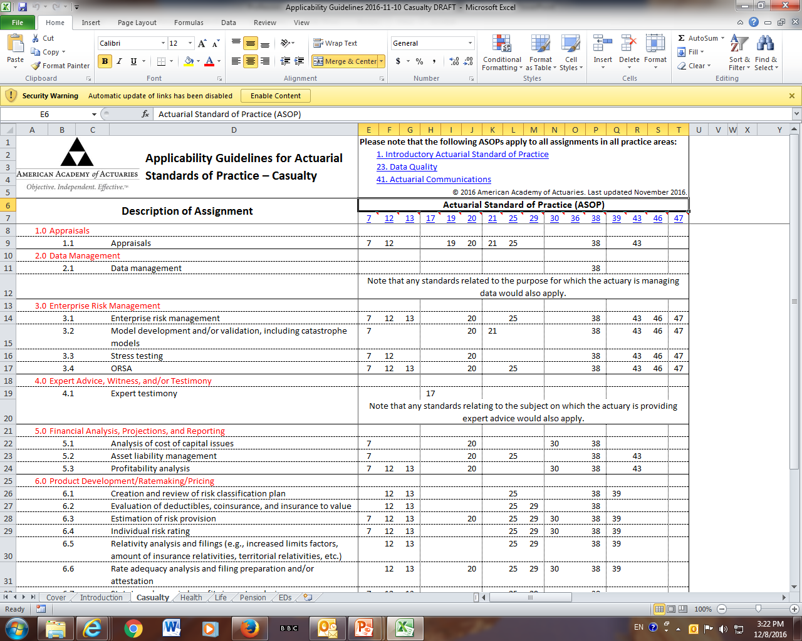
Notes:
Resource: “Reliance and the ASOPs: In Good Faith and Subject to Disclosure,” Actuarial Update, October 2017

Slide 64
Actuarial Board for Counseling and Discipline

Slide 65
The ABCD
Two primary functions:
Respond to requests for guidance (RFGs) on professionalism issues.
Consider complaints about possible violations of the Code.

Slide 66
Requests for Guidance
You may seek guidance on an actuarial matter that you believe may affect your obligations under the Code.
Confidential and can be made anonymously.
An individual member of the ABCD or the whole ABCD may respond with confidential advice on good professional practice.

Slide 67
Complaints
Inquiries into possible material violations of the Code can be initiated by
a complainant,
receipt of outside information, or
the ABCD itself.

Slide 68
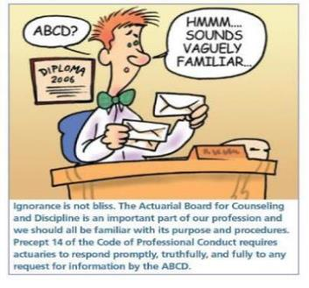
ABCD Complaint Process
Complaint is sent to Subject Actuary (SA), and a response is requested.

Slide 69
ABCD Complaint Process
ABCD chairperson and vice chairs perform preliminary review and decide whether to
dismiss the case (with or without guidance),
investigate further, or
refer the case for mediation.
If decision is to continue investigation, ABCD appoints an investigator and sends notice of the investigator to SA.
SA can object to investigator for good cause.

Slide 70
Findings and Recommendation
After hearing, ABCD decides whether to
(a) request additional information;
(b) dismiss the case;
(c) confidentially counsel the subject actuary; or
(d) recommend that the subject actuary be disciplined.

Slide 71
Findings and Recommendation
If decision is to recommend discipline, ABCD writes a Findings and Recommendation report.
Disciplinary recommendations may include private or public reprimand, suspension, or expulsion from membership (i.e. losing one’s actuarial credentials).
ABCD does not impose discipline, but sends findings and recommendations to membership organizations.

Slide 72
ABCD Inquiries
Inquiries
 | 2016 | First Half 2017 | Third Quarter 2017
Cases in progress | 33 | 19 | 24
Cases resolved | 14 | 8 | 4
Dismissed | 10 (1 after investigation) | 6 (1 w. guidance) | 3
Counseled | 2 | 1 | 0
Recommended public discipline | 2 | 1 | 1

Slide 73
ABCD Inquiries
Primary Practice Area of Subject Actuaries
 | 2016 | First Half 2017 | Third Quarter 2017
Casualty | 6 | 1 | 5
Health | 3 | 1 | 3
Pension | 20 | 20 | 19
Life | 4 | 4 | 1

Slide 74
ABCD Requests for Guidance
Requests for Guidance Responded To
 | 2016 | First Half 2017
Total | 108 | 54
Pension | 26 | 15
Health | 25 | 16
Life | 23 | 9
Property & Casualty | 28 | 14
General | 6 | 0

Slide 75
ABCD RFGs—Third Quarter 2017
21 Requests for Guidance were responded to

Slide 76
Professionalism Resources
Academy Professionalism webpage www.actuary.org/content/professionalism
* Code of Professional Conduct * U.S. Qualification Standards
* Standards of practice (ASB) * Applicability Guidelines
* Discussion papers * Webinars
Qualifications Attestation Form: http://attest.actuary.org
eLearning Modules http://www.actuary.org/content/actuarial-elearning-center

Slide 77
Questions?

