Slide 1
Update: Medicare Accountable Care Organization (ACO) Programs Tom Nolan CMS Office of the Actuary Fall 2016 MAAC Presentation
Notes:
Came from a consulting background at Mercer with a focus on consumer driven health plan design
Where cost sharing put the onus on members to make efficient decisions
And where there were constraints in terms of sample sizes, selection, and uniformity of plan designs that made evaluation very difficult
At CMS, there are stark differences:
Huge membership with stable common plan design
Medicare has leveraged its market share to make industry leading innovations in FFS payment
Prospective payment systems
Physician fee schedule
Which have driven efficiency improvements within episodes like hospital stays and outpatient surgeries, for example
Medicare has also instituted targeted quality measurement tweaks to payment rates
But the volume and intensity problems remain inherent in FFS, so the quest goes on to improve efficiency of care…
Demographically and clinically its not possible to expect beneficiary’s to be educated consumers to drive down the cost and improve quality of care
Elderly, frail, dementia
High proportion of cost at end of life
So its intuitive that a focus would be placed on providers
Berwick… freeing primary care to take a larger role
ACOs are an effort to make that happen under a total cost of care incentive layered on top of the existing mature FFS payment system.
ADVANTAGE – NO ADMIN FEE
DISADVANTAGE – NO ENROLLMENT / UTILIZATION GATEKEEPER

Slide 2
Overview
Brief intro to Medicare ACO Programs/Models
Making sense of ACO performance to date
Benchmark results
Independent evaluations
OACT observations
Market-level trend comparisons
ACO performance a question of organizational type or revenue participation?
Policy Updates
Advanced APM incentive
Regional benchmark adjustment at rebasing
Regional trend replacing national trend
Notes:
50 million with both part A and B coverage
of whom about 35 million are enrolled in Traditional FFS.

Slide 3
Context – Medicare Spending by Category
Note: Totals represent incurred benefits only and do not include admin & other.

Slide 4
ACO Rationale
Fee-for-Service (FFS) Medicare is fragmented
Rewards providers that increase volume and intensity
Minimal incentives for higher quality care
No incentive to manage care across providers/settings
Minimizes role of primary care
Augment FFS payment with annual reconciliation that creates incentives for quality and efficiency
Assign patients based on utilization (not active enrollment)
Create spending benchmark based on patients assigned during baseline
Risk adjust
Trend/Update
Corridor (minimum savings/loss rate)
Quality adjustment to sharing rate

Slide 5
Medicare’s ACO Initiatives
Medicare Shared Savings Program (SSP)
Track 1 waives risk (for now)
Advance Payment Model
ACO Investment Model
Other Models Test Higher Risk/Reward
SSP Track 2 and 3
Pioneer ACO Model
Next Generation ACO Model
ESRD ACO Initiative

Slide 6
Specific ACO examples
 | Beth Israel Deaconess | Banner Health Network | Partners HealthCare | Montefiore
Area served | Eastern Massachusetts | Phoenix, Arizona Metropolitan Area | Eastern Massachusetts | New York City (the Bronx) and lower Westchester County, NY
PY15 beneficiaries | 56,410 | 59,298 | 84,854 | 40,287
Description of ACO (from: https://innovation.cms.gov/Files/x/Pioneer-ACO-Model-Selectee-Descriptions-document.pdf) | provider network /IPA model physician organization of over 1600 physicians including 400 primary care physicians | Comprises Banner Health-affiliated physicians, 13 acute-care Banner hospitals, more than 2,600 private and employed physicians | integrated health system consisting of two academic medical centers, community and specialty hospitals, a physician network, home health and long-term care services, and other health-related entities | independent practice association with an integrated delivery system of nearly 2,400 employed and community-based primary and specialist physicians plus allied health professionals; Montefiore Medical Center’s four hospitals; 21 primary care sites; and home care agency
Net Bonus Through PY2015 | $28 million | $66 million | $20 million | $36 million
Description of | “use a sophisticated computer algorithm and see who's at risk for hospitalization… Then we run that data past the primary-care doctors and develop care-management resources as appropriate.’ … Nurse practitioners make monthly house calls to sick, homebound patients who had emergency department visits. Less acutely ill patients receive phone calls or visits from registered nurses, he said.” ¹ | “‘Beneficiaries are able to remain at home and connect via a tablet with a centralized care team, to a physician, pharmacist, nurse,’ [CEO Lisa Stevens Anderson] said. ‘In Year 2, overall we've had a 27 percent reduction in total cost of care for beneficiaries that have extremely complex conditions.’" ² | “has an integrated care management program called iCMP that focuses on medically complex patients in the home. Nurse care managers oversee complicated and chronically ill patients with multiple medical conditions, such as diabetes or heart disease. The iCMP program helps keep these high-risk individuals healthier and lowers the overall cost for them by preventing avoidable hospital visits” ² | “’Early in Montefiore's ACO development, we created a predictive analytics model that assists in the identification of patients who will benefit from advanced interventions,’ said Andrew D. Racine, senior vice president ‘... By focusing on the right care for the right patient at the right time, we were able to substantially reduce admissions and all-cause 30-day readmissions.’” ³

Slide 7
ACOs vary in structure
REPORTED COMPOSITION (Shared Savings Program only)
Multiple responses may apply to an ACO
 | ACOs |  |  | % Increase
 | 2015 | 2016
Networks of Individual Practices | 225 | 234 |  | 4%
Group Practices | 149 | 134 |  | -10%
Hospital/Professional Partnerships | 136 | 166 |  | 22%
Hospital employing ACO professionals | 103 | 135 |  | 31%
Federally Qualified Health Center | 47 | 60 |  | 28%
Rural Health Clinic | 35 | 65 |  | 86%
Critical Access Hospital | 31 | 55 |  | 77%
Participation growth driven by ACOs that include hospitals
Incentives may be very different compared to physician ACOs
Physician ACOs also face leveraged risk if in Track 2 or 3 (or if in a CMMI model with downside risk)
Hospital ACOs may form defensively (i.e. to avoid losing market share as opposed to eagerness to reduce utilization)

Slide 8
Medicare ACO Assignment By Year (Approximate)
 | 2012 | 2013 | 2014 | 2015 | 2016 | 2017
FFS Assignable Population | 29.4 | 29.6 | 29.6 | 29.7 | 30.0 | 30.4 | A
ACO Upside Only (SSP T1) | 1.1 | 3.2 | 5.3 | 7.0 | 7.3 | 7.6 | B
ACO Downside Risk | 0.7 | 0.7 | 0.7 | 0.5 | 1.4 | 2.0 | C
SSP T2 & T3 | 0.0 | 0.1 | 0.0 | 0.0 | 0.4 | 0.8
Pioneer (CMMI) | 0.7 | 0.6 | 0.6 | 0.5 | 0.3 | 0.0
Next Gen (CMMI) |  |  |  |  | 0.6 | 1.1
Comp. ESRD Care (CMMI) |  |  |  |  | 0.0 | 0.0
Total ACO | 1.8 | 3.9 | 6.0 | 7.5 | 8.7 | 9.6 | D | = B+C
Total ACO Penetration | 6% | 13% | 20% | 25% | 29% | 31% | E | = D/A
Upside Only / Track 1 | 4% | 11% | 18% | 24% | 24% | 25% | F | = B/A
Downside Risk (incl. CMMI) | 2% | 2% | 2% | 2% | 5% | 6% | G | = C/A
Assignment expressed in millions of person-years (i.e. 12-month exposure units)
Nearly one-third of assignable FFS beneficiaries are expected to be assigned to an ACO in 2017 (row E)
The majority of ACOs expected to remain in SSP Track 1 in 2017 with shared savings but no downside risk (row B)
Future assignment figures for 2017 are rough/illustrative projections
Assignable FFS population loosely defined as beneficiaries incurring at least one qualifying primary care E&M (or related) service in given calendar year
2012 Track 1 (first column of row B) person years are prorated for ACOs beginning April or July and includes approximately 150,000 person-years from last year of the Physician Group Practice Transition Demonstration

Slide 9
2017 assignment a preliminary projection
CMMI models include Pioneer ACO, Next Generation ACO, and Comprehensive ESRD Care
Current regulation limits ACO participation in sharing-only Track 1 to two agreement periods (i.e. six years)

Slide 10
Shared Savings Program (2016)
 | Track 1 | Track 2 | Track 3
ACO Count | 411 | 6 | 16
Attribution | Retrospective | Retrospective | Prospective
Min Savings Rate (MSR) | 2% to 3.9% Based on # benes | Optional up to 3.9% | Optional up to 3.9%
Min Loss Rate (MLR) | N/A | Symmetric to MSR | Symmetric to MSR
ACO’s Share of Savings | Up to 50% | Up to 60% | Up to 75%
Savings Example: Assume quality = 80% | 40% = 50% x 80% | 48% = 60% x 80% | 60% = 75% x 80%
ACO’s share if Loss | N/A | Max = 60% Min = 40% | Max = 75% Min = 40%
Loss Example Assume quality = 80% | N/A | 52% = 1-(60% x 80%) | 40% = 1-(75% x 80%)

Slide 11
MSRs provide limited protection against random bonuses
PBPY Cost Trend % Difference from Nat’l Avg
Red line signifies empirical 99th percentile; green line approximates Track 1 MSR policy

Slide 12
Scatter Plot – ACO Gross Savings (Loss) % by Size (2015)

Slide 13
Scatter Plot – ACO Net Savings (Loss) % by Size (2015)

Slide 14
2015 Financial results for Medicare ACOs
 | PIONEER 2015 $Mil % |  | SSP 2015 $Mil %
Benchmark | $5,490 | 100.0% | $73,298 | 100.0%
Actual Spend | 5,453 | 99.3 | 72,868 | 99.4
Difference | 37 | 0.7 | 429 | 0.6
Paid to ACO | 34 | 0.6 | 646 | 0.9
Paid to CMS | 2 | 0.0 | 0 | 0.0
Net | 5 | 0.1 | -216 | -0.3
Only 12 of original 32 Pioneers from 2012 remained in 2015
SSP bonus payments exceeded nominal benchmark savings
True impact of both Programs more complex than just tallying benchmark results

Slide 15
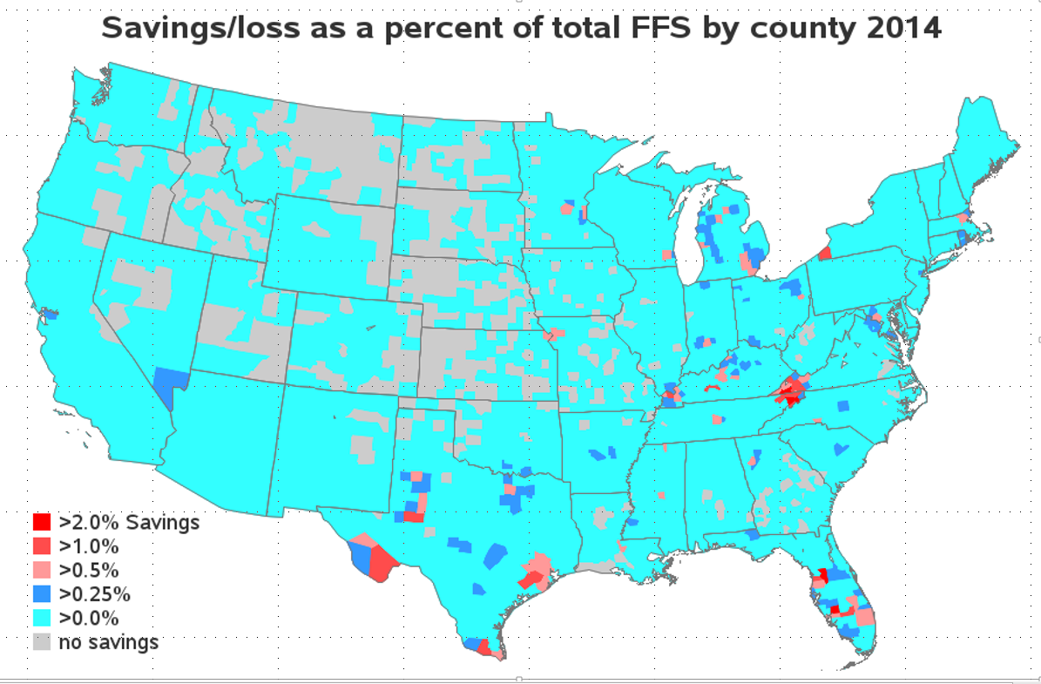
Geography of SSP Shared Savings Bonus Payments
Map apportions each ACO’s shared savings (or loss) dollars according to distribution of assigned beneficiary county of residence

Slide 16
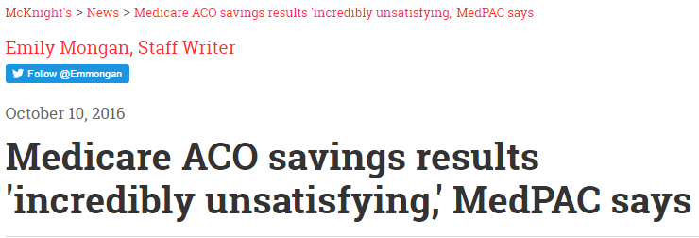
Interpreting results to date
At face value, program is barely treading water financially, if one considers bonus payments now exceed total reduced spending as measured by benchmarks…
But several considerations for context of benchmark results:
Feedback on national trend implicitly bakes portion of savings into targets
Independent researchers estimated roughly double the benchmark savings when measuring against local non-ACO comparison groups through 2014
Evidence building for secondary spillover effects
Evaluating program impacts requires going beyond benchmark data alone…

Slide 17
Evidence Compiled for Pioneer Certification
Three key ways of estimating overall impact:
Combined benchmark gross/net savings (minimal net impact)
Formal Pioneer evaluation (estimated gross savings ~3% y1 and ~1% y2)
OACT market trend comparison (savings likely to have exceeded bonus pay)
First two perspectives ignore spillover effects
ACO physicians are assigned only a portion of the beneficiaries they actually serve each year
Feedback affect on national comparison trend
Evidence from private ACO model (AQC)
Internal analysis of Medicaid cost trends for PGP ACO assigned benes
Pioneer certification relied in part on corroborating modest net savings for Pioneer ACOs under #1 and #2 with larger total market savings implied by broader analysis from #3

Slide 18
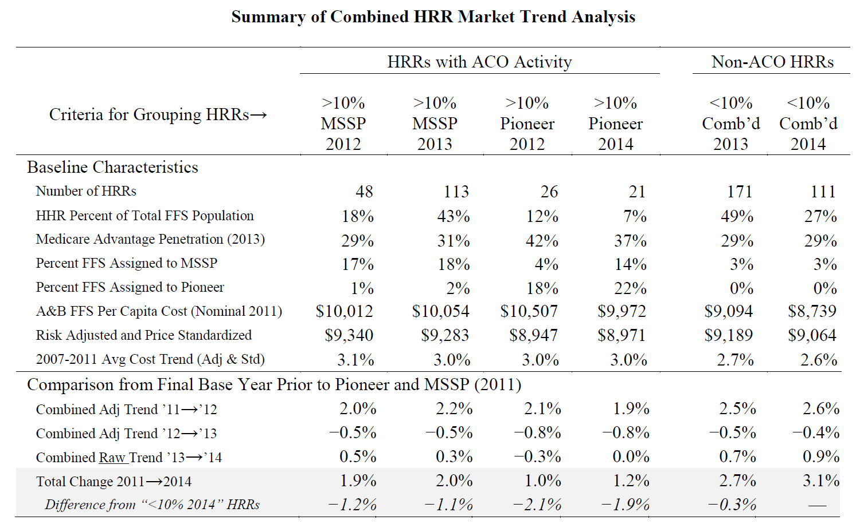
Pioneer Certification: Comparing Adjusted Cost Trends by HRR ACO Activity
Source – Certification of Pioneer ACO Model
Markets active in either/both ACO programs demonstrated lower adjusted cost trend than markets with very low ACO assignment
Implied aggregate savings exceed net bonus payments by several multiples or more

Slide 19
Market Trend Comparison (Draft)
Potential evidence for dose/response effect: lower average relative trend exhibited the earlier a market crossed the 10% threshold for MSSP assignment
Boston an example of a market with significant ACO activity including downside risk (5 Pioneer ACOs)
Excluded HRRs with significant CPC presence from all buckets
Also excluded ESRD population
Working to update with 2015 data

Slide 20
Per Cap Trend Diff from Low-ACO-Comparison-Market Average (Draft) → Baseline Includes HRRs w/ <10% Assignment as of 2014 → ACO Markets Grouped by Year when Assignment First Exceeded 10%
 |  | ACO Active Mid 2012 |  |  |  | Newly Active 2013 |  |  |  | Newly Active 2014
 |  | 2012 | 2013 | 2014 |  | 2012 | 2013 | 2014 |  | 2012 | 2013 | 2014
Rough % | PBPY Spend (raw) | -0.3% | -0.6% | -1.9% |  | -0.3% | -0.8% | -1.7% |  | -0.4% | -0.7% | -1.3%
of Spend | Price & Risk Adjust | -0.5% | -1.0% | -1.4% |  | -0.1% | -0.2% | -1.3% |  | -0.1% | -0.2% | -0.8%
29% | Inpatient | -0.2% | -0.7% | -0.6% |  | 0.0% | -0.1% | -0.9% |  | -0.3% | -0.3% | -0.5%
14% | Outpatient | -1.1% | -1.6% | -3.2% |  | -0.9% | -0.7% | -1.9% |  | -0.6% | -1.5% | -1.7%
18% | Post Acute & HH | 0.4% | 0.4% | -1.3% |  | -0.7% | -0.6% | -0.9% |  | -0.5% | -0.7% | -1.9%
10% | Eval & Man | -1.2% | -1.6% | -2.3% |  | -0.2% | -0.5% | -0.5% |  | -0.5% | -0.7% | -0.5%
3% | Tests | -3.2% | -3.7% | -4.3% |  | -1.0% | -0.8% | -3.4% |  | -2.3% | -3.0% | -3.9%
2% | DME | 0.3% | -1.0% | -3.9% |  | 1.1% | 0.9% | -1.3% |  | 0.0% | -0.6% | -2.0%
2% | Ambulance | -4.3% | -5.0% | -17.4% |  | -0.2% | 1.2% | -6.0% |  | -3.1% | -3.0% | -11.7%
1% | ER Utilization | -0.3% | -0.1% | -0.7% |  | -0.4% | -0.3% | -1.6% |  | 0.2% | -0.3% | -0.8%
2% | Imaging | 1.4% | 2.2% | 2.1% |  | 0.9% | 1.4% | 0.8% |  | 0.4% | 0.5% | -0.3%
4% | Part B Drug | 2.5% | 3.8% | 2.9% |  | 2.0% | 0.9% | 0.3% |  | 3.2% | 5.9% | 6.3%
1% | Amb Surg Center | 0.5% | 0.4% | 1.5% |  | 1.0% | 2.6% | 4.8% |  | 0.8% | 0.0% | 0.8%
7% | Procedures | 0.3% | -0.4% | -0.1% |  | 0.3% | -0.6% | -0.3% |  | 0.7% | 0.3% | 0.4%
3% | Hospice | 2.0% | 1.7% | 3.2% |  | -0.1% | -1.4% | -1.8% |  | 0.0% | -0.7% | -0.5%
 | Readmits / IP User | 0.4% | -0.5% | -1.0% |  | 0.8% | 1.3% | 1.6% |  | -0.3% | -0.1% | 0.4%
Total Cost, Hospital, and subset of other services showed lower trends in ACO HRRs
Others showed higher trends
Others show mixed trends
OACT preliminary/draft analysis using ACO program assignment data and PUF HRR claims data

Slide 21
ACO performance by start date
Average Per Capita Savings Relative to Benchmark (Before Offsetting Cost of Bonuses)
Start Date | ACO Count at Start | ACO Count as of 2015 | 2013 | 2014 | 2015
4/1/2012 | 27 | 22 | 0.7% | 1.4% | 4.0%
7/1/2012 | 87 | 78 | 1.5% | 1.6% | 0.7%
1/1/2013 | 106 | 91 | 0.4% | 0.5% | 1.5%
1/1/2014 | 119 | 112 |  | -0.3% | -0.2%
1/1/2015 | 89 | 89 |  |  | -0.1%
Combined | 428 | 392 | 0.8% | 0.6% | 0.7%
Note: Analysis of 2013 excludes an ACO that started 7/12 which was a clear outlier – showing a loss 8 standard deviations outside the mean.
Prior to 2016 only five SSP ACOs elected downside risk (2 of which dropped out after 2013)
ACOs tend to show greater savings the earlier they entered the program
SSP net bonus payments roughly offset measured benchmark savings in 2013 and exceeded benchmark savings by 20% in 2014, and 50% in 2015
Savings measured by benchmarks may be understated for several reasons:
ACOs appear to have spillover effects on non-assigned populations
Benchmarks are updated by national trend that contains ACO impact (including spillover impacts)
National trend would also bake in the effect of CMMI interventions targeted at non-SSP-ACO populations (e.g. CPC & Pioneer)

Slide 22
III. Performance by ACO Type
Histogram counts ACOs by their rounded 2015 savings (loss)
Physician-only ACOs showed higher average savings in 2015
Large hospital ACOs skew toward losses… Might we assume that some/many hospitals have been forming ACOs as a defensive measure rather than a material effort to improve efficiency?
Small defined as <10,000 benes
Large defined as >20,000 benes

Slide 23
Average Savings by Physician/Hospital and Advance Pay
Average 2015 Savings (Loss) by ACO Type and Start Date
All '15 SSP ACOs | Non-Advance-Pay |  |  | Advance Pay
(excl FQHC RHC) | 2013 | 2014 | 2015 | 2013 | 2014 | 2015
Hospital | 0.6% | 0.0% | 0.2% | 0.0% | 0.3% | 0.7%
2012 Starters | 1.0% | 1.1% | 0.8%
2013 Starters | 0.2% | -0.5% | 0.2% | 0.0% | 0.3% | 0.7%
2014 Starters |  | -0.5% | -0.3%
2015 Starters |  |  | 0.0%
Physicians only | 0.3% | 0.3% | 0.5% | 1.0% | 2.4% | 3.4%
2012 Starters | 0.6% | 1.5% | 1.4% | 1.4% | 2.1% | 2.1%
2013 Starters | 0.0% | 0.3% | 0.7% | 0.5% | 2.6% | 4.9%
2014 Starters |  | -0.4% | -0.1% |  | 3.0% | 8.2%
2015 Starters |  |  | 0.4% |  |  | -7.5%
Grand Total | 0.5% | 0.2% | 0.3% | 0.9% | 2.3% | 3.4%
Advance payment correlated to higher average savings
Advance payment is essentially limited to physician-only ACOs that happen to have lower revenue retention (5% as apposed to 10% on average for physician ACOs without advance pay)

Slide 24
Examining ACO Revenue
Physician-only ACOs tend to participate in only 5 to 10 % of spending for FFS services supplied to their assigned beneficiaries
For hospital ACOs the ratio is mostly higher, with some reaching as high as 60%

Slide 25
Savings for ACOs that Resemble Physician Only Revenue
Average 2015 Savings (Loss) for ACOs with Less than 15% Revenue Retention
 | Non-Advance-Pay |  |  | Advance Pay
 | 2013 | 2014 | 2015 | 2013 | 2014 | 2015
Hospital | 0.7% | 0.6% | 2.7% | 0.0% | 0.3% | 0.7%
2012 Starters | 0.9% | 1.4% | 2.5%
2013 Starters | 0.4% | -0.3% | 3.3% | 0.0% | 0.3% | 0.7%
2014 Starters |  | 0.5% | 4.6%
2015 Starters |  |  | 1.2%
Physicians only | 0.9% | 0.6% | 0.9% | 1.0% | 2.4% | 3.6%
2012 Starters | 1.4% | 2.0% | 1.6% | 1.5% | 2.1% | 2.3%
2013 Starters | 0.3% | 1.1% | 2.2% | 0.5% | 2.6% | 4.9%
2014 Starters |  | -0.3% | 0.0% |  | 3.0% | 8.2%
2015 Starters |  |  | 0.8% |  |  | -7.5%
Grand Total | 0.8% | 0.6% | 1.4% | 1.0% | 2.3% | 3.5%
ACOs with hospitals that only provide <15% of ACO bene services (by dollars) have significantly better average savings in 2015
Notably the case for such hospital ACOs, which tended to show savings closer to advance pay physician ACOs in 2015

Slide 26
Average Savings for Higher Revenue ACO Buckets
 | 15-25% Rev Capture |  |  | 25-50% Rev Capture |  |  | >50% Rev Capture
 | 2013 | 2014 | 2015 | 2013 | 2014 | 2015 | 2013 | 2014 | 2015
Hospital | 4.8% | 2.9% | 2.2% | -0.2% | -0.6% | -1.0% | 0.1% | -2.1% | -4.6%
2012 Starters | 1.7% | 0.7% | 3.8% | 0.7% | 1.2% | -0.5% | 2.5% | 0.1% | -1.5%
2013 Starters | 7.9% | 8.3% | 6.2% | -0.9% | -1.6% | -1.1% | -2.4% | -4.5% | -6.0%
2014 Starters |  | 1.0% | 1.0% |  | -1.2% | -1.2% |  | -2.0% | -9.9%
2015 Starters |  |  | 0.4% |  |  | -1.0% |  |  | 0.4%
Phys. only | -1.5% | 0.1% | -0.8% | -3.2% | -4.6% | -3.0%
2012 Starters | -2.3% | 0.1% | 0.8% | -6.8% | -6.7% | -3.4%
2013 Starters | 1.0% | -0.3% | -4.6% | -2.3% | -4.1% | -5.8%
2014 Starters |  | 0.5% | -3.9% |  | -4.7% | -3.7%
2015 Starters |  |  | -0.3% |  |  | -0.6%
Grand Total | 1.7% | 1.8% | 1.2% | -0.5% | -1.0% | -1.2% | 0.1% | -2.1% | -4.6%
Physician-only ACOs also tend to skew toward losses as their share of assigned beneficiary services grows

Slide 27
OK, so what’s it all mean?
Impact to Date
ACOs appear to be producing greater total savings than explicitly measured for assigned beneficiary spending
Even considering secondary effects, savings are still likely to be modest
Reference point: 2010 study estimated 3.6% lower cost for patients served by ACO-like physicians
Will Performance Improve?
Stakeholder calls for greater movement to downside risk to further improve ACO performance (e.g. Medpac)
Leaner ACOs tend to show better results, but risk exposure is leveraged for such ACOs and appetite for risk may be limited
Also concern that variation creates too much risk for small ACOs
Others point to benchmark rebasing as barrier to higher order savings
Several recent policy changes attempt to improve incentives going forward
(A) MACRA incentive boosts physician fee schedule payments by 5% starting in 2019 for providers participating in advanced Alternative Payment Models
(B) – June 2015 and June 2016 Final Rule changes

Slide 28
Alternative Payment Model Impact on ACOs (rel to bmark)
APM 5% bonus revenue may account for generally between 0.2% and 2% of an ACO’s benchmark
Track 2 and 3 expose ACOs to risk as high as 15% of benchmark

Slide 29
SSP Policy Changes
June 2015 Final Rule – More generous upside in Track 3
June 2016 Final Rule modified benchmark calculations including rebasing
Portion of savings no longer loaded back into rebased bmark
Instead, rebased benchmarks will be blended with risk-adjusted county-average benchmarks
Also replace national trend/growth with county-weighted FFS trends in calculating historical benchmarks and updating them to performance year bases
May help certain ACOs gain confidence in taking on risk, a concern for selective participation response
Also a concern for enhanced feedback effect of regional trend
Regional $ Weight | If Low Cost | If High Cost
First Rebasing | 35% | 25%
Second Rebasing | 70% | 50%

Slide 30
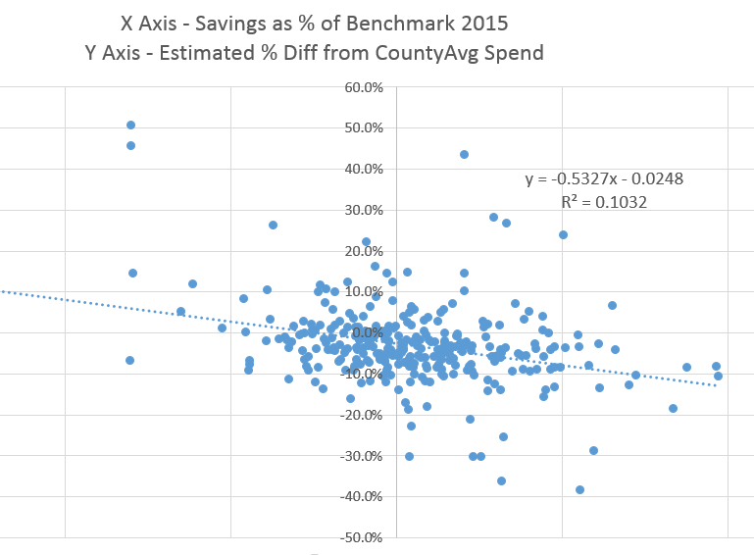
Greater savings in 2015 correlates to lower cost relative to ACO’s region
Note: Certain data points adjusted slightly to preserve ACO anonymity
On average, 2015 ACOs showed about 3% lower per capita cost than their risk adjusted county-weighted region

Slide 31
County-weighted regional trend reduces variation in measured savings/losses, but feedback on benchmarks will be an issue for ACOs…

Slide 32
As ACO participation expands, opportunity for comparison to low-ACO markets diminishes
Massachusetts

Slide 33
Challenges / Uncertainties
Evaluation: Increasingly difficult to identify comparison populations for evaluating ACO (and other CMMI) programs and models
Effectiveness: Will regional benchmark adjustment and advanced APM bonus present sufficient incentive for ACOs to take on risk and produce higher-order savings?
Can hospital ACOs can begin to sacrifice FFS revenue for future savings?
Selection: May lead to inflated costs as regional adjustment ramps up
Includes potential for existing ACOs to tweak their provider make-up to reduce spending relative to region without actually changing care delivery
Alternatively, high cost ACOs (or ACO participants serving high cost populations) may be increasingly underrepresented in the program once rebasing kicks in
Potential for Future Adjustments: CMMI models (especially Next Gen) may offer policy improvements, including:
Imparting a national efficiency adjustment in coordination with county-level adjustment
Limiting adjustments at the tails of the distribution
Applying quality adjuster to a discount and sharing risk symmetrically at the bottom line

