Slide 1
CMS’s Actions to Address the Opioid Epidemic
Notes:
This session explains the actions that the Centers for Medicare & Medicaid Services (CMS) is taking to address the opioid epidemic in detail as it relates to current data and coverage through Medicare, Medicaid, and the Marketplace. This training session was developed and approved by the CMS, the federal agency that administers Medicare, Medicaid, the Children’s Health Insurance Program (CHIP), and the Health Insurance Marketplace.
The information in this module was correct as of January 2019. This is an informational resource for our partners. It’s not a legal document or intended for press purposes. The press should contact the CMS Press Office at press@cms.hhs.gov. Official program legal guidance is contained in the relevant statutes, regulations, and rulings.

Slide 2
CMS Roadmap: Actions to Address the Opioid Epidemic—Overview
Scope of the problem
Key areas of focus
Successes so far
Moving forward
To review the CMS Opioids Roadmap, go to
CMS.gov/About-CMS/Agency-Information/Emergency/Downloads/Opioid-epidemic-roadmap.pdf
Notes:
The CMS Roadmap: Actions To Address The Opioid Epidemic summarizes the scope of the problem, key strategic elements, key areas of focus, accomplishments and plans to move forward. To view the entire roadmap, go to CMS.gov/About-CMS/Agency-Information/Emergency/Downloads/Opioid-epidemic-roadmap.pdf.

Slide 3
Scope of the Problem
¹ CDC: CDC.gov/drugoverdose/data/index.html
² HHS: HHS.gov/opioids/about-the-epidemic/index.html
Notes:
There are many statistics about the opioid crisis, but the statistics on the slide show its magnitude. Opioids killed more than 42,000 people in 2016, or 116 people a day. Forty percent of all opioid overdose deaths involve a prescription opioid.
Sources:
CDC: CDC.gov/drugoverdose/data/index.html
HHS: HHS.gov/opioids/about-the-epidemic/index.html

Slide 4
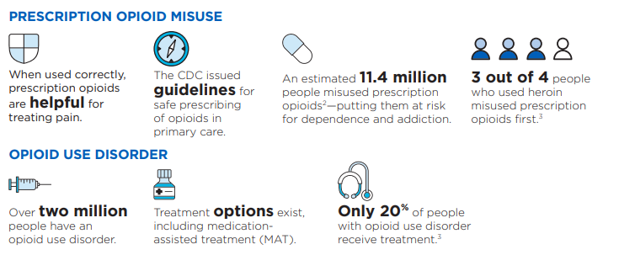
Scope of the Problem
² Source: HHS: HHS.gov/opioids/about-the-epidemic/index.html
³ Source: SAMHSA: SAMHSA.gov/sites/default/files/aatod_2018_final.pdf
Notes:
When used correctly, prescription opioids are helpful for treating pain. The CDC outlined guidelines for the safe prescribing of opioids. There are certain chronic conditions where opioids are prescribed and necessary for pain management, like sickle cell disease, cancer, and for those receiving hospice or palliative end-of-life care.
An estimated 11.5 million people misused prescription opioids—putting them at risk for dependence and addiction. Three out of 4 people who used heroin misused prescription opioids first.
Over 2 million people suffer from opioid use disorder. There are treatment options that exist, which include medication-assisted treatment (MAT). However, only 20% of people with opioid use disorder get treatment.
Sources:
HHS.gov/opioids/about-the-epidemic/index.html
SAMHSA.gov/sites/default/files/aatod_2018_final.pdf

Slide 5
Opioids and Older Adults
Pain is one of the most common health problems for people older than 65 and is linked to less mobility, avoiding activity, falls, depression, anxiety, sleep disruption, and isolation
Opioids can help some older adults remain independent—a key predictor of health—and can effectively treat some debilitating pain that impacts function and quality of life
Opioid use can pose certain health risks for older adults, including constipation, breathing issues, confusion, drug interactions, and increased fall risk
Prescribers play a key role in weighing the benefits and risks of opioid use in their older patients
For more information about opioids and older adults, visit
SAMHSA.gov/capt/sites/default/files/resources/resources-opiod-use-older-adult-pop.pdf
Notes:
Pain is one of the most common health problems for people older than 65 and is linked to less mobility, avoiding activity, falls, depression, anxiety, sleep disruption, and isolation.
Opioids can help some older adults remain independent—a key predictor of health—and can effectively treat some debilitating pain that impacts function and quality of life.
Opioid use can pose certain health risks for older adults, including constipation, breathing issues, confusion, drug interactions, and increased fall risk.
Prescribers play a key role in weighing the benefits and risks of opioid use in their older patients
For more information about opioids and older adults, visit
SAMHSA.gov/capt/sites/default/files/resources/resources-opiod-use-older-adult-pop.pdf

Slide 6
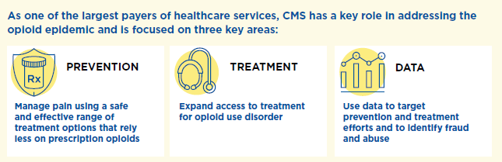
Key Areas of CMS Focus
Notes:
The key areas of CMS focus are prevention, treatment, and data.
Prevention: Manage pain using a safe and effective range of treatment options that rely less on prescription opioids.
Treatment: Expand access to treatment for opioid disorder.
Data: Use data to target prevention and treatment efforts and to identify fraud and abuse.

Slide 7
Prevention
Starting in January 2019, Part D Plans can opt to use drug management plans for at-risk beneficiaries
Includes Medicare Advantage Prescription Drug Plans (MA-PDs) and stand-alone Medicare Prescription Drug Plans (PDPs)
Exclusions for Medicare beneficiaries who have cancer, receive palliative care, or are in hospice or long-term care
Notes:
CMS is implementing new CARA (Comprehensive Addiction and Recovery Act of 2016) requirements to provide an important additional tool to address the growing opioid epidemic that’s devastating families and communities across the nation. CARA requires CMS to establish a framework that allows Part D plans to implement drug management programs. Under such programs, a plan can limit access to coverage for frequently abused drugs for those identified as at risk beginning with the 2019 plan year. CMS designates opioids and benzodiazepine as frequently abused drugs.
Drug management programs will be integrated with CMS’s existing Overutilization Monitoring System (OMS). The clinical guidelines used to determine if a person is potentially “at-risk”, which are based on using opioids from multiple prescribers and/or multiple pharmacies, will be expanded from those currently used in OMS. Sponsors will be allowed to limit an at-risk person’s access to frequently abused drugs to a selected prescriber(s) and/or pharmacy(ies) (“lock-in”), and through the use of person-specific point-of-sale (POS) claim edits, which are already allowed. Part D sponsors may allow limitations unless they have engaged in case management with the prescribers of these drugs, and the person can submit prescriber and pharmacy preferences.
CMS will also exempt people who are being treated for active cancer-related pain, are receiving palliative or end-of-life care, or are in hospice or long-term care from drug management programs. CMS is limiting the availability of the Special Enrollment Period (SEP) for dually or other low-income subsidy (LIS) eligible people with Medicare who are identified as at-risk or potentially at-risk for prescription drug abuse under such drug management programs. At-risk determinations, which include prescriber and pharmacy lock-in, will be subject to the appeals process.
For more information, visit CMS.gov/Medicare/Prescription-Drug-coverage/PrescriptionDrugCovContra/RxUtilization.html.

Slide 8
Prevention
Medicare Part D drug plans may send safety alerts to pharmacies before a person’s prescription is filled for
Possible unsafe amounts of opioids
First prescription fills for opioids
Use of opioids and benzodiazepines at the same time
Notes:
As of January 1, 2019, Medicare drug plans will perform additional safety checks on opioid prescriptions, and may send the pharmacy an alert for review before a prescription is filled. Safety alerts may cover situations like
Possible unsafe amounts of opioids—The pharmacist or Medicare drug plan may need to review the prescription with the doctor to make sure the medications are safe
First prescription fills for opioids—A person may be limited to a 7-day supply or less if they haven’t recently taken opioids
Use of opioids and benzodiazepines at the same time
If a prescription can’t be filled as written, including the full amount on the prescription, the pharmacist will give the person a notice explaining how they or their doctor can contact the plan to ask for a coverage determination. If a person’s health requires it, a fast coverage decision can be requested. The person may also ask the plan for an exception to its rules before going to the pharmacy, to know if the plan will cover the medication.
Certain exceptions apply to each of these policies to ensure access to medically necessary pain medications, like exemptions for those with an active cancer diagnosis or who are receiving hospice or palliative care. For more information, visit CMS.gov/Medicare/Prescription-Drug-coverage/PrescriptionDrugCovContra/RxUtilization.html.

Slide 9
Prevention
Medicaid Pharmacy Program Drug Use Management Strategies
Preferred drug list
Clinical criteria
Step therapy
Prior authorization
Quantity limits
Drug utilization review
State Prescription Drug Monitoring Program (PDMP)
Notes:
State Medicaid programs may choose to design benefit requirements. The Medicaid Pharmacy Program outlines the following drug use management strategies.
Preferred drug list—Providers are permitted to prescribe preferred drugs without seeking prior authorization. By removing a drug from a preferred drug list to a non-preferred, it would limit the use to only those patients for whom treatment with other medications is ineffective.
Clinical criteria—If a medication remains on the preferred list, claims would be authorized only when the recipient satisfies the clinical criteria established to ensure appropriate utilization of the drug.
Step therapy—It requires that another drug is tried prior to a specific drug.
Prior authorization: Medicaid won’t pay for a drug unless the provider has obtained permission before prescribing the drug.
Quantity limits—Medicaid may impose quantity limits on medications as a way to promote safe and appropriate use of the medication, ensuring that they are not overprescribed.
Drug Utilization Review—Retrospective and concurrent drug utilization review can identify inappropriate prescribing practices.
State Prescription Drug Monitoring Program (PDMP)—Data is collected from pharmacies, outpatient clinics and others on dispensed, controlled substance prescriptions. Each state designates an agency to oversee their program and programs can vary by state. PDMPs have been shown to prevent drug diversion.

Slide 10
Prevention
Medicaid Drug Utilization Review Annual Report
Drug utilization review (DUR) program activities and processes from every state Medicaid agency
Ensures appropriate drug utilization policies, including appropriate opioid utilization
Medicaid.gov/Medicaid/prescription-drugs/drug-utilization-review/index.html
Notes:
State Medicaid agencies are required to report annually to the Centers for Medicare & Medicaid Services (CMS) their drug utilization review (DUR) program activities and processes to ensure appropriate drug utilization, including appropriate opioid utilization, which could include placing quantity limits on opioids, monitoring the concurrent use of opioids and benzodiazepines, employing Prescription Drug Monitoring Program (PDMP) requirements, and using tools that measure morphine milligram equivalents (MME) per day.
CMS also inquires about the use of patient review and restriction programs (i.e. lock-in programs) to address potential prescription opioid misuse or abuse. CMS compiles this collected information within the CMS Medicaid DUR State Comparison/Summary Report, which is posted annually at Medicaid.gov/Medicaid/prescription-drugs/drug-utilization-review/index.html.

Slide 11
Treatment
MAT, including opioid treatment programs (OTPs), combines behavioral therapy and medications to treat substance use disorders.
Can be prescribed only by certain providers | Can be prescribed by any health professional with prescribing authority
Examples: Methadone – administered at a clinic that meets certain federal opioid treatment program standards Suboxone®(Buprenorphine/Naloxone combined) – prescribed or dispensed at a doctor’s office/by a physician or practitioner meeting specific standards | Example: Vivitrol® (Naltrexone injection) is administered in a physician’s office. Used for outpatient maintenance therapy and requires a prescription
Notes:
Medication-assisted treatment (MAT), including opioid treatment programs (OTPs), combines behavioral therapy and medications to treat substance use disorders (SAMHSA).
The following examples of medications used for MAT require a prescription and can be prescribed only by certain providers (check with your plan to see what is covered).
Methadone is used to treat opioid use disorders (OUD) and must be obtained at an opioid treatment program (OTP) that meets federal standards.
Suboxone® (Buprenorphine/Naloxone combined) is prescribed or dispensed in doctor’s offices by a physician or practitioner with a DATA 2000 waiver and is used for outpatient maintenance therapy
The following example of medication used for MAT can be prescribed by any health professional with prescribing authority (check with your plan to see what is covered). The amount that can be prescribed depends on the state and insurance requirements.
Vivitrol® (Naltrexone injection) is administered in a physician's office and is used for outpatient maintenance therapy. It requires a prescription.
Methadone (Dolophine, Methadose), buprenorphine (Subutex, brand discontinued in the U.S.), buprenorphine combined with naloxone (Suboxone®), and naltrexone (Depade, ReVia) are approved in the U.S. to treat opioid dependence.
Methadone isn’t a covered outpatient treatment option by Medicare at this time for substance abuse because when it’s used to treat opioid use disorder, it may only be administered or dispensed in opioid treatment programs which aren’t covered by Medicare. It’s only covered for pain management.
Methadone is covered under Part A for inpatient detox. It's not covered under Part D unless it's for pain management. Coverage is restricted through 2019, but due to the SUPPORT Act, it will be covered after January 1, 2020.
Other new drugs for opioid treatment may include Probuphine (implanted buprenorphine) and Sublocade (injectable buprenorphine).
Source: SAMHSA.gov/medication-assisted-treatment

Slide 12
Treatment: Coordination Across HHS
The Department of Health and Human Services (HHS):
Established a comprehensive, national high-level strategy for pain
Leads the Pain Management Best Practices Inter-Agency Task Force
Notes:
The Department of Health and Human Services (HHS) is involved in efforts to improve the treatment of pain. HHS established a comprehensive high-level strategy for pain and they lead the Pain Management Best Practices Inter-Agency Task Force. HHS proposed updates to best practices and issued recommendations that address gaps or inconsistencies for managing chronic and acute pain. For more information, visit HHS.gov/opioids/ and https://www.hhs.gov/ash/advisory-committees/pain/reports/2018-12-draft-report-on-updates-gaps-inconsistencies-recommendations/index.html.

Slide 13
Treatment: Medicare
Medicare will cover drug treatment services if
Services are from a Medicare-participating facility, other provider, or physician/practitioner
Services are reasonable and necessary
Covered services include
Psychotherapy
Individual and group counseling
Patient education regarding diagnosis and treatment
Post-hospitalization follow-up
Screening, Brief Intervention, and Referral to Treatment (SBIRT) services
Alcohol misuse screening and counseling
Screening for depression
Notes:
Medicare will cover alcohol and drug treatment (substance use disorder (SUD)) services if services are from a Medicare-participating facility, other provider or physician/practitioner, and the services are reasonable and necessary. Covered services include
Psychotherapy.
Individual and group counseling.
Patient education regarding diagnosis and treatment.
Post-hospitalization follow-up.
Screening, Brief Intervention, and Referral to Treatment (SBIRT) services: SBIRT is an early intervention approach for individuals with nondependent substance use to effectively help them before they need more extensive treatment. It involves: (1) Screening/assessment to quickly determine the severity of substance use and identify the appropriate level of treatment; (2) Brief intervention through a short conversation that increases insight and awareness of substance use and motivation toward behavioral change; and, (3) Referral to treatment if needed. For the SBIRT fact sheet, go to
CMS.gov/Outreach-and-Education/Medicare-Learning-Network-MLN/MLNProducts/Downloads/SBIRT_Factsheet_ICN904084.pdf.
Alcohol misuse screening and counseling.
Screening for depression.
For more information visit
CMS.gov/Outreach-and-Education/Medicare-Learning Network MLN/MLNMattersArticles/Downloads/SE1604.pdf, or
CMS.gov/Medicare/Prescription-Drug-Coverage/PrescriptionDrugCovContra/Downloads/Part-D-Benefits-Manual-Chapter-6.pdf.

Slide 14
Treatment: Medicare
New Opioid Treatment Program (OTP) Coverage starting January 1, 2020:
SAMHSA-certified OTP providers
Bundled payments for comprehensive services
Coordinated care with necessary medications, testing, and counseling
Notes:
Medicare will cover alcohol and drug treatment (substance use disorder (SUD)) services if services are from a Medicare-participating facility, other provider or physician/practitioner, and the services are reasonable and necessary. Covered services include
Psychotherapy.
Individual and group counseling.
Patient education regarding diagnosis and treatment.
Post-hospitalization follow-up.
Screening, Brief Intervention, and Referral to Treatment (SBIRT) services: SBIRT is an early intervention approach for individuals with nondependent substance use to effectively help them before they need more extensive treatment. It involves: (1) Screening/assessment to quickly determine the severity of substance use and identify the appropriate level of treatment; (2) Brief intervention through a short conversation that increases insight and awareness of substance use and motivation toward behavioral change; and, (3) Referral to treatment if needed. For the SBIRT fact sheet, go to
CMS.gov/Outreach-and-Education/Medicare-Learning-Network-MLN/MLNProducts/Downloads/SBIRT_Factsheet_ICN904084.pdf.
Alcohol misuse screening and counseling.
Screening for depression.
For more information visit
CMS.gov/Outreach-and-Education/Medicare-Learning Network MLN/MLNMattersArticles/Downloads/SE1604.pdf, or
CMS.gov/Medicare/Prescription-Drug-Coverage/PrescriptionDrugCovContra/Downloads/Part-D-Benefits-Manual-Chapter-6.pdf.

Slide 15
Treatment: Medicaid
States have the option to cover substance use disorder (SUD) treatment services
States offer pharmacy benefits
Varies by state and the drug
In most cases, providers are permitted to prescribe covered, preferred drugs without prior authorization
Notes:
Most substance use disorder (SUD) services are optional Medicaid benefits for most populations. States have the option to cover SUD treatment services like counseling, psychosocial, and behavioral health therapies. States offer pharmacy benefits. They vary by state and the drug. They’re required to provide coverage of drugs meeting the definition of covered-outpatient drugs when they’re prescribed for medically-accepted indications.
In most cases, providers are permitted to prescribe covered, preferred drugs without seeking prior authorization. SUD services are required for individuals under 21 with Early and Periodic Screening, Diagnostic and Treatment (EPSDT) and the newly eligible adult group (19-64 with income at or under 133% of the Federal Poverty Level (FPL)) in states that have expanded Medicaid.
For more information, see these Informational Bulletins:
Medication-Assisted Treatment for Substance Use Disorders, July 11, 2014, (Medicaid.gov/federal-policy-guidance/downloads/cib-07-11-2014.pdf)
Best Practices for Addressing Prescription Opioid Overdoses, Misuse and Addiction, January 28, 2016, (Medicaid.gov/federal-policy-guidance/downloads/cib-02-02-16.pdf)
State flexibilities to provide additional services.
Under the SUPPORT Act, states are required to offer all three forms of MAT.

Slide 16
Treatment: Medicaid
Final Mental Health and SUD parity rule
Strengthens access to mental health and SUD benefits
Plans must disclose information on mental and SUD benefits information
States must disclose reasons for denying reimbursement or payment
CMS/federal partners work with states to improve SUD and behavioral health services
Innovation Accelerator Program (IAP)
Health Homes
Certified Community Behavioral Health Centers
Section 1115 SUD demonstrations (26)
Notes:
There are many ways that states can address mental health and Substance Use Disorders (SUDs) for their Medicaid program.
Final Mental Health and SUD parity rule for Medicaid and Children’s Health Insurance Program (CHIP) (March 2016)
Final Rule strengthens access to mental health and SUD benefits for low-income Americans aligning with protections already required of private health plans. It maintains state flexibility while guaranteeing Medicaid enrollees are able to access mental health and substance abuse services in the same manner as medical benefits (eg., comparable co-pays, out-of-pocket costs, limits on outpatient, etc.).
Plans must disclose information on mental health and SUD benefits upon request, including the criteria for determinations of medical necessity.
It also requires the state to disclose the reason for any denial of reimbursement or payment for services with respect to mental health and SUD benefits.
CMS, in cooperation with federal partners, works with states to improve their services for individuals with Medicaid who have mental health conditions and SUD.
Innovation Accelerator Program (IAP)—The goal of the IAP initiative on SUDs is to support participating states for better SUD delivery system reforms and primary care and mental health integration.
Health Homes that focus on mental health and SUD—Health homes as defined by the Affordable Care Act offer coordinated care to individuals with multiple chronic health conditions including mental health and SUDs.
Work with the Substance Abuse and Mental Health Administration (SAMHSA) on Certified Community Behavioral Health Centers.
Section 1115 SUD demonstration opportunity.
For more information visit Medicaid.gov/Medicaid/benefits/bhs/index.
For guidance visit Medicaid.gov/federal-policy-guidance/downloads/smd18011.pdf.

Slide 17
Treatment: The Marketplace
Essential health benefits (EHB) rules require coverage for key categories of benefits
Specific benefits depend on your state, but the health plan must include coverage for
Mental health and SUD benefits (including behavioral health treatment)
Prescription drugs
Notes:
All Marketplace plans cover essential health benefits (EHB). Specific benefits depend on your state and the health plan but must include coverage for mental and behavioral health services, substance use disorder benefits, including opioid use disorder services, and prescription drug coverage. For more information, Healthcare.gov/coverage/mental-health-substance-abuse-coverage.

Slide 18
Treatment: The Marketplace
Other protections for Marketplace plans include
Cost sharing for EHB benefits must count towards the plan’s annual limitation
No yearly or lifetime dollar limits
Must comply with “parity" protections
Must not discriminate
Notes:
There are other protections for Marketplace plans including
Cost sharing for EHB benefits must count towards the plan’s annual limitation
No yearly or lifetime dollar limits on coverage for EHB benefits
Must comply with “parity" protections between mental health and substance use disorder benefits and medical benefits
Prohibited from discriminating based on an individual's age, expected length of life, present or predicted disability, degree of medical dependency, quality of life, or other health conditions. Issuers are allowed to use reasonable medical management

Slide 19
Data
Track prescription opioid trends
Monitor effects of CMS interventions
Identify patients at-risk of OUD
Helps target areas most in need of prevention and treatment efforts

Slide 20
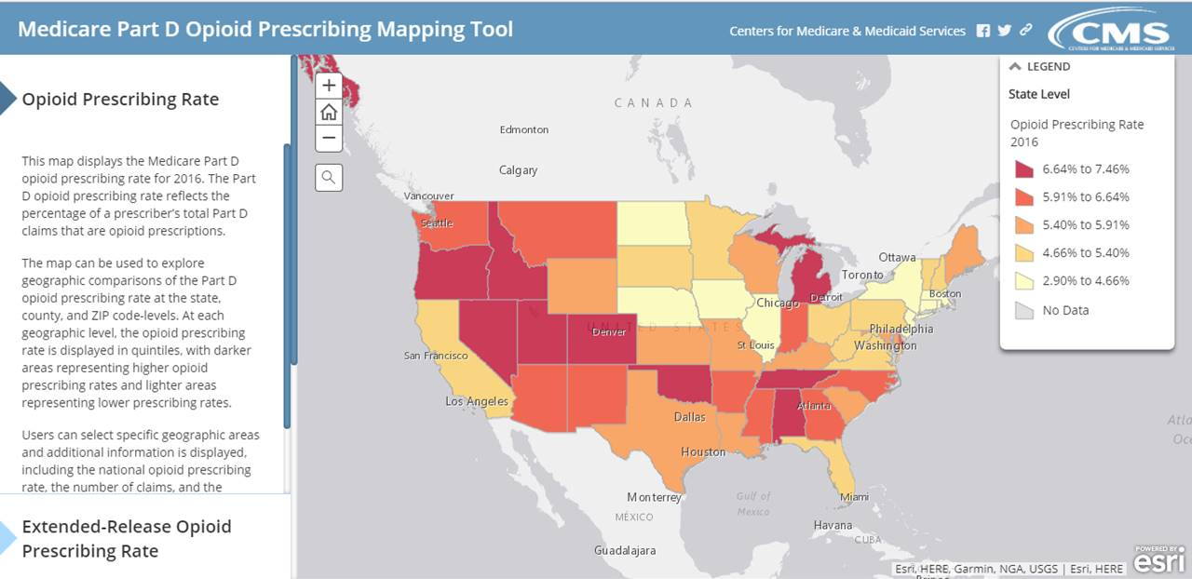
Data
The Opioid Prescribing Mapping Tool for Part D and Medicaid
Go.CMS.gov/opioidheatmap
Notes:
The Medicare Part D Opioid Drug Mapping Tool gives providers, local health officials, and others the data about their community's Medicare opioid prescription rate so they can better target prevention and treatment efforts. It shows geographic comparisons at the state, county, and ZIP code levels and Medicare Part D opioid prescription claims with the personally identifiable information removed for prescriptions written and then submitted to be filled within the U.S.
It’s helpful to look at your area for the percentage of opioid claims. The 2017 updated version of the mapping tool presents Medicare Part D opioid prescribing rates for 2015 as well as the change in opioid prescribing rates from 2013 to 2015. New for this release is additional information on extended-release opioid prescribing rates. The tool is available at Go.CMS.gov/opioidheatmap.

Slide 21
Data
Transformed Medicaid Statistical Information System (T-MSIS)
Highest-level Medicaid data in the history of the program – from all 50 states
Continuous improvement in data quality
SUD Data Book from T-MSIS data
Will be released in November 2019
Go.CMS.gov/opioidheatmap
Notes:
The Medicare Part D Opioid Drug Mapping Tool gives providers, local health officials, and others the data about their community's Medicare opioid prescription rate so they can better target prevention and treatment efforts. It shows geographic comparisons at the state, county, and ZIP code levels and Medicare Part D opioid prescription claims with the personally identifiable information removed for prescriptions written and then submitted to be filled within the U.S.
It’s helpful to look at your area for the percentage of opioid claims. The 2017 updated version of the mapping tool presents Medicare Part D opioid prescribing rates for 2015 as well as the change in opioid prescribing rates from 2013 to 2015. New for this release is additional information on extended-release opioid prescribing rates. The tool is available at Go.CMS.gov/opioidheatmap.

Slide 22
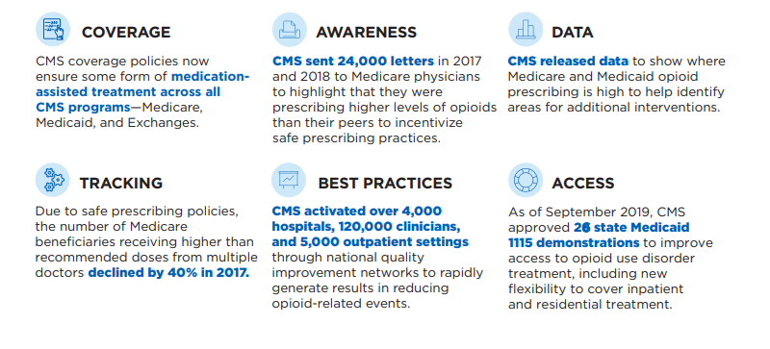
CMS’s Successes So Far
Notes:
CMS’s successes so far have included:
Coverage—CMS coverage policies now ensure some form of medication-assisted treatment across all CMS programs—Medicare, Medicaid, and Marketplace (Exchanges).
Awareness—CMS sent 24,000 letters in 2017 and 2018 to Medicare physicians to highlight that they were prescribing higher levels of opioids than their peers to incentivize safe prescribing practices.
Data—CMS released data in 2018 and 2019 to show where Medicare opioid prescribing is high to help identify areas for additional interventions.
Tracking—Due to safe prescribing policies, the number of people with Medicare receiving higher than recommended doses from multiple doctors declined by 40% in 2017.
Best Practices—CMS activated over 4,000 hospitals, 120,000 clinicians, and 5,000 outpatient settings through national quality improvement networks to rapidly generate results in reducing opioid-related events.
Access—As of June 2018, CMS approved 12 state Medicaid 1115 demonstrations to improve access to opioid use disorder treatment, including new flexibility to cover inpatient and residential treatment while ensuring quality of care.

Slide 23
CMS’s Successes So Far
13 of 49 SUPPORT Act provisions completed
Between 2012 and 2018, there was a 43% decrease in the rate of Part D enrollees meeting or exceeding 90 MME for at least one day
Disbursed grants of nearly $50m to 15 states to help them plan demonstrations for expanded SUD treatment and recovery services
Notes:
CMS’s successes so far have included:
Coverage—CMS coverage policies now ensure some form of medication-assisted treatment across all CMS programs—Medicare, Medicaid, and Marketplace (Exchanges).
Awareness—CMS sent 24,000 letters in 2017 and 2018 to Medicare physicians to highlight that they were prescribing higher levels of opioids than their peers to incentivize safe prescribing practices.
Data—CMS released data in 2018 and 2019 to show where Medicare opioid prescribing is high to help identify areas for additional interventions.
Tracking—Due to safe prescribing policies, the number of people with Medicare receiving higher than recommended doses from multiple doctors declined by 40% in 2017.
Best Practices—CMS activated over 4,000 hospitals, 120,000 clinicians, and 5,000 outpatient settings through national quality improvement networks to rapidly generate results in reducing opioid-related events.
Access—As of June 2018, CMS approved 12 state Medicaid 1115 demonstrations to improve access to opioid use disorder treatment, including new flexibility to cover inpatient and residential treatment while ensuring quality of care.

Slide 24
CMS’s Successes So Far
86% of Part D contracts have a drug management program (DMP), which are currently voluntary in 2019
Expanded access to telehealth services for SUD treatment for all Medicare beneficiaries
Two new innovative model programs to support advances in the coordination of clinical care: the Maternal Opioid Misuse (MOM) model for pregnant women and infants, and the Integrated Care for Kids (InCK) model
Notes:
CMS’s successes so far have included:
Coverage—CMS coverage policies now ensure some form of medication-assisted treatment across all CMS programs—Medicare, Medicaid, and Marketplace (Exchanges).
Awareness—CMS sent 24,000 letters in 2017 and 2018 to Medicare physicians to highlight that they were prescribing higher levels of opioids than their peers to incentivize safe prescribing practices.
Data—CMS released data in 2018 and 2019 to show where Medicare opioid prescribing is high to help identify areas for additional interventions.
Tracking—Due to safe prescribing policies, the number of people with Medicare receiving higher than recommended doses from multiple doctors declined by 40% in 2017.
Best Practices—CMS activated over 4,000 hospitals, 120,000 clinicians, and 5,000 outpatient settings through national quality improvement networks to rapidly generate results in reducing opioid-related events.
Access—As of June 2018, CMS approved 12 state Medicaid 1115 demonstrations to improve access to opioid use disorder treatment, including new flexibility to cover inpatient and residential treatment while ensuring quality of care.

Slide 25
Additional Information and Resources
Notes:
The Medicare Part D Opioid Drug Mapping Tool gives providers, local health officials, and others the data about their community's Medicare opioid prescription rate so they can better target prevention and treatment efforts. It shows geographic comparisons at the state, county, and ZIP code levels and Medicare Part D opioid prescription claims with the personally identifiable information removed for prescriptions written and then submitted to be filled within the U.S.
It’s helpful to look at your area for the percentage of opioid claims. The 2017 updated version of the mapping tool presents Medicare Part D opioid prescribing rates for 2015 as well as the change in opioid prescribing rates from 2013 to 2015. New for this release is additional information on extended-release opioid prescribing rates. The tool is available at Go.CMS.gov/opioidheatmap.

Slide 26
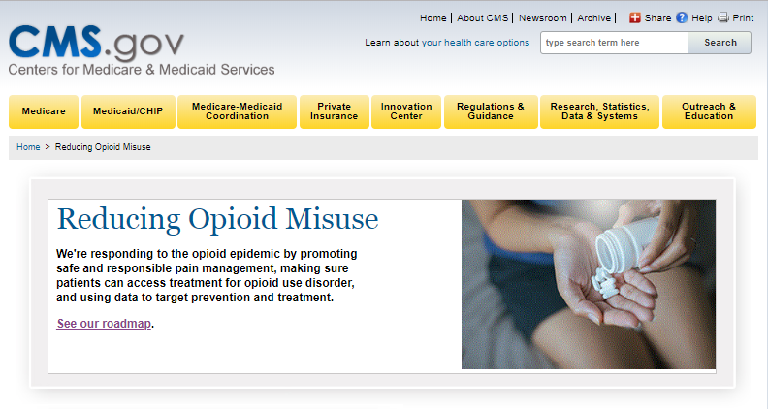
CMS Opioid Resources
CMS.gov/about-cms/story-page/reducing-opioid-misuse.html
Notes:
CMS is responding to the opioid epidemic by promoting safe and responsible pain management, making sure patients can access treatment for opioid use disorder, and using data to target prevention and treatment. For more information, visit CMS.gov/about-cms/story-page/reducing-opioid-misuse.html.

Slide 27
CMS Collaboration With Federal and Private Partners
“Informational Bulletin on Medication-Assisted Treatment (MAT) for Substance Use Disorders”
Surgeon General’s letter campaign on the prescription drug epidemic
Centers for Disease Control and Prevention’s (CDC) “Guideline for Prescribing Opioids for Chronic Pain”
Discussions about expanding the evidence base to inform coverage determinations for alternative therapies
Healthcare Fraud Prevention Partnership (HFPP)
Notes:
CMS engages with other Department of Health and Human Services (HHS) operating divisions to share best practices and coordinate efforts. Examples include
Released “Informational Bulletin on Medication-Assisted Treatment (MAT) for Substance Use Disorders with CDC, Substance Abuse and Mental Health Services Administration (SAMHSA) and National Institutes of Health (NIH)” – July 2014 (Medicaid.gov/federal-policy-guidance/downloads/cib-07-11-2014.pdf).
Facilitated Surgeon General’s letter campaign to 2.3 million clinicians to “Turn the Tide” on the prescription drug epidemic (for more information visit addiction.surgeongeneral.gov/sites/default/files/Spotlight-on-Opioids_09192018.pdf).
Disseminating Centers for Disease Control and Prevention’s (CDC) “Guideline for Prescribing Opioids for Chronic Pain” through CMS Quality Improvement Organization- Quality Innovation Network (QIO-QIN) efforts to reduce adverse drug events for opioids (CDC.gov/drugoverdose/prescribing/guideline.html).
Discussions with CDC, Food & Drug Administration (FDA) and NIH about expanding the evidence base to inform coverage determinations for alternative therapies
Healthcare Fraud Prevention Partnership (HFPP)
Example: Creation of an HFPP-branded White Paper entitled “Healthcare Payer Strategies to Reduce the Harms of Opioids: The Healthcare Fraud Prevention Partnership’s Commitment to the Management of Opioid Misuse and Opioid Use Disorder” (HFPP.cms.gov).

Slide 28
U.S. Department of Health and Human Services (HHS) Opioid Resources
HHS Opioids Initiative HHS.gov/opioids
Substance Abuse & Mental Health Services Administration SAMHSA.gov
Centers for Disease Control and Prevention CDC.gov/drugoverdose/opioids/index.html
U.S. Food and Drug Administration FDA.gov/drugs/drugsafety/informationbydrugclass/ucm337066.htm
National Institute on Drug Abuse Drugabuse.gov/publications/research-reports/prescription-drugs/opioids
Health Resources & Services Administration HRSA.gov/opioids
Administration for Community Living (ACL)
ACL.gov/search/node?keys=opioids&=Search
Agency for Healthcare Research and Quality AHRQ.gov/topics/opioids.html
Notes:
HHS has made it a priority to address opioid abuse, dependence, and overdose. Several agencies within HHS have joined the effort.
HHS Opioids Initiative HHS.gov/opioids
Substance Abuse & Mental Health Services Administration SAMHSA.gov
Centers for Disease Control and Prevention CDC.gov/drugoverdose/opioids/index.html
U.S. Food and Drug Administration FDA.gov/drugs/drugsafety/informationbydrugclass/ucm337066.htm\
National Institute on Drug Abuse Drugabuse.gov/publications/research-reports/prescription-drugs/opioids
Health Resources & Services Administration HRSA.gov/opioids
Administration for Community Living (ACL) ACL.gov/search/node?keys=opioids&=Search
Agency for Healthcare Research and Quality AHRQ.gov/topics/opioids.html

Slide 29
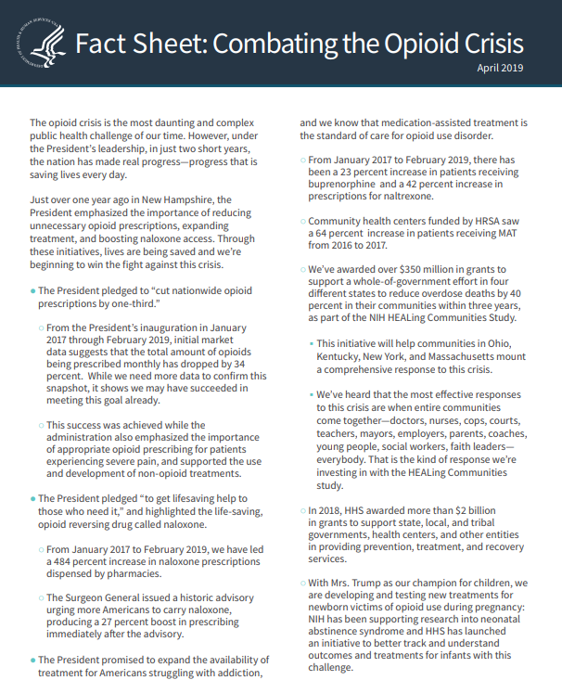
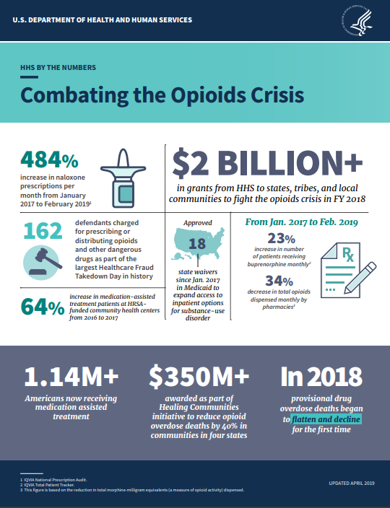
NEW—U.S. Department of Health and Human Services (HHS) Combatting the Opioids Crisis
Fact sheet HHS.gov/sites/default/files/opioids-fact-sheet-april-2019.pdf
Infographic HHS.gov/sites/default/files/opioids-infographic-april-2019.pdf
Watch HHS Secretary Azar explain the HHS 5-point plan for combating the opioid crisis
Notes:
There is a NEW HHS Combatting the Opioids Crisis fact sheet and infographic.
Fact sheet HHS.gov/sites/default/files/opioids-fact-sheet-april-2019.pdf
Infographic HHS.gov/sites/default/files/opioids-infographic-april-2019.pdf
Watch HHS Secretary Azar explain the HHS 5-point plan for combating the opioid crisis

Slide 30
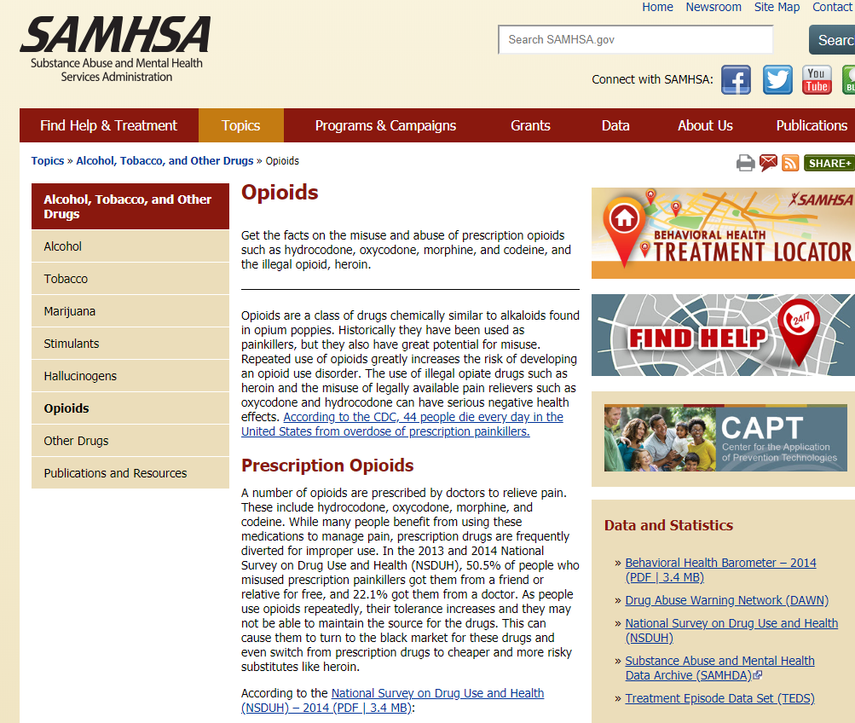
Substance Abuse & Mental Health Services Administration (SAMHSA) Resources
Behavioral Treatment Services Locator
SAMHSA National Helpline
Treatment program locators (buprenorphine and methadone) for opioid addiction
Notes:
There are multiple resources available on the Substance Abuse & Mental Health Services Administration (SAMHSA) website, SAMHSA.gov/find-help. The graphic shows a portion of the SAMHSA website with the following resources: Behavioral Health Treatment Services Locator, SAMHSA National Helpline, and Treatment Program Locators (buprenorphine and methadone) for opioid addiction. The “Medication-Assisted Treatment of Opioid Use Disorder Pocket Guide” offers guidance for doctors on the use of medication-assisted treatment for patients with opioid use disorder.

Slide 31
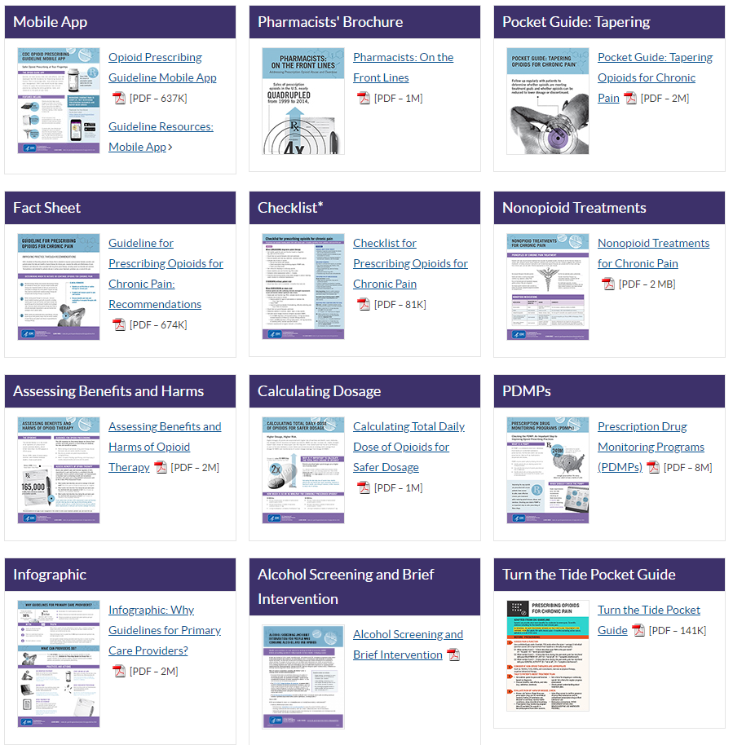
Centers for Disease Control and Prevention (CDC) Resources for Providers
CDC.gov/drugoverdose/prescribing/clinical-tools.html
Notes:
Here are a few of the CDC resources that are available for providers. Some of these include a mobile app, pharmacists’ brochure, fact sheets and pocket guides. Visit CDC.gov/drugoverdose/prescribing/clinical-tools.html to review the resources.

Slide 32
This Training is Provided By
CMS National Training Program (NTP)
To view all available NTP training materials,
or to subscribe to our email list, visit
CMSnationaltrainingprogram.cms.gov.
Stay connected.
Contact us at training@cms.hhs.gov, or
follow us @CMSGov #CMSNTP
Notes:
Here are a few of the CDC resources that are available for providers. Some of these include a mobile app, pharmacists’ brochure, fact sheets and pocket guides. Visit CDC.gov/drugoverdose/prescribing/clinical-tools.html to review the resources.

