Slide 1
How Emerging Technology is Transforming Actuarial Science
MAAC Annual 2018

Slide 2
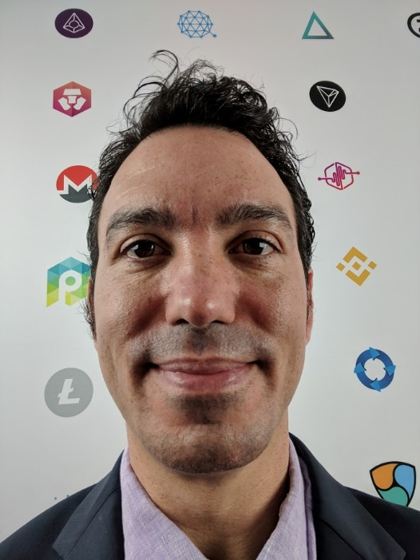
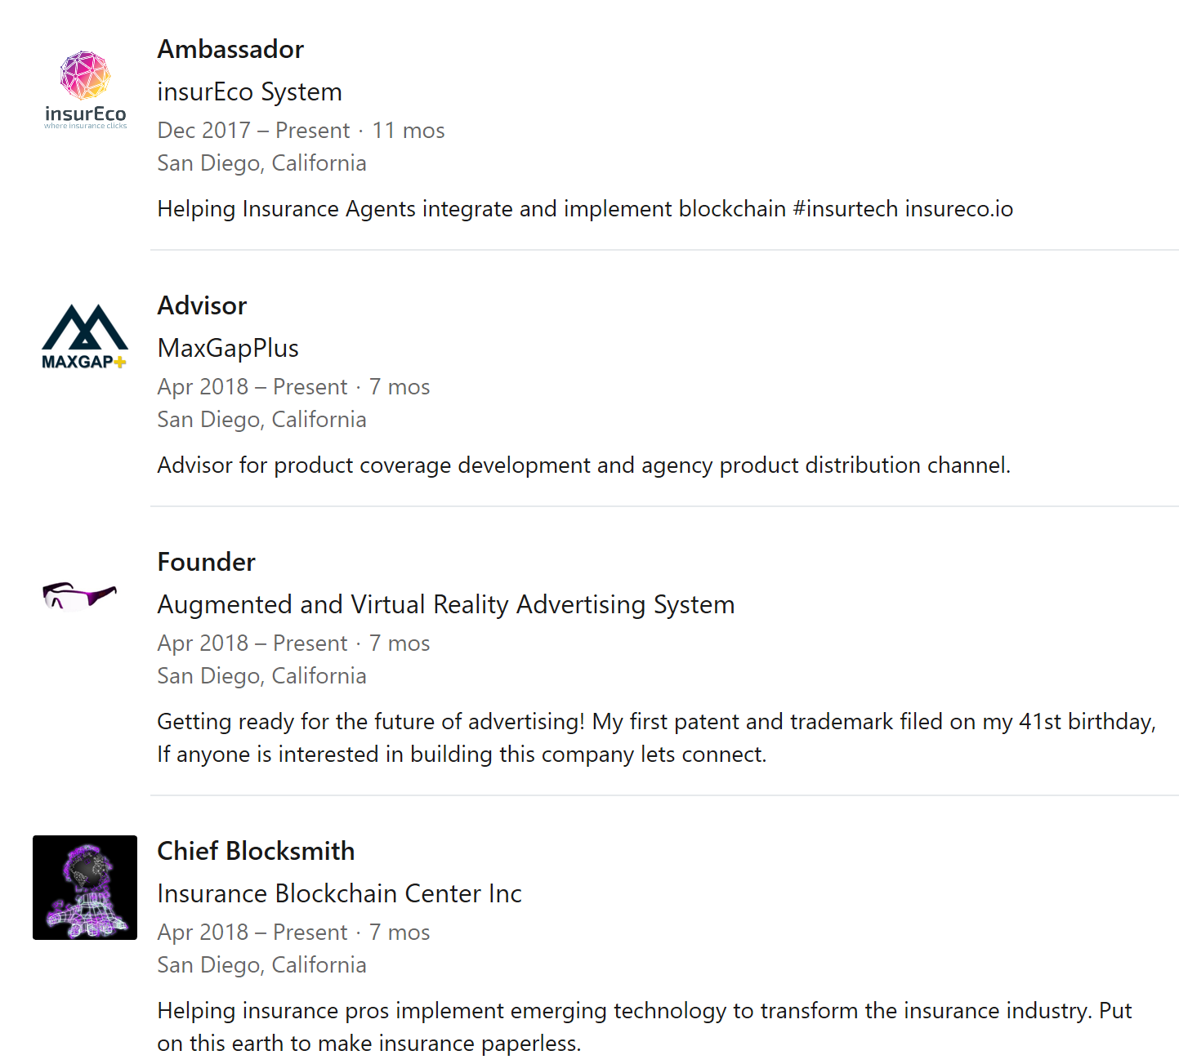
Phil Duncan COO of
““Changing is hard but not changing is disastrous.”

Slide 3
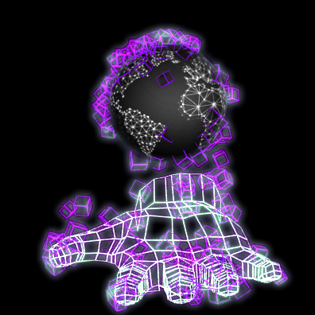
Embrace the future!
Development of new Models using emerging technology
Big Data, Machine Learning and AI changing the game
Improved Reporting, faster modeling and the potential benefits of blockchain

Slide 4
Nick Leimer Principal Program Manager, Industry Experiences Cloud + Enterprise - Microsoft
“New regulations, such as International Financial Reporting Standard 17 (IFRS 17), Solvency II, and Actuarial Guideline XLIII, are increasing the pressure by requiring significant actuarial modeling and additional compute power.
With increasingly complicated risk models and new broader regulations, the demand for calculation capacity will grow as well. The cloud is the only feasible solution to meet this growing need.”

Slide 5
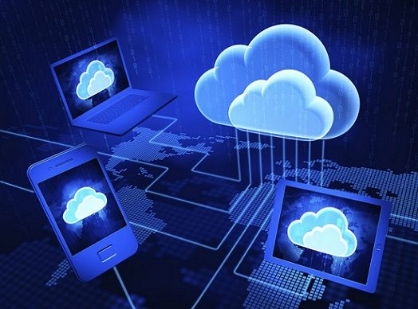
Cloud Computing – What is it?
Storing and accessing data and programs over the Internet instead of your computer's hard drive
Clouds = Internet
Information is “synced”
Online real-time back
Software and processing power accessed through the internet

Slide 6
Cloud Computing - Benefits
More time to review, evaluate, and validate results
Reduce the friction between systems
Improved data preparation and parallelization
Data protection retention and recovery
Investment in operations not hardware that depreciates

Slide 7
Cloud Computing – Big News!
IBM pays 34B for Redhat
Alibaba 825M revenue in a quarter
Hyperscale 400G data centers
Super-computer brings 'cloud' computing to astronauts in space
Underwater data centers in expanding global cloud computing platform

Slide 8
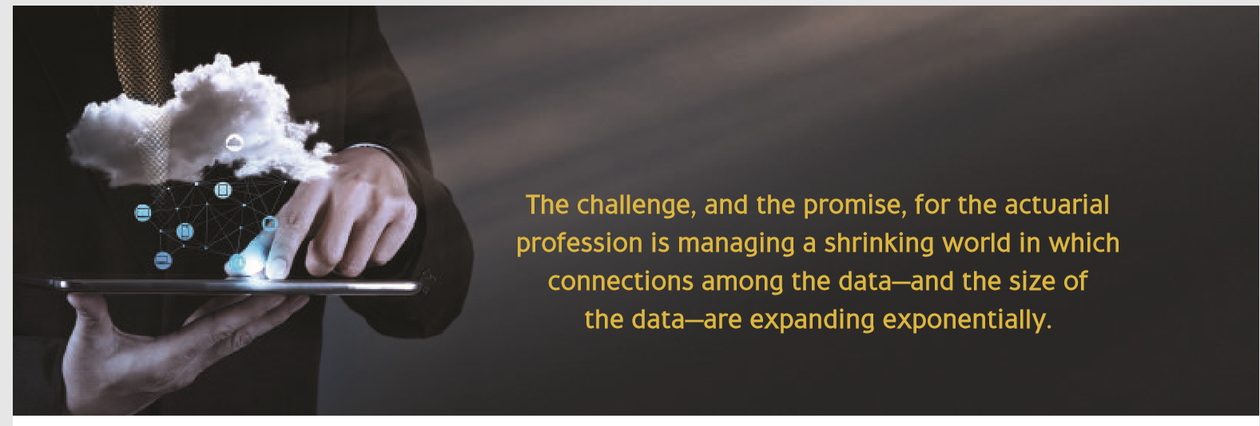
2014 InsuranceERM Study on the impact of Cloud Computing
The production of quarterly numbers took 97.5 percent less time and required 95 percent fewer staff hours
Manual processes were reduced from 900 to 44
Individual modeling and processing systems decreased from hundreds to one unified platform
Opportunities to grow business expanded
The firm was better prepared for Solvency II and ICAS+
Operational risk was lowered.

Slide 9
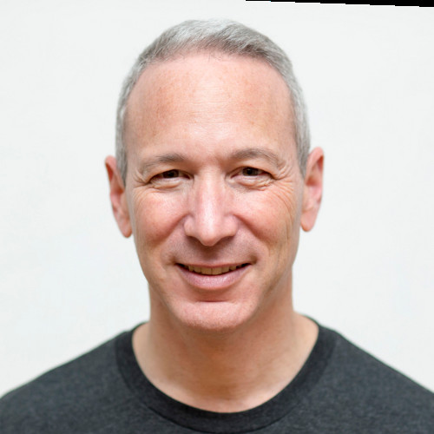
Daniel Schreiber CEO of Lemonade
“Insurtech 2.0 is a Delightful customer centric experience becoming a deep seeing insightful experience where bots and AI replace actuaries”

Slide 10
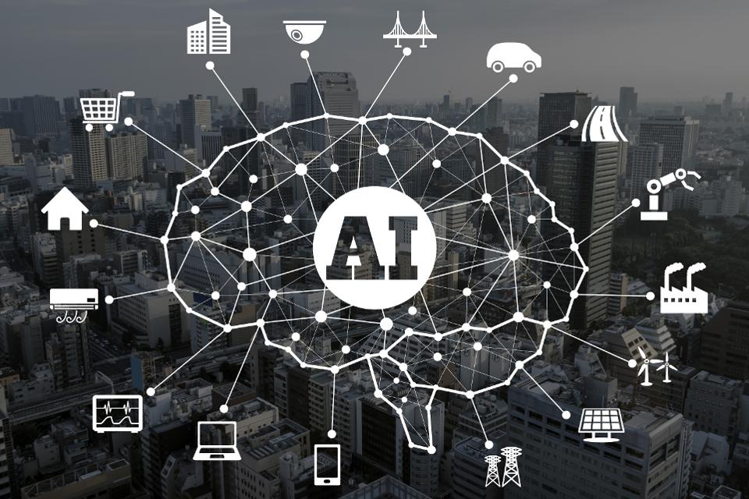
AI, Big Data and Machine Learning – What is it?
AI - the theory and development of computer systems able to perform tasks that normally require human intelligence, such as visual perception, speech recognition, decision-making, and translation between language
Big Data - extremely large data sets that may be analyzed computationally to reveal patterns, trends, and associations, especially relating to human behavior and interactions.
Machine Learning - is an application of artificial intelligence (AI) that provides systems the ability to automatically learn and improve from experience without being explicitly programmed.

Slide 11
AI, Big Data and Machine Learning - Benefits
More data and less noise
Better predictive abilities
Realtime data and IoT
Faster response to emerging risk and changing risk factors
Augments and enhances existing methods

Slide 12
AI, Big Data and Machine Learning – Big News!
“As AI gets probably much smarter than humans, the relative intelligence ratio is probably similar to that between a person and a cat, maybe bigger” Elon Musk
AI Cameras for retail stores
Last year VCs invested $5 billion in 658 companies, a 61% increase over the year prior
Machine-learning algorithm beats 20 lawyers in NDA legal analysis

Slide 13
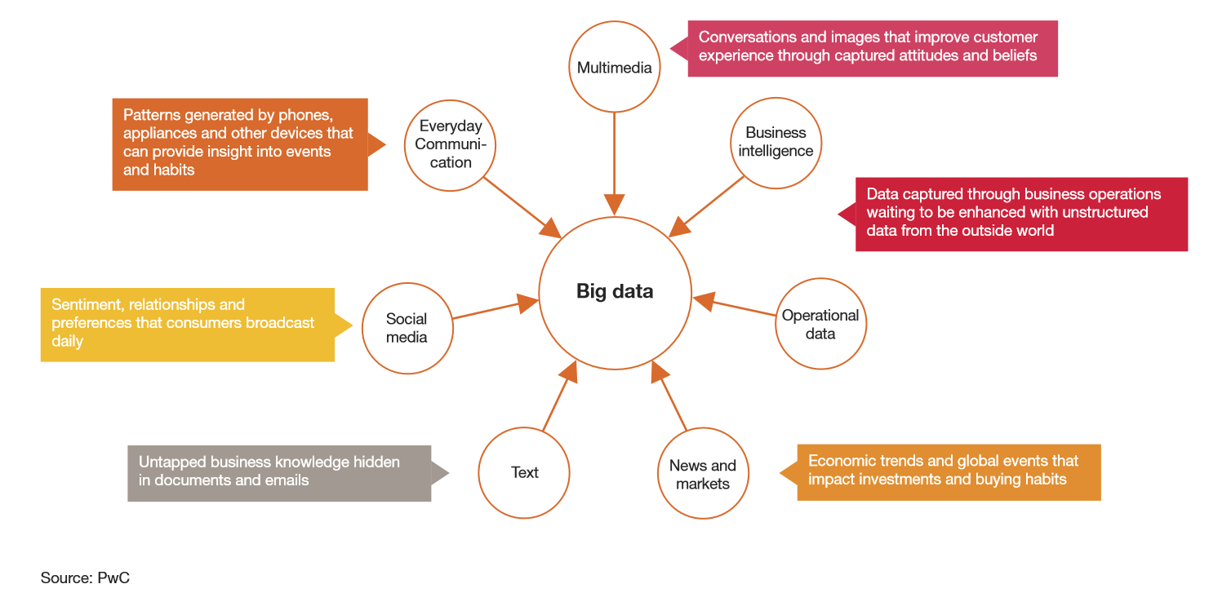
2012 PWC Study Life insurance 2020: Competing for a future
Surge in data traffic and development of advanced analytical techniques
AI & Machine Learning augments customer data with public, open source information, and can make predictions about customer behavior based on trends
Customers demanding better value and more transparency

Slide 14
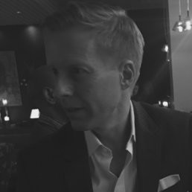
Dave Nuernberg Principal Ernst & Young LLP
Blockchain has the potential to evolve into a core, underlying element in the technology “stacks” of most P&C carriers, supporting a diverse range of processes and part of your company’s future technology “plumbing.”

Slide 15
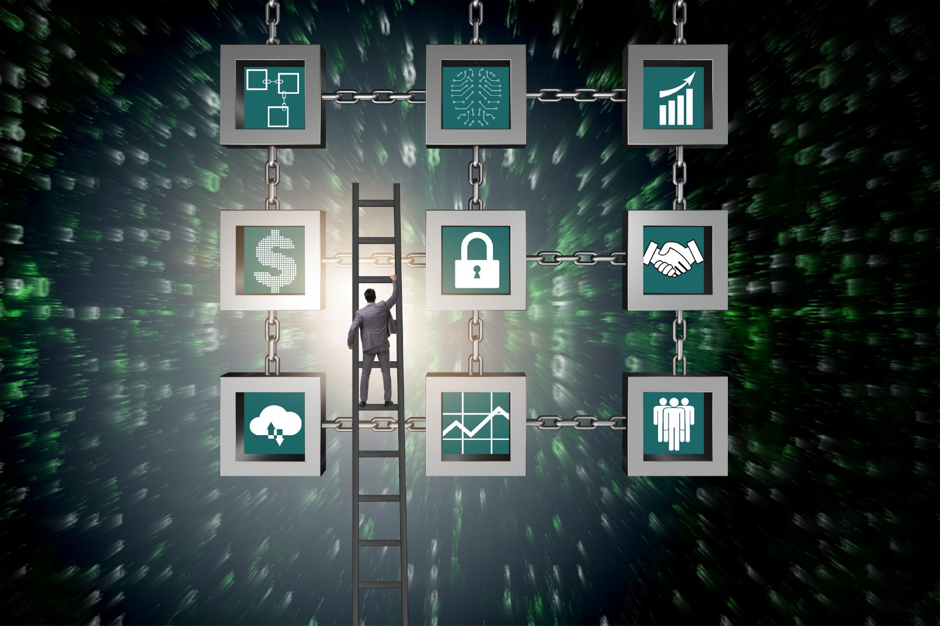
Blockchain – What is it?
Another way to store data that is linked to other parties
Decentralized, Secure & Immutable
Single source of truth
Cryptocurrency is only one application of blockchain
Multiple Blockchains
Smart Contracts
Mining & Consensus

Slide 16
Blockchain - Benefits
Fraud detection and risk prevention
Claims prevention and management
Internet of Things (IoT) and product development
New distribution and payment models
Reinsurance

Slide 17
Blockchain – Some current uses
Consortiums - B3i, R3, Risk Block Alliance
Ecosystems – Galileo & insurEco
Internet of Things (IoT) and product development – Etherisc using Smart Contracts
New distribution payment models - Fizzy 100% Indemnification
Reinsurance and New methods of Risk Financing - Asset Tokenization and Digitizing Risk

Slide 18
Blockchain – Big News!
GDPR and Blockchain
Over 20B IoT and IDoT by 2020
Two-thirds of large firms considering blockchain
Parametric products for low premium, high volume business
Don’t believe the hype!

Slide 19
2018 IBM and Maersk - A global trade platform using blockchain technology aimed at improving the cost of transportation, lack of visibility and inefficiencies with paper-based processes
Fast, secure access to end-to-end supply chain information; single source of truth
Verifiable authenticity and immutability of digital documents
Trusted cross-organizational workflows
Better risk assessments and fewer unnecessary interventions
Far lower administrative expenses and elimination of costs to move physical paper across international borders

Slide 20
The Digital Transformation is Great News for Data Scientist!
Top 25 job with a 22% Growth – Business Insider 2018
Skills are needed across industries
If Data is the “New Gold” then you are the modern prospector
Technology is much easier to use don’t be afraid
You are solving real problems that have big impact
You are directly responsible for shaping the way all of this emerging technology is being used

Slide 21
THANK YOU!
““Changing is hard but not changing is disastrous.”
Tips:
Daily research and subscription to informational and transformational learning
Podcasts
Blogs
News
Prioritize this
Weekly inter-office collaboration
Monthly review reassessing the investment of your time.
Quarterly review. After three months of deep learning and commitment to this process you will be able to put your plan into action.
Phil Duncan
phil@insureco.io
619-684-3851

Slide 22
Q&A
Are there new security risks posed by blockchain?
How does blockchain differ from bitcoin and other cryptocurrencies?
What exactly is a cryptocurrency and how is it regulated?
What is an Initial Coin Offering (ICO) ?
What are the regulatory concerns with ICOs?
With all the fraud out there, how can we tell if a business using blockchain or having an ICO is legit?
Can you give examples of litigation involving blockchain or cryptos and the impact on different insurance products (e.g. D&O, Crime, Cyber, etc.)?
Phil Duncan
phil@insureco.io
619-684-3851

