Slide 1
The Cost of Pharmacy Innovation

Slide 2
Eteplirsen (DMD)
Approved 9/19/16 – under accelerated approval program
Duchenne Muscular Dystrophy (DMD) is a rare disease primarily affecting boys
DMD patients with exon skipping mutation of the dystrophin gene (13%) are eligible for Eteplirsen (Source: FDA press release)
AWP of $960 per ml, or $750K annually for a fully compliant 55-pound patient
No clinical benefit yet – must prove or could be withdrawn

Slide 3
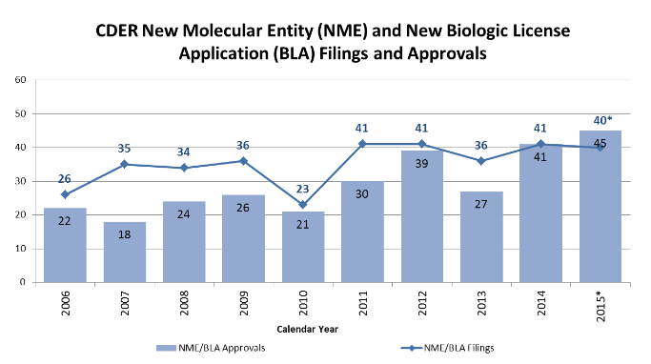
Specialty Drug Approvals

Slide 4
Recent Innovation
Cystic Fibrosis
Cancer
Hepatitis C
ALS
Enzyme Replacement
Muscular Dystrophy
Psoriasis
HIV
How do we pay for innovation?

Slide 5
High Cost/Clinical Effectiveness
High costs – spread out over less people vs. traditional drugs
Orphan Drugs – being used for non-rare diseases
Expanded indications
High cost trends on high cost drugs
Clinical Effectiveness – how to measure, who decides

Slide 6
Paying for Innovation
Innovation
Patients
Government
Payers
Employers
Other Insureds

Slide 7
Patients
Aging population, increase in chronic diseases means larger percent of population eligible for treatment
Direct-to-consumer marketing – members want the “latest and greatest”
Insurance
Coinsurance/Copay
Deductibles and Maximum out-of-pocket
Manufacturer copay assistance programs

Slide 8
Employers
High cost innovation = higher premiums
Specialty cost sharing
Manufacturer copay assistance programs – patient benefit, not employer
Other benefit design considerations
Impact of treatment and adherence on work productivity

Slide 9
Payers – Forecasting Cost Impact
Who will be eligible?
How much will it cost?
New products are reviewed to ensure appropriate clinical edits
Channel management – specialty pharmacy, site of care
Medical cost impact? Extension of life

Slide 10
Payers - Challenges
Products released at higher cost than originally projected
Manufacturers setting/increasing prices at their sole discretion
Use of preferred agents and adherence to clinical policies
Trend relief of biosimilar launches is questionable
Few blockbuster generics coming to help hold down trend

Slide 11
High Cost Drugs in Medicare Part D

Slide 12
Part D Reinsurance
Part D Reinsurance pays 80% of the gross drug costs above the true out of pocket maximum, less the catastrophic portion of rebates
High cost drugs are the majority of these expenditures
Reinsurance payments have increased by double digits in each of the last 5 years
The last three years have increased more than 20% each year

Slide 13
Revolution versus Improvement
Drugs that radically alter the treatment of a condition or disease draw our attention
These drugs cause sudden, dramatic spikes in cost
Alter the landscape for previously untreatable conditions
Hepatitis-C drugs
Kalydeco for cystic fibrosis
Alzheimer’s?
Many other drugs offer improvements over existing therapies, but take time to gain footing in the market
Substantially higher cost than existing therapies
Varying clinical gains over prior agents
Blood thinners
Prostate Cancer
Diabetes

Slide 14
Pipeline
Revolutionary
Liver Disease
Cancer
HIV
Alzheimer’s
Always promising, but rarely materializes
Improvements
Rheumatoid arthritis
Cancer
Diabetes
COPD

Slide 15
Hepatitis-C
Sovaldi and Olysio take off in the market as Hepatitis-C becomes a curable disease
Impacts vary widely by plan, as a small difference in the number of members has a large effect on costs
Unclear where these costs will ultimately settle

Slide 16
Managing Utilization and Price
Prior Authorization is one of the few tools available to manage utilization
Consider criteria carefully
Formulary management to obtain the best price
Variety of clinical and price concerns when determining strategy

Slide 17
Blood Thinners
Brand name blood thinners have increased significantly in recent years
More convenient than generic agent
Safety concerns
Impacts to medical cost
Unit cost not alarming, but much higher than generic
Part D Allowed Drug Cost PMPM
Drug | 2012 | 2013 | 2014
Eliquis | $0.00 | $0.10 | $0.70
Pradaxa | $1.04 | $1.17 | $1.23
Xarelto | $0.26 | $1.21 | $2.40
Warfarin Sodium | $0.47 | $0.43 | $0.36

Slide 18
Prostate Cancer
Xtandi is a newer anti-androgen drug
Launched in 2012, at a significant premium over Zytiga
Since 2012, Zytiga has increased prices to near Xtandi levels
Xtandi use has increased more quickly than Zytiga
Lower overall spend levels may not draw attention
Part D Allowed Drug Cost PMPM
Drug | 2012 | 2013 | 2014
Zytiga | $0.59 | $1.10 | $1.56
Xtandi | $0.09 | $0.54 | $0.99

Slide 19
Insulins
One of the highest cost drug classes
Dynamic marketplace is challenging to predict and manage
Biosimilar drug Basaglar approved at end of 2015
New branded drugs: Tresiba and Toujeo
Will the biosimilar be widely used?
How successful will manufacturers be at moving patients to new therapies?
New combination agents in pipeline

Slide 20
Managing Improvements
Typical techniques still apply (clinical edits, formulary)
Can be trickier as evidence is often mixed
Consider impacts to medical expense as well
Value-based contracting
Outcomes or Indications?
Recent development
Oncology pathways
Requires provider cooperation
New techniques require more legwork to put in place

Slide 21
Blood Thinners Revisited
How would we have managed Pradaxa when it entered the market?
Standard Management
Place on high (non-preferred tier)
Put on a step-edit through cheaper generic
Holistic Management
Consider condition rather than drug
Are there impacts to medical cost?
Is there enough data on safety?
What other drugs will be entering the class?
Organization priorities

Slide 22
Questions

