Slide 1
Predictive Modeling Workshop
Nick Hanewinckel, FSA, CERA, AVP and Actuary, Mortality Solutions
MAAC
Monday, November 5, 2018

Slide 2
SOA Antitrust Compliance Guidelines
Active participation in the Society of Actuaries is an important aspect of membership. While the positive contributions of professional societies and associations are well-recognized and encouraged, association activities are vulnerable to close antitrust scrutiny. By their very nature, associations bring together industry competitors and other market participants.
The United States antitrust laws aim to protect consumers by preserving the free economy and prohibiting anti-competitive business practices; they promote competition. There are both state and federal antitrust laws, although state antitrust laws closely follow federal law. The Sherman Act, is the primary U.S. antitrust law pertaining to association activities. The Sherman Act prohibits every contract, combination or conspiracy that places an unreasonable restraint on trade. There are, however, some activities that are illegal under all circumstances, such as price fixing, market allocation and collusive bidding.
There is no safe harbor under the antitrust law for professional association activities. Therefore, association meeting participants should refrain from discussing any activity that could potentially be construed as having an anti-competitive effect. Discussions relating to product or service pricing, market allocations, membership restrictions, product standardization or other conditions on trade could arguably be perceived as a restraint on trade and may expose the SOA and its members to antitrust enforcement procedures.
While participating in all SOA in person meetings, webinars, teleconferences or side discussions, you should avoid discussing competitively sensitive information with competitors and follow these guidelines:
-Do not discuss prices for services or products or anything else that might affect prices
-Do not discuss what you or other entities plan to do in a particular geographic or product markets or with particular customers.
-Do not speak on behalf of the SOA or any of its committees unless specifically authorized to do so.
-Do leave a meeting where any anticompetitive pricing or market allocation discussion occurs.
-Do alert SOA staff and/or legal counsel to any concerning discussions
-Do consult with legal counsel before raising any matter or making a statement that may involve competitively sensitive information.
Adherence to these guidelines involves not only avoidance of antitrust violations, but avoidance of behavior which might be so construed. These guidelines only provide an overview of prohibited activities. SOA legal counsel reviews meeting agenda and materials as deemed appropriate and any discussion that departs from the formal agenda should be scrutinized carefully. Antitrust compliance is everyone’s responsibility; however, please seek legal counsel if you have any questions or concerns.

Slide 3
Presentation Disclaimer
Presentations are intended for educational purposes only and do not replace independent professional judgment. Statements of fact and opinions expressed are those of the participants individually and, unless expressly stated to the contrary, are not the opinion or position of the Society of Actuaries, its cosponsors or its committees. The Society of Actuaries does not endorse or approve, and assumes no responsibility for, the content, accuracy or completeness of the information presented. Attendees should note that the sessions are audio-recorded and may be published in various media, including print, audio and video formats without further notice.

Slide 4
Disclaimer
This presentation does not address the investment objectives or financial situation of any particular person or legal entity. Investors should seek independent professional advice and perform their own analysis regarding the appropriateness of investing in any of our securities.
While Hannover Re has endeavoured to include in this presentation information it believes to be reliable, complete and up-to-date, the company does not make any representation or warranty, express or implied, as to the accuracy, completeness or updated status of such information.
Some of the statements in this presentation may be forward-looking statements or statements of future expectations based on currently available information. Such statements naturally are subject to risks and uncertainties. Factors such as the development of general economic conditions, future market conditions, unusual catastrophic loss events, changes in the capital markets and other circumstances may cause the actual events or results to be materially different from those anticipated by such statements.
This presentation serves information purposes only and does not constitute or form part of an offer or solicitation to acquire, subscribe to or dispose of, any of the securities of Hannover Re.
© Hannover Rück SE. All rights reserved. Hannover Re is the registered service mark of Hannover Rück SE.

Slide 5
Getting Started

Slide 6
Goals
Overview of Predictive Modeling Process
Extensible to Any Platform
Interactive and Technical
→ R will be used for technical work

Slide 7
What is Predictive Modeling?
Statistical Models – Implies inference
Seek the relationships between variables
Predictive Models – Implies prediction
Seek to predict target on new data
Many “Statistical Models” are used for prediction. “Machine Learning” models are generally poor for inference.
Notes:
Point out that this question is in so many presentations, it’s almost a cliché.
People get confused by the ‘Blurry Line’ and it shouldn’t be a big deal.
Any model (statistical or otherwise) could fall under Predictive Modelling – it depends on use.

Slide 8
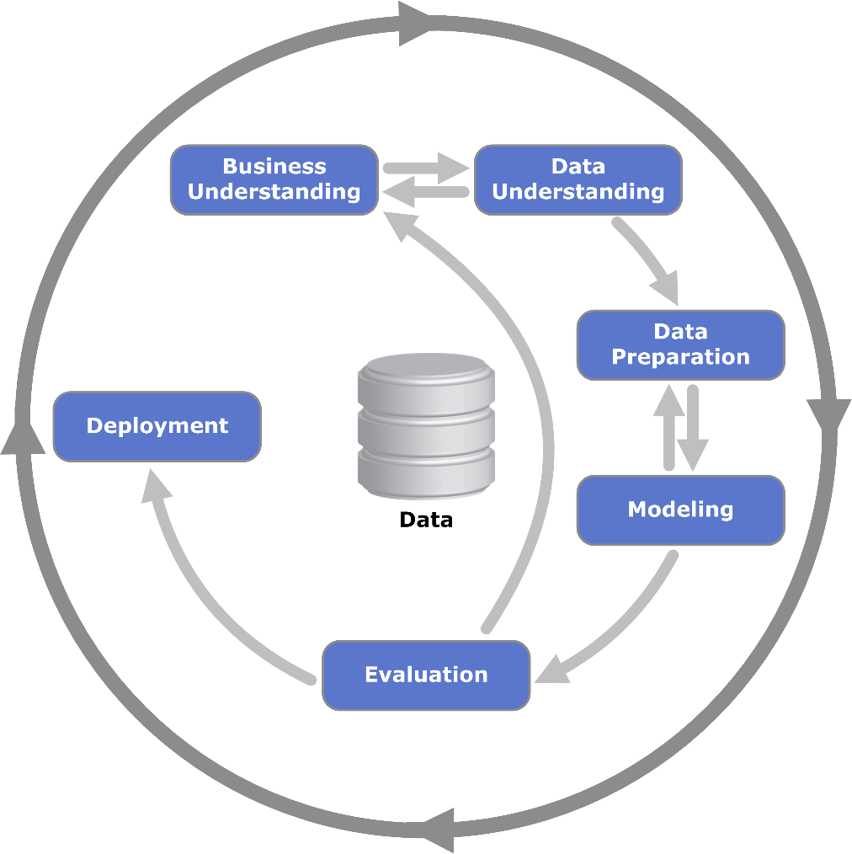
Predictive Modeling Frameworks
CRISP-DM
Cross-Industry Standard Process for Data Mining
By Kenneth Jensen - Own work based on: (link)
Notes:
There are many PM frameworks/steps you can google. CRISP-DM is nice because it shows the interactive/recursive nature of the process.
Widely used (SPSS Modeller). “Data Mining” is a misnomer in this context.
Often the more general terms (large scale) data analysis and analytics – or, when referring to actual methods, artificial intelligence and machine learning – are more appropriate. (Wikipedia)

Slide 9
Predictive Modeling Frameworks
7-Steps Predictive Modeling Process
Understand Business Objective
Define Modeling Goals
Select/Get Data
Prepare Data
Analyze and Transform Variables. Random Sampling
Model Selection and Develop Models (Training)
Validate Models (Testing), Optimize and Profitability
“Open Source” Example
From Rstudio site
By Ariful Mondal
Notes:
In many frameworks – Step 1 and 2 are often combined. There is often an additional step for model maintenance.

Slide 10
R / RStudio

Slide 11
What is Predictive Modeling?
R language
R:
Statistical Programming Language
Free/Open Source
Extensible with “Packages”
R Studio:
A highly advanced UI
Also allows for robust report creation

Slide 12
What is Predictive Modeling?
To Get R/RStudio
R: www.r-project.org/
Also the site for packages/documentation
Rstudio: www.rstudio.com/
A good source for professional packages and documentation

Slide 13
Business Understanding

Slide 14
Ask the Right Questions
“Bad” Questions:
How “Predictive” is variable X?
What’s the relationship between X and Y?
How much value does Z add?
Is buying data Q worth the money?
Notes:
Business users and modelers often use different language.
Questions aren’t really “bad”, but may need to be translated to something with a specific goal and way to quantify.
Does relationship imply a linear correlation? Could we use other tests of dependence (Kendall’s Tau, Spearman’s Rho)?
What do we mean “add”? Economic value of data is separate from the predictive modeling process.

Slide 15
Ask the Right Questions
Better Questions:
How much does variable X improve our prediction accuracy?
How does target variable Y change as X increases? (inference)
Does Z normalize residuals?
Can we generate data Q’s predictions for input to a cash-flow model?
Notes:
Business users and modelers often use different language.
Questions aren’t really “bad”, but may need to be translated to something with a specific goal and way to quantify.
Explain “normalize” – If errors are non-random, an additional variable may account for this. If so, under many models, this should be Gaussian (normal) noise.
A cash flow model is a separate (non-predictive model). The modeler may be interested in financial questions, but would not try to solve it within the Modeling framework.

Slide 16
Data Understanding

Slide 17
Can the data answer the modeling question?
If not, what else is needed?

Slide 18
Is the data generalizable to new data?
If not, do NOT make financial decisions on predictions!
Notes:
Important point – we cannot answer this question by simply staring at a data table.
This speaks to the iterative nature of the framework – after testing a model, our testing/training set may tell us if it is generalizable.
However, what we know about the data may help answer the question before putting in the work.
Example:
- A bank wants to predict forclosure rates for underwritten mortgages. They obtain a sample of internal data from Calendar Years 2008-2012. Can you tell why they might not want to rely on a model built on this data, even though you have not built and evaluated a model?

Slide 19
Does data have errors?
Is missing data meaningful?
Both statistical testing and business knowledge are key.
Notes:
Explain “meaningful missingness”
Can we accurately detect the errors?
Can we impute missing values?
If we eliminate missing observations, do we have enough data?

Slide 20
Does data have ‘quirks’ or ‘pitfalls’?
This may indicate data may need ‘cleaning’
Example: Life insurance data has
Conversions – these should not be treated as newly underwritten!
Notes:
Because of this, we’ll still have jobs!

Slide 21
Data Preparation
Notes:
Some of this is easy – what we discovered in the previous step, take action!

Slide 22
Data Preprocessing
Center and Scale
Remove Skewness
Deal with Correlated Variables
Remove low-variance predictors
Splitting (Training/Testing Set)
Note: R users may want to take advantage of the caret package’s ability to deal with these preprocessing steps.
Notes:
Many of this depends on the model form. Many statistical models, esp. GLM are very sensitive to correlated variables and outliers for mathematical reasons.

Slide 23
Center and Scale
Subtract the mean from each variable
Divide by the Standard Deviation
Notes:
Note that much of this may be ‘built in’. Check your software package.

Slide 24
Deal with Skewness
If necessary, we could use:
Log Transformations
Box-Cox Transformation
Yeo-Johnson if zeroes or negative values
Notes:
Note that much of this may be ‘built in’. Check your software package.

Slide 25
Correlated Variables
Computationally problematic for GLM, others
Options:
Eliminate the “lesser” of the correlated variables
Engineer a new variable (e.g. ratio of X1/X2)
Dimension Reduction (e.g. Principal Component Analysis)

Slide 26
Near Zero Variance
Rule of thumb for removal:
Low fraction of unique values to sample size
Ratio of frequency of most prevalent value to second-most prevalent value is low
Notes:
From Applied Predictive Modeling pg 45

Slide 27
Data Splitting (crucial)
To prevent overfit, use Training and Testing Set
Can be random or stratified to ensure equal sampling
Notes:
Concept of overfit – data may not generalize well. Variance-Bias tradeoff.
Bias = underfit
Variance = overfit

Slide 28
Data Splitting (crucial)
Often 80% of the data is used to train (fit) the model
The remaining 20% is used to test the model on new data
Other values may be used
75%/25% or even 50%/50%
Notes:
Considerations for data allocations:
-How much data is there? If scarce, we may need more to train the model.
-Will the model have ‘tuning parameters’? If so, the training set may need sufficient data to further split for model tuning
-Is there risk of overfitting? Then we may want more data in the testing set to for more robust fit testing.

Slide 29
Data Splitting (crucial)
Non-random methods:
Example: One Calendar Year of data is held out to make sure the model generalizes over time
Stratified Sampling:
Balance Test/Train across a variable
Notes:
My preference is to always AT LEAST do random holdouts. This tells whether the data is at least generalizable within itself. A structural deficiency in the model, if discovered, could still be fixed with a model enhancement, secondary model, or manual adjustment.

Slide 30
Interactive Modeling
Notes:
Note that the “Evaluation” step in the CRISP-DM framework is embedded in the process.

Slide 31
Time is short
We will pre-determine:
Business Goals
Data Gathering/Prep
These are BIG parts of any project
Notes:
We provide pre-made datasets for time. Data gathering/prep are often the bulk of the work.
This is to get to the “heart” of creating models.

Slide 32
Linear Regression
Notes:
Most people are familiar with this. Since this framework provides an easy way to “imagine” any model’s workings, it makes sense to briefly review.
Interactive – Audience Input

Slide 33
Linear Regression
Everyone has done this (STAT101)
Okay…so what is it?
At a Very Basic Level:
Linear relationship assumed between Y and X
Y= βX+ 𝜀
Support (-∞, ∞)
Homoscedastic – (normal) constant variance in errors
Non-Collinear Predictors
Minimize Sum of Squared Errors (distance)

Slide 34
GLM Models

Slide 35
GLM
Generalized Linear Model
“Secret” among data scientists – GLMs used very frequently
Linear Regression + “Link Function”
Response Variable Support other than (-∞, ∞)
Example: Probability: [0,1]
“Logit” Link Function creates log-odds
Log-odds: (-∞, ∞)
Notes:
LM are part of GLM

Slide 36
Which Link Function?
Data Understanding
Data Preparation
Notes:
There is no right or wrong universally
These are statistical models – form follows the nature of the predictor variables and response
It is crucial to understand your data – how it is or could be structured that fits the support of a link function.
This sounds complicated, but is much easier with examples.

Slide 37
Which Link Function?
Mortality Data
At a minimum: Age/Start Exposure/End Exposure/Status
Not optimal for many statistical models
Re-Structured:
Single Year – Age/Duration/Sum exposure
If done as Probability – Binomial distribution
Logit link (log odds)
If done as Rate – Poisson Link
Log link
By Oren neu dag - Own work, CC BY-SA 3.0, <link>
Notes:
It depends on the distribution implied by your data

Slide 38
What is Predictive Modeling?
Interactive Example – Cane Disease
To Load Data:
install.packages(‘boot’)
library(boot)
data(‘cane’)
To Run Model:
model <- glm(cbind(r,n-r)~
x+var,data=cane,
family=binomial(link='logit'))
Notes:
r = plants contracting disease
n= total plants in group
x= number of plants exposed to disease
var= variety of cane plant

Slide 39
Interactive Example – Cane Disease
But what about this model?:
model2 <- glm(cbind(r,n-r)~
x+var+block,data=cane,
family=binomial(link='logit'))
summary(model)
summary(model2)
Notes:
block – which groups the plants were in

Slide 40
Notes:
Point out the flaw in blindly following AIC!

Slide 41
Penalized Models
Notes:
Helps prevent overfit. Some models may also include feature selection

Slide 42
Outliers Can Distort a Regression
Linear Regression with Outlier
Most points are below the line
Notes:
Outliers are not the only reason to consider regularization (a.k.a. penalization)

Slide 43
With Penalization (Regularization)
Simulated Ridge Regression
Note – This is a simulation as the real regression only “works” in multiple dimensions.

Slide 44
How do penalties work?
Simple Linear regression (OLS) minimizes the sum of distances between predicted and actual:
min$\left\{{\left\|Y−Xβ\right\|}^{2}\right\}$
Regularized regressions add a “penalty” relative to the size of the coefficients:
min$\left\{{\frac{1}{n}\left\|Y−Xβ\right\|}^{2}+(penalty term)\right\}$

Slide 45
What are the penalty terms?
What are the penalty terms?
$L_{1} (LASSO)$ min$\left\{{\frac{1}{n}\left\|Y−Xβ\right\|}^{2}+λ{\left\|β\right\|}_{1}\right\}$
(subscript 1 → sum of absolute value of coef)
$L_{2} (Ridge)$ min$\left\{{\frac{1}{n}\left\|Y−Xβ\right\|}^{2}+λ{\left\|β\right\|}_{2}^{2}\right\}$
(subscript 2 → square root of sum of squared coef)
“Blend” of $L_{1}$and $L_{2}$(Elastic Net)
Alpha parameter gives the weight between penalties
Notes:
I’m glad you asked, Power Point Presentation.
IMPORTANT – Note that “Lambda” is the penalty parameter. And that “You” choose it. “You” in quotes to introduce the idea of parameter tuning.

Slide 46
So what do I pick?
Many theoretical reasons when LASSO/Ridge/Elastic Net may be better
However…
LASSO is Magic!!!
Notes:
Google it (jklol)

Slide 47
LASSO
Least Absolute Shrinkage and Selection Operator
Tends to “shrink away” less important variables
Ridge tends to “Adjust” them
This includes interaction terms!
Very useful for categorical variables
Only certain categories will “shrink away”
“Ordinary” regressions require you to use all categories, or none
Notes:
“Shrink away” means the coefficients plunge to zero
In other words, this model can pick your variables for you! (Your mileage may vary and is dependent on individual circumstances. Consult your model summaries for more details).

Slide 48
LASSO Interactive Example
Notes:
Helps prevent overfit. Some models may also include feature selection

Slide 49
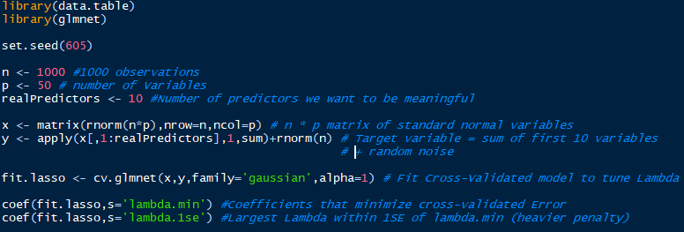
Example
Notes:
library(data.table)
library(glmnet)
set.seed(605)
n <- 1000 #1000 observations
p <- 50 # number of Variables
realPredictors <- 10 #Number of predictors we want to be meaningful
x <- matrix(rnorm(n*p),nrow=n,ncol=p) # n * p matrix of standard normal variables
y <- apply(x[,1:realPredictors],1,sum)+rnorm(n) # Target variable is sum of first 10 variables + random noise
fit.lasso <- cv.glmnet(x,y,family='gaussian',alpha=1) # Fit Cross-Validated model to tune Lambda
coef(fit.lasso,s='lambda.min') #Coefficients that minimize cross-validated Error
coef(fit.lasso,s='lambda.1se') #Largest Lambda within 1SE of lambda.min (heavier penalty)

Slide 50
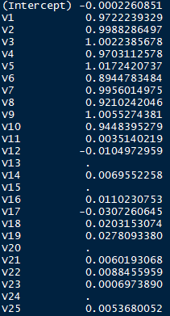
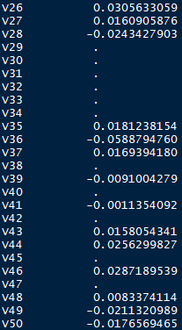
Coefficients at Minimum MSE

Slide 51
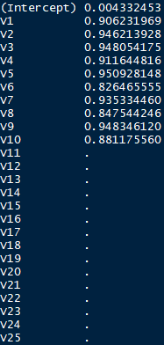
Coefficients 1se above Minimum MSE
Notes:
We “know” that this one is “right” because we created it that way. I.e. The right answer is intercept = 0 and X1-10 = 1
But how would you know in real life which penalty parameter to choose? (when you don’t know the answer a priori)
Ask audience for answer, which is TESTING SET

Slide 52
Machine Learning Models
Notes:
Helps prevent overfit. Some models may also include feature selection

Slide 53
Very Briefly
Great diversity of algorithms – outside the scope of this discussion
Two huge benefits:
These generally select their own features
Great at picking up interactions
Pitfalls:
Overfit
Impossible to determine

Slide 54
Difficult to Interpret
Consider “Gradient Boosting Machines” and its relatives
A coefficient is easy to explain:
“An increase of 1 in X means an increase in β for Y
Hundreds to thousands of decision trees are not
They are good for Predictive Modelling, but not Statistical Inference
Notes:
Verbal Explanation of Gradient Boosting (in very non-technical/imprecise language):
-We will make a series of decision trees
-Since these are prone to overfit, we will penalize them so that they are “Weak learners”
-The first tree does the best job it can
-The next tree tries to be “right” where the first one is “wrong”
-The next tree tries to be “right” where the second one is “wrong” (etc)
-To make a prediction, a weighted “vote” is taken by all the trees
-Lots of parameters to choose (how complex the trees can be, the “learning rate”, number of trees to use) and is computationally intense (cannot be completely parallelized since each tree depends on the prior)

Slide 55
Questions
Questions

