Slide 2
TABLE OF CONTENTS
VA base product
Risks in retirement years (responsibility shifted to individual, market risk, inflation risk, longevity risk)
Retirement income solutions: deferred VA’s with living benefits
Principles-based approach for statutory reserves and capital
Timeline of Statutory VA reserves and capital
Current Statutory VA reserves
Current Statutory VA capital
Framework challenges and industry response
NAIC Statutory VA review
NAIC VA reserves and capital framework changes and next steps
Contact info

Slide 3
OVERVIEW OF VA BASE PRODUCT
Accumulation Phase (Deferred Annuity) – Similar to Mutual Funds, but earnings grow on a tax deferred basis
Income Phase (Income Annuity) – Annuitize the contract to convert to a steady stream of income

Slide 4
THE PROBLEM
Responsibility has shifted to the individual
Number of Defined Benefit plans has decreased by 50% in last 20 years*
Social Security accounts for just 38% of total income for retired people age 65 or older**
401(k) plans often don’t provide for lifetime income
*Source: Department of Labor Pension and Welfare Administration
**Social Security Administration, January 2003

Slide 5
THE RISKS
Market Risk
Inflation Risk
Longevity Risk

Slide 6
MARKET RISK

Slide 7
INFLATION RISK

Slide 8
LONGEVITY RISK
Many people greatly underestimate the time they will live in retirement
50% Chance of
25% Chance of
living beyond
living beyond
Male (age 65)
85
92
Female (age 65)
88
Source: 1996 US 2000 Annuity Male and Female Tables

Slide 9
LONGEVITY RISK
Many people greatly underestimate the time they will live in retirement
50% Chance of
25% Chance of
living beyond
living beyond
Male (age 65)
85
92
50% Chance of
25% Chance of
living beyond
living beyond
Female (age 65)
88
94
Source: 1996 US 2000 Annuity Male and Female Tables

Slide 10
LONGEVITY RISK
Many people greatly underestimate the time they will live in retirement
50% Chance of
25% Chance of
living beyond
living beyond
Male (age 65)
85
92
50% Chance of
25% Chance of
living beyond
living beyond
Female (age 65)
88
94
50% Chance of
25% Chance of
At least one person has a:
living beyond
living beyond
Couple (both age 65)
92
97
Source: 1996 US 2000 Annuity Male and Female Tables

Slide 11
THE SOLUTION
Retirement
Income
Solutions
Deferred Variable Annuities Living Benefits
GMIB
GMWB
LWG
GMAB

Slide 12
VARIABLE ANNUITIES – GMxB HISTORY
I
-----------------------
-
Introduction of Living Benefits
---------------------
I
Guaranteed
Minimum
Variable Annuities
Accumulation Benefit
with Guaranteed
(GMAB)
Minimum
Death Benefits
Lifetime
Withdrawal
(GMDB)
Guarantee
(Lifetime GMWB)
Guaranteed
Minimum
Income Benefit
De
-
(GMIB)
Guaranteed
Withdrawal
Risking
Benefit
Guarantees
(GMWB)

Slide 13
PRINCIPLES – BASED APPROACH FOR STATUTORY RESERVING & CAPITAL
What is it?
Why is it introduced?
Where does it apply
Benefits?

Slide 14
WHAT ARE PRINCIPLES-BASED RESERVES AND RISK-BASED CAPITAL (RBC)?
Approach that determines reserves and capital using specific model based approaches that include the use of the company’s own experience, among other things
Goal: Develop reserves and capital that are reasonably conservative, but not excessive

Slide 15
WHAT IS IT?
Actuarial principals, not prescribed formulas
Reserve = Present value of future benefits and expense less present value of future gross premiums
Assumptions include margin for adverse deviation
Stochastic modeling where necessary
Deterministic scenario floor
Goal: Develop reserves and capital that are reasonably conservative, but not excessive

Slide 16
WHY WAS IT INTRODUCED?
Complexity of products and guarantees
Fat tail liabilities
Concern over excessive formula reserves
Regulator concern over inadequate reserves

Slide 17
WHERE DOES IT APPLY?
Initial implementation focused on capital requirements
RBC C3 Phase 1 – 2000
Applies to fixed annuities and single premium life insurance
No longer optional for big companies
RBC C3 Phase 2 – 2005
Applies to variable annuities

Slide 18
WHERE DOES IT APPLY?
VACARVM
Passed through as actuarial guideline – AG 43
Applies to variable annuities
Applied retrospectively – in force and new business
Effective 12/31/2009
Principles – Based Reserves
Life insurance products are next on slate to be implemented
Requires changes to state regulations
Implementation date – 2018
Applies prospectively – new business only
Fixed annuity products – still under development

Slide 19
BENEFITS TO VALUATION AND FINANCIAL REPORTING
Reflects company experience
Benefit of hedging
Sophisticated models vs. simplistic formula

Slide 20
BACKGROUND – STATUTORY VA RESERVES AND CAPITAL
VA Reserve and Capital requirements are a “compromise” regulatory framework of principles-based approaches over last ten years
Evolution of VA Statutory regulations from formulaic to principles-based reflect VA liabilities with complex living benefit guarantees
Complexity of products and guarantees
“Fat Tail Risk” liabilities
Concern over excessive formula reserves
Regulator concern over reserve adequacy
Principles-based reserves use model-based approaches reflecting insurer-specific assumptions → difficult to audit
Four year timing difference in development created disconnect between Capital (C3P2) and Reserves (AG43)
1980s 1998 2002 2005 2009 2015/16
Formulaic Reserves
For GMWBs
AG39
NAIC initiates
VA Statutory review
QIS
Formula Based Reserves
CARVM
Principles-based Capital
Framework
C3P2
Principles-based
Reserves
AG43(VACARVM)
Formulaic Reserves
for GMDBs
AG34
Formulaic
Principles-Based

Slide 21
VA STATUTORY RESERVES
Current VA Statutory Reserves include principles-based and formulaic components
Reserves for annuity contracts are measured under AG43 (Actuarial Guideline 43; 2009) as greater of two calculations: Stochastic and Standard Scenario
Measurement of policyholder benefit liability under moderately adverse conditions
Standard Scenario included as a floor to address regulator concerns with principles-based valuation
Stochastic Reserve
Allow insurers to reflect their own experience and hedging strategies (principles-based)
Calculate for 1000 scenarios
Reserve is average worst 300 scenarios (CTE70: Conditional Tail Expectation @ 70%)
Standard Scenario Reserve
Control/floor against aggressive assumptions in Stochastic Reserve calculation
Calculate for one scenario
Assumptions for capital markets and policyholder behavior are prescribed (formula-based)
Reserves | Stochastic | Standard Scenario
Methodology | Pre-tax Aggregate Discount at general account earned rate Average worst 300 (CTE70) | Pre-tax Policy-level Discount rate locked-in at policy issue
Capital Markets | Interest rates revert to insurer long-term assumption | Initial equity drop of 13.5% followed by recovery
Policyholder Behavior | Prudent best-estimate | Conservative prescribed assumptions
Hedging | Insurers choose whether or not to reflect future hedging | Currently-held hedges reflected during initial equity drop only

Slide 22
VA STATUTORY CAPITAL
Capital measurement includes assumptions that differ from Reserve measurement
Assumptions and reflection of hedging in Stochastic calculations vary across industry
Capital defined in C3P2 (C3 Phase II; 2005) as difference between Total Asset Requirement (TAR) and Reserves
Purpose to ensure adequate capital under more severe conditions
TAR calculation also includes Stochastic (CTE90) and Standard Scenario components
CAPITAL
TAR
DIFFERENCE
Reserves
MAX
MAX
Stochastic TAR
Standard Scenario TAR
Stochastic Reserve
Standard Scenario Reserve
Capital (TAR) | Stochastic | Standard Scenario
Methodology | Post-tax Aggregate Discount at general account earned rate Average worst 100 (CTE90) | Post-tax Aggregate Discount at 10-Yr UST floored at 3%
Capital Markets | Same as Reserves | Initial equity drop of 20% followed by recovery
Policyholder Behavior | Same as Reserves | Same as Reserves
Hedging | Insurers choose whether or not to reflect future hedging (independent of Reserve treatment) | Currently-held hedges reflected during initial equity drop only

Slide 23
FRAMEWORK CHALLENGES AND INDUSTRY RESPONSE
Challenges of current VA Statutory framework has motivated insurers to use captives and other methods to manage Statutory financials
Differences between STAT and GAAP (and IFRS) measurements create challenges in monitoring industry capital and earnings volatility
Insurance industry response to STAT framework challenges
VA captives used to reinsure GMxBs away from NAIC Stat framework
Captives report based on GAAP or modified GAAP
Primary benefit – reduced volatility of Statutory earnings, Required Capital and RBC Ratio stabilization
State regulations or permitted practices have differed from state to state
“Voluntary Reserve” used to stabilize Required Capital and RBC Ratio
Shifts amounts from required Capital to Reserve
Primary benefits
Reduced volatility of Required Capital
Reduced Required Capital in stress markets → capital cushion relative to insurer risk limits
Statutory framework challenges
Interaction between Reserve and Capital measures with differing methodologies creates non-economic volatility
Disconnect with economic or GAAP-based hedging strategies
Statutory Reserves do not include significant interest rate sensitivity
Hedge assets (derivatives) at market value
Statutory Reserves and Capital – higher in stress equity markets and lower in normal equity markets (pro-cyclical)
Ongoing Capital requirements accelerate in adverse markets
STAT VA Framework
TAR
Capital
VA Voluntary Reserve
Reserve

Slide 24
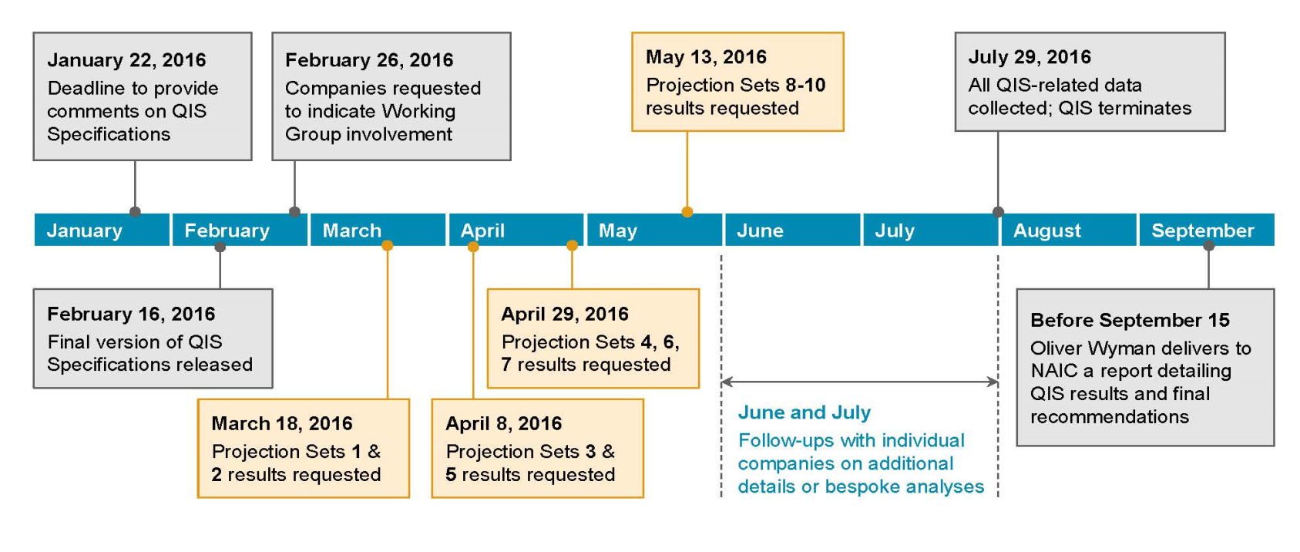
NAIC VA STATUTORY REVIEW
2016 NAIC VA Statutory framework review objective: to eliminate need for VA captives by YE ‘18
Spring 2015: NAIC expressed desire to eliminate VA captives and conform state Statutory accounting practices
Summer 2015: Phase I VA Statutory review identified five principal motivations for captive use
Mitigate non-economic volatility in Statutory Capital ratios
Align Statutory market risk profile with hedging
Mitigate Reserve and Capital requirement net of hedging in stress markets
Consolidate exposures across legal entities
Deferred Tax Asset admissibility
Fall 2015: NAIC engaged Oliver Wyman (OW) to study and recommend changes to Statutory framework
Proposal to be informed by industry Quantitative Impact Study (QIS)
15 VA insurers participate, total $1.2 trillion AUM*
OW presented recommendations at NAIC meeting August 23rd 2016
Likely implementation effective YE ’20 (original target YE ‘17)

Slide 25
NAIC VA RESERVES AND CAPITAL FRAMEWORK – BACKGROUND
NAIC reviewing framework for Variable Annuity Statutory Reserves and Capital
Industry participating in review through Quantitative Impact Studies (QIS)
Second Round of QIS in 2017 with results and recommendations presented by OW at NAIC Fall Meeting in December
objectives
Feb. thru Aug. ’16 – QIS1 testing based on OW initial September 2015 recommendations
8/23/16 – OW Proposal for VA Reserves and Capital exposed for industry comments
OW recommendations included significant changes to VA Statutory reserves and capital methodology (see appendix for details)
Industry responses focused on conceptual framework and alternatives to evaluate and quantify
Major concerns with OW proposal
Maintaining Standard Scenario for reserves
Unnecessarily complex and unsupported policyholder behavior in proposed Standard Scenario
Testing of alternative calibration criteria in stochastic scenarios that take significant time and effort without justification

Slide 26
NAIC VA RESERVES AND CAPTIAL FRAMEWORK – UPDATE
November 2016 NAIC and Industry reached consensus to perform 2nd round of testing (QIS2)
QIS2 scheduled Q1 ‘17 thru Q3 ’17
Provides industry opportunity for evaluation, quantification and ability to assess impacts
3-cycle iterative approach with feedback loop between OW, industry and regulators
Significant discussions and modifications on major issues such as economic scenario generator and standard scenario
QIS2 Objectives
Allow companies to test recommended framework revisions that had not been tested in QIS1
Calibrate specific parameters that remain outstanding in OW’s 8/23/16 recommendations
Evaluate modifications to OW’s recommended framework revisions based on industry feedback
Test comprehensive “package”, to understand impact on company funding, hedging and other business practices
Provide opportunity for remainder of VA industry that did not participate in QIS1 to understand recommendations and conduct internal financial analysis
November 2017 OW recommendations to NAIC
Significant regulation drafting, exposure and approvals necessary
1/1/20 earliest expected effective date (NAIC original target 1/1/17)
May 2018 Final framework with 27 recommendations
Adopted by VAIWG and NAIC E Committee in July

Slide 27
VA FRAMEWORK – NOTABLE ELEMENTS
Align reserve and capital framework to reduce non-economic volatility in statutory capital ratios
VM-20 economic scenario generator (ESG) for interest and equity returns
Use of proprietary ESGs only if it increases results
More guidance on discount rates and asset projection
Promote hedging by aligning the market risk profile of hedge program and statutory funding requirements, and allowing for close to full reflection of hedge impact
Enhance disclosures requirements
Expand the scope of prescribed assumptions and set regulatory thresholds

Slide 28
VA FRAMEWORK – STANDARD SCENARIO
Remove C-3 Phase II Standard Scenario (SS)
Rebrand reserves SS as Standard Projection (SP)
Align SP with Stochastic Amount (adjusted)
Aggregate calculation with disclosure
Prescribe policyholder behavior assumptions based on industry experience
VAIWG decided to use SP as a minimum reserve floor rather than solely as a disclosure tool
Indicated it will be looked at in 3 years

Slide 29
VA FRAMEWORK – NEXT STEPS
NAIC C-3 Phase II / AG43 Subgroup
Developing revisions to AG43/VM-21 and C3P2
Coordinating other implementation issues
Assumption governance and scenario generators
Early adoption and phase-in options are being discussed
1/1/2020 target effective date
Both C3P2 and AG43 changes will apply to all inforce

Slide 30
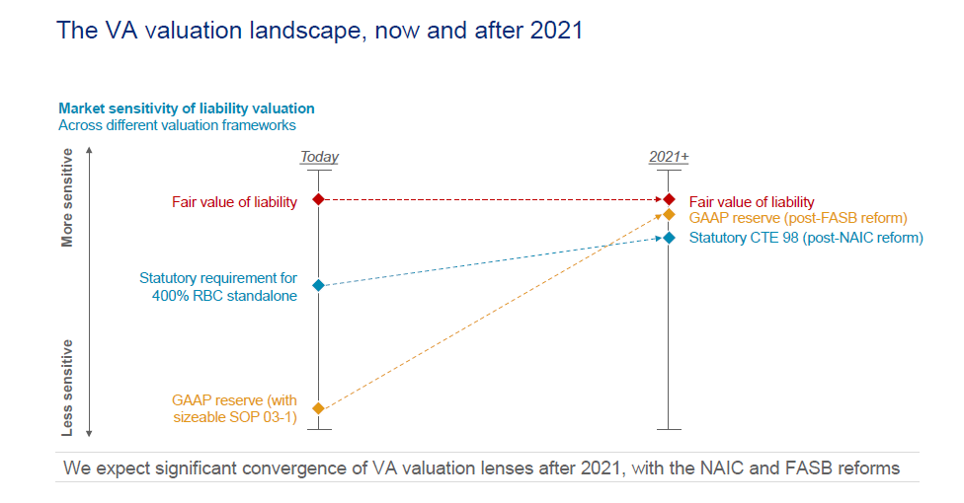
THE VA VALUATION LANDSCAPE

Slide 31
QUESTIONS ?

Slide 32
THANK YOU!!!
Contact: Peter Abramovich
peter.abramovich@pacificlife.com
949-698-8837

